Slide 1

Empowering Union and Intersection Types with Integrated Subtyping
Fabian Muehlboeck and Ross Tate

Slide 2
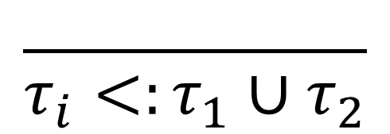
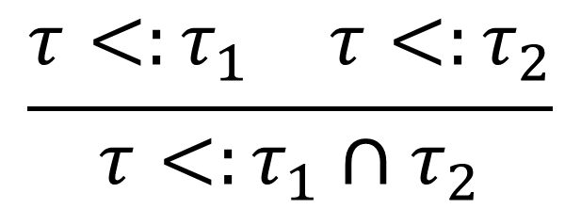
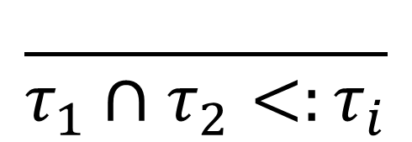
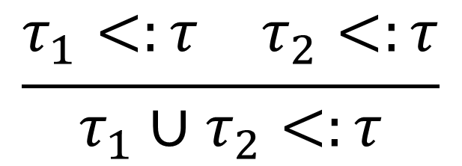
Intersection Types
Union Types
$$\frac{ }{τ_{i}<:τ_{1}∪τ_{2}}$$
$$\frac{ }{τ_{1}∩τ_{2}<:τ_{i}}$$
$$\frac{\begin{matrix}τ_{1}<:τ & τ_{2}<:τ\end{matrix}}{τ_{1}∪τ_{2}<:τ}$$
$$\frac{\begin{matrix}τ<:τ_{1} & τ<:τ_{2}\end{matrix}}{τ<:τ_{1}∩τ_{2}}$$
Algol 68
Coppo, Dezani-Ciancaglini, Sallé, Pottinger, late 1970s

Slide 3





Unions and Intersections
Ceylon
Racket

Slide 4




Nullability in Ceylon
$$⊤$$
$$\text{Null}$$
$$\text{Object}$$
$$\text{Everything} \text{Else}$$

Slide 5





Nullability in Ceylon
$$⊤$$
Nullable $X ≔X∪\text{Null}$
$$\text{Null}$$
$$\text{Object}$$
$$\text{Everything} \text{Else}$$

Slide 6

Nullability in Ceylon
$\text{List}\left\langle \text{String}∪\text{Null}\right\rangle \text{nstrs}= …;$
$\text{List}\left\langle \text{String}\right\rangle \text{strs}=$
filterNulls(nstrs);
$\text{List}\left\langle T∩\text{Object}\right\rangle \text{f}\text{ilterNulls}〈T⟩\left(\text{List}\left\langle T\right\rangle \text{elems}\right)$ {…}

Slide 7

Nullability in Ceylon
$\text{List}\left\langle \text{String}∪\text{Null}\right\rangle \text{nstrs}= …;$
$\text{List}\left\langle \text{String}\right\rangle \text{strs}=$
filterNulls(nstrs);
$\text{List}\left\langle \text{String}\right\rangle \text{strs}:>$
$$\text{List}\left\langle \left(\text{String}∪\text{Null}\right)∩\text{Object}\right\rangle$$
$\text{List}\left\langle T∩\text{Object}\right\rangle \text{f}\text{ilterNulls}〈T⟩\left(\text{List}\left\langle T\right\rangle \text{elems}\right)$ {…}

Slide 8









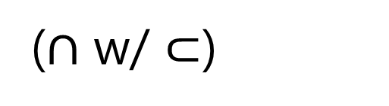
Nullability in Ceylon
$\text{List}\left\langle \text{String}\right\rangle \text{strs}=$
filterNulls(nstrs);
$$≈$$
$$\text{List}\left\langle \text{String}\right\rangle$$
($∩$ w/ $⊂$)
$$≈$$
$$\text{List}\left\langle \left(\text{String}∩\text{Object}\right)\right\rangle$$
($∪$ w/ $∅$)
$$≈$$
$$\text{List}\left\langle \left(\text{String}∩\text{Object}\right)∪ ⊥\right\rangle$$
(Disjointness)
$$≈$$
$$\text{List}\left\langle \left(\text{String}∩\text{Object}\right)∪\left(\text{Null}∩\text{Object}\right)\right\rangle$$
(Distributivity)
$$\text{List}\left\langle \left(\text{String}∪\text{Null}\right)∩\text{Object}\right\rangle$$

Slide 9







Nullability in Ceylon
$\text{List}\left\langle \text{String}\right\rangle \text{strs}=$
filterNulls(nstrs);
$$≈$$
$$\text{List}\left\langle \text{String}\right\rangle$$
($∩$ w/ $⊂$)
$$≈$$
$$\text{List}\left\langle \left(\text{String}∩\text{Object}\right)\right\rangle$$
($∪$ w/ $∅$)
$$≈$$
$$\text{List}\left\langle \left(\text{String}∩\text{Object}\right)∪ ⊥\right\rangle$$
(Disjointness)
$$≈$$
$$\text{List}\left\langle \left(\text{String}∩\text{Object}\right)∪\left(\text{Null}∩\text{Object}\right)\right\rangle$$
(Distributivity)
$$\text{List}\left\langle \left(\text{String}∪\text{Null}\right)∩\text{Object}\right\rangle$$

Slide 10
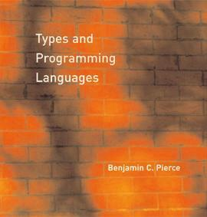











Subtyping Extension
$$ℰ$$
$$φ$$
$$⊓$$
“Textbook”
Subtyping
Integrated
Subtyping
Our Framework
$$ℓ$$
$$<:_{ℰ}$$
$$<:$$
$$≤$$
$$≤_{⊓}$$

Slide 11







Textbook Subtyping
$$ℓ$$
$$<:$$
$$≤$$
“Literals”
$$τ∷=⊤∣ ⊥ ∣τ∪τ∣τ∩τ∣ℓ$$
$$ℓ∷=int∣τ→τ$$
$$ℓ∷=C⟨τ⟩$$
$$ℓ∷=B∣\left\{l_{i}:τ\right\}$$

Slide 12
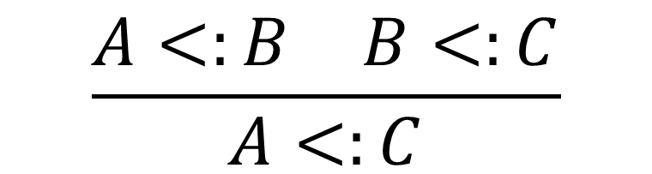

Textbook Subtyping
$$ℓ$$
$$<:$$
$$≤$$
Declarative Subtyping $<:$
$$\frac{\begin{matrix}A<:B & B<:C\end{matrix}}{A<:C}$$

Slide 13

Textbook Subtyping
$$ℓ$$
$$<:$$
$$≤$$
Declarative Subtyping $<:$
Reductive Subtyping $≤$
$$\frac{\begin{matrix}A<:B & B<:C\end{matrix}}{A<:C}$$

Slide 14
Textbook Subtyping
$$ℓ$$
$$<:$$
$$≤$$
Declarative Subtyping $<:$
Reductive Subtyping $≤$
Syntax-Directed
Well-founded
$$\frac{\begin{matrix}A<:B & B<:C\end{matrix}}{A<:C}$$

Slide 15
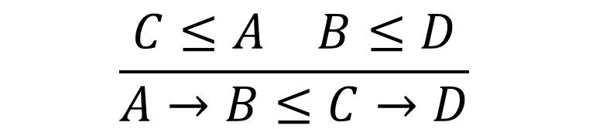
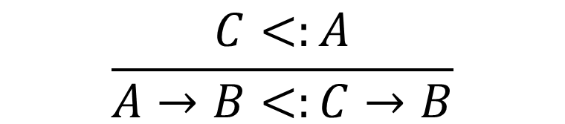
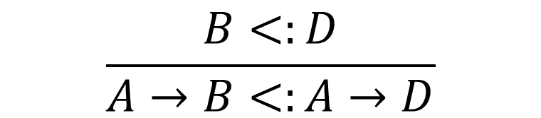
Textbook Subtyping
$$ℓ$$
$$<:$$
$$≤$$
Declarative Subtyping $<:$
Reductive Subtyping $≤$
$$\frac{C<:A}{A→B<:C→B}$$
$$\frac{\begin{matrix}C≤A & B≤D\end{matrix}}{A→B≤C→D}$$
$$\frac{B<:D}{A→B<:A→D}$$

Slide 16
Textbook Subtyping
$$ℓ$$
$$<:$$
$$≤$$
Declarative Subtyping $<:$
Reductive Subtyping $≤$
$$\frac{C<:A}{A→B<:C→B}$$
$$\frac{\begin{matrix}C≤A & B≤D\end{matrix}}{A→B≤C→D}$$
$$\frac{B<:D}{A→B<:A→D}$$

Slide 17


“Textbook”
Subtyping
Decision
Procedure
Our Framework
$$ℓ$$
$$<:$$
$$≤$$
$$<:$$
$$≤$$

Slide 18
Nullability in Ceylon
$\text{List}\left\langle \text{String}\right\rangle \text{strs}=$
filterNulls(nstrs);
$$≈$$
$$\text{List}\left\langle \text{String}\right\rangle$$
($∩$ w/ $⊂$)
$$≈$$
$$\text{List}\left\langle \left(\text{String}∩\text{Object}\right)\right\rangle$$
($∪$ w/ $∅$)
$$≈$$
$$\text{List}\left\langle \left(\text{String}∩\text{Object}\right)∪ ⊥\right\rangle$$
(Disjointness)
$$≈$$
$$\text{List}\left\langle \left(\text{String}∩\text{Object}\right)∪\left(\text{Null}∩\text{Object}\right)\right\rangle$$
(Distributivity)
$$\text{List}\left\langle \left(\text{String}∪\text{Null}\right)∩\text{Object}\right\rangle$$

Slide 19


Distributivity
$A∩\left(B∪C\right)≈\left(A∩B\right)∪\left(A∩C\right)$
In dnf
$$\left(A∩B\right)∪\left(A∩C\right)≤A∩\left(B∪C\right)$$
$A∩\left(B∪C\right)≤\left(A∩B\right)∪\left(A∩C\right)$
DNF

Slide 20

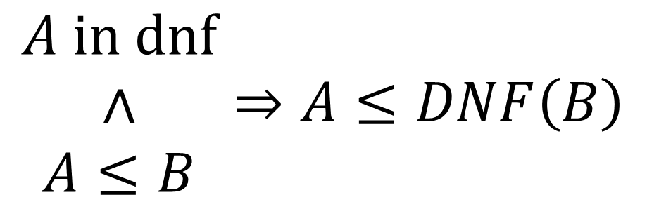
Disjunctive Normal Form
$DNF(A)$is $\text{in} \text{dnf}$
$$\begin{matrix}A \text{i}\text{n} \text{dnf} \\ ∧ \\ A≤B\end{matrix}⇒A≤DNF\left(B\right)$$
Promotion

Slide 21
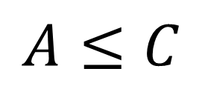


Preserving DNF
Still in dnf
$$A≤C$$
$$B≤C$$
$$A∪B≤C$$
In dnf

Slide 22
Preserving DNF
Not necessarily in dnf
$$C≤A$$
$$B≤D$$
$$A→B≤C→D$$
In dnf

Slide 23

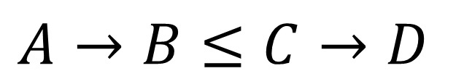

Integrating DNF into the Subtyping Algorithm
Re-Establish dnf
$$DNF\left(C\right)≤A$$
$$DNF(B)≤D$$
$$A→B≤C→D$$

Slide 24


“Textbook”
Subtyping
Decision
Procedure
Our Framework
+Distributivity
$$ℓ$$
$$<:_{Dist}$$
$$<:$$
$$≤$$
$$<:$$
$$≤$$
$$≤_{DNF}$$

Slide 25
Nullability in Ceylon
$\text{List}\left\langle \text{String}\right\rangle \text{strs}=$
filterNulls(nstrs);
$$≈$$
$$\text{List}\left\langle \text{String}\right\rangle$$
($∩$ w/ $⊂$)
$$≈$$
$$\text{List}\left\langle \left(\text{String}∩\text{Object}\right)\right\rangle$$
($∪$ w/ $∅$)
$$≈$$
$$\text{List}\left\langle \left(\text{String}∩\text{Object}\right)∪ ⊥\right\rangle$$
(Disjointness)
$$≈$$
$$\text{List}\left\langle \left(\text{String}∩\text{Object}\right)∪\left(\text{Null}∩\text{Object}\right)\right\rangle$$
(Distributivity)
$$\text{List}\left\langle \left(\text{String}∪\text{Null}\right)∩\text{Object}\right\rangle$$

Slide 26
Subtyping Extension
$$ℰ$$
$$φ$$
$$⊓$$
“Textbook”
Subtyping
Our Framework
+Distributivity
$$ℓ$$
$$<:_{Dist}$$
$$<:$$
$$≤$$
$$≤_{DNF}$$

Slide 27
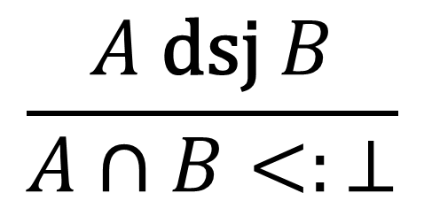





Integrated Subtyping
$$ℰ$$
$$φ$$
$$⊓$$
$$\text{Null} \text{dsj} \text{Object}$$
$$\frac{A \text{dsj} B}{A∩B<:⊥}$$
$$ℰ$$
Additional
Subtyping
Relationships

Slide 28











Integrated Subtyping
$$ℰ$$
$$φ$$
$$⊓$$
$$\left(\text{String}∪\text{Null}\right)∩\text{Object}$$
$$DNF$$
Intersectedness: $φ$
$$∪$$
$$∩$$
$$∩$$
$$\text{String}$$
$$\text{Object}$$
$$\text{Null}$$
$$\text{Object}$$
$$φ$$

Slide 29

Integrated Subtyping
$$ℰ$$
$$φ$$
$$⊓$$
$$\left(\text{String}∪\text{Null}\right)∩\text{Object}$$
$$DNF$$
Intersectedness: $φ$
$$∪$$
$$∩$$
$$∩$$
$$\text{String}$$
$$\text{Object}$$
$$\text{Null}$$
$$\text{Object}$$
$$φ$$
$$φ$$

Slide 30



Integrated Subtyping
$$ℰ$$
$$φ$$
$$⊓$$
$$\left(\text{String}∪\text{Null}\right)∩\text{Object}$$
$$DNF$$
$$⊓$$
Intersectedness: $φ$
$$∪$$
Intersector: $⊓$
$$∩$$
$$∩$$
$$⊓$$
$$\text{String}$$
$$\text{Object}$$
$$\text{Null}$$
$$\text{Object}$$
$$φ$$
$$φ$$

Slide 31

Integrated Subtyping
$$ℰ$$
$$φ$$
$$⊓$$
$$\left(\text{String}∪\text{Null}\right)∩\text{Object}$$
$$DNF$$
$$⊓$$
Intersectedness: $φ$
$$∪$$
Intersector: $⊓$
$$∩$$
$$∩$$
$$⊓$$
$$\text{String}$$
$$\text{Object}$$
$$\text{Null}$$
$$\text{Object}$$
$$φ$$
$$φ$$

Slide 32


Integrated Subtyping
$$ℰ$$
$$φ$$
$$⊓$$
$$\left(\text{String}∪\text{Null}\right)∩\text{Object}$$
$$DNF$$
$$⊓$$
Intersectedness: $φ$
$$∪$$
Intersector: $⊓$
$$∩$$
$$⊥$$
In ${\text{dn}\text{f}}_{φ}$
$$\text{String}$$
$$\text{Object}$$
$$φ$$

Slide 33





Integrated Subtyping
$$ℰ$$
$$φ$$
$$⊓$$
$$⊓\left(\vec{ℓ}\right)\text{is} \text{in} {\text{dnf}}_{φ}⇒$$
$DNF(A)$is $\text{in} \text{dnf}$
$$⊓$$
$$φ$$
$$\begin{matrix}A \text{i}\text{n} \text{dnf} \\ ∧ \\ A≤B\end{matrix}⇒A≤DNF\left(B\right)$$
$$φ$$
Promotion
$$⊓$$

Slide 34



Integrated Subtyping Algorithm
Re-Establish ${\text{dn}\text{f}}_{φ}$
$$DNF_{⊓}\left(C\right)≤A$$
$$DNF_{⊓}(B)≤D$$
$$A→B≤C→D$$

Slide 35



Subtyping Extension
$$ℰ$$
$$φ$$
$$⊓$$
$$ℰ$$
$$φ$$
$$⊓$$
“Textbook”
Subtyping
Integrated
Subtyping
Our Framework
+Distributivity
$$ℓ$$
$$<:_{Dist}$$
$$<:_{ℰ}$$
$$<:$$
$$≤$$
$$≤_{DNF}$$
$$≤_{⊓}$$

Slide 36





Subtyping Extension
$$ℰ$$
$$φ$$
$$⊓$$
$$ℰ$$
$$φ$$
$$⊓$$
“Textbook”
Subtyping
Our Framework
$$ℓ$$
$$<:$$
$$≤$$

Slide 37








Composition
$$ℰ_{1}$$
$$φ_{1}$$
$$⊓_{1}$$
$$ℰ_{2}$$
$$φ_{2}$$
$$⊓_{2}$$
“Textbook”
Subtyping
Integrated
Subtyping
Our Framework
$$ℓ$$
$$<:_{ℰ_{1}∪ℰ_{2}}$$
$$<:$$
$$≤$$
$$≤_{⊓_{1}∘⊓_{2}}$$

Slide 38






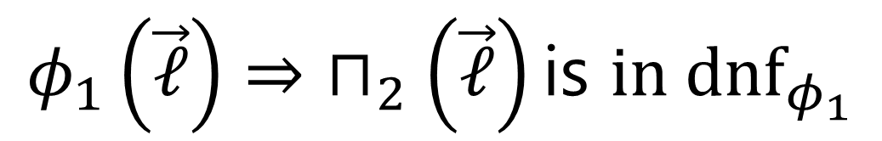
Composition
$$ℰ_{1}$$
$$φ_{1}$$
$$⊓_{1}$$
$$φ_{1}\left(\vec{ℓ}\right)⇒\left.⊓_{2}\left(\vec{ℓ}\right)\text{is} \text{in} {\text{dnf}}_{φ_{1}}\right.$$
$$ℰ_{2}$$
$$φ_{2}$$
$$⊓_{2}$$

Slide 39


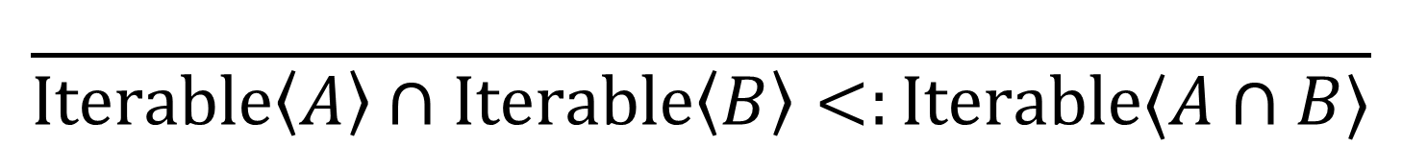
More Ceylon Extensions
Classes with Enumerated Cases
$$\frac{ }{\text{List}\left\langle T\right\rangle <:\text{Nil}∪\text{Cons}⟨T⟩}$$
Object or Null
$$\frac{ }{⊤<:\text{Null}∪\text{Object}}$$
Principal Instantiations
$$\frac{ }{\text{Iterable}\left\langle A\right\rangle ∩\text{Iterable}\left\langle B\right\rangle <:\text{Iterable}⟨A∩B⟩}$$

Slide 40
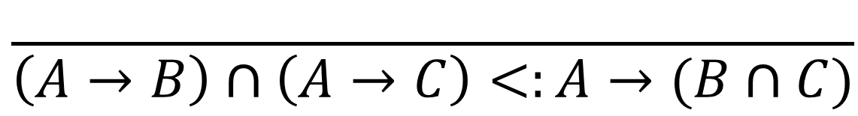
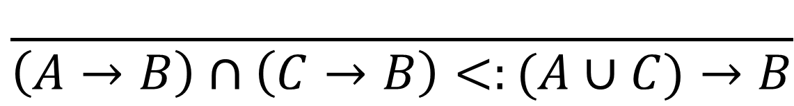
Extensions for Other Languages
$$\frac{ }{\left(A→B\right)∩\left(A→C\right)<:A→(B∩C)}$$
$$\frac{ }{\left(A→B\right)∩\left(C→B\right)<:(A∪C)→B}$$
$$\frac{ }{⊤<:⊤→⊤}$$

Slide 41
Composition
$$ℰ_{1}$$
$$φ_{1}$$
$$⊓_{1}$$
$$ℰ_{2}$$
$$φ_{2}$$
$$⊓_{2}$$
“Textbook”
Subtyping
Integrated
Subtyping
Our Framework
$$ℓ$$
$$<:_{ℰ_{1}∪ℰ_{2}}$$
$$<:$$
$$≤$$
$$≤_{⊓_{1}∘⊓_{2}}$$
www.cs.cornell.edu/~ross/empower

