Slide 1




Transitioning from Structural to Nominal Code with Efficient Gradual Typing
Fabian Muehlboeck and Ross Tate

Slide 2
Gradual Typing
fun zorp()
{
: dyn
return new
{
: dyn
: dyn
{
fun foo(x
)
return x * x;
}
;
}
}

Slide 3
Gradual Typing
fun zorp()
: dyn
{
return new
{
int)
int
fun foo(x : dyn): dyn {
return x * x;
}
Run-Time Type Check
;
}
}

Slide 4
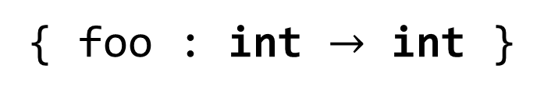
Gradual Typing
fun zorp()
: dyn {
?
{
{ foo : int $→$ int }
return new
Bar()
class Bar
int)
int
fun foo(x : dyn): dyn {
return x * x;
}
;
}
}

Slide 5
fun main() {
twice(zorp());
}
fun zorp() : dyn {
return new {
fun foo(x : dyn) : dyn { return x * x; };
};
}
fun twice(f : dyn) : dyn {
return f.foo(f.foo(0));
}
fun zorp() : dyn {
return new {
fun foo(x : int) : int { return x * x; };
};
}
fun twice(f : dyn) : dyn {
Foo F = f;
return F.foo(F.foo(0));
}
class Bar() implements Baz {
fun foo(x : int) : int { return x * x; };
}
fun zorp() : dyn { return new Bar(); }
fun twice(f : Baz) : int {
return f.foo(f.foo(0));
}
class Bar() implements Baz {
fun foo(x : int) : int { return x * x; };
}
fun zorp() : Baz { return new Bar(); }
interface Baz {
fun foo(x : int) : int;
}

Slide 6
MonNom

Slide 7
MonNom Objects
Nominal Types
new C(e₁, …)
: C
dyn instead of Structural Types
new λ(x₁ : τ₁, …) : τ ⟼ e
: dyn
new x := {f₁ := e₁; … | m₁(x₁ : τ₁, …) : τ ⟼ ${\text{e}}_{1}^{′}$; …}
: dyn
this/self
field
method
(can be field name or λ)

Slide 8


MonNom Casts
Casts to classes C
succeed for instances of C
Casts to interfaces I
succeed for instances of classes explicitly implementing I
succeed for all lambda objects
succeed for all record objects unless I requires a λ method and the record has no λ method
fail for structural values
Monotonic

Slide 9
Migration

Slide 10


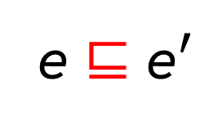
Cross-Discipline Guarantees
If e type-checks
then ${\text{e}}^{′}$ type-checks
e ⊑ ${\text{e}}^{′}$
If e executes successfully
then so does ${\text{e}}^{′}$

Slide 11
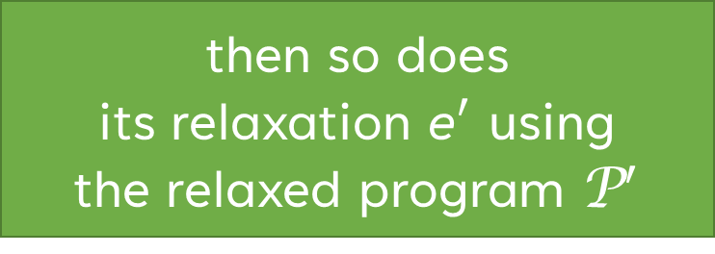
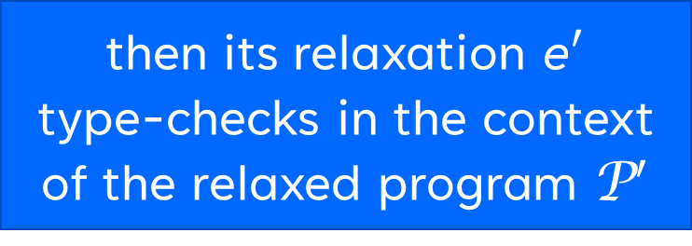
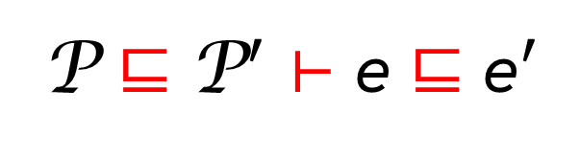
Cross-Paradigm Guarantees
If e type-checks
in the context
defined by program P
then its relaxation ${\text{e}}^{′}$
type-checks in the context
of the relaxed program ${\text{P}}^{′}$
P ⊑ ${\text{P}}^{′}$ ⊢ e ⊑ ${\text{e}}^{′}$
If e executes successfully using the implementation defined by program P
then so does
its relaxation ${\text{e}}^{′}$ using
the relaxed program ${\text{P}}^{′}$

Slide 12

Cross-Paradigm Guarantees
Types in more relaxed expression must be valid
in the more relaxed program
$$\frac{\begin{matrix}\begin{matrix}{\text{P}}^{′}⊢τ^{′} & τ⊑τ′\end{matrix} \\ \text{P} \text{⊑} {\text{P}}^{′} \text{⊢} e_{x}⊑e_{x}^{′} \\ \text{P} \text{⊑} {\text{P}}^{′} \text{⊢} e[x↦x^{′}]⊑e′\end{matrix}}{\text{P} \text{⊑} {\text{P}}^{′} \text{⊢} \text{let} x\text{ : }τ\text{ := }e_{x} \text{in} e \text{⊑} \text{let} x′\text{ : }τ′\text{ := }e_{x}^{′} \text{in} e^{′}}$$

Slide 13

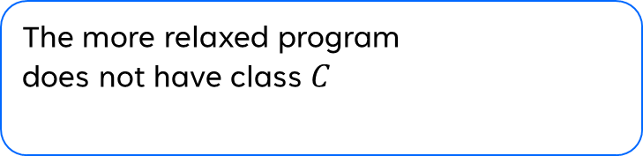
Cross-Paradigm Guarantees
The more relaxed program does not have class $C$
$$\frac{\begin{matrix}\begin{matrix}¬ {\text{P}}^{′}⊢C \\ \text{class} C\left(x :τ\right) \left\{f_{1}:τ_{1}≔e_{1};…\right| m_{1}\left(…\right)…\}∈\text{P}\end{matrix} \\ \begin{matrix}{\text{P}}^{′}⊢τ^{′} & τ⊑τ′ & \text{P} \text{⊑} {\text{P}}^{′} \text{⊢} e_{x}⊑e_{x}^{′}\end{matrix} \\ \text{P} \text{⊑} {\text{P}}^{′} \text{⊢} x≔\left\{f_{1}≔e_{1};…\right| m_{1}\left(…\right)…\}⊑e′\end{matrix}}{\text{P} \text{⊑} {\text{P}}^{′} \text{⊢} \text{new} C\left(e_{x}\right) \text{⊑} \text{let} x^{′}\text{ : }τ^{′}\text{ := }e_{x}^{′} \text{in} e′}$$

Slide 14
Performance

Slide 15
Representation
Typed
Untyped
64-bit values
Pointers
Pointers
64-bit aligned
64-bit Integers
62-bit Integers
Doubles with
10-bit Exponents
+2 Tag Bits
IEEE-754 Doubles

Slide 16

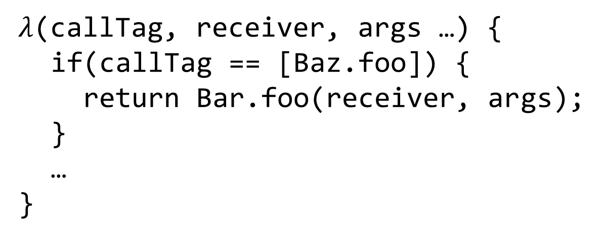
Call Tags
$λ$(callTag, receiver, args …) {
if(callTag == [Baz.foo]) {
return Bar.foo(receiver, args);
}
…
}
IMT Entry 1
IMT Entry 2
…
IMT Entry 13
$λ$(callTag, receiver, args …) {
return callTag(receiver, args …);
}
Interface-Method Table

Slide 17
Call Tags
Call Tag: Function Pointer = Identifier for Interface/Method Pair
[Baz.foo](receiver, args …) {
1.) look up “foo” in receiver
2.) pack/box integer argument
3.) call “foo” with (converted) args
4.) check return value is int
5.) convert int representation
}

Slide 18
Experimental Setup
Excessive overheads
Fully Typed/Nominal
Add Interface
Add Type Annotation
…
…
…
…
Plausible overheads
Running time
…
…
…
…
Distance to fully typed
…
Ideal path
…
…
…
…
Turn Record
Into Class
Distance to fully typed
Fully Untyped/Structural

Slide 19
intersort
PyPy

Slide 20
sieve & float
PyPy
sieve
float

Slide 21
Summary
Gradual migration not only between typing disciplines
MonNom: co-design for gradual guarantees and efficient implementation
In the paper/technical report:
Formalization; Gradual Guarantees, Safety
More details on Benchmarks
In the artifact:
Complete source code (MonNom + Benchmarks)
Invariant Generics, Static Methods, Ints/Floats/Null, Top/Bottom, …

