Slide 1


Sound Gradual Typing is Nominally Alive and Well
Fabian Muehlboeck and Ross Tate

Slide 2













Gradual Typing
Static Type-Checking
Dynamic Type-Checking
Whoa, dude. Chillax!
Gradual Typing
A place for everything,
and everything in its place.

Slide 3
Gradual Typing
Run-Time Type Checks
Static Type-Checking
Dynamic Type-Checking
Whoa, dude. Chillax!
Sound Gradual Typing
A place for everything,
and everything in its place.

Slide 4
Typical Perspective
Gradual typing is added to existing language
Typically: dynamically typed
e.g.: Typed Racket, Reticulated Python, Safe TypeScript, StrongScript, Gradualtalk, etc.

Slide 5
Our Perspective
Design language where gradual typing is an equal member
Advantage: not constrained by existing language and runtime
➔ enables co-design of type system and runtime

Slide 6
Co-Design
Predictable Semantics
Efficiency
Type System Features
Implementation

Slide 7
Our Design
Nom: a gradually-typed, nominal, object-oriented language
Efficiency
Compared to Racket, Reticulated Python
Predictable Semantics
Compared to C#
Expressivity Tradeoffs

Slide 8
Expressivity and Usefulness
There's a language out there that's "useful". We have to be useful these days.
-- Glynn Winskel

Slide 9
Assumptions
1. Most code in our language is typed

Slide 10


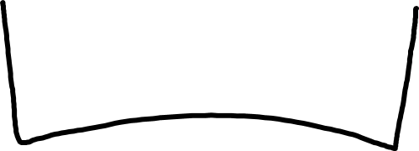
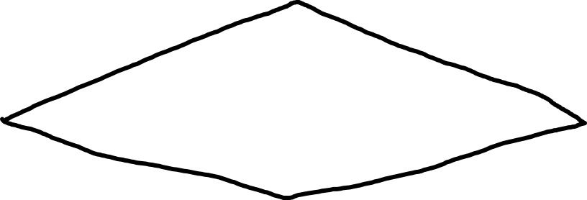
Education

Slide 11



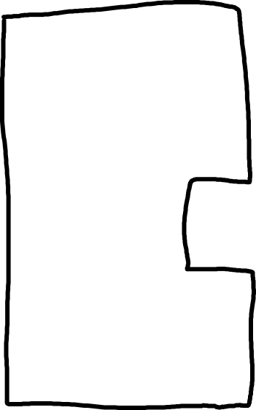
Interoperability
Education

Slide 12





Scripting
Education
Interoperability

Slide 13
























Prototyping
Education
Interoperability
Scripting

Slide 14
Education
Interoperability
Scripting
Prototyping

Slide 15
Assumptions
1. Most code in our language is typed
2. All values know their most precise type

Slide 16

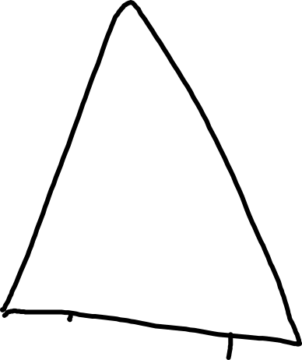
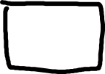



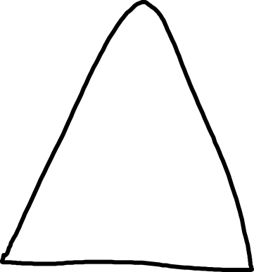

All values know their most precise type
Hi, I’m an
Integer
Hi, I’m a
Graph

Slide 17
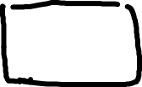

All values know their most precise type
List l = …;
l.sort((x,y) => x > y);
Something must go here
Hi, I’m a

Slide 18
All values know their most precise type
List l = …;
l.sort((x,y) => x > y);
Something must go here
Hi, I’m a

Slide 19

All values know their most precise type
List l = …;
l.sort(Comparator(x,y) => x > y);
Hi, I’m a
Comparator

Slide 20
Efficiency
6:13 And set up false witnesses, which said, This is a major gain in efficiency.
-- King James Programming

Slide 21
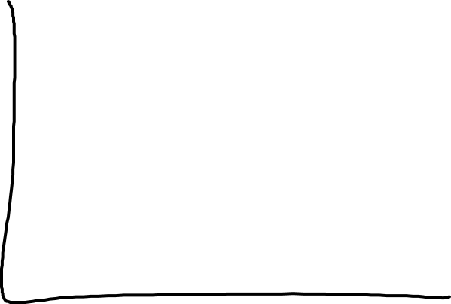

Efficiency Expectations
Running Time
More Typed →

Slide 22
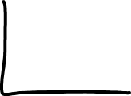
Overhead
Running Time
Overhead due to run-time checks
More Typed →

Slide 23

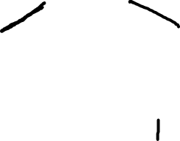




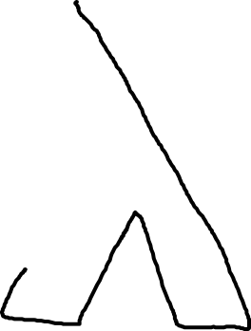
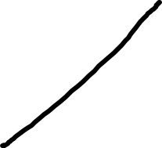

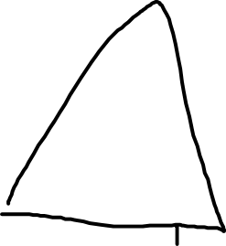



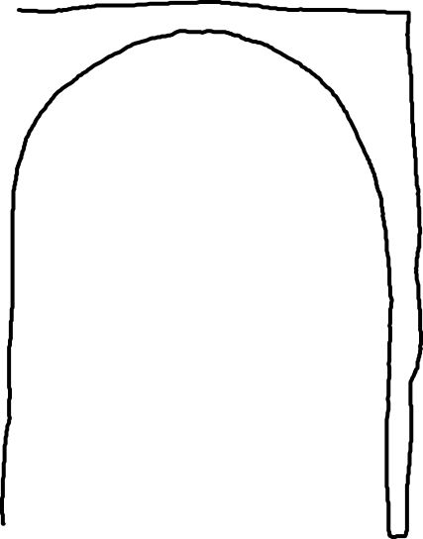
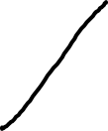
You are entering
the typed sector
Hey, are you
a Boolean?

Slide 24
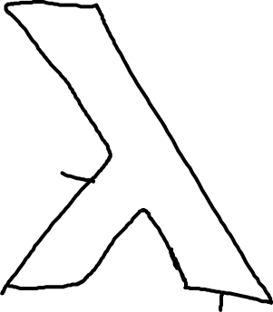



You are entering
the typed sector
Hey, are you an
Int → Int → Bool?
I don’t know!
Well, off in the
box with you!

Slide 25
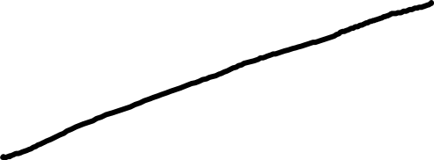
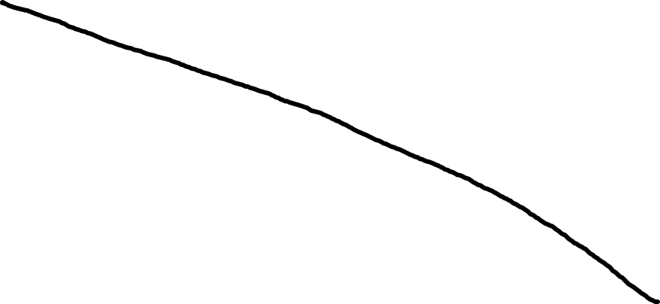
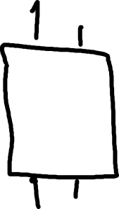

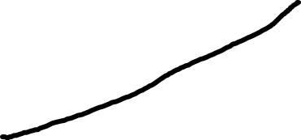

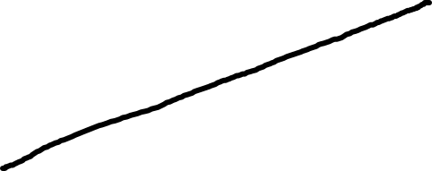
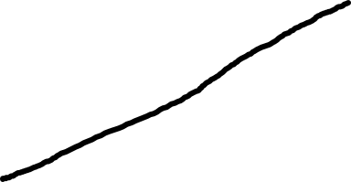

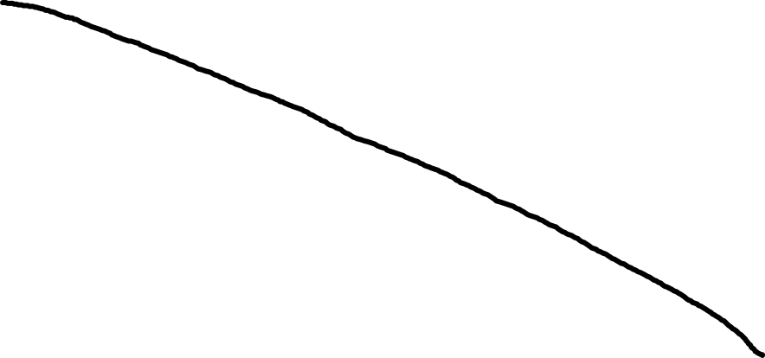

Ints
IN
Bool
OUT

Slide 26

Checks outputs every time the function is called

Slide 27




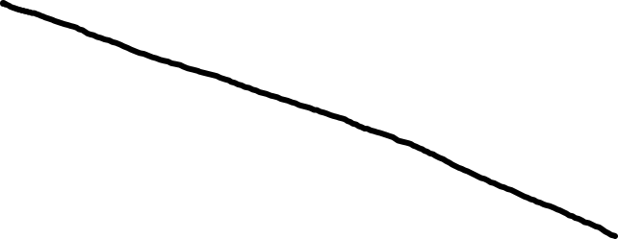
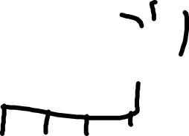

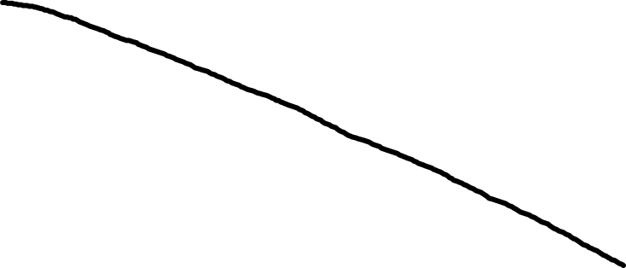
Blame Label
Ints
IN
Bool
OUT
Created at Line #XYZ

Slide 28




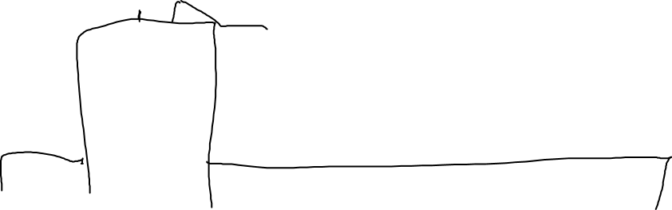


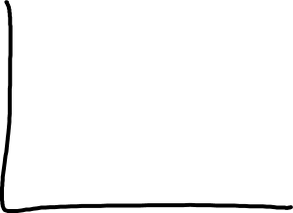




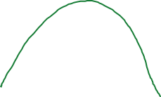

Is Sound Gradual Typing Dead?
Running Time
More Typed →

Slide 29







Benchmarking Mixed Configurations
?
?
?
?
$$τ$$
$$τ$$
$$τ$$
$$τ$$
Module 1
Module 1
Typed ➔
?
?
?
?
$$τ$$
$$τ$$
$$τ$$
$$τ$$
Module 2
Module 2
⬅ Untyped
?
?
?
?
$$τ$$
$$τ$$
$$τ$$
$$τ$$
Module 3
Module 3
???
$$τττ$$
Takikawa, Feltey, Greenman, New, Vitek, and Felleisen, POPL 2016

Slide 30















Benchmarking Mixed Configurations
?
?
?
?
$$τ$$
$$τ$$
$$τ$$
$$τ$$
?
?
$$τ$$
$$τ$$
?
?
$$τ$$
$$τ$$
?
$$τ$$
?
$$τ$$
?
$$τ$$
?
$$τ$$
???
??$τ$
?$τ$?
?$ττ$
$τ$??
$τ$?$τ$
$ττ$?
$$τττ$$
Takikawa, Feltey, Greenman, New, Vitek, and Felleisen, POPL 2016

Slide 31
Sieve

Slide 32
Snake

Slide 33
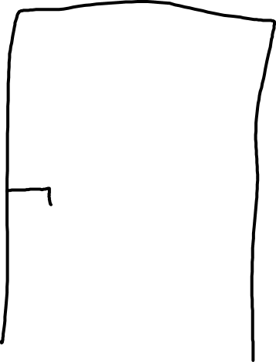

Graphs
only!

Slide 34

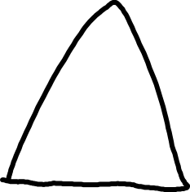


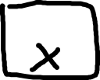

Graphs
only!
Evil!
Hi, I’m a
Socket

Slide 35
?
Socket <: Graph
Graphs
only!
Hi, I’m a
Socket

Slide 36




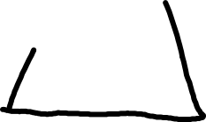




?
Socket <: Graph
Graphs
only!
Hi, I’m a
Socket

Slide 37
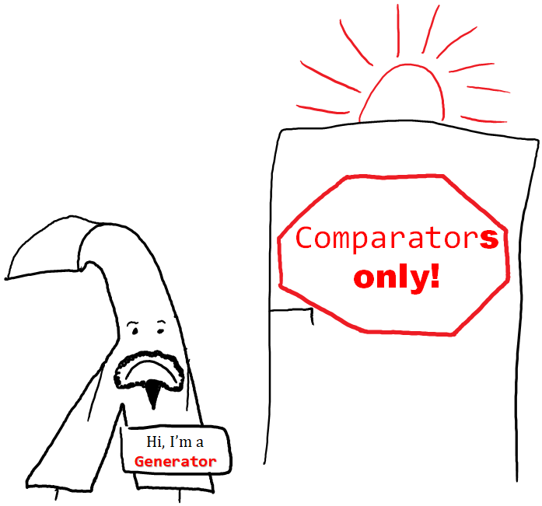
?
Serializer <: Comparator

Slide 38
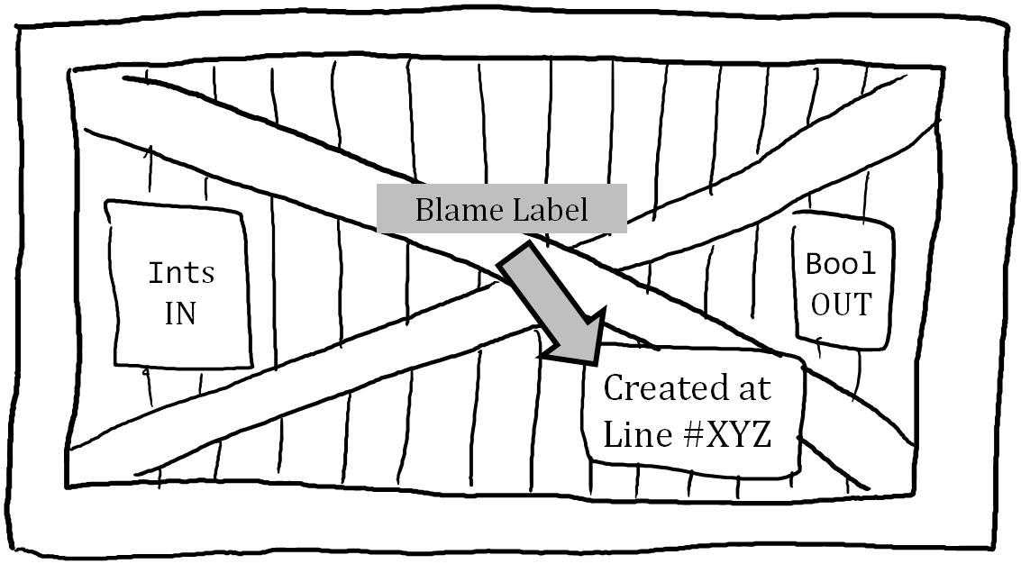
No wrapper allocation
No subsequent checks
No blame tracking

Slide 39


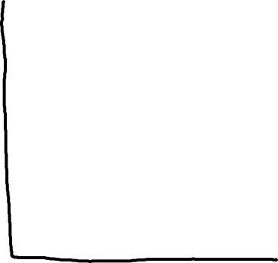
Efficiency Expectations
Running Time
More Typed →

Slide 40

Efficiency Expectations
Typed code
slower than
untyped code
Running Time
More Typed →

Slide 41
Reticulated Python: More Types – Slower Programs
Vitousek, Swords, and Siek, POPL 2017
Fully untyped program

Slide 42
Efficiency Expectations
Running Time
More Typed →

Slide 43
Efficiency Expectations
Untyped code
significantly
slower than
typed code
Running Time
More Typed →

Slide 44
Sieve

Slide 45
Snake

Slide 46
dynamic in C#
bool Eq(dynamic l, dynamic r) {
return l == r;
}
Eq(1056, 1044 + 12)
bool Eq(object l, object r) {
return l == r;
}
Reference Equality

Slide 47
dynamic in C#
bool Eq(dynamic l, dynamic r) {
return l == r;
}
Overloaded Operator
Eq(1056, 1044 + 12)
bool Eq(object l, object r) {
return l == r;
}
bool Eq(int l, int r) {
return l == r;
}
Reference Equality
Value Equality

Slide 48
dynamic in C#
bool Eq(dynamic l, dynamic r) {
return l == r;
}
Overloaded Operator
Eq(1056, 1044 + 12)
bool Eq(dynamic l, object r) {
return l == r;
}
bool Eq(dynamic l, int r) {
return l == r;
}
?
?

Slide 49
Predictable Semantics
Since 2006, the term gradual typing has become quite popular but its meaning has become diluted to encompass anything related to the integration of static and dynamic typing.
-- Siek, Vitousek, Cimini, and Boyland: “Refined Criteria for Gradual Typing”

Slide 50

correct
Changes to the annotations of a gradually typed program should not change the static or dynamic behavior of the program.
Siek, Vitousek, Cimini, and Boyland, SNAPL 2015
“Gradual Guarantee”

Slide 51
Exploiting the Gradual Guarantee
Meta-Info
Field 1
Field 2
Field 3
Nominal Type
Virtual Method Table
Interface Table
Object Layout

Slide 52
Exploiting the Gradual Guarantee
Meta-Info
Field 1
Field 2
Field 3
Nominal Type
Virtual Method Table
Interface Table
Dynamic Dictionary
Object Layout
Allende, Fabry, and Tanter, DLS 2013

Slide 53
Co-Design
Type System Features
Implementation

Slide 54
Snake
Fully untyped running time

Slide 55
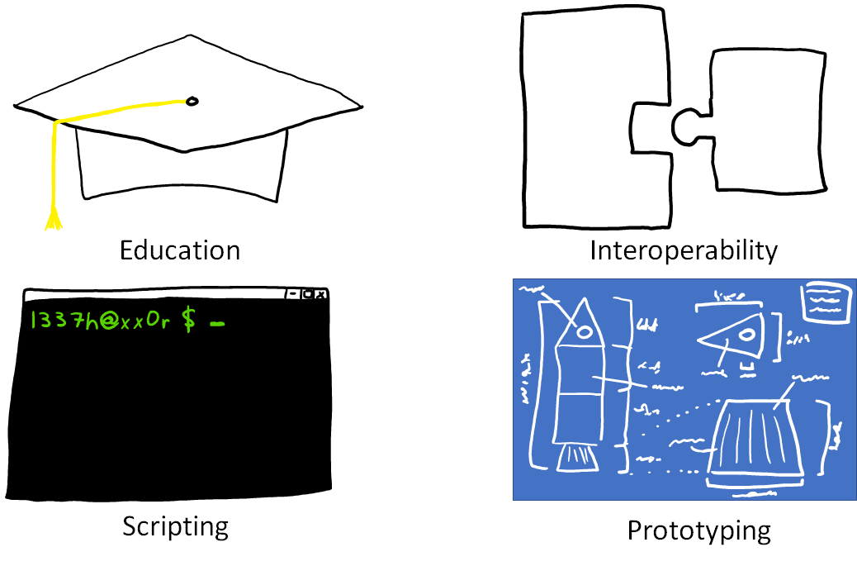
Prototyping

Slide 56
Sound Gradual Typing is Nominally Alive and Well

