Slide 1

Strict and Lazy Semantics for Effects Layering Monads and Comonads
Andrew K. Hirsch and Ross Tate

Slide 2





$$x ≔3;y≔\text{error};\text{return}(x)$$
Reduce 1st
Reduce $x$
$$y≔\text{error};\text{return}(3)$$
$$y ≔\text{error};\text{return}(3)$$
Done reducing;
Discard unused
Reduce 1st
$$\text{throw}()$$
$$\text{return}\text{(3)}$$

Slide 3

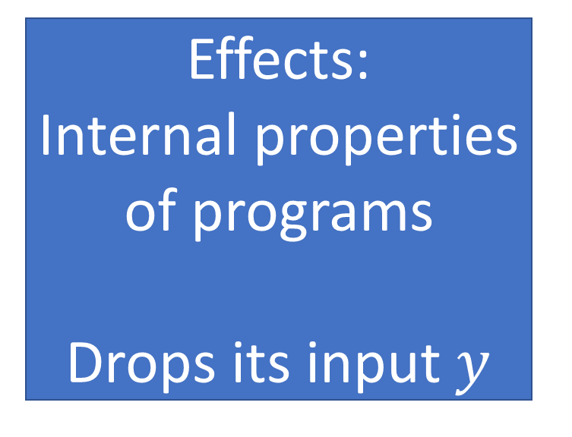
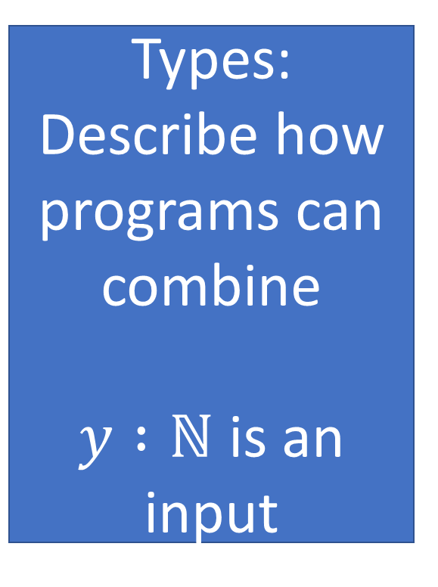
Unused
Throws Exception
$$x ≔3;y≔\text{error};\text{return}(x)$$
Types:
Describe how programs can combine
$y :ℕ$ is an input
Effects:
Internal properties of programs
Drops its input $y$

Slide 4



Never uses $y$
Might not produce its outputs
Might not consume its inputs
Throws an exception
$$y≔\text{error}$$
$$\text{return}(x)$$
Producer Choice (of Quantity)
Consumer Choice (of Quantity)
Pure = Linear
Notes:
Not having them makes it use all inputs once, produce all outputs once – pure = linear

Slide 5

There was a problem, stop everything!
Producer Choice
Consumer Choice

Slide 6
We don’t need that, don’t bother evaluating it
Producer Choice
Consumer Choice

Slide 7




Monads
Comonads
Effects
Strictness & Laziness
Notes:
Take a second for comonad – effect connection

Slide 8

How do I use these together?
Monads
Comonads
Notes:
Stress: Layerings discovered before (in CT, by Brookes and van Stone), but they aren’t the default way of doing things.

Slide 9
Effectful Language
Pure Language
Non-Linear Language with Exceptions
Linear Language without Exceptions
Example language with strict and lazy semantics
Process calculus with linear session types
Comp – Language of Computations
Proc – Language of Processes

Slide 10



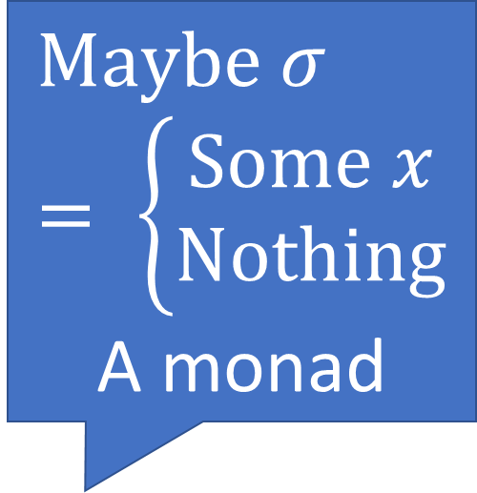







$$τ$$
exn
$$σ$$
$$σ$$
exn
$$ρ$$
And this program never runs
$$\text{Maybe} σ= \left\{\begin{aligned}\text{Some} x \\ \text{Nothing}\end{aligned}\right.$$
A monad
Linear Proc Program
$$σ$$
$$\text{Maybe} ρ$$
If this throws an exception
So this throws an exception
Bind propagates that exception
bind
$$τ$$
$$\text{Maybe} σ$$
$$\text{Maybe} σ$$
$$\text{Maybe} ρ$$
Capturing Exceptions in a Monad
Notes:
No clouds
Arrows to lollipop

Slide 11










Connections to logic in paper
$$τ$$
drop
$$σ$$
$$σ$$
drop
$$ρ$$
And this does not need to run
From linear logic
A comonad
$$!τ$$
$$σ$$
Cobind propagates that drop
If this is dropped
So this should be dropped
cobind
$$!τ$$
$$!σ$$
$$!σ$$
$$ρ$$
Capturing Drops in a Comonad

Slide 12










Comp
Proc
Generalizes Maybe
From Linear Logic
$$τ$$
exn
$$σ$$
$$τ$$
$$?σ$$
$$τ$$
drop
$$σ$$
$$!τ$$
$$σ$$
$$τ$$
exn, drop
$$σ$$

Slide 13
How do I use these together?
Monads
Comonads
Notes:
Stress: Layerings discovered before (in CT, by Brookes and van Stone), but they aren’t the default way of doing things.

Slide 14










Comp
Proc
Generalizes Maybe
From Linear Logic
$$τ$$
exn
$$σ$$
$$τ$$
$$?σ$$
$$τ$$
drop
$$σ$$
$$!τ$$
$$σ$$
straightforward
$$τ$$
exn, drop
$$σ$$
$$!τ$$
$$?σ$$

Slide 15






$$τ$$
exn, drop
$$σ$$
$$σ$$
exn, drop
$$ρ$$
$$τ$$
exn, drop
$$ρ$$

Slide 16













$$τ$$
exn, drop
$$σ$$
$$σ$$
exn, drop
$$ρ$$
$$!τ$$
$$?σ$$
$$!σ$$
$$?ρ$$
cobind
Distributive Law
bind
$$!τ$$
$$!?σ$$
$$?!σ$$
$$?ρ$$
$$τ$$
exn, drop
$$ρ$$

Slide 17
With a distributive law
How do I use these together?
Monads
Comonads
Notes:
Stress: Layerings discovered before (in CT, by Brookes and van Stone), but they aren’t the default way of doing things.

Slide 18












$$τ$$
exn, drop
$$σ$$
$$σ$$
exn, drop
$$ρ$$
$$!τ$$
$$?σ$$
$$!σ$$
$$?ρ$$
Distributive Law
cobind
bind
$$!τ$$
$$?!σ$$
$$?!σ$$
$$?ρ$$

Slide 19
With a distributive law
How do I use these together?
Monads
Comonads
Notes:
Stress: Layerings discovered before (in CT, by Brookes and van Stone), but they aren’t the default way of doing things.

Slide 20


Producer Choice
Consumer Choice

Slide 21






$$τ$$
exn, drop
$$σ$$
$$σ$$
exn, drop
$$ρ$$
So this program never runs
If this program throws an exception
$$!σ$$
$$?!ρ$$
Bind will propagate that exception
bind
$$!τ$$
$$?!σ$$
$$?!σ$$
$$?!ρ$$
The Monad-Prioritizing Layering

Slide 22

Comp
Proc
Generalizes Maybe
From Linear Logic
$$τ$$
exn
$$σ$$
$$τ$$
$$?σ$$
$$τ$$
drop
$$σ$$
$$!τ$$
$$σ$$
Monad-Prioritizing
$$τ$$
exn, drop
$$σ$$
$$!τ$$
$$?!σ$$

Slide 23
Producer Choice
Consumer Choice

Slide 24






$$τ$$
exn, drop
$$σ$$
$$σ$$
exn, drop
$$ρ$$
So this program never runs
$$!?τ$$
$$?σ$$
Cobind will propagate that drop
If this program drops its input
cobind
$$!?τ$$
$$!?σ$$
$$!?σ$$
$$?ρ$$
The Comonad-Prioritizing Layering

Slide 25


Comp
Proc
Generalizes Maybe
From Linear Logic
$$τ$$
exn
$$σ$$
$$τ$$
$$?σ$$
$$τ$$
drop
$$σ$$
$$!τ$$
$$σ$$
Comonad-Prioritizing
$$τ$$
exn, drop
$$σ$$
$$!?τ$$
$$?σ$$

Slide 26




Programs
Values
Comp
strict
$$p :τ→σ$$
$$v$$
Monad-Prioritizing
Monad-Prioritizing
Proc
$$ρ :!τ⊸?!σ$$
$$ν$$
Notes:
Commuting Diagram

Slide 27

Programs
Values
Comp
lazy
$$p :τ→σ$$
$$v$$
Comonad-Prioritizing
Comonad-Prioritizing
Proc
$$ρ :!?τ⊸?σ$$
$$ν$$
Notes:
Commuting Diagram

Slide 28
By choosing a layering
How do I use these together?
Monads
Comonads
Notes:
Stress: Layerings discovered before (in CT, by Brookes and van Stone), but they aren’t the default way of doing things.

Slide 29
Monads
Comonads
Effects
Strictness & Laziness
Notes:
Take a second for comonad – effect connection

Slide 30









Producer Effect
$$ε_{P}, \text{drop}$$
$$τ$$
$$σ$$
$ε_{P}$ run even if program is not needed
$ε_{P}$ not run if program is not needed
$$!τ$$
$$M!σ$$
$$!Mτ$$
$$Mσ$$
Generalizing Layering
Notes:
Talk in tech report about strong monad gives interaction with !

Slide 31





Producer Effect
Consumer Effect
$$ε_{P}, ε_{C}$$
$$τ$$
$$σ$$
Monad-Prioritizing
“Strict”
Comonad-Prioritizing
“Lazy”
$$Cτ$$
$$MCσ$$
$$CMτ$$
$$Mσ$$
Generalizing Layering
Notes:
Stress: “Strict” and “Lazy” are just monikers, with crazy monad/comonad pairs it could be anything.

Slide 32

Choice is between a “strict” and a “lazy” semantics for effects.
If there is not a distributive law:
Monad-Prioritizing Layering
Comonad-Prioritizing Layering

Slide 33
Theorem:
All three semantics are the same.
If there is a distributive law:
Monad-Prioritizing Layering
Comonad-Prioritizing Layering
Distributive-Law Based Semantics

Slide 34





Theorem:
If there is a distributive law, then all three semantics are the same.
$$x ≔3;y≔\text{error};\text{return}(x)$$
Reduce 1st
Reduce $x$
Corollary:
There is no distributive law of ! over ?
$$y≔\text{error};\text{return} 3$$
$$y ≔\text{error};\text{return}(3)$$
Reduce 1st
Done reducing;
Discard unused
$$\text{throw}()$$
$$\text{return}\text{(3)}$$

Slide 35
In the paper
Connections to logic (linear and classical)
A formalization of doubly-effectful languages
Categorical Formalization
Theorem Details
mostly in the tech report

Slide 36
Thanks

