Slide 1



WATER SQUAD
Raghav Joshi – Agronomy
Ross Unruh - Agronomy
Nishadini Widanagamage - Agronomy
Priyanka Gautam – Electrical and Computer Engineering

Slide 2
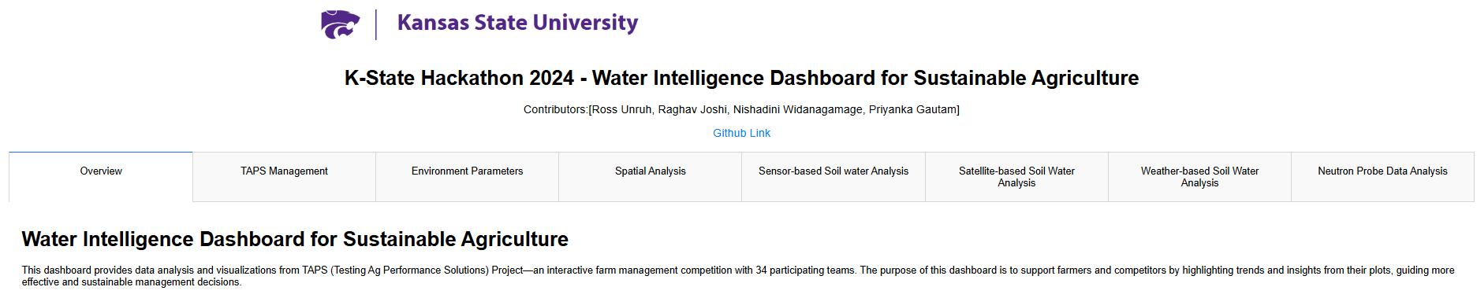
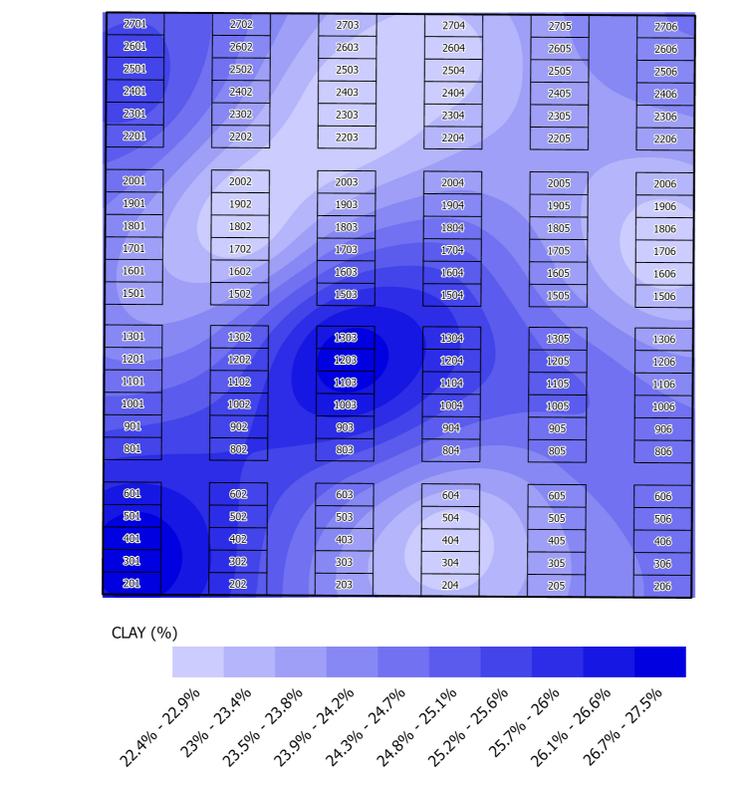
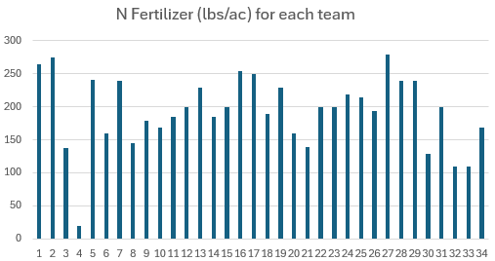
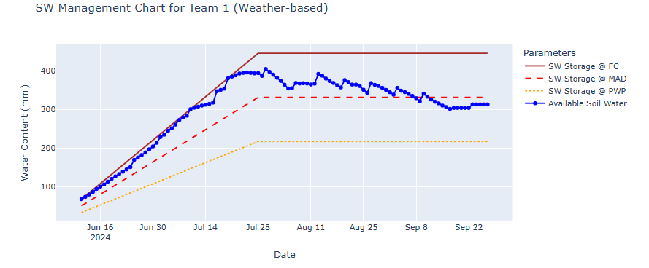
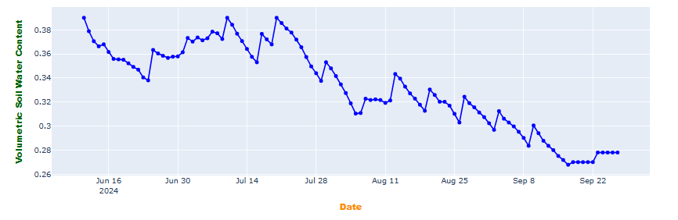
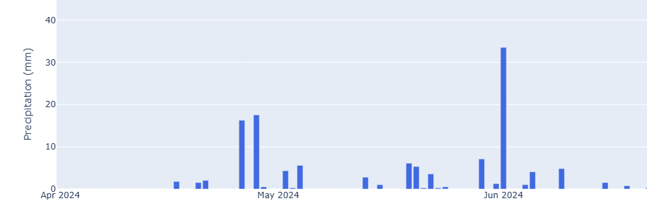
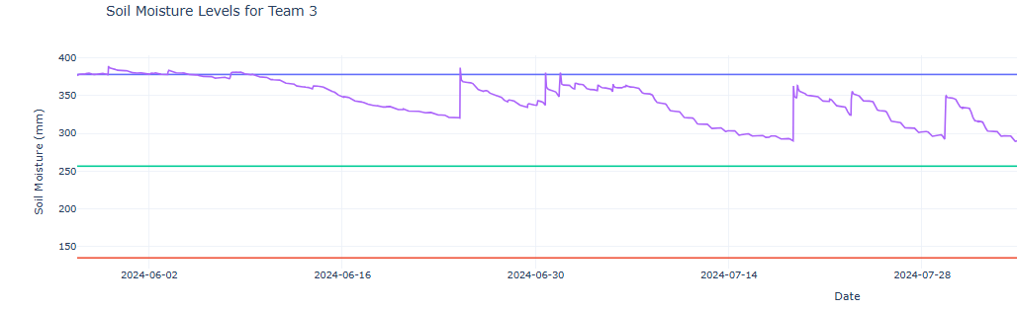
TABS
INPUTS
PIPELINE
OUTPUT
DASHBOARD VIEW
TAPS Management
Environmental Parameters
Rainfall Temperature Relative Humidity Evapotranspiration (ETo)
Spatial Analysis
Soil analysis at different locations Satellite imagery from Planet Labs from different dates
Sensor-based Soil water Analysis
Satellite-based Soil Water Analysis
Weather-based Soil Water Analysis
Planting Dates Seeding Rates Irrigation
Management plots for each team
Spatial Soil Maps (% Sand-Silt-Clay) Crop NDVI Maps
Soil Volumetric Water Content Plot SW Management Chart
Soil Volumetric Water Content Plot SW Management Chart
Soil Volumetric Water Content Plot SW Management Chart
Time-series weather plots for the field
PyPlot, MatplotLib, seaborn, Plotly, dash
PyPlot, Pandas, MatplotLib, plotly, dash
ArcPy, MatplotLib, plotly, dash
Sentek soil moisture data Planting dates Soil type
MatplotLib, Pandas, plotly, dash
Weather NDVI Maps Planting dates Soil type
Tool – KANSCHED
MatplotLib, PyPlot, Glob, ArcPy, plotly, dash
Weather Planting dates Soil type
Tool – KANSCHED
MatplotLib, PyPlot, Glob, plotly, dash

