Slide 1



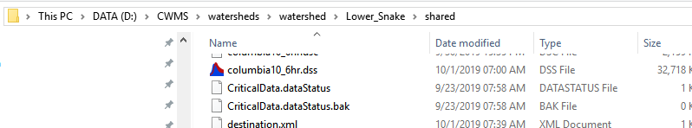
1. Downloading ESP Data
Connects to NWFC website and saves ESP to DSS using R script
scripts/Download_ESP_5mins.py launches
scripts/esp_download/Download_ESP.bat, which then launches R and passes the output DSS file name ( to be saved in watershed shared)
scripts/esp_download/ESP Download.R using R (w/ dssrip package)
Configuration within scripts/esp_download/ESP Download.R file
R script
saveLocation = commandArgs(trailingOnly=T) ["columbia10_6hr.dss“]
‘siteIDs’ strings define sites to downloaded ESP feeds
See rfc_esp_links.xlsm file for the urls. Note: will only download natural ESP traces
See ‘ESP_Description_Webinar_20160518.pdf’ for more info on ESP “flavors” (pg 12) and general info
saveLocation argument
Download_ESP_5mins.py
Download_ESP.bat
ESP Download.R
set dssfile="columbia10_6hr.dss"

Slide 2
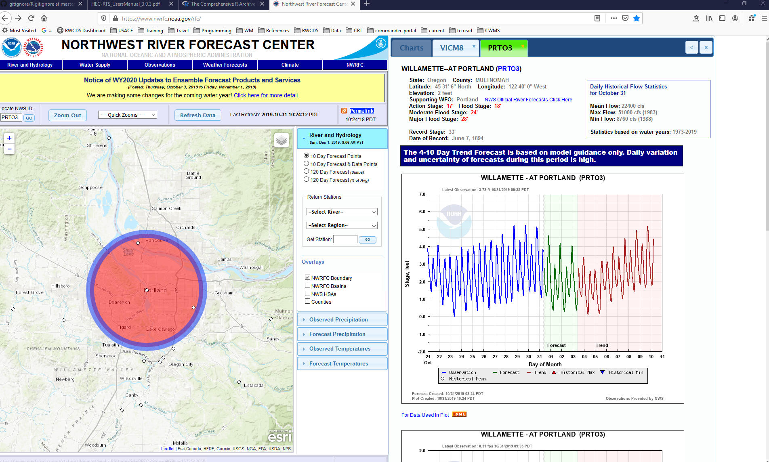
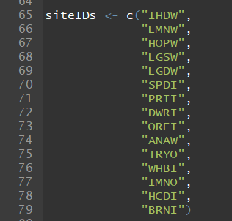
Finding NWRFC IDs
Navigate to NWRFC site: https://www.nwrfc.noaa.gov/rfc/
Click on a specific location
NWRFC ID is in parentheses next to full site name (only first four characters are needed for R script)
Example input to R script:
scripts/esp_download/ESP Download.R

Slide 3
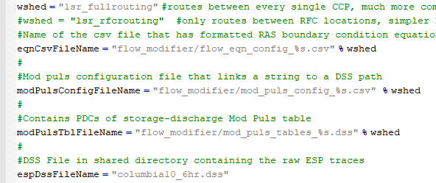
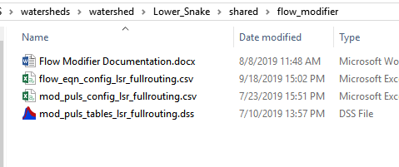
2. Route ESP Flows
Needs to be done if you want to preserve similar routing as HMS would do for flows
See shared/flow_modifier/Flow Modifier Documentation.docx for documentation on how to set up configuration
CAVI runs the scripts/Flow_Modifier.py script
Flow_Modifier.py Configuration (references files shared/flow_modifier and shared directories)
Flow_Modifier.py

Slide 4
3. Run ESP ResSim Alternative

Slide 5
4. Save ESP Data to SQLite

Slide 6
5. Run GUI

