Slide 1



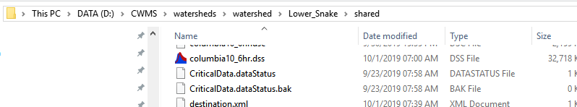
Downloading ESP Data
Connects to NWFC website and saves ESP to DSS using R script
scripts/Download_ESP_5mins.py launches
scripts/esp_download/Download_ESP.bat, which then passes the output DSS file name ( to be saved in watershed shared) to call of calls
scripts/esp_download/ESP Download.R using R (w/ dssrip package)
Configuration of RFC locations to download set in config.xlsx file in ‘download_sites’ tab
R script
saveLocation = commandArgs(trailingOnly=T) ["columbia10_6hr.dss“]
‘siteIDs’ strings define sites to downloaded ESP feeds, read in from config.xlsx
See rfc_esp_links.xlsm file for the urls. Note: will only download natural ESP traces
See ‘ESP_Description_Webinar_20160518.pdf’ for more info on ESP “flavors” (pg 12) and general info
Natural is the best option for ESP. Water supply is legacy. Unadjusted has no routing.
saveLocation argument
Download_ESP_5mins.py
Download_ESP.bat
ESP Download.R
set dssfile="columbia10_6hr.dss"

Slide 2
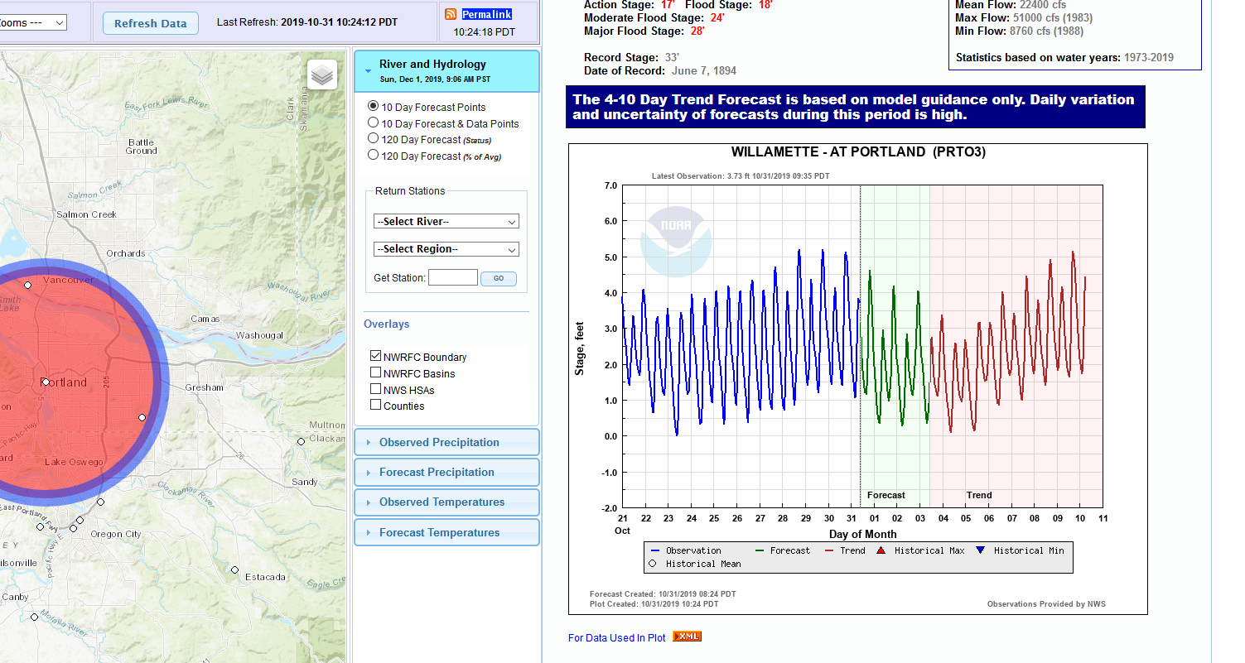
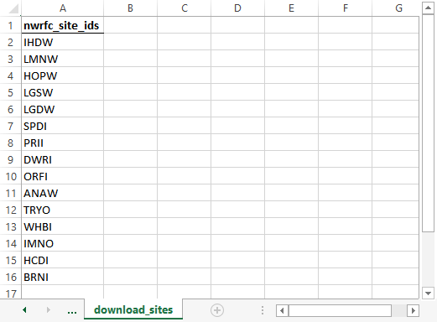
Finding NWRFC IDs
Navigate to NWRFC site: https://www.nwrfc.noaa.gov/rfc/
Click on a specific location
NWRFC ID is in parentheses next to full site name (only first four characters are needed for R script)
Tool matches site IDs against csv file names in scripts/esp_download/rfc_esp_links.xlsm using regular expressions
Example config.xlsx ‘download_sites’ tab:
Uses: scripts/esp_download/ESP Download.R

Slide 3
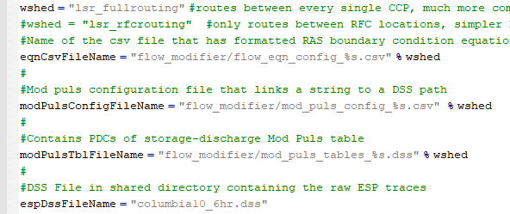
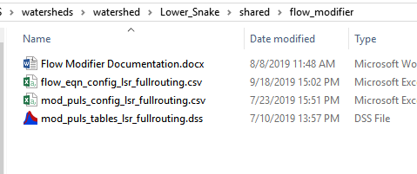
Route ESP Flows
Needs to be done if you want to preserve similar routing as HMS would do for flows
Get Mod Puls (or other routing) from (RAS) analysis
See documentation on how to set up configuration
CAVI runs the scripts/Flow_Modifier.py script
Flow_Modifier.py Configuration (references files shared/flow_modifier and shared directories)
Flow_Modifier.py

Slide 4
Run ESP ResSim Alternative

Slide 5
4. Save ESP Data to SQLite

Slide 6
5. Run GUI

Slide 7
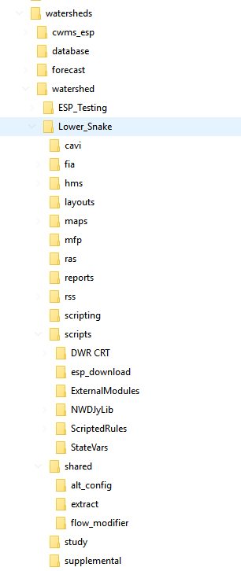
<Base CWMS Directory>
Main ESP Tool directory
CAVI Folders
Additional Python scripts for CAVI
ESP Download Tool
jar file for SQLite script
ESP Local Flow Tool

Slide 9
Figures for config.xlsx

Slide 10
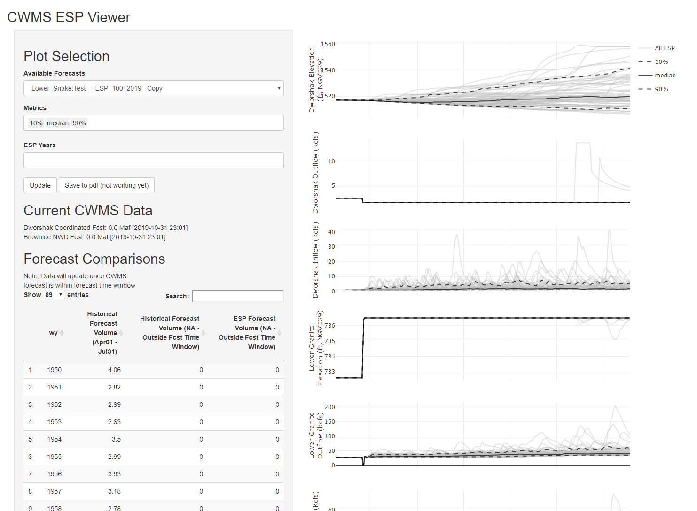
Forecasts with ‘forecast.db’ SQLite files
Established in config.xlsx under ‘plot_config’ tab
Established in webapp/global.R script via ‘metricsToCompute’ dataframe
Interpreted from catalog IDs of time series output
Established in config.xlsx under ‘current_data_tbl’ tab
Established in config.xlsx under ‘fcst_tbl’ tab

Slide 11
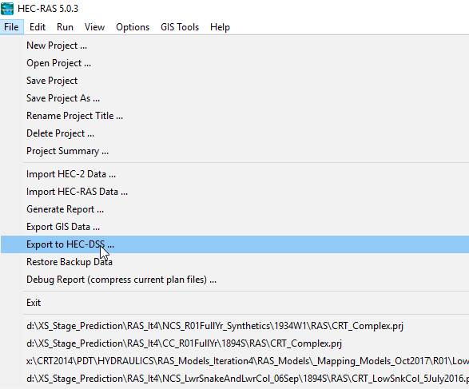
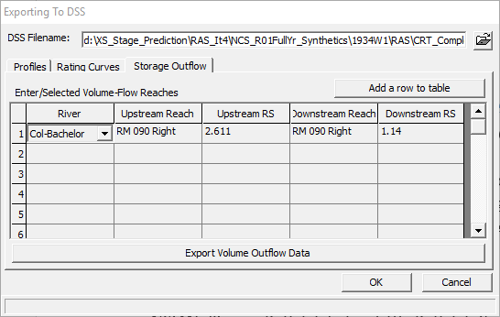
Mod Puls Table Extract from RAS

Slide 12
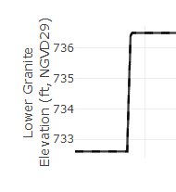
Printf formatting
Respects html formatting. For example:
“Lower Granite<br>Elevation (ft, NGVD29)” will be interpreted similar to figure on the right. Not the ‘<br>’ syntax to indicate new line

Slide 13
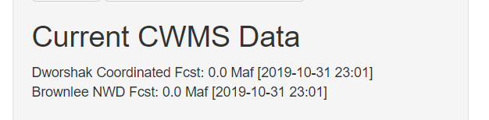

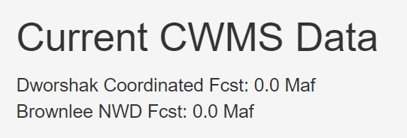

Current tbl formatting
Respects ‘printf’ formatting. For example, “%.1f” indicates a floating point value with one decimal space. “%s” indicates a string.
The inclusion of “%s” to indicate the most recent date-time of available CWMS data is optional, but the floating point value is required. If specified, the “%s” must be placed after the floating point specifier.
Example inputs, and resulting ‘Current CWMS Data’ text:
With “%s” syntax:
Without “%s” syntax:

Slide 14
Forecast Table Configuration

Slide 15
CCP in ResSIm
Not a CCP in ResSim
CCP in ResSIm
Not a CCP in ResSim
RFC Forecast Location
RFC Forecast Location
Neglect and account for net local flow contribution downstream as difference
Not an RFC Forecast Location
Not am RFC Forecast Location
Develop relationship between another ESP forecast location to estimate flows

Slide 16
ESP Example Routing
DWRI1
Dworshak
PRII1
Potlatch below Little Potlatch
ResSim Model Reach
SPDI1
Clearwater at Spalding (local)
CCP Inflow Location and RFC Forecast Location
ORFI1
Clearwater at Orofino
CCP not associated with RFC Forecast Location
Lapwai Ck near Lapwai
USGS 13342450
SPDI1_{local} = SPDI1_{total} –PRII1_{total,routed}– 0.14*PRII1_{total,routed}– ORFI1_{total,routed} – DWRI1_{total,routed}
Lapwai Ck near Lapwai

Slide 17
ResSim: ESP Network Setup
Snake River
No ESP Inflows for these CCPs
ANAW1
Snake near Anatone (local
ResSim Model Reach
TRYO3
Grande Ronde at Troy
Reach Not Modeled in ResSim
WHBI1
Salmon at Whitebird
RFC Forecast Location Only
CCP Inflow Location and RFC Forecast Location
IMNO3
Imnaha at Imnaha
HCDI1
Hells Canyon (unreg)
CCP Inflow Location only
ANAW1_{local} = ANAW1_{total} – HCDI1_{total,routed}

Slide 18
Tucannon near Starbuck
USGS 13344500
ResSim: ESP Network Setup
HOPW1
Palouse at Hooper (unreg)
IHDW1
Ice Harbor (local)
DWRI1
Dworshak (unreg)
LMNW1
Lower Monumental (local)
LGDW1
Lower Granite (local)
PRII1
Potlatch below Little Potlatch
LGSW1
Little Goose (local)
SPDI1
Clearwater at Spalding (local)
ORFI1
Clearwater at Orofino
Inflow Equations to Properly Account for Mass Balance:
*These are total flows, produced by RFC and used as boundary conditions
BRNI1, ORFI1, DWRI1, PRII1, HOPW1
*These are routing calcs for local flows
ANAW1_{local} = ANAW1_{total} – HCDI1_{total,routed} (note: HCDI1_{total} =BRNII1_{total})
LGDW1_{local} = LGDW1_{total} – ANAW1_{total,routed} – SPDI1_{total,routed} -0.16*IMNO3_{total,routed,Asotin} (Note: 0.16*IMNO3 = Asotin)
SPDI1_{local} = SPDI1_{total} –PRII1_{total,routed}– 0.14PRII1_{total,routed,Lapwai}– ORFI1_{total,routed} – DWRI1_{total,routed}
LGSW1_{local} = LGSW1_{total} - LGDW1_{total,routed}
LMNW1_{local} = LMNW1_{total} – LGSW1_{total,routed} – HOPW1_{total,routed} – 0.15*HOPW1_{total,routed,Tucannon}
IHRW1_{local} = IHRW1_{total} – LMNW1_{total,routed}
*These are relationships of locations without ESP data to locations with ESP data
**These are also routed in the local flow calculations
Lapwai Ck near Lapwai = 0.14*PRII1
Tucannon near Starbuck = 0.15*HOPW1
Asotin Ck = 0.16*IMNO3
Asotin Ck at Asotin
USGS 13335050
ANAW1
Snake near Anatone (local)
Lapwai Ck near Lapwai
USGS 13342450
TRYO3
Grande Ronde at Troy
WHBI1
Salmon at Whitebird
RFC Routing Reach
ResSim Model Reach
IMNO3
Imnaha at Imnaha
HCDI1
Hells Canyon (unreg)
Reach Not Modeled
RFC Forecast Location
CCP Inflow Location
Non-RFC Forecast Location; inflows to be computed in relation to RFC Location
BRNI1
Brownlee (unreg)
*BRNI1 = HCDI1 RFC flows

Slide 19
ResSim

Slide 20
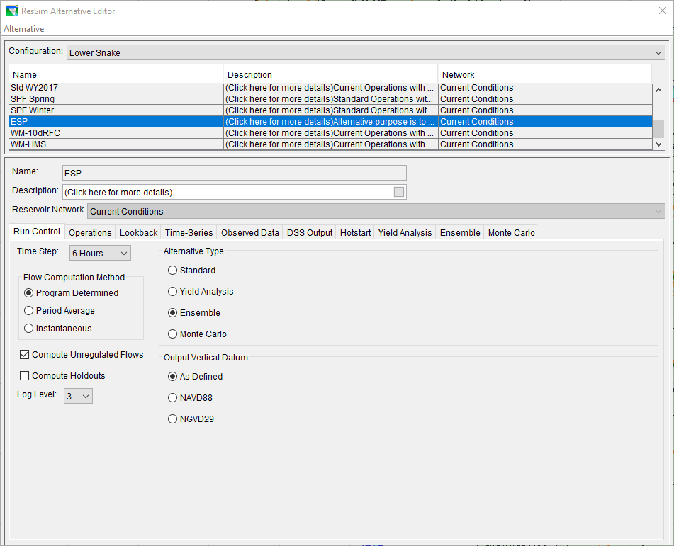
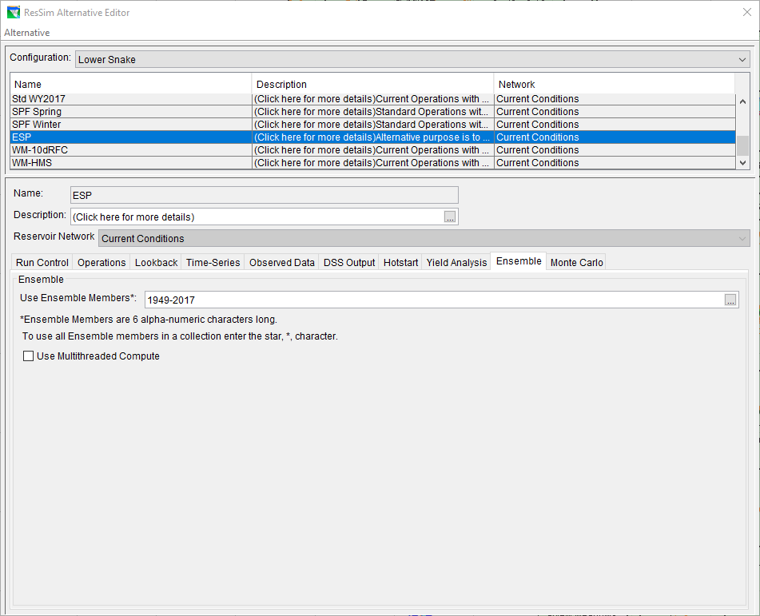
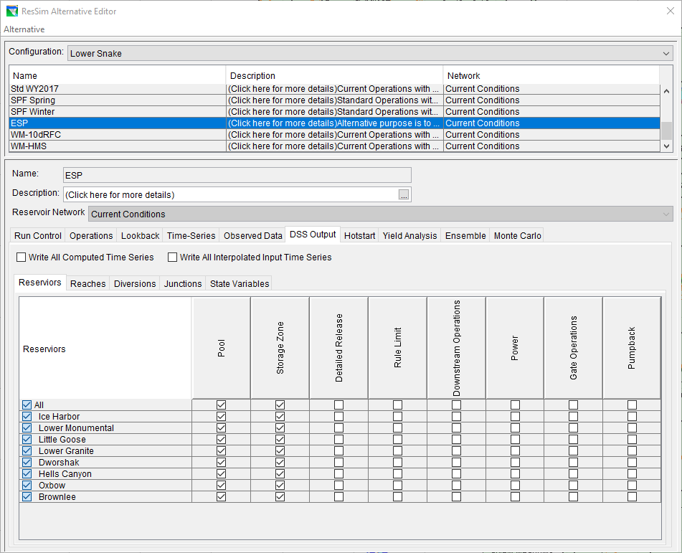

Slide 21
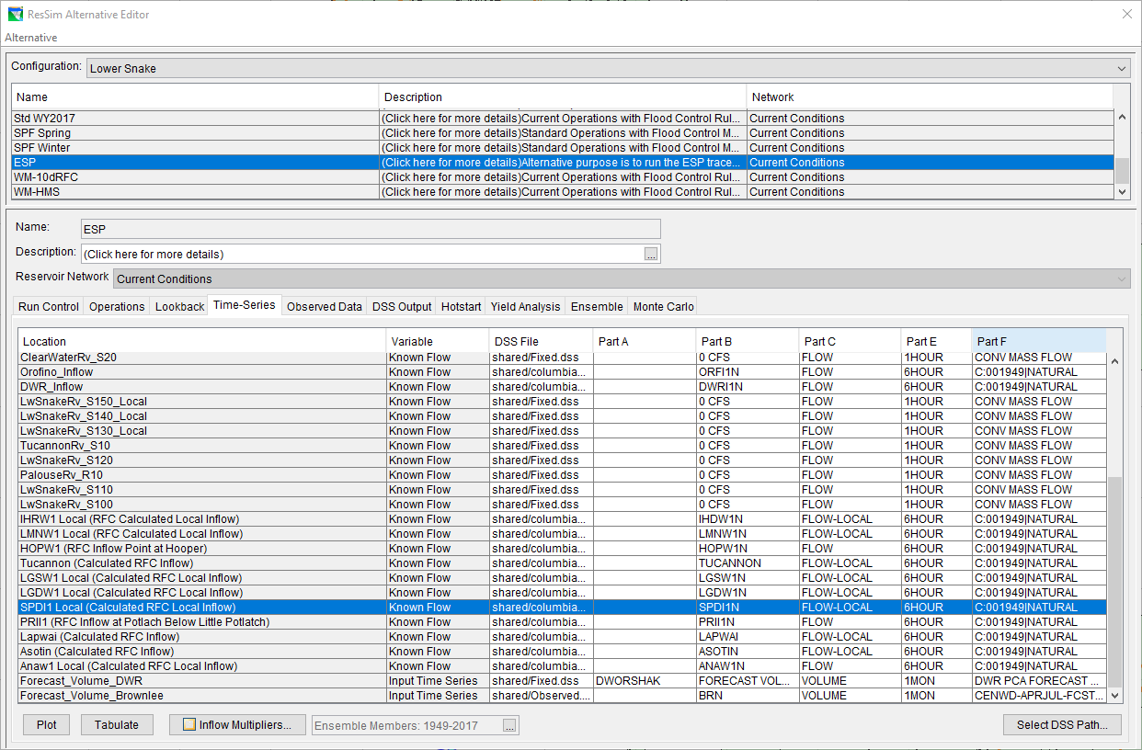
Flow Modifier csv
ResSim ESP Alternative

