Slide 1
PIXELS TO FEELINGS
A Comparison of Visual Sentiment Methods

Slide 2

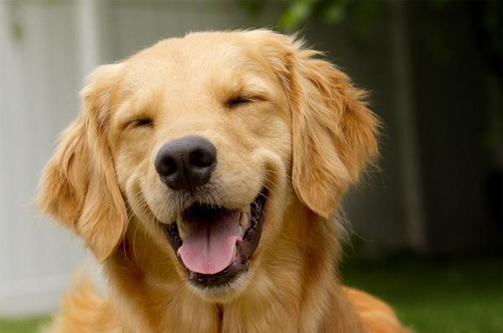
THE DIFFICULTY
What’s different in object recognition...
CAT
DOG

Slide 3
THE DIFFICULTY
...can represent the same emotion...
JOY
JOY

Slide 4
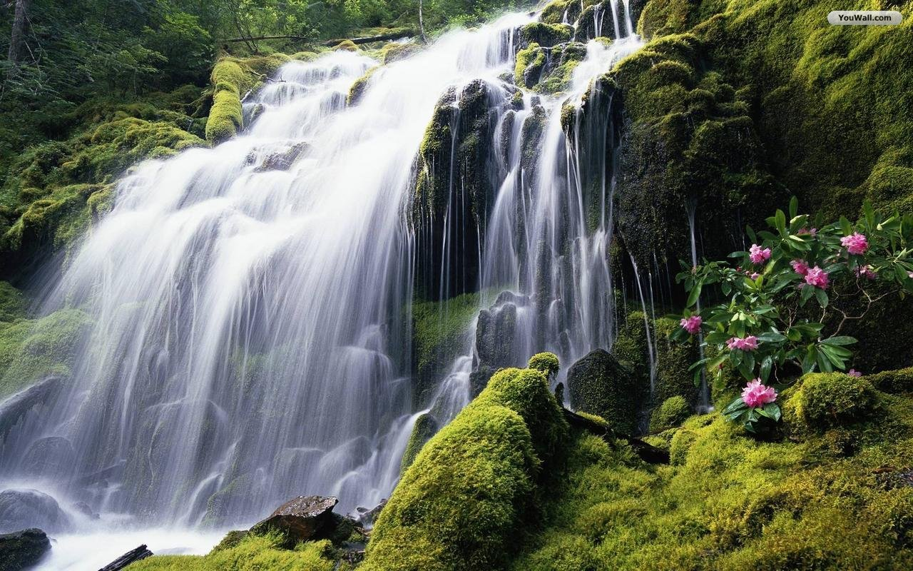
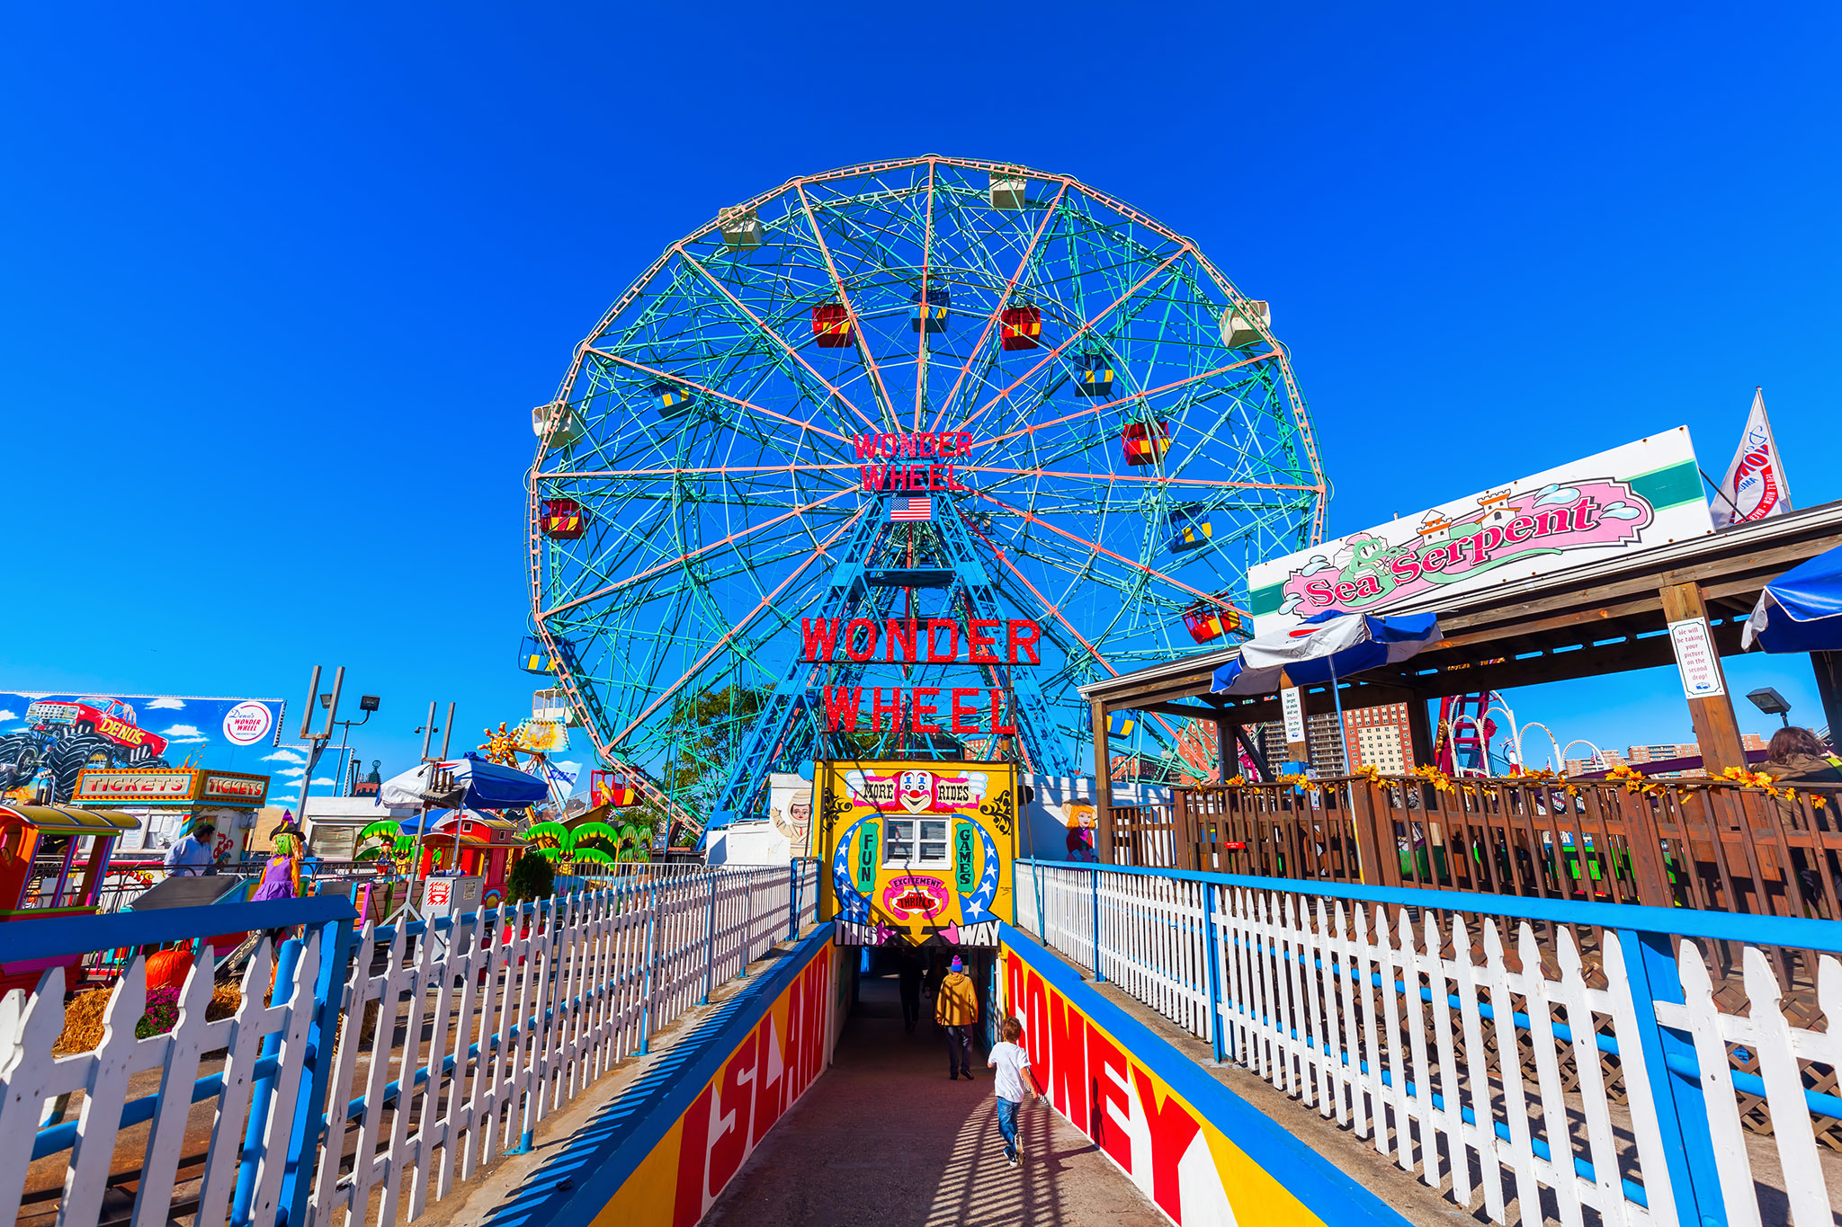

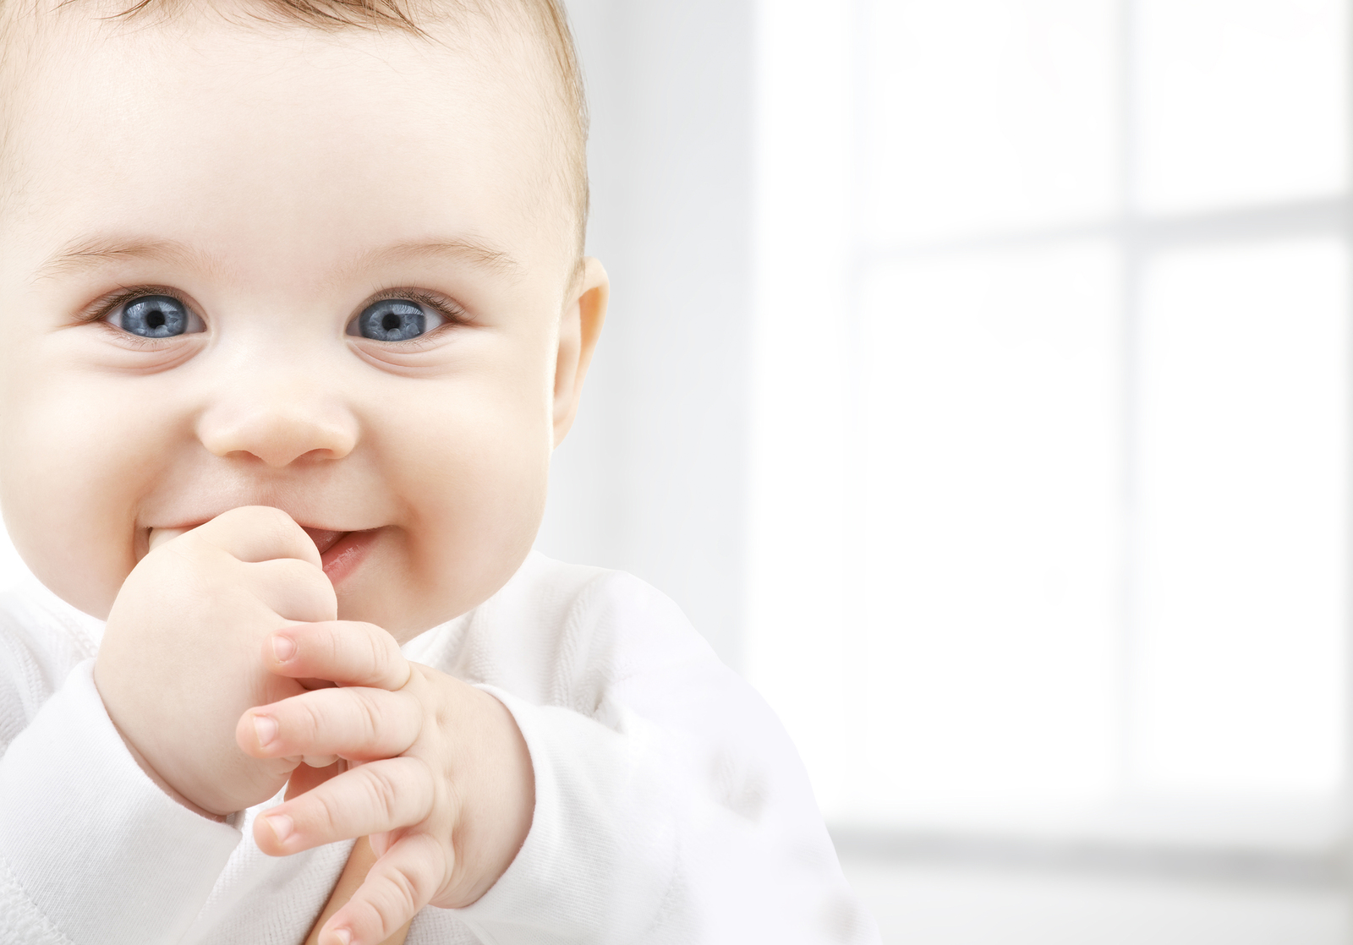
THE DIFFICULTY
...with that emotion applicable across a variety scenes/objects.
JOY

Slide 5
USE CASE
Historically, sentiment analysis has been text-based
But text is only a portion of social media content
Research suggests associations between images and wide range of emotions (Kurdi, Lozano, & Banaji, 2016)

Slide 6
01
REPRESENTATIVE TRAINING DATA
OBSTACLES
02
MODELING AFFECTIVE COMPONENTS

Slide 7
POTENTIAL SOLUTIONS
01
02
WEBEmo
Curriculum Learning
~268,000 images
Hierarchical labeling
Series of models
Sequentially learn nuances

Slide 8

CURRICULUM LEARNING
Resnet 50 (level 1)
Level 2 layers
Level 1 layers
Fully-connected
Fully-connected
Fully-connected
2 classes
6 classes
25 classes

Slide 9
RESEARCH QUESTION
How does a curriculum-based WEBEmo model compare to current alternatives?

Slide 10
EXPERIMENT
WEBEmo Accuracy
WEBEmo
Resnet 50
ImageNet (alternative #1)
ImageNet Accuracy
UnBiasedEmo
Deep Emotion (alternative #2)
Deep Emotion Accuracy

Slide 11
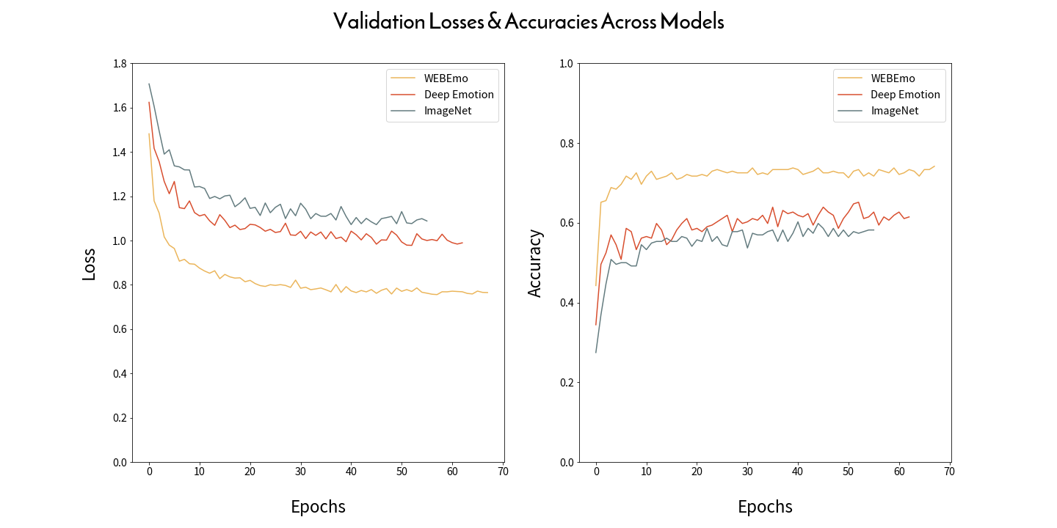
TRAINING METRICS
72.95%
65.16%
58.61%

Slide 12
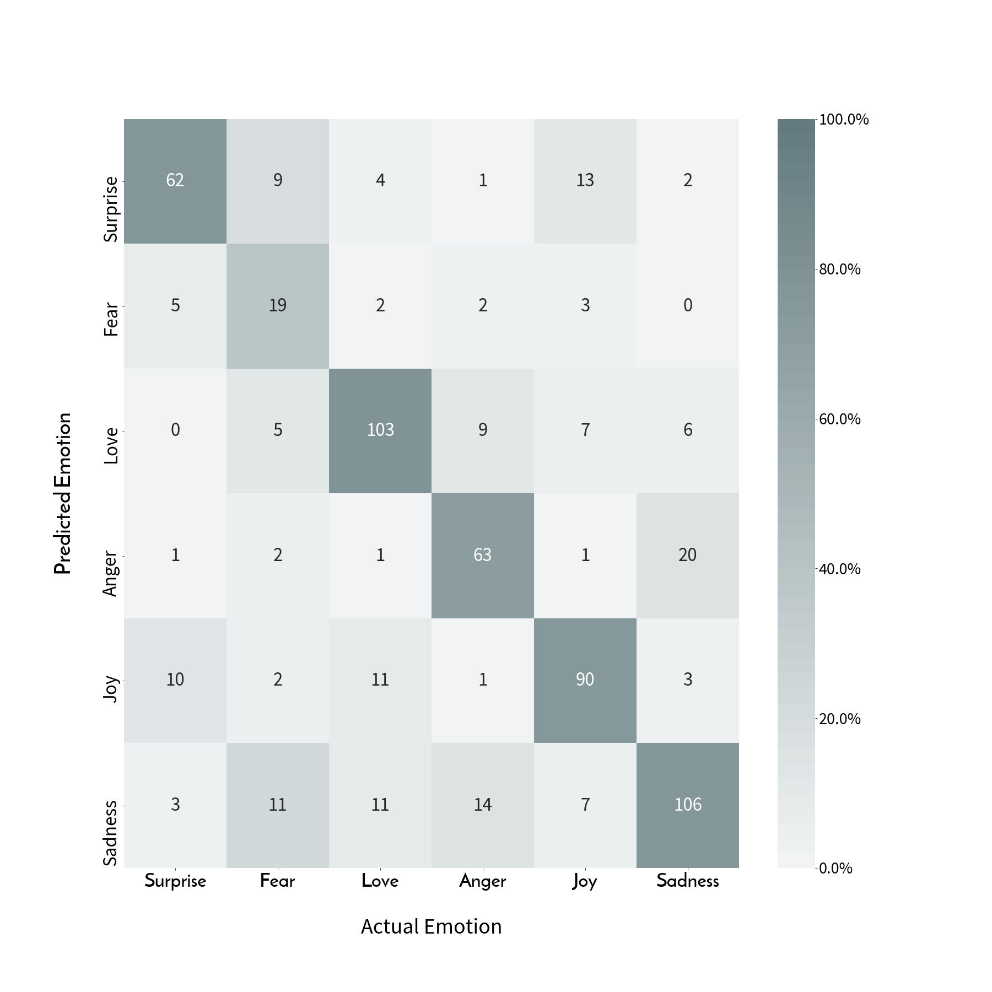
RESULTS
WEBEmo Model
Test accuracies:
WEBEmo – 72.74%
Deep Emotion - 66.50%
ImageNet – 59.61%

Slide 13
TAKEAWAYS
In this experiment, results favor the curriculum-based WEBEmo trained model for generalizability
Deserves consideration for transfer learning

Slide 14
FUTURE WORK
Exploration of other architectures
Alternative feature extraction strategies
Specific low, mid, and high-level features of images

Slide 15
THANKS
Email: bryan.ross.529@my.csun.edu
Github: https://github.com/rossbj92
Linkedin: https://www.linkedin.com/in/bryan-ross-07871452
Please keep this slide for attribution
References:
Kurdi, B., Lozano, S., & Banaji, M. R. (2016). Introducing the Open Affective Standardized Image Set (OASIS). Behavior Research Methods, 49(2), 457–470. doi:10.3758/s13428-016-0715-3

Slide 16
APPENDIX

Slide 17
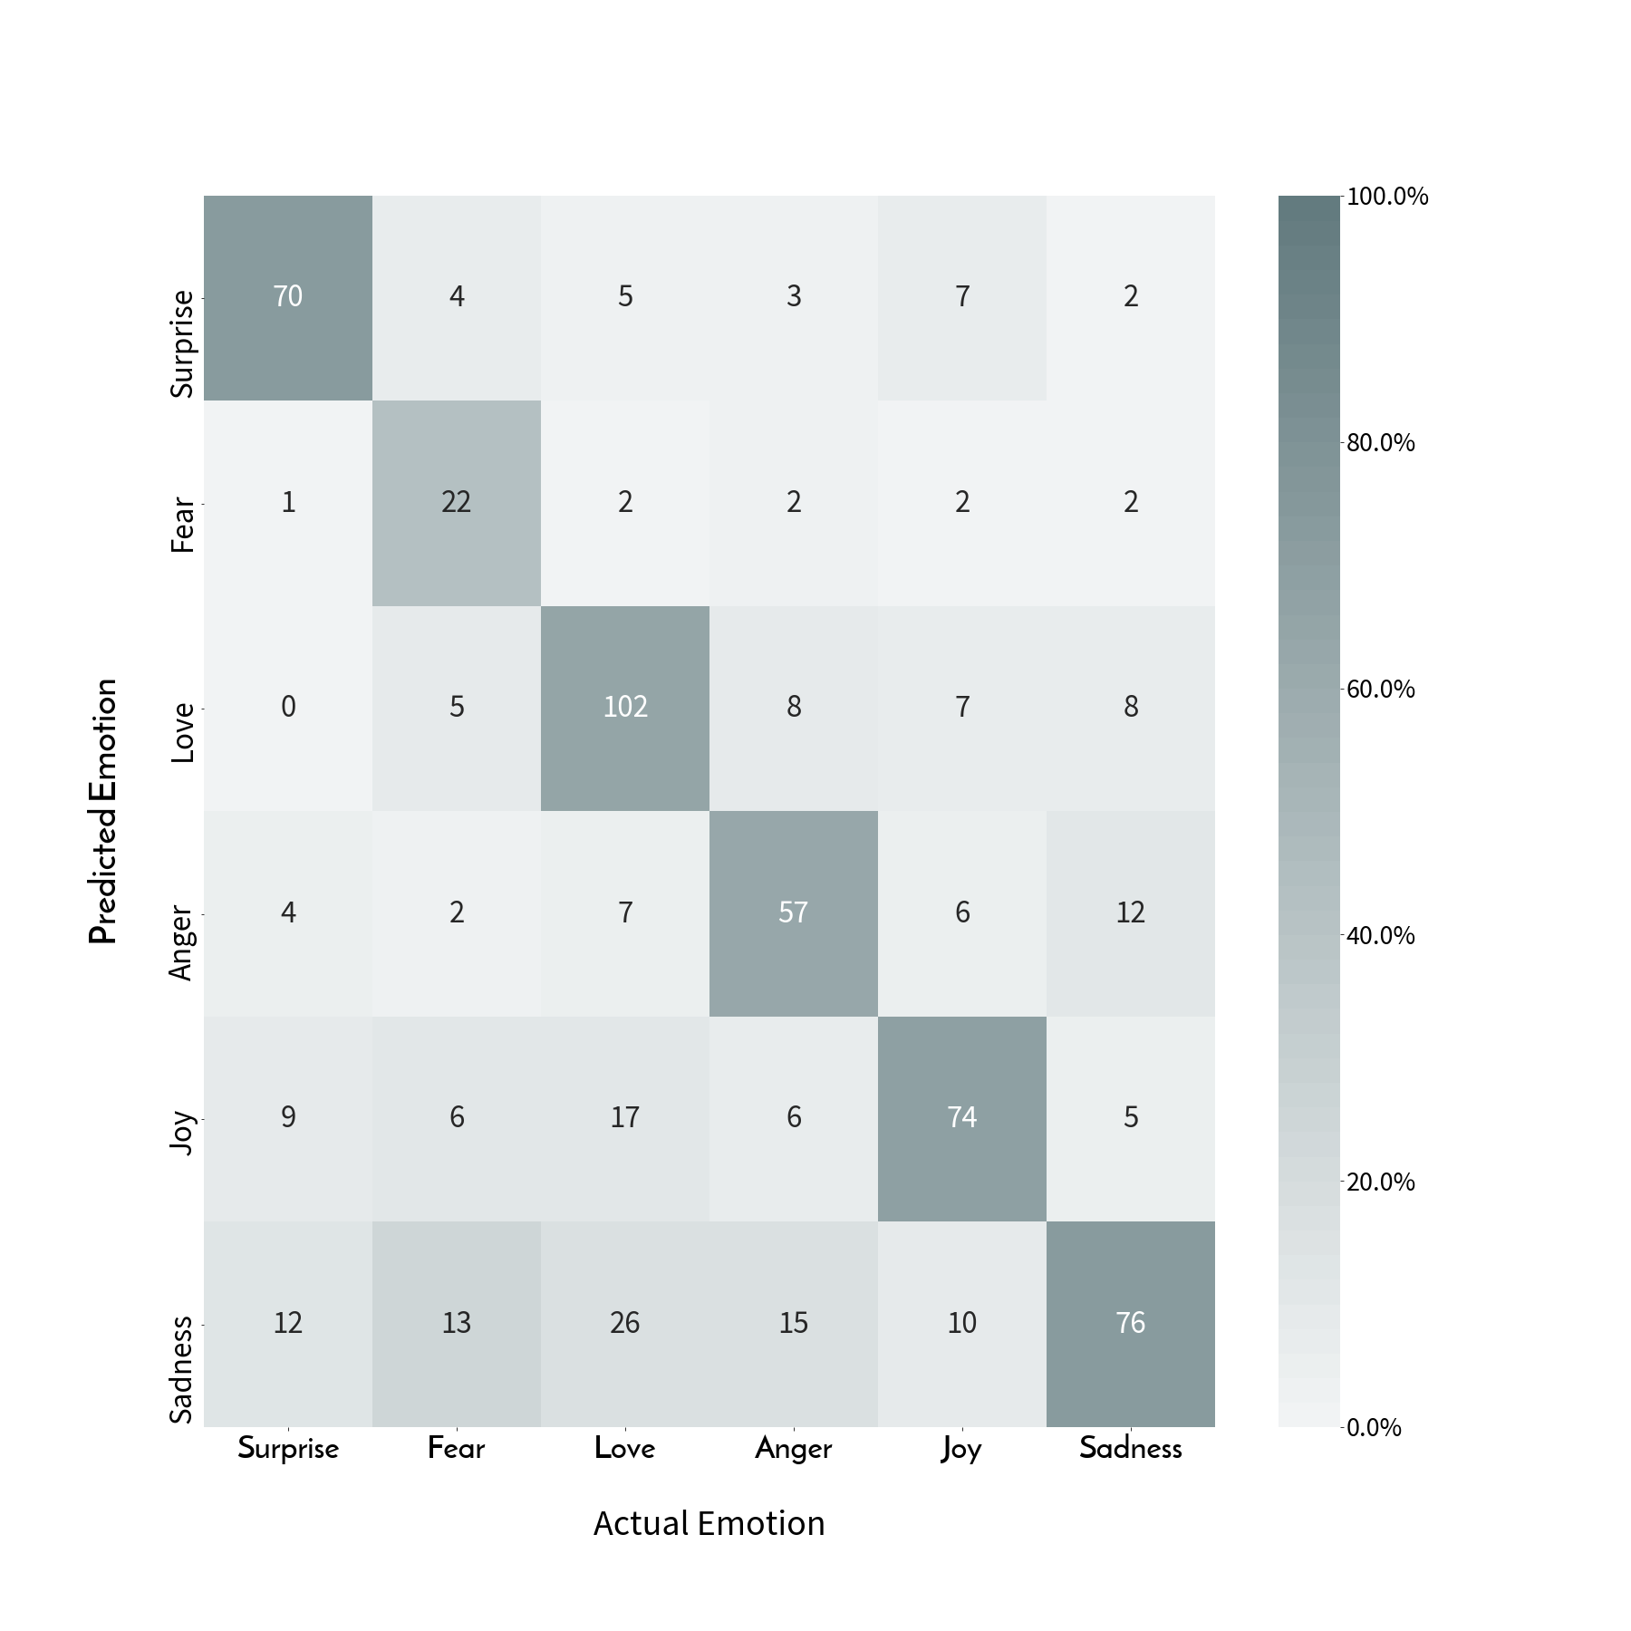
RESULTS CONT.
Deep Emotion Model

Slide 18
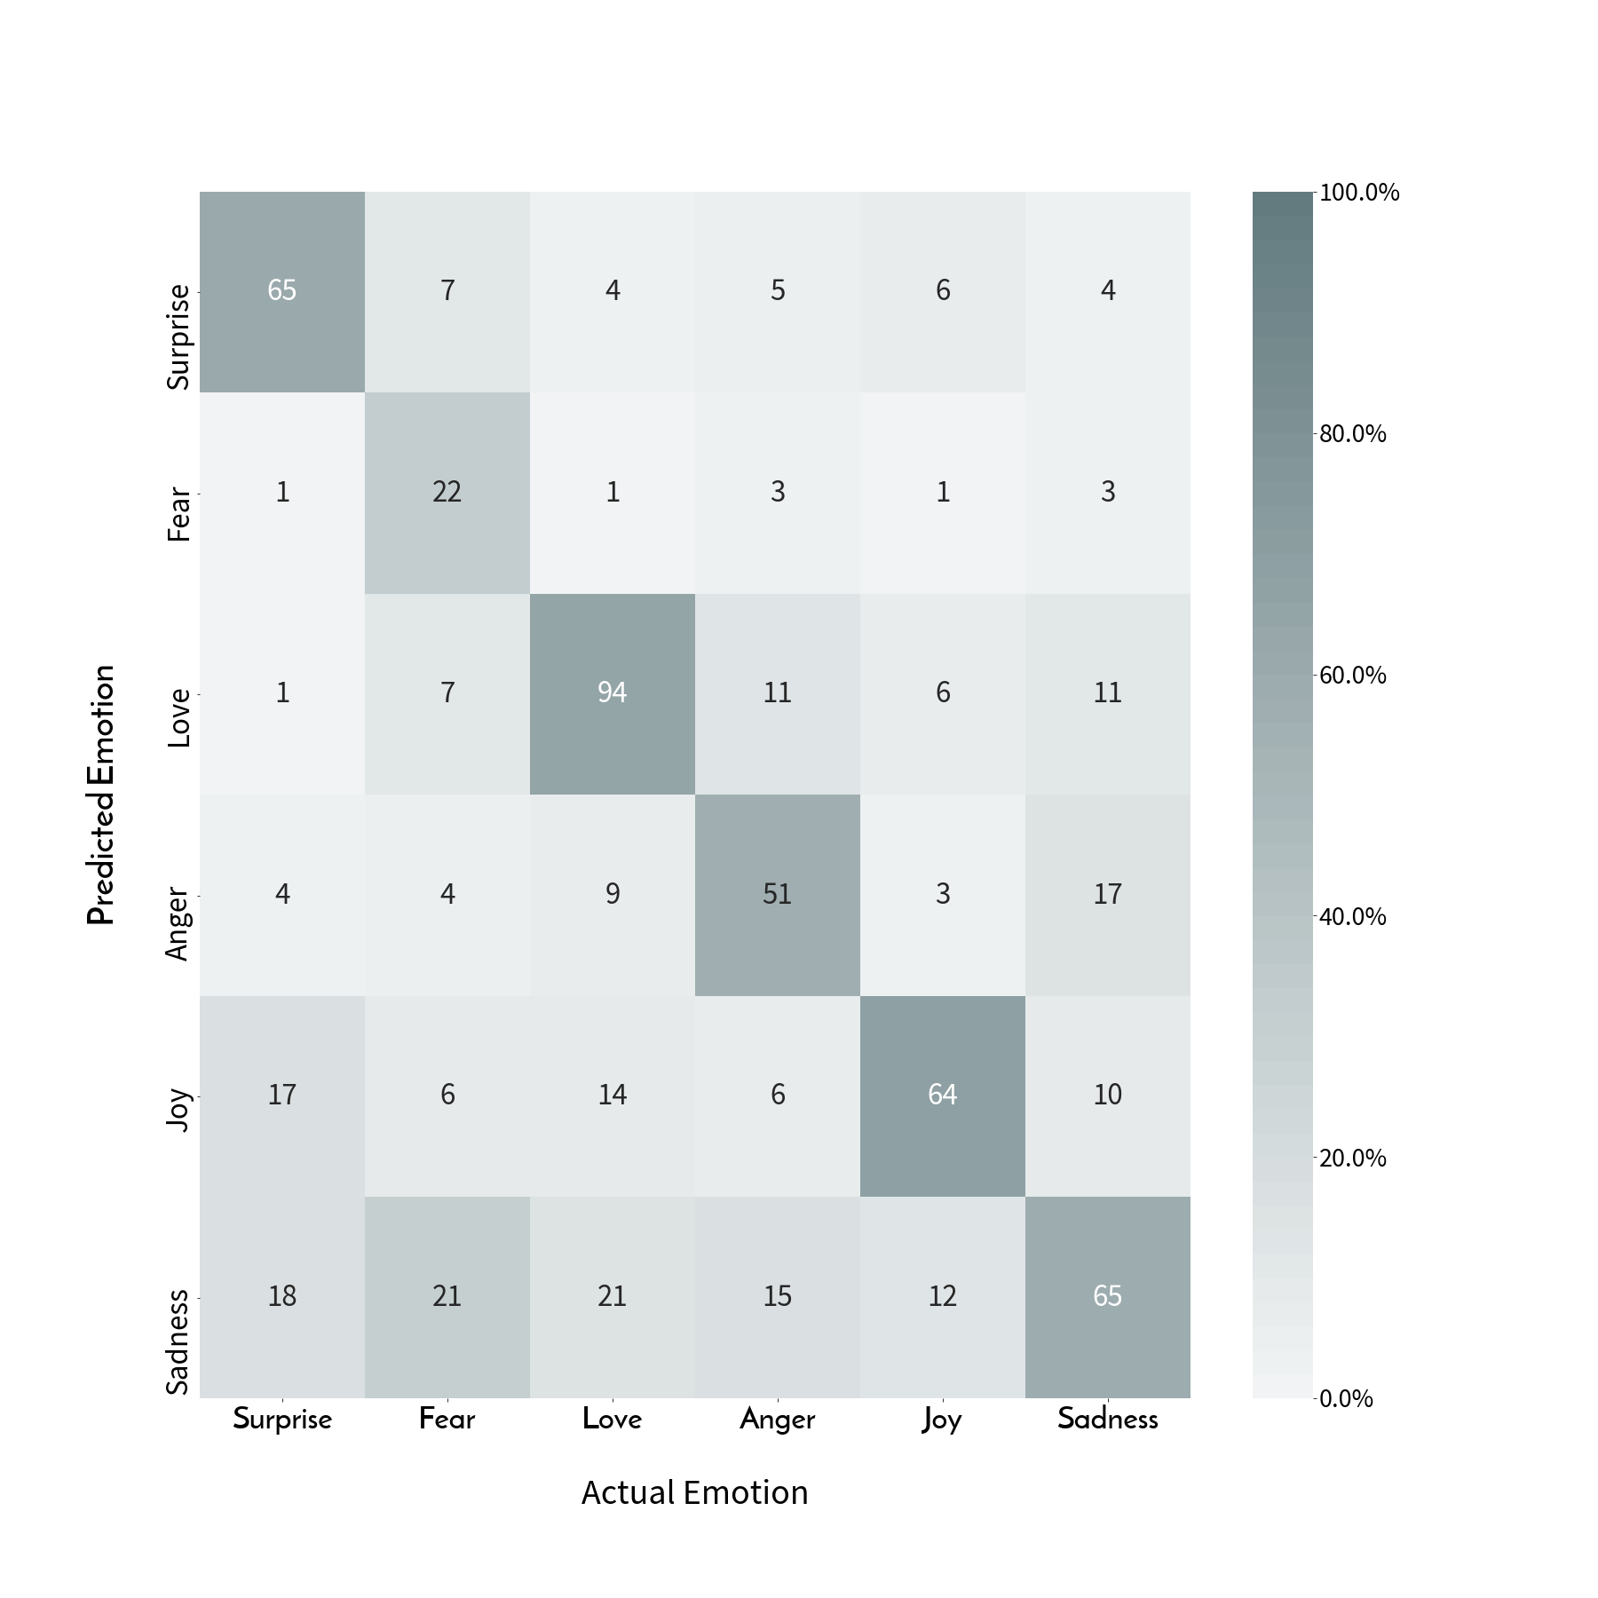
RESULTS CONT.
ImageNet Model

