Slide 1

Classifying Mental Health: The Reddit Proxy
Bryan Ross

Slide 2
IMPORTANCE
Patient insights outside of appointments
Enhancements in:
Diagnostic screening
Treatment progression
Risk prevention

Slide 3





METHODOLOGY
01
02
03
04
Query
Engineer
Model
Visualize

Slide 4
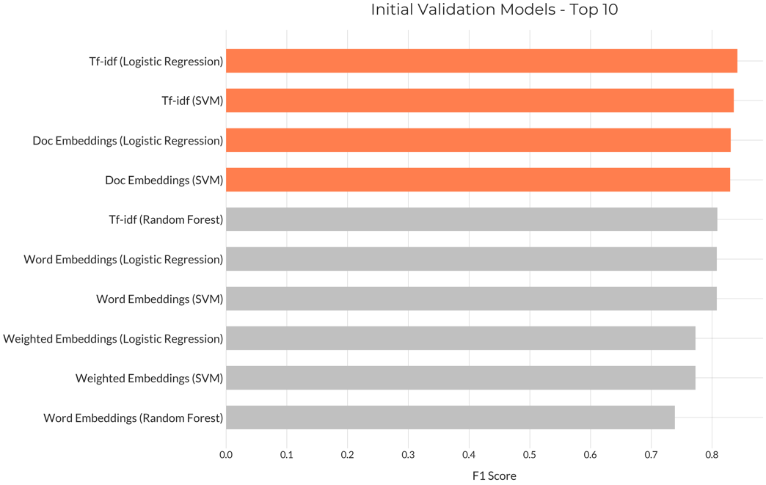
SIMPLEST IS BEST

Slide 5
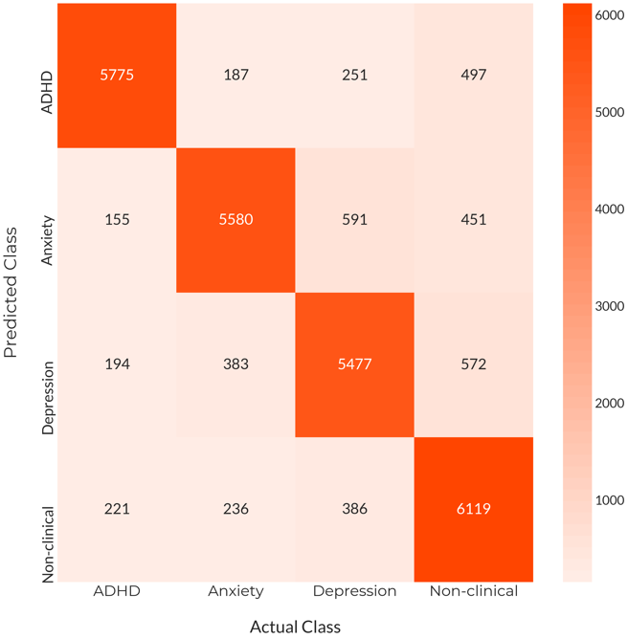
RESULTS
Biggest strength: non-clinical
Some struggles with depression & anxiety
Highly nuanced diagnostically

Slide 6
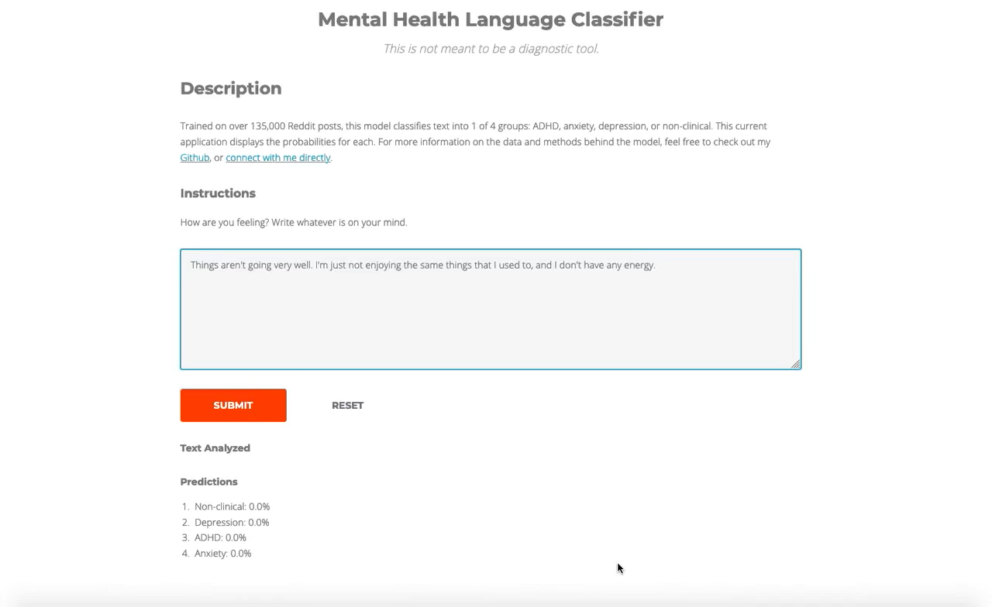

Slide 7
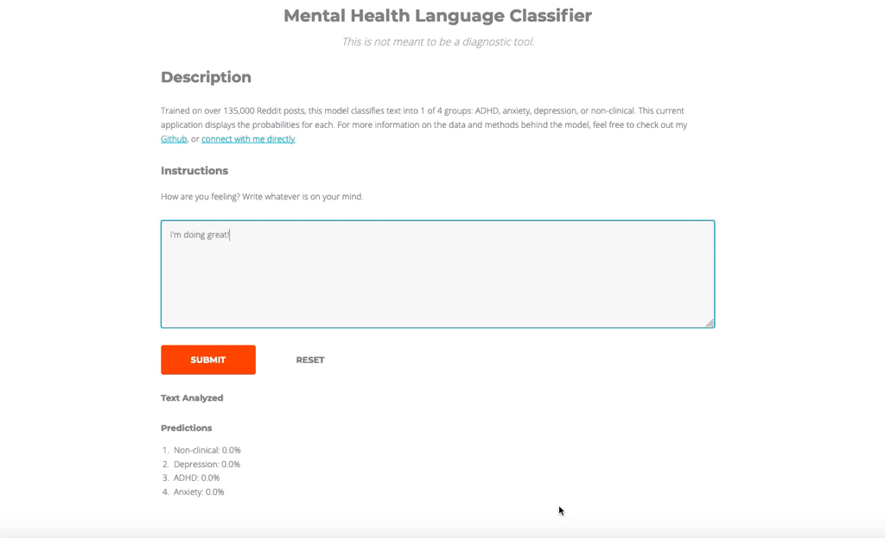

Slide 8
FUTURE WORK
Expand disorders
Fine-tune custom embeddings, collect more data
Explore other pre-trained embeddings

Slide 9
THANK YOU!
Email: Bryan.ross.529@my.csun.edu
Github: https://github.com/Rossbj92
Linkedin: https://www.linkedin.com/in/bryan-ross-07871452/
App: https://mental-health-classifier.herokuapp.com/

Slide 10
APPENDIX

Slide 11
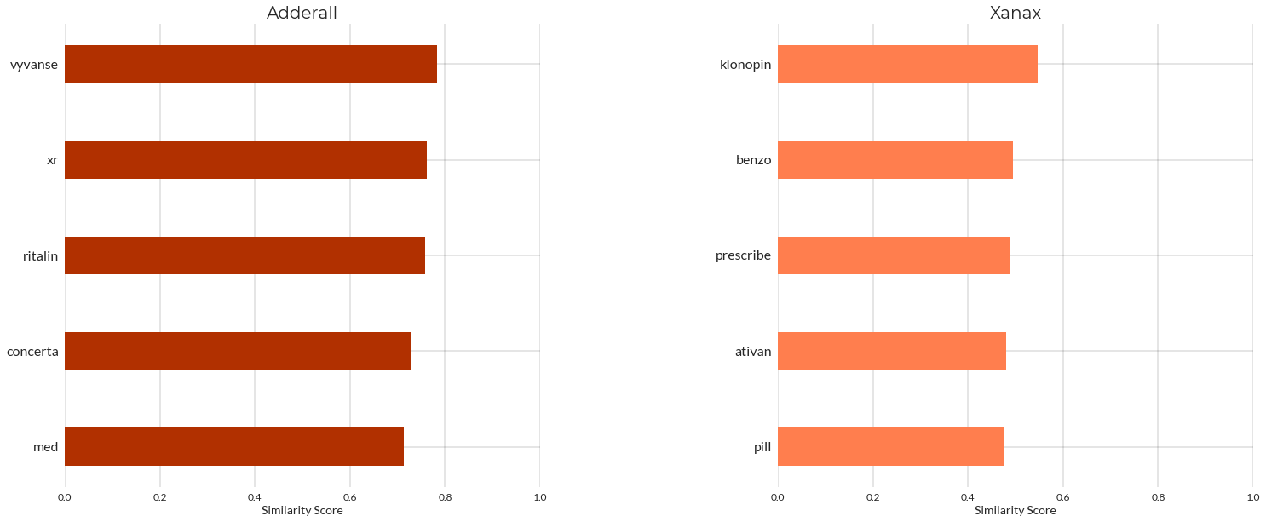
FACE VALIDITY
Medication word similarities: like are with like.

Slide 12
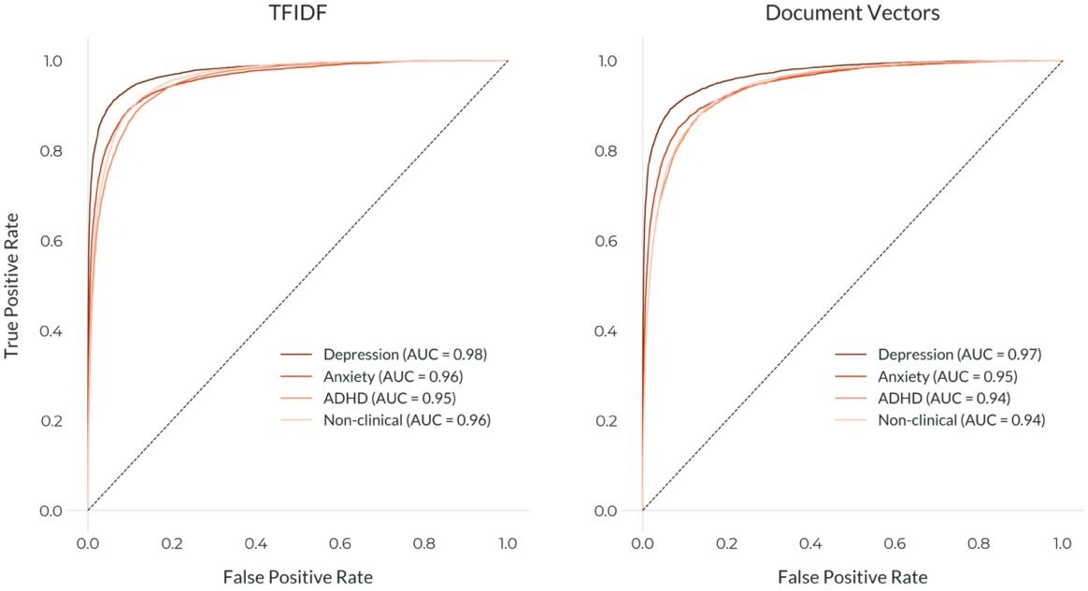
TOP MODEL COMPARISON

Slide 13

Credits
Presentation templated by Slidesgo, icons by Flaticon, and infographics & images by Freepik
Please keep this slide for attribution.

