Slide 1
SSFDoc
SSFD

Slide 2
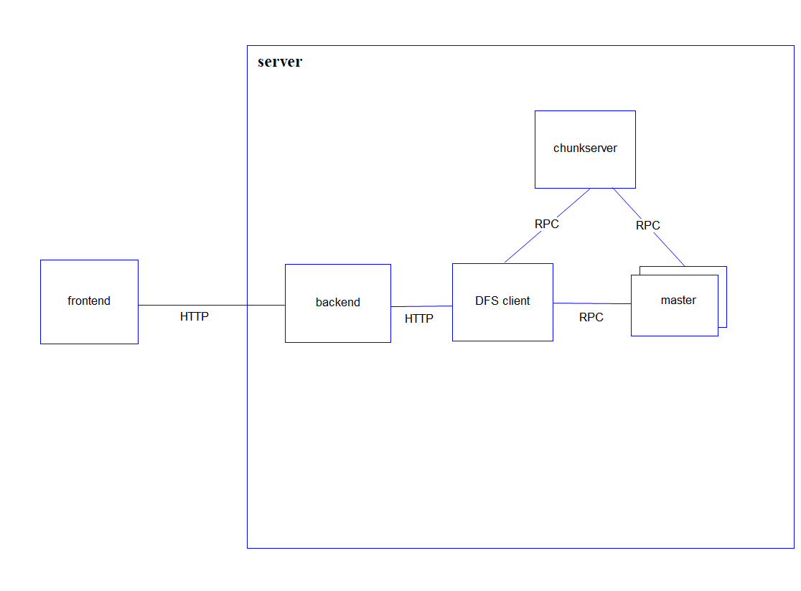
System Structure

