Slide 1
QSVM FOR BIG DATA CLASSIFICATION OF ASTRONOMICAL EVENTS
Team Quanstellar @ Qiskit Hackathon Europe 2021

Slide 2
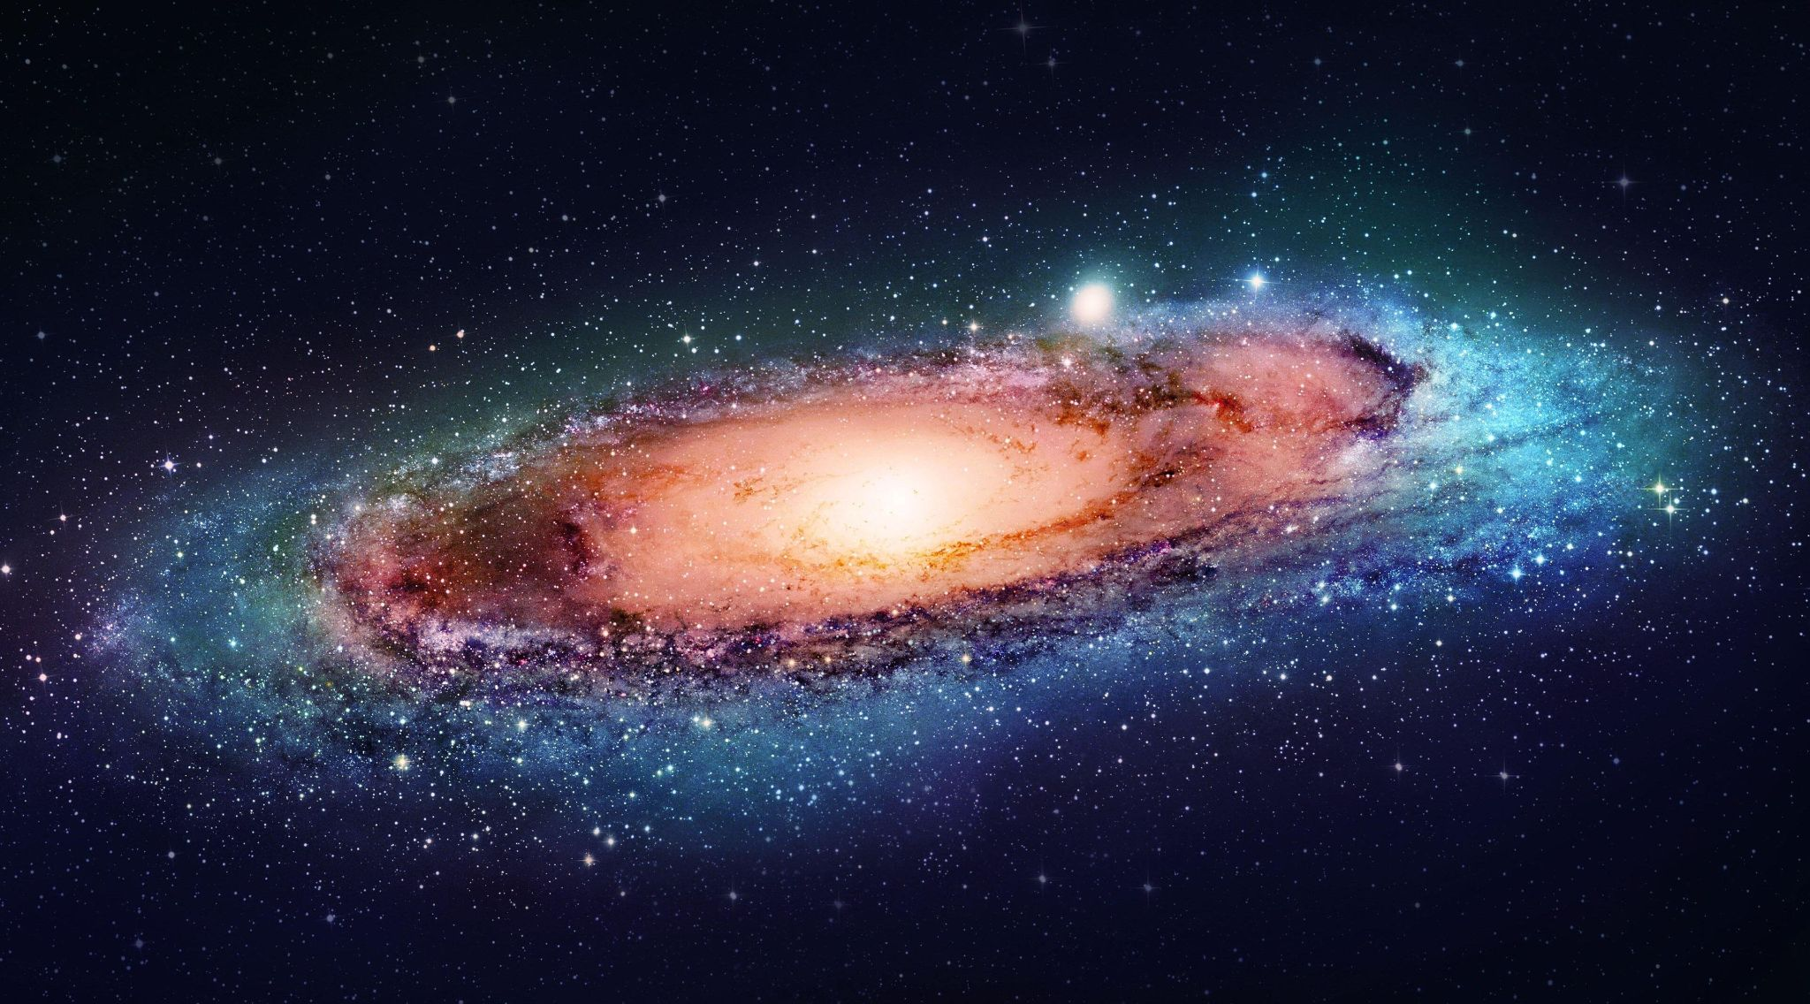
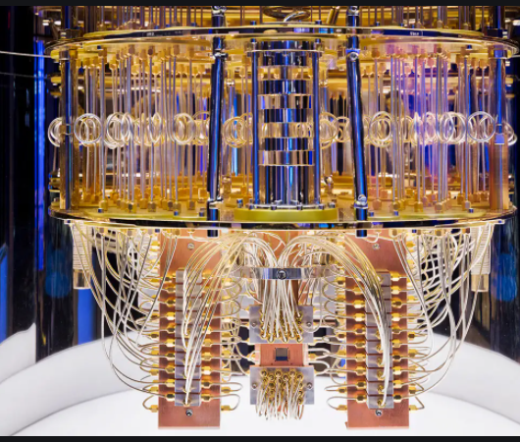
Motivation

Slide 3
Research Questions
Question 1: Can a hybrid approach of classical and quantum machine learning algorithms outperform conventional machine learning algorithms?
Question 2: Can we achieve quantum speed up with this hybrid approach of implementing quantum machine learning using a classical training dataset?

Slide 4
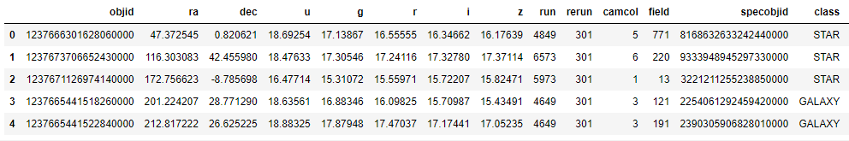
Data Release 16 Dataset
Sloan Digital Sky Survey Data Release (DR16).
100,000 observations with 16 variables and one multiclass target
Proof-of-concept for future PLAsTiCC dataset from Fink project
Table 1: Sample of DR16 dataset

Slide 5
Methodology
Load and understand DR16 dataset
Benchmarking Structure
Modelling Structure
Feature Engineering
Platforms
Classical SVM
Quantum SVM
local qasm simulator
IBM online qasm simulator
Real Quantum
Device
Kernel method
Feature Mapping
Tests
Results Evaluation
Model Performance
Runtime

Slide 6
Result Analysis
Algorithms | No. of training samples | No. of test samples | Feature Selection and Transformation | Dimensionality Reduction | Feature map | Success Ratio (accuracy) | Runtime (s)
QSVM | 100 | 150 | Yes | Yes (ISO Map) | ZZFeatureMap | 0.55 | 3584.3
SVM | 100 | 150 | Yes | Yes (ISO Map) | Rbf_kernel | 0.5 | 0.026
QSVM | 200 | 150 | Yes | Yes (LLE) | PauliFeatureMap (Z, ZZ) | 0.39 | 4124.3
SVM | 200 | 150 | Yes | Yes (LLE) | Rbf_kernel | 0.33 | 0.06
QSVM | 200 | 150 | Yes | No | PauliFeatureMap (Z, X, ZY) | 0.81 | 6978.1
SVM | 200 | 150 | Yes | No | Rbf_kernel | 0.63 | 0.04
Table 2: Model Performance and Runtime Comparison

Slide 7
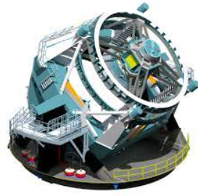

Future Work
LSST
* Credited By Fink & LSST

Slide 8


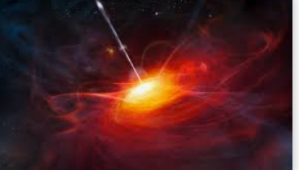
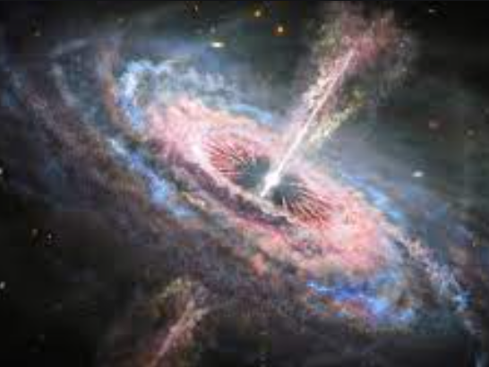
How colorful and capricious the journey was,
With Discord, Slack, Medium integral parts of the Quantstellar bus.
Eureka moments albeit errors in syntax and semantics,
It felt like a cruise vacation in the Atlantic!
Grateful we are to our friends, IBM and mentors,
Because of them this hackathon we adore,
Excited we are to see Qiskit dominate the world,
Very soon its beauty, potential will be embellished and pearled!
* Credited By IBM, Qiskit, SDSS

Slide 9
References
[1] Montanaro, A. Quantum algorithms: an overview. npj Quantum Inf 2, 15023 (2016). https://doi.org/10.1038/npjqi.2015.23
[2] Lee, Joong-Sung, et al. "Experimental demonstration of quantum learning speedup with classical input data." Physical Review A 99.1 (2019): 012313.
[3] Belis, Vasileios, et al. "Higgs analysis with quantum classifiers." arXiv preprint arXiv:2104.07692 (2021).
[4]Ding, Chen, Tian-Yi Bao, and He-Liang Huang. "Quantum-inspired support vector machine." arXiv preprint arXiv:1906.08902 (2019).
[5] Rønnow, Troels F., et al. "Defining and detecting quantum speedup." science 345.6195 (2014): 420-424.
[6] Powers, David MW. "Evaluation: from precision, recall and F-measure to ROC, informedness, markedness and correlation." arXiv preprint arXiv:2010.16061 (2020).

