Slide 1

Anomalous Model-Driven-Telemetry Network-Stream BGP Detection
This research was supported in part by
NSF grants CNS- 1618339, CNS 1814322,
CNS-1836772 and CNS-1901103.
Rostand A. K. Fezeu
Prof. Zhi-Li Zhang

Slide 2


Network Visibility is Hard
SNMP
Syslog
CLI Commands
MDT data collector
- Issues:
Too Slow
Data is incomplete
Coarse grain
Hard to operationalize

Slide 3
Model-Driven-Telemetry (MDT)
(YANG) Models
MDT data collector
- MDT Data:
High frequency
Push-based
Fine-grained
Granular and easy to operationalize

Slide 4
Data center BGP
Data center for BGP for multi-path routing.
What we are particularly looking at anomaly detection using BGP. This is building up on the previous work.
Next slide, what is the contribution.
Bravo (what is bravo) why?
How to use large amount of data, BGP detection for inter domain routing.
State clearly contribution. 1) Design bravo, 2) Improve next paper slide.
Do not need all results.

Slide 5
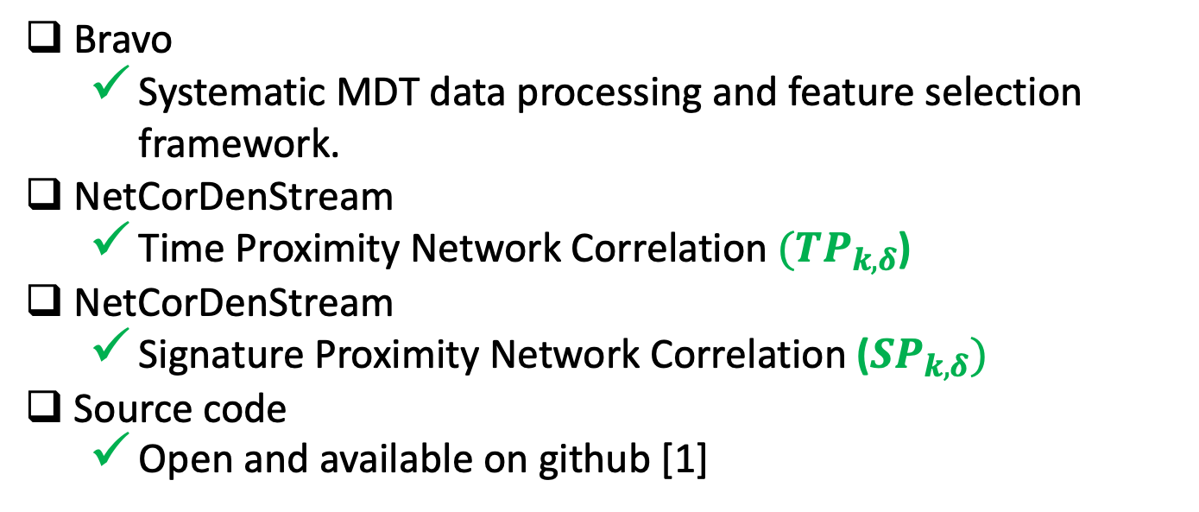
Major Contributions
Bravo
Systematic MDT data processing and feature selection framework.
NetCorDenStream
Time Proximity Network Correlation $({TP}_{k,δ}$)
NetCorDenStream
Signature Proximity Network Correlation (${SP}_{k,δ})$
Source code
Open and available on github [1]
[1] R. A. K. Fezeu. Netcordenstream. https://github.umn.edu/fezeu001/ NetCorDenStream, 08 2020
[2] A.Putina,D.Rossi,A.Bifet,S.Barth,D.Pletcher,C.Precup,andP.Ni- vaggioli. Telemetry-based stream-learning of bgp anomalies.
In ACM SIGCOMM Workshop on Big Data Analytics and Machine Learning for Data Communication Networks (Big-DAMA’18), Aug. 2018.

Slide 6



Bravo - Feature selection
Plug & play system for “on-the-fly” MDT data preprocessing.
Portable to other MDT vendors
Modularize pipeline
MDT Data Collector
Module
A
Module
C
Module
E
Bravo
Module
B
Module
D
Normalization
New Telemetry Data
MDT (YANG)
Data
Old Telemetry Data
Model Learning
Model
Outcome
Network

Slide 7
MDT Datasets and Ground Truth Labels
- Dataset and Annotated ground truth:
12 Physical Cisco XR 6.2.2 routers [1,2]
6 Cisco XR 6.2.1 virtual routers
[1] A.Putina,D.Rossi,A.Bifet,S.Barth,D.Pletcher,C.Precup,andP.Ni- vaggioli. Telemetry-based stream-learning of bgp anomalies. In ACM SIGCOMM Workshop on Big Data Analytics and Machine Learning for Data Communication Networks (Big-DAMA’18), Aug. 2018.
[2] A. Putina, S. Barth, A. Bifet, D. Pletcher, C. Precup, P. Nivaggioli, and D. Rossi. Unsupervised real-time detection of bgp anomalies leveraging high-rate and fine-grained telemetry data. In IEEE INFOCOM 2018- IEEE Conference on Computer Communications Workshops (INFOCOM WKSHPS), pages 1–2. IEEE, 2018.

Slide 8
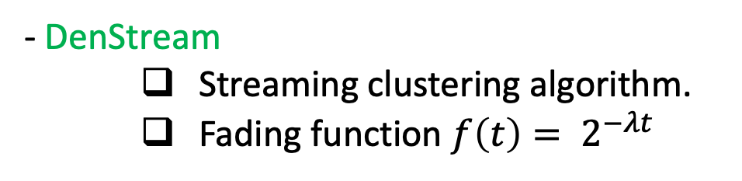

DenStream and OutlierDenStream
- DenStream
Streaming clustering algorithm.
Fading function $f\left(t\right)= 2^{−λt}$
- OutDenStream [1], [2]
Anomaly detection engine based on DenStream.
Temporal order $k_{t}$ and Spatial order $k_{s}$
[1] A.Putina,D.Rossi,A.Bifet,S.Barth,D.Pletcher,C.Precup,andP.Ni- vaggioli. Telemetry-based stream-learning of bgp anomalies. In ACM SIGCOMM Workshop on Big Data Analytics and Machine Learning for Data Communication Networks (Big-DAMA’18), Aug. 2018.
[2] A. Putina, S. Barth, A. Bifet, D. Pletcher, C. Precup, P. Nivaggioli, and D. Rossi. Unsupervised real-time detection of bgp anomalies leveraging high-rate and fine-grained telemetry data. In IEEE INFOCOM 2018- IEEE Conference on Computer Communications Workshops (INFOCOM WKSHPS), pages 1–2. IEEE, 2018.

Slide 9
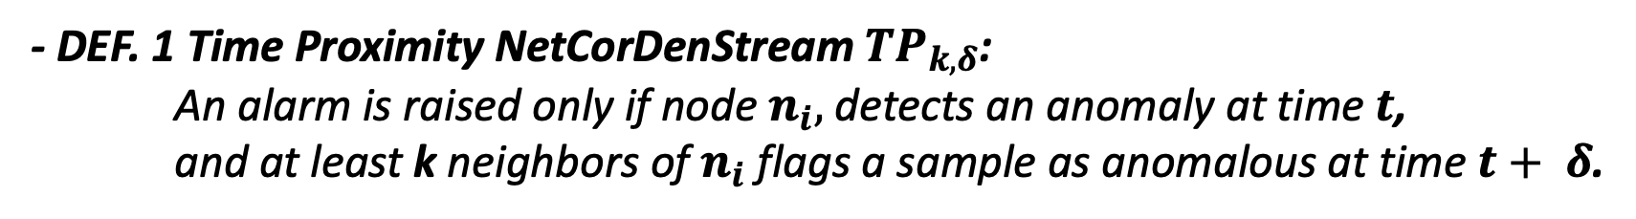
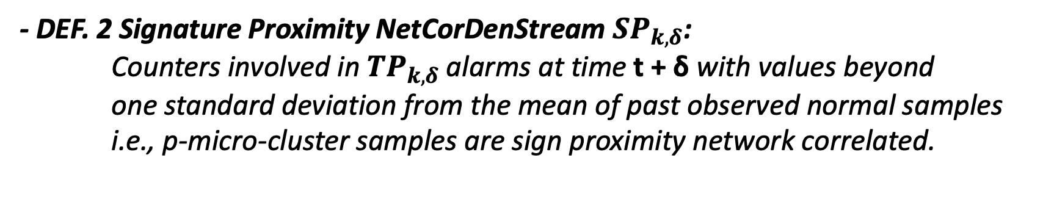
NetCorDenStream
- Drawbacks of OutlierDenStream:
Alarms raised are too high, overwhelms data center network operators.
False alarms is also very high, waste of resources.
- DEF. 1 Time Proximity NetCorDenStream ${TP}_{k,δ}$:
An alarm is raised only if node $n_{i},$ detects an anomaly at time $t$,
and at least k neighbors of $n_{i}$ flags a sample as anomalous at time $t+ δ$.
- DEF. 2 Signature Proximity NetCorDenStream ${SP}_{k,δ}$:
Counters involved in ${TP}_{k,δ}$ alarms at time t + δ with values beyond
one standard deviation from the mean of past observed normal samples
i.e., p-micro-cluster samples are sign proximity network correlated.

Slide 10
Evaluation setup
Hardware
2.6 GHz Intel Core i5 Macbook Pro with 16GB memory, macOS Mojave
Implementation
OutlierDenStream
NetCorDenStream
Datasets
90+ h of physical network data
24 h of virtual network data

Slide 11
Bravo Evaluation
60 % feature overlap with domain expert feature selection
Comfortably handle high speed data streams.

Slide 12
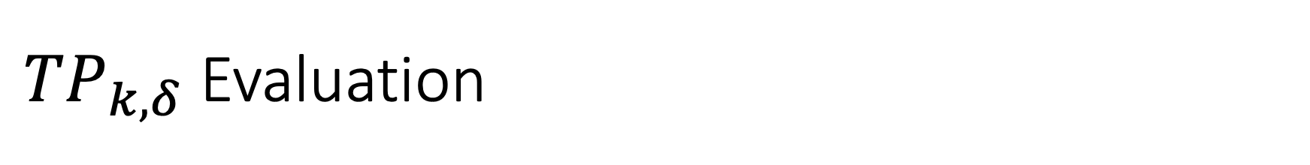
${TP}_{k,δ}$ Evaluation
59 % reduction in alarms with NetCorDenStream on average.

Slide 13
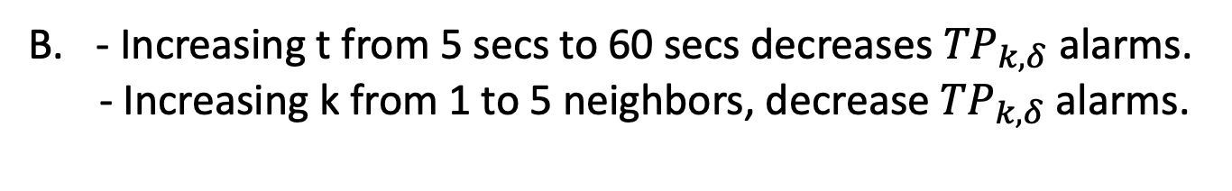
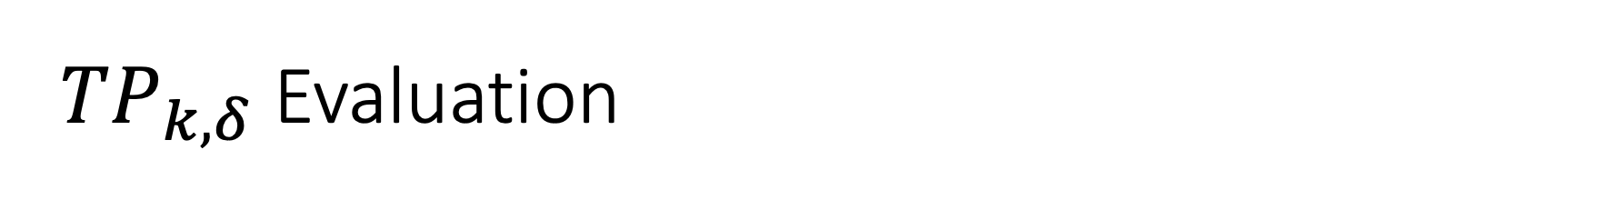
${TP}_{k,δ}$ Evaluation
- Increasing t from 5 secs to 60 secs decreases ${TP}_{k,δ}$ alarms.
- Increasing k from 1 to 5 neighbors, decrease ${TP}_{k,δ}$ alarms.

Slide 14
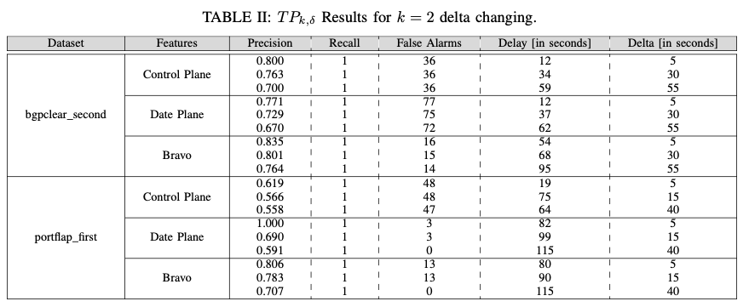

${TP}_{k,δ}$ Evaluation
- Precision decreases for the same dataset.
- Delay increases as delta increases

Slide 15
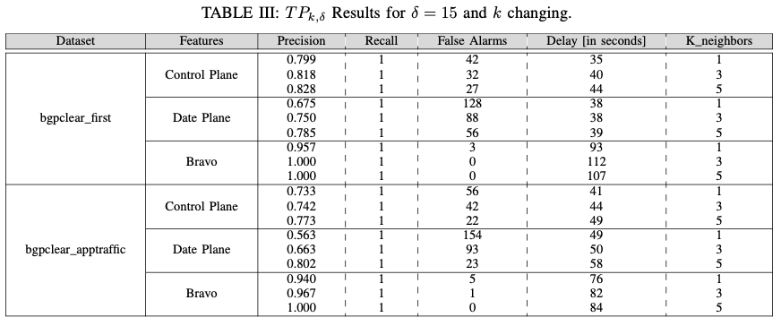
${TP}_{k,δ}$ Evaluation
Talk about this here.
Notes:
Notes go here.

Slide 16
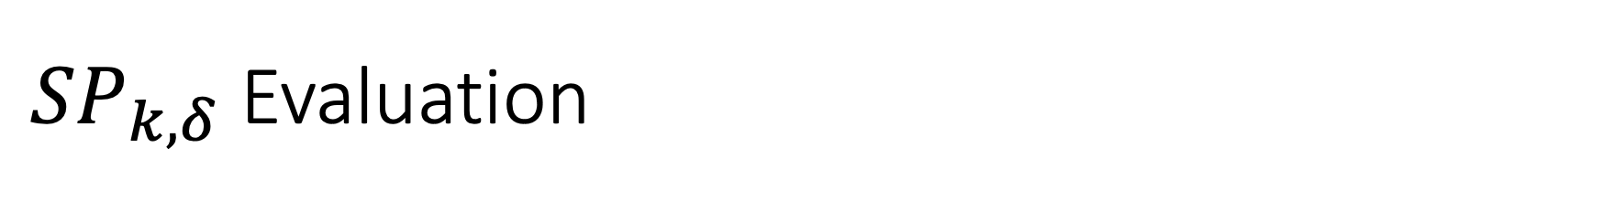
${SP}_{k,δ}$ Evaluation
Presences features affected in the alarm across neighbors
E.g. Features 4, 5, 7 and 11 caused the alarm

Slide 17
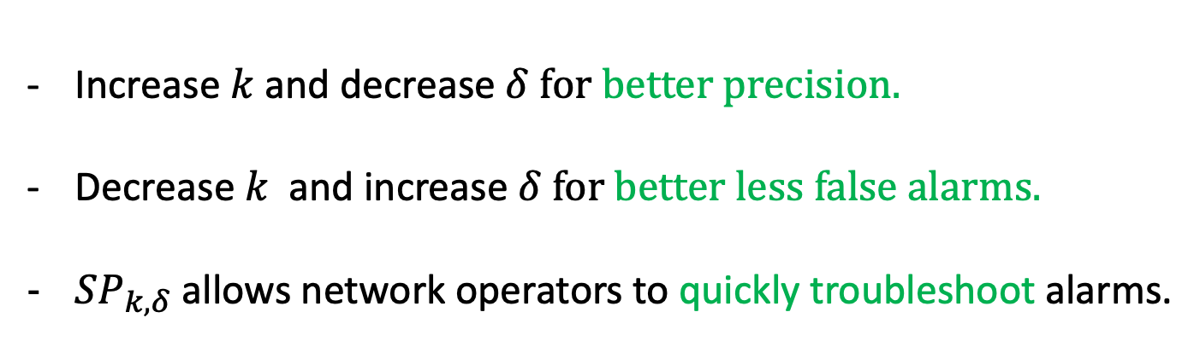
Conclusions
Increase $k$and decrease $δ for better precision.$
Decrease $k$ and increase $δ for better less false alarms.$
${SP}_{k,δ}$ allows network operators to quickly troubleshoot alarms.

Slide 18
Thanks! Questions?
Rostand Fezeu
Prof. Zhi-Li Zhang

