Slide 1
Gothic Architecture
FIRST-YEAR ARCHITECTURE · HISTORY
Stone, light and the race towards heaven
Presented by [Your name] · [Date]
Notes:
SLIDE 1 OF 13 · GOTHIC ARCHITECTURE (TITLE)
About 0:45 on this slide · clock 0:00 to 0:45
Say the text below word for word. Words in [brackets] are actions: do them, do not read them out.
[Wait for the first slide to appear. Smile and look at the audience.]
Good morning everyone. My name is [your name], and today I will talk about Gothic architecture.
[Point to the picture.] This is Cologne Cathedral, in Germany. Imagine you are a farmer in the year 1200. You live in a small, dark house. One Sunday, you walk into a cathedral like this one. The walls seem to disappear. Coloured light falls on the floor. The ceiling is thirty metres above your head. It feels like walking into heaven. That is exactly what the builders wanted.
I will answer four questions. Where does Gothic come from? Why was it built? How does it stand up? And what did it leave us?

Slide 2
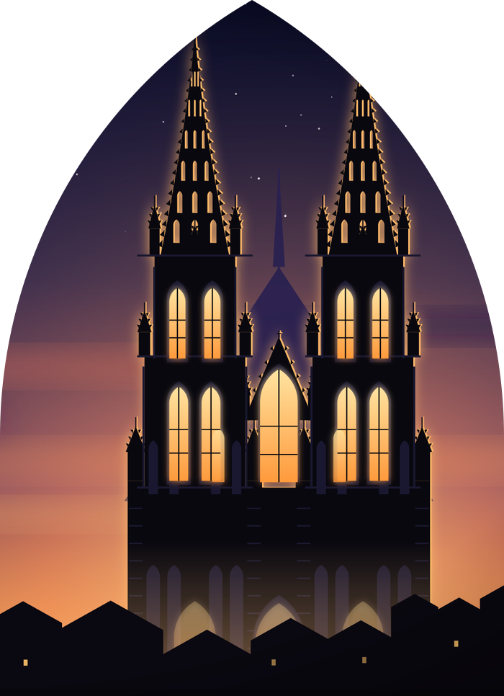
Why does it still give us chills?
WHY GOTHIC?
1140
≈ 400
Abbot Suger starts rebuilding Saint-Denis, near Paris
years of Gothic building across Europe
48 m
632
Beauvais: the highest Gothic vault ever built
years to finish Cologne Cathedral (1248–1880)
TODAY Origins & faith → Structure → Space & making → Legacy
Notes:
SLIDE 2 OF 13 · WHY DOES IT STILL GIVE US CHILLS?
About 0:45 on this slide · clock 0:45 to 1:30
Say the text below word for word. Words in [brackets] are actions: do them, do not read them out.
Let me start with four numbers. [Point to each number as you say it.]
1140: the year when Abbot Suger started rebuilding the church of Saint-Denis, near Paris. Most historians see it as the birth of Gothic.
About 400 years: how long Gothic dominated building in Europe. It was not a fashion. It was a whole civilisation.
48 metres: the vault of Beauvais Cathedral. That is a 16-storey building, in the 13th century, with no steel and no concrete.
632 years: Cologne Cathedral was started in 1248 and finished in 1880.
At the bottom, you can see our road map. So, let's begin. When did all this happen?

Slide 3
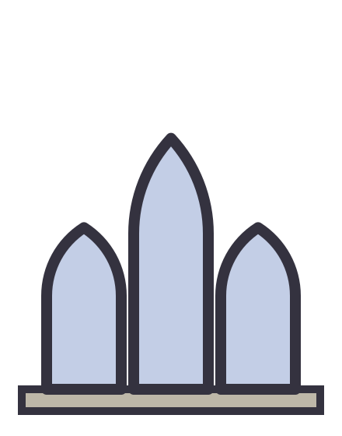

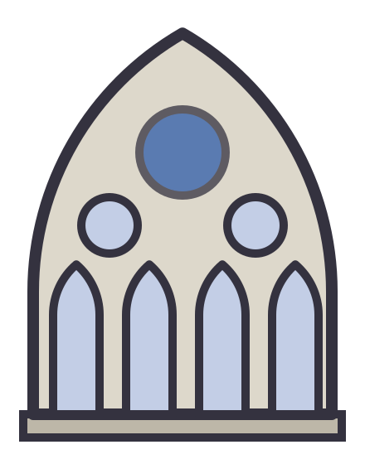
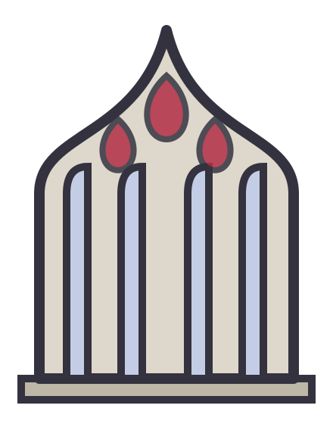
Four centuries in four chapters
ORIGINS
1140–1200
1200–1240
1240–1350
1350–1520
Early Gothic
High Gothic
Rayonnant
Late Gothic
Born near Paris
Taller, lighter, bolder
Walls dissolve into glass
Flames and fans
Saint-Denis (1140)
Sens
Notre-Dame de Paris (1163)
Chartres
Reims
Amiens
Sainte-Chapelle (1248)
Westminster Abbey
Cologne (1248)
Flamboyant tracery
Fan vaults, England
After the Black Death (1347)
Notes:
SLIDE 3 OF 13 · FOUR CENTURIES IN FOUR CHAPTERS
About 1:15 on this slide · clock 1:30 to 2:45
Say the text below word for word. Words in [brackets] are actions: do them, do not read them out.
Gothic was not invented in one day. Historians divide it into four chapters. [Move your hand from left to right along the slide.]
Chapter one: Early Gothic, 1140 to 1200. It starts at Saint-Denis, and then Notre-Dame de Paris, in 1163. See the window: simple, tall and narrow.
Chapter two: High Gothic, 1200 to 1240. The golden age: Chartres [say "SHAR-truh"], Reims and Amiens. Everything becomes taller and lighter, with a round rose window above.
Chapter three: Rayonnant, 1240 to 1350. It means "radiating", like rays of light. The walls almost disappear and become glass, held by thin stone patterns called tracery. The masterpiece is the Sainte-Chapelle in Paris.
Chapter four: Late Gothic, 1350 to about 1520. Decoration explodes. In France it is called Flamboyant, because the stone looks like flames. And in 1347, the Black Death kills maybe a third of Europe's people, so many cathedrals slow down or stop.
One small fact: nobody at the time said the word "Gothic". I will come back to this at the end.
But first: why did people spend so much money on these buildings?

Slide 4
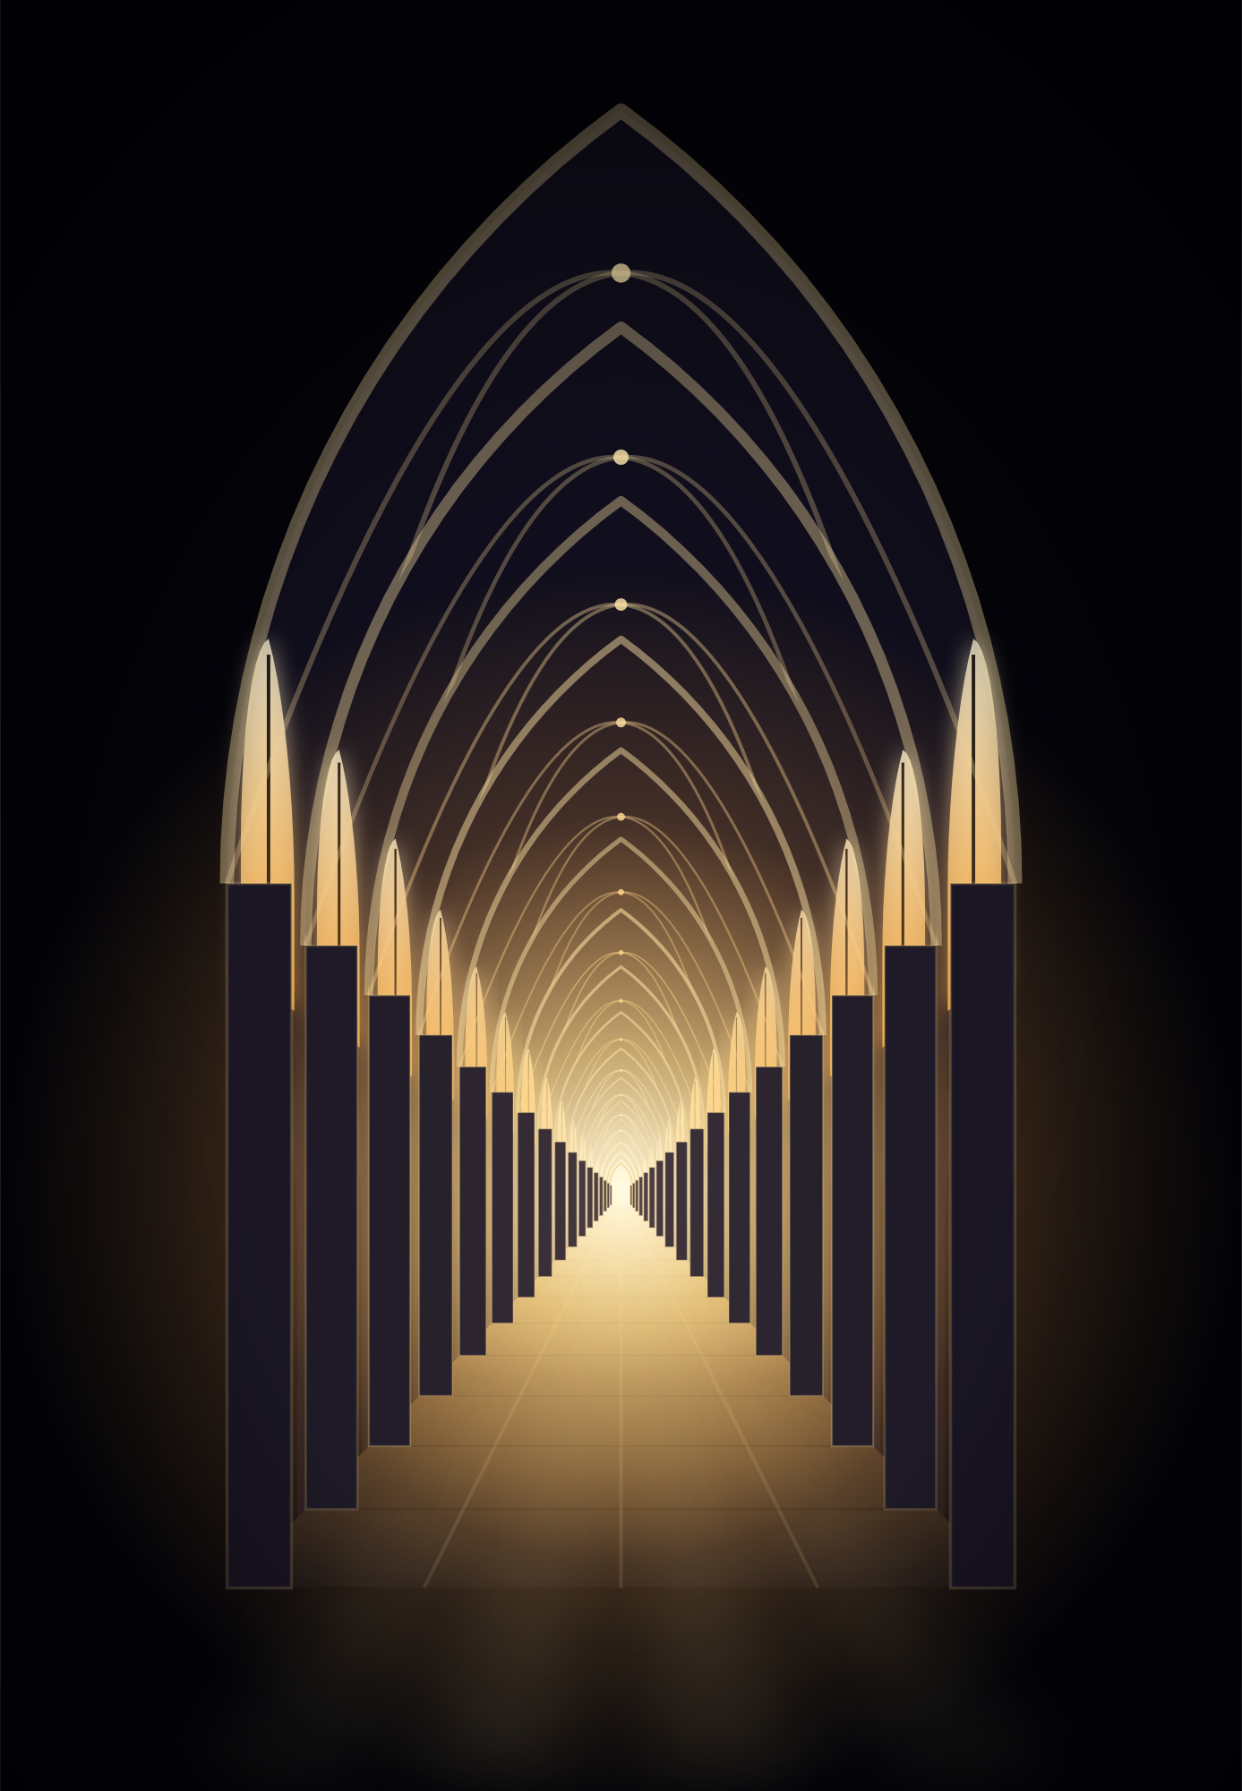
A heaven made of stone
WHY IT WAS BUILT
“The dull mind rises to truth through that which is material.”
Abbot Suger, Saint-Denis, c. 1144
Light is divine
God is pure light: windows, gold and jewels lift the soul.
Mary and pilgrims
Relics drew crowds; their gifts paid the builders.
Power and pride
Bishops, kings and cities competed to build higher.
Notes:
SLIDE 4 OF 13 · A HEAVEN MADE OF STONE
About 1:20 on this slide · clock 2:45 to 4:05
Say the text below word for word. Words in [brackets] are actions: do them, do not read them out.
To understand Gothic, we must understand medieval faith. I will give you three ideas.
First, light is divine. [Point to the quote.] Abbot Suger [say "soo-ZHAY"] was an adviser to the kings of France. He read a philosopher who taught that God is pure light. So he rebuilt his church to be full of light. He wrote: "The dull mind rises to truth through that which is material." In simple words: beautiful things, like stone, gold and coloured glass, can lift the soul towards God.
Second, Mary and the pilgrims. Notre-Dame means "Our Lady", the Virgin Mary. Relics attracted thousands of pilgrims. They needed a lot of space, and their donations helped to pay for the building.
Third, power and pride. Bishops, kings and rich cities competed. A taller cathedral meant a more important city. It was also the meeting place, the market and the school of the town.
The Bible describes heaven as the Heavenly Jerusalem, a city of light and jewels. A Gothic cathedral tries to build this picture on earth.
So faith explains why. But what made it possible?

Slide 5
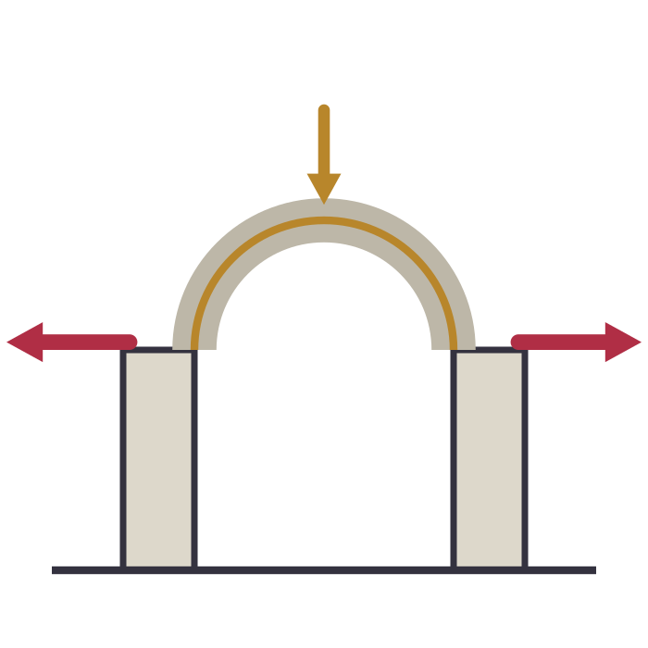
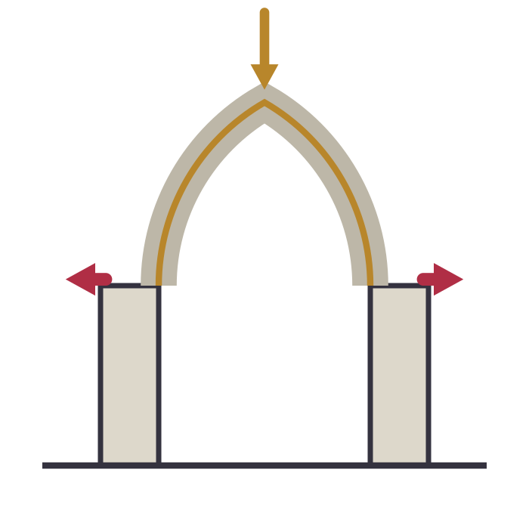
From fortress-church to lantern
STRUCTURE
ROMANESQUE
c. 1000–1150
GOTHIC
c. 1140–1500
ARCH
Round
Pointed
VAULT
Heavy barrel or groin vault
Light ribbed vault
WALLS
Thick, load-bearing mass
Thin skin on a stone skeleton
WINDOWS
Small and few
Huge, filled with coloured glass
FEELING
Solid, protective, earthly
Soaring, bright, heavenly
Notes:
SLIDE 5 OF 13 · FROM FORTRESS-CHURCH TO LANTERN
About 0:50 on this slide · clock 4:05 to 4:55
Say the text below word for word. Words in [brackets] are actions: do them, do not read them out.
[Go quickly, row by row.]
Before Gothic, Europe built in the Romanesque style. On the left: round arches, thick walls like a fortress, and small windows, because every hole makes a thick wall weaker. The result is dark, solid and protective.
On the right, Gothic: pointed arches, light vaults, thin walls and enormous windows. The result is tall, bright and, for people at that time, heavenly.
The key point: Gothic did not use a new material. It is still stone. What changed is the logic. A Romanesque church is a heavy mass. A Gothic church is a skeleton. It is the difference between a cave and a tent with poles.
This skeleton is made of three inventions.

Slide 6
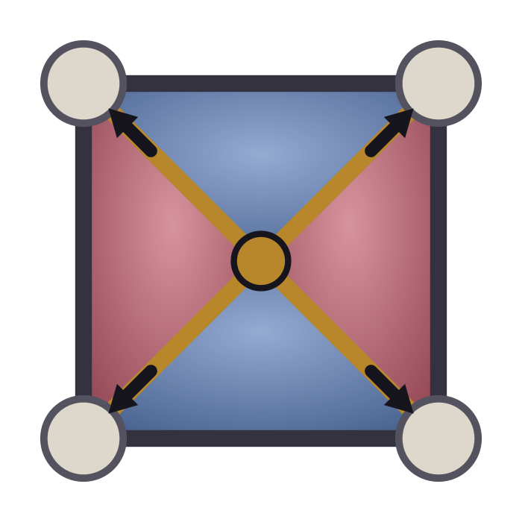
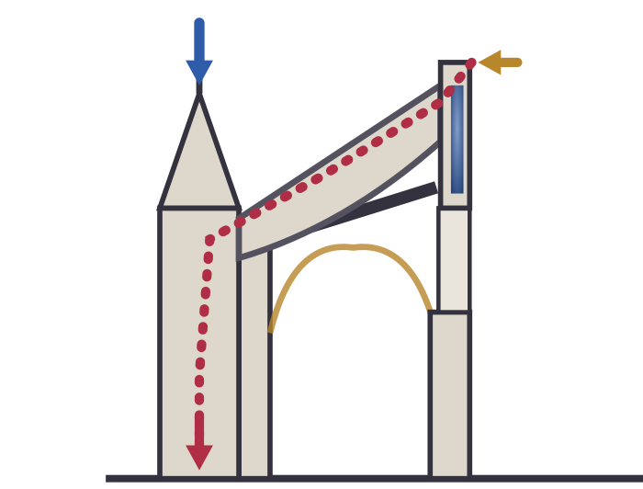
Three ideas that changed everything
STRUCTURE
1 Pointed arch
2 Ribbed vault
3 Flying buttress
Steeper sides push the load down, not out. Any width can reach any height.
Stone ribs form a skeleton with thin panels between. Loads flow to the piers.
An arch outside the wall catches the roof's push and carries it to a heavy pier.
Notes:
SLIDE 6 OF 13 · THREE IDEAS THAT CHANGED EVERYTHING
About 1:15 on this slide · clock 4:55 to 6:10
Say the text below word for word. Words in [brackets] are actions: do them, do not read them out.
Here are the three inventions. [Point to each card as you speak.]
One: the pointed arch. A round arch pushes strongly outwards. Look at the red arrows. The pointed arch has steeper sides, so more weight goes straight down, and less pushes sideways. And you can make it as tall as you want for the same width.
Two: the ribbed vault. This is a plan seen from above. The ribs, in gold, cross diagonally. The masons built the ribs first, then filled between them with thin, light panels. The ribs send the weight down to the corners, to the piers. So the wall does not carry the roof any more. Only the points do.
Three: the flying buttress. The vault still pushes outwards at the top of the wall. The flying buttress is a half-arch, outside the church, that catches this push and carries it over the side aisle to a heavy pier.
Together, they make a stone skeleton with its bones on the outside. Now the walls are free to become windows. Let me show you all three working together.

Slide 7
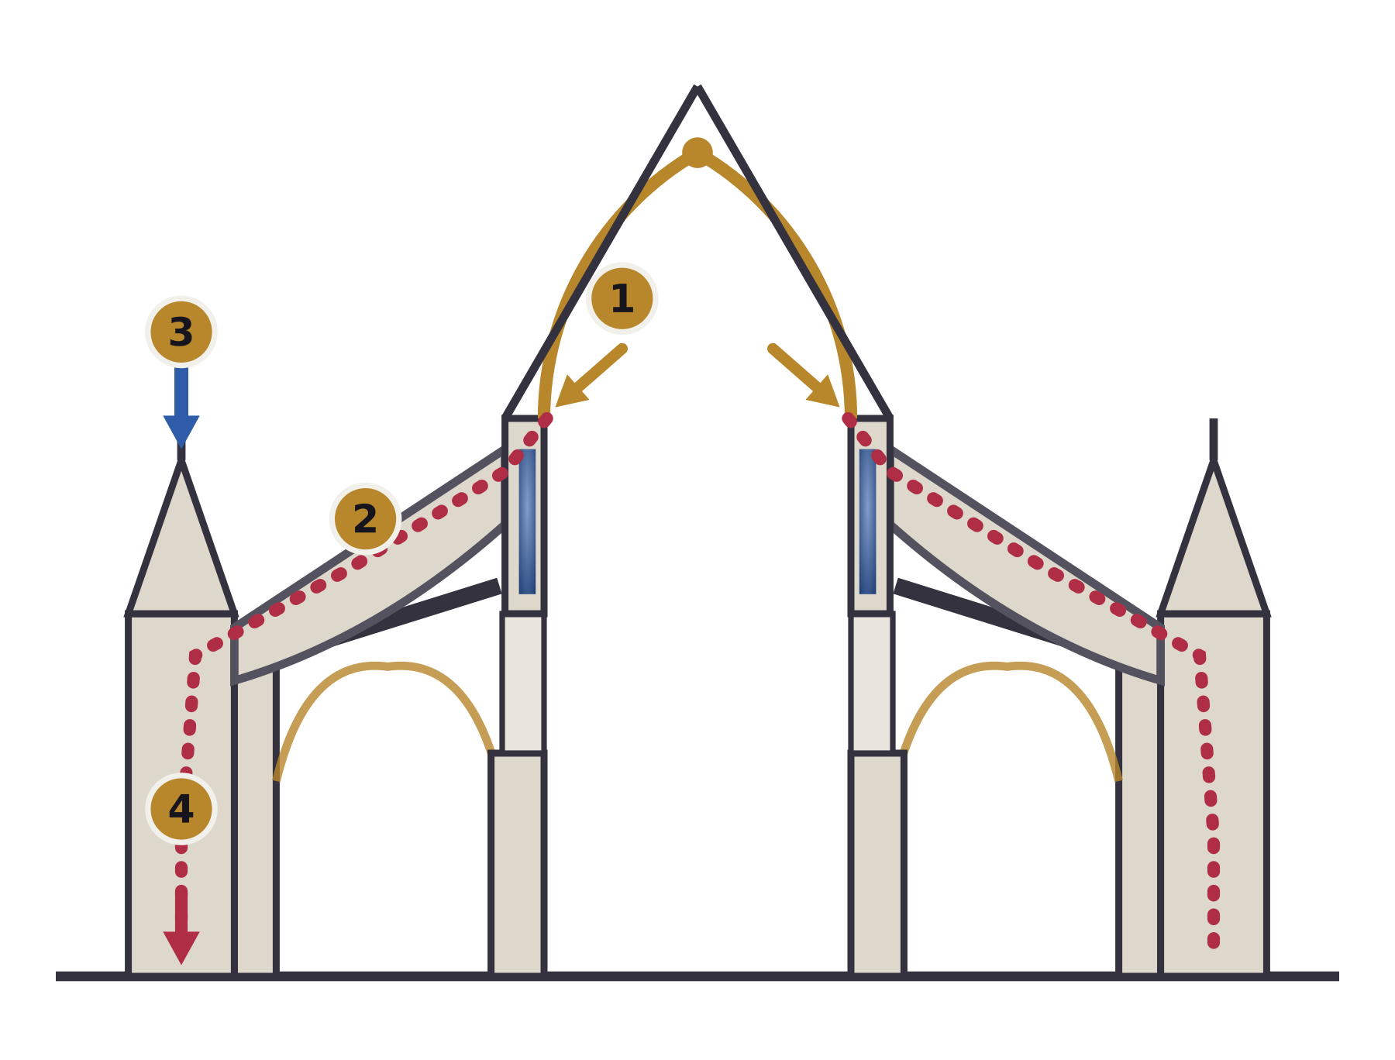
Follow the force
STRUCTURE
1
The vault pushes
Heavy stone presses down and outwards at the top of the wall.
2
The flying buttress catches it
A half-arch sends the thrust over the aisle.
3
The pinnacle adds weight
CLERESTORY
It keeps the line of force inside the pier.
TRIFORIUM
4
The pier reaches the ground
The wall itself carries almost nothing.
ARCADE
A cathedral is an exoskeleton.
Notes:
SLIDE 7 OF 13 · FOLLOW THE FORCE
About 1:20 on this slide · clock 6:10 to 7:30
Say the text below word for word. Words in [brackets] are actions: do them, do not read them out.
This is the technical heart of my talk, so I will go slowly. [Point to the drawing.]
This is a cross-section through the nave, like cutting the cathedral with a knife. Let's follow the force, like water running downhill.
One: the stone vault is heavy. It pushes down and outwards, at the top of the wall.
Two: at exactly that height, the flying buttress catches the push and sends it diagonally down, over the side aisle.
Three: the pinnacle, the small spire on the outer pier. It looks like decoration, but its weight presses down on the pier and keeps the force inside it, so the pier does not tip over.
Four: the pier brings everything to the ground.
So what is left for the wall to do? Almost nothing. That is why it can be filled with glass.
Look at the three levels inside: the arcade at the bottom, the triforium, a narrow passage, in the middle, and at the top the clerestory [say "CLEAR-story"], the high windows that bring in the light.
A cathedral is an exoskeleton, like a crab. And what does this skeleton give us? Light.

Slide 8
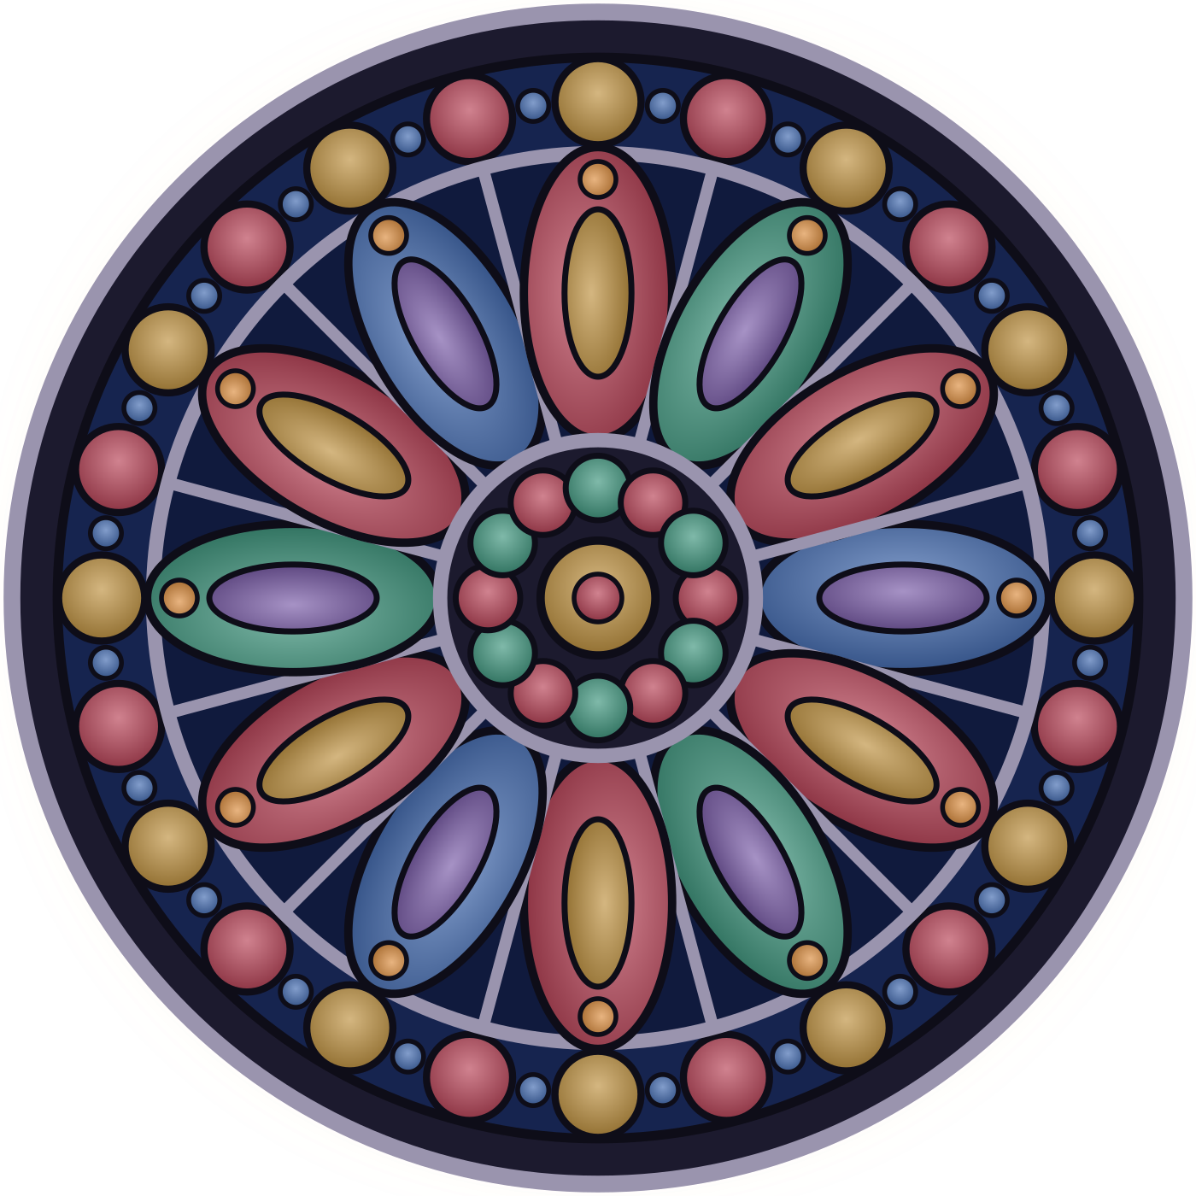
Walls made of light
SPACE AND MAKING
1,113
Bible scenes in the windows of the Sainte-Chapelle, Paris
15 m
height of each window: glass replaces almost the whole wall
≈ 7 yrs
to build it: 1241–1248, for King Louis IX
Metal oxides colour the glass: cobalt blue, copper red.
Notes:
SLIDE 8 OF 13 · WALLS MADE OF LIGHT
About 1:15 on this slide · clock 7:30 to 8:45
Say the text below word for word. Words in [brackets] are actions: do them, do not read them out.
Remember Suger: light is divine. All this structure exists to give us this: walls made of light.
How is stained glass made? The glassmakers added metal oxides to melted glass. Cobalt gives blue, and copper gives red. The pieces were joined with strips of lead and held in stone patterns. When the sun shines, coloured light moves across the floor. The building changes with the hour.
The windows were also books. Most people could not read, so the glass told Bible stories in pictures.
The best example is the Sainte-Chapelle in Paris, built between 1241 and 1248 for King Louis the Ninth, to hold what he believed was the Crown of Thorns. [Point to the numbers.] Fifteen windows, fifteen metres tall, and 1,113 scenes. Inside, it feels like a jewellery box.
The round window is a rose window: a circle of stone patterns holding glass.
If you remember only one thing from my talk: in Gothic, light is a building material.
Now let's walk inside and learn how to read a cathedral.

Slide 9
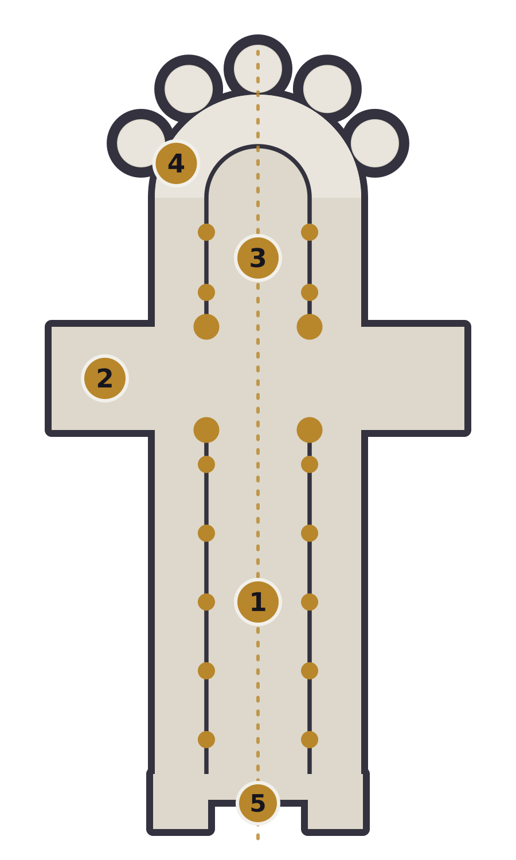
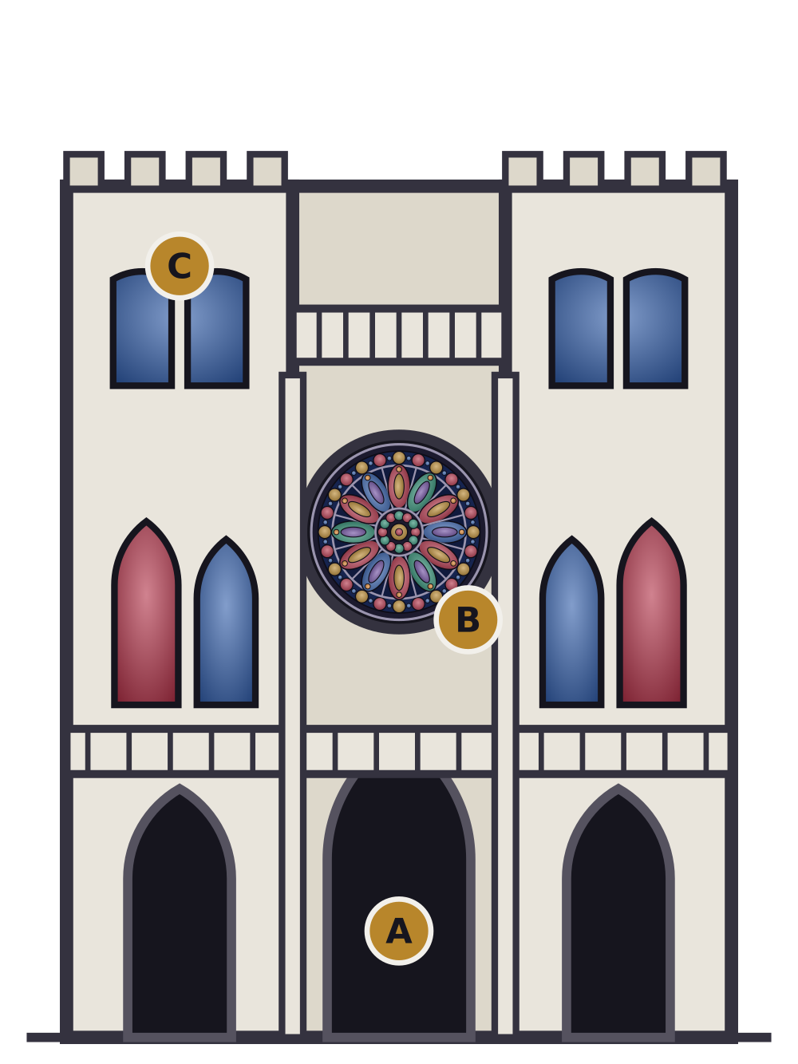
Reading a cathedral
SPACE AND MAKING
PLAN: A LATIN CROSS
1
Nave & aisles hall for the people
2
Transept arms of the cross
3
Choir clergy and altar, east
4
Ambulatory walkway to relic chapels
5
West front main entrance
FACADE
A
Portals carved stone stories
B
Rose window circle of glass
C
Twin towers bell towers
Notes:
SLIDE 9 OF 13 · READING A CATHEDRAL
About 1:15 on this slide · clock 8:45 to 10:00
Say the text below word for word. Words in [brackets] are actions: do them, do not read them out.
[Use your hand to "walk" on the plan.]
On the left, the plan. It is a Latin cross: a long arm and a short arm. It symbolises the cross of Christ. The altar is at the east end, towards the sunrise and Jerusalem.
Walk with me from the main door, in the west. Number five, the west front. You enter the nave, number one: the long hall for the people, with an aisle on each side. Then the transept, number two: the arms of the cross. Then the choir, number three: the place for the clergy and the altar. And around the end, number four: the ambulatory and the radiating chapels. The ambulatory lets pilgrims walk around and see the relics without disturbing the service.
Now the facade, on the right. A: three deep portals, covered with sculpture. Above the central door you often find the Last Judgement. People who could not read learned the Christian story from the stone. B: the rose window. C: the two towers, like Notre-Dame.
But who built all this, and how?

Slide 10
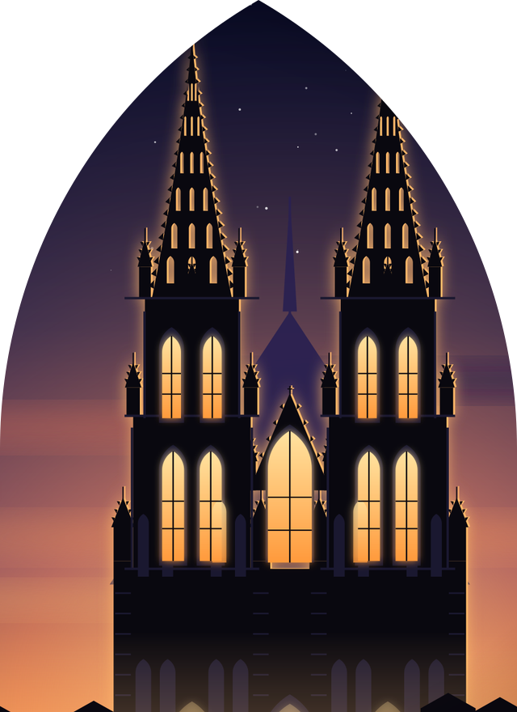





Built by generations, not by one genius
SPACE AND MAKING
Fund
≈ 180 years
Bishops, kings, guilds and pilgrims pay.
Design
Notre-Dame de Paris, 1163 to about 1345
A master mason draws with compass and geometry.
Carve
Each stone is cut on the ground and marked.
632 years
Lift & set
Treadwheel cranes, scaffolds, wooden centering.
Cologne Cathedral, 1248 to 1880
Wait
Decades, even centuries. Many never saw the end.
Cologne Cathedral, 157 m towers
Notes:
SLIDE 10 OF 13 · BUILT BY GENERATIONS, NOT BY ONE GENIUS
About 1:15 on this slide · clock 10:00 to 11:15
Say the text below word for word. Words in [brackets] are actions: do them, do not read them out.
How do you build this with no computer and no engine? Five steps.
One, money. The bishop, the king, the guilds and the pilgrims paid. Often the money ran out, and work stopped for years.
Two, design. There was no architect with a diploma. There was the master mason: designer, engineer and site manager in one. He used geometry: compass, straightedge, circles, squares and triangles. The same tools we use in our drawing class! He even drew full-size templates on plaster floors.
Three, carving. The masons cut each stone on the ground and marked it with a personal sign, so they could be paid.
Four, lifting. Treadwheel cranes, like giant hamster wheels with workers walking inside. Arches were built on wooden frames, called centering, removed when the keystone was in place.
Five, time. Notre-Dame took about 180 years. Cologne, on the right, took 632. A mason who started a cathedral knew that he would never see it finished. Gothic is architecture across generations.
But sometimes, the ambition went too far.

Slide 11
The race to the sky
LEGACY
+45%
in about 60 years: each bishop wanted to beat the last.
1284
Beauvais' vault collapses, only 12 years after the choir was finished.
Trial & error
No structural theory yet: every failure taught the masons something.
Notes:
SLIDE 11 OF 13 · THE RACE TO THE SKY
About 1:00 on this slide · clock 11:15 to 12:15
Say the text below word for word. Words in [brackets] are actions: do them, do not read them out.
Here is the race to the sky. [Point to the chart.] The height of the main vault: Notre-Dame, 33 metres. Chartres, 37. Reims, 38. Amiens, 42. And Beauvais, 48 metres. In about 60 years, the height grew by almost half. The bishops wanted to beat each other.
But Beauvais went too far. In 1284, only twelve years after the choir was finished, part of the vault collapsed. The builders added extra piers, but the cathedral was never completed.
Why did this happen? There was no mathematics of structures yet. The masons learned by trial and error, and every collapse was a lesson. This is how structural engineering was born: building, failing, and improving.
As students, I find this inspiring: every bold idea has a risk.
So, what happened to Gothic after the Middle Ages?

Slide 12
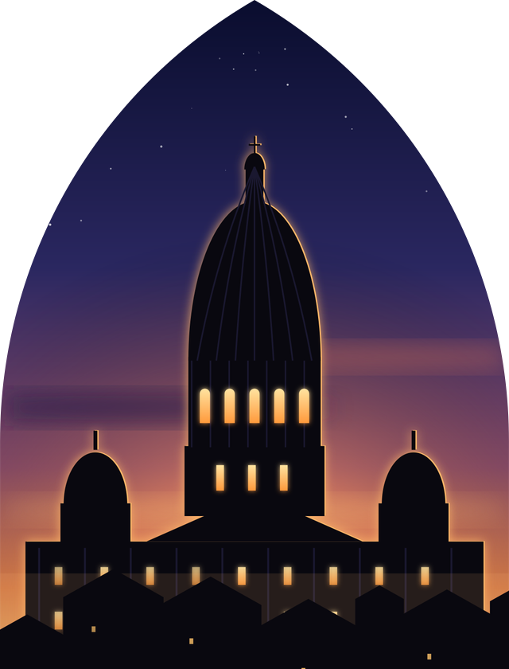
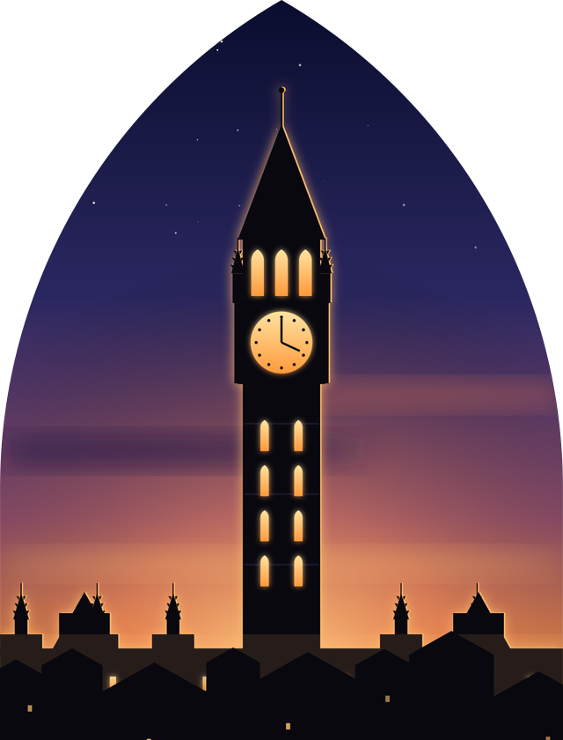
Spread, decline and rebirth
LEGACY
1
2
3
Spread
Decline
Rebirth
Every country adds an accent
The Renaissance looks back to Rome
Romantic love for the Middle Ages
England: Salisbury, Westminster Abbey
Germany: Cologne
Italy: Milan Duomo, in marble
Spain: Seville, the largest Gothic cathedral
Columns, domes and symmetry return
Vasari calls the old style “Gothic”: barbarian, like the Goths
The name began as an insult
Houses of Parliament, London (1840)
Viollet-le-Duc restores Notre-Dame
Gaudí's Sagrada Família (1882)
Notre-Dame: fire 2019, reopened 2024
Notes:
SLIDE 12 OF 13 · SPREAD, DECLINE AND REBIRTH
About 1:05 on this slide · clock 12:15 to 13:20
Say the text below word for word. Words in [brackets] are actions: do them, do not read them out.
The story has three acts. [Point to the three pictures: Cologne, a Renaissance dome, and the clock tower of the Houses of Parliament.]
Act one, spread. From France, Gothic travels across Europe, and each country adds its own accent: Salisbury and Westminster in England, Cologne in Germany, the Duomo in Milan, and Seville in Spain, the largest Gothic cathedral in the world.
Act two, decline. In the 1400s, the Renaissance looked back to ancient Rome: columns, domes, symmetry. For writers like Vasari, medieval buildings were barbaric. They called them "Gothic", after the Goths who destroyed Rome. So the name we use today started as an insult!
Act three, rebirth. In the 1800s, Europe fell in love with the Middle Ages again. The Houses of Parliament in London are Gothic Revival. Viollet-le-Duc [say "vee-oh-LAY luh DUKE"] restored Notre-Dame. Gaudí began the Sagrada Família in 1882. And in April 2019, a terrible fire hit Notre-Dame. After five years of work, it reopened in December 2024.
So, what do we keep from Gothic?

Slide 13
What Gothic teaches an architect
1
Structure can be beauty
The skeleton is the design. A frame with a glass skin is the ancestor of the skyscraper.
2
Light is a material
Shape it, colour it, and the room changes with the hour.
3
Big ideas take generations
Hundreds of hands and one shared dream.
Thank you. Questions?
Notes:
SLIDE 13 OF 13 · WHAT GOTHIC TEACHES AN ARCHITECT
About 0:40 on this slide · clock 13:20 to 14:00
Say the text below word for word. Words in [brackets] are actions: do them, do not read them out.
[Speak slowly and confidently.]
In one sentence: the Gothic builders took the heaviest material, stone, and turned it into light.
Three lessons for future architects.
One: structure can be beauty. In Gothic, the skeleton is the design. A frame with a glass skin is the ancestor of the modern skyscraper.
Two: light is a material. Think about how you will use light in your own projects.
Three: great architecture can take generations. It needs hundreds of hands and one shared dream.
Thank you very much for your attention. I am happy to answer your questions.
----------
IF SOMEONE ASKS (short answers, not to be read out)
Q: What is the difference between Gothic and Romanesque?
A: Romanesque has round arches, thick walls and small windows. Gothic has pointed arches, ribbed vaults, flying buttresses and big windows.
Q: Why are there gargoyles?
A: They are water spouts. They throw the rainwater away from the walls. They also had a symbolic role: protecting the church from evil.
Q: Why was the Notre-Dame fire so serious?
A: The roof frame, mostly 13th-century oak, burned and the spire collapsed. The stone vaults stopped most of the fire from reaching the inside.
Q: Why did cathedrals take so long to build?
A: Money came slowly from donations, and building stopped in winter, during wars and after the Black Death. Many were finished by the grandchildren of the first builders.
Q: Is the pointed arch really stronger than the round arch?
A: It pushes less sideways for the same span, so thinner supports can carry it. The round arch is not weak, but it needs more mass to resist its thrust.

Slide 14
Sources and further reading
REFERENCES
Otto von Simson
The Gothic Cathedral: Origins of Gothic Architecture and the Medieval Concept of Order (1956)
Erwin Panofsky
Abbot Suger on the Abbey Church of St.-Denis and Its Art Treasures (1946)
Jean Gimpel
The Cathedral Builders (1958)
Georges Duby
The Age of the Cathedrals: Art and Society, 980–1420 (1976)
Online
Encyclopaedia Britannica and Wikipedia entries on Gothic architecture, Sainte-Chapelle, Beauvais Cathedral, Notre-Dame de Paris
All illustrations were drawn for this presentation.
Notes:
Do not present this slide. Keep it for questions, or for your teacher.
All illustrations in this presentation were drawn for it. If your teacher asks for exact sources, check the construction dates and the vault heights of each cathedral in the books listed here.

