Slide 1
ABOUT FLEXBOX
by Rostyslav Synenko

Slide 2
WHY FLEXBOX · Semantic · Responsive · Vertical align · Order
Notes:
For a long time, the only reliable cross browser-compatible tools available for creating CSS layouts were things like floats and positioning. These are fine and they work, but in some ways they are also rather limiting and frustrating.
The following simple layout requirements are either difficult or impossible to achieve with such tools, in any kind of convenient, flexible way:
Vertically centering a block of content inside its parent.
Making all the children of a container take up an equal amount of the available width/height, regardless of how much width/height is available.
Making all columns in a multiple column layout adopt the same height even if they contain a different amount of content.
As you'll see, flexbox makes a lot of layout tasks much easier. Let's dig in!

Slide 3
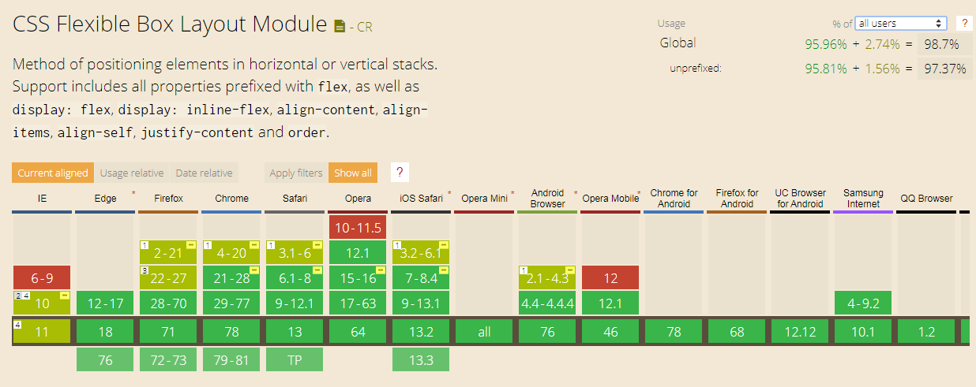
.

Slide 4
Terminology · Flex container · Flex items · Main axis / Cross axis · Start / end

Slide 5
Flex container To start with, we need to select which elements are to be laid out as flexible boxes. To do this, we set a special value of display on the parent element of the elements you want to affect.
display: flex | inline-flex;

Slide 6
Flex items Items in a flex container are, by default, flex items
display: flex | inline-flex;
Flex item
Flex item
Flex item

Slide 7
Example
display: block;
1
2
3
4

Slide 8
Example
display: flex;
1
2
3
4
2
display: inline-flex;
1
3
2
3
4
4

Slide 9
Main axis / cross axis
main start
main axis
main end
cross start
Flex container
cross axis
Flex item
Flex item
Flex item
cross end
Notes:
The main axis is the axis running in the direction the flex items are being laid out in (e.g. as rows across the page, or columns down the page.) The start and end of this axis are called the main start and main end.
The cross axis is the axis running perpendicular to the direction the flex items are being laid out in. The start and end of this axis are called the cross start and cross end.

Slide 10
Columns or rows? Flex direction
1
2
3
4
flex-direction: row;
1
flex-direction: column;
2
3
4
Notes:
Flexbox provides a property called flex-direction that specifies what direction the main axis runs in (what direction the flexbox children are laid out in) — by default this is set to row, which causes them to be laid out in a row in the direction your browser's default language works in

Slide 11
row-reverse / column-reverse
flex-direction: row-reverse;
4
3
2
1
4
flex-direction: column-reverse;
3
2
1

Slide 12
Flex container properties · align-items · align-content · flex-direction · flex-wrap · justify-content · flex-flow (shorthand for flex-direction and flex-wrap)

Slide 13
Flex items properties · align-self · flex-basis · flex-grow · flex-shrink · flex(shorthand for flex-grow, flex-shrink, flex-basis) · order

Slide 14
Horizontal and vertical alignment · justify-content · align-items

Slide 15
justify-content · flex-start · flex-end · center · space-between · space-around

Slide 16
justify-content
justify-content: flex-start;
1
2
3
4
justify-content: flex-end;
1
2
3
4
justify-content: center;
1
2
3
4

Slide 17
justify-content
justify-content: space-between;
1
2
3
4
justify-content: space-around;
1
2
3
4

Slide 18
align-items · flex-start · flex-end · center · stretch(default) · baseline

Slide 19
align-items
1
2
3
4
align-items: stretch; (default)
1
2
3
4
align-items: flex-start;

Slide 20
align-items
align-items: flex-end;
1
2
3
4
align-items: center;
1
2
3
4

Slide 21
align-self You can override the align-items behavior for individual flex items by applying the align-self property to them.
1
3
4
align-items: flex-start;
2
align-self: flex-end;

Slide 22
Perfect Centering
justify-content: center;
align-items: center;
Notes:
Set both the justify-content and align-items properties to center, and the flex item will be perfectly centered

Slide 23
Wrapping One issue that arises when you have a fixed amount of width or height in your layout is that eventually your flexbox children will overflow their container, breaking the layout
1
2
3
4
5
6
7
Notes:
One issue that arises when you have a fixed amount of width or height in your layout is that eventually your flexbox children will overflow their container, breaking the layout.

Slide 24
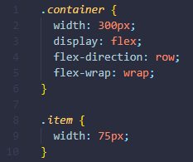
flex-wrap: wrap | nowrap | wrap-reverse;
1
2
3
4
5
6
7
Notes:
We now have multiple rows — as many flexbox children are fitted onto each row as makes sense, and any overflow is moved down to the next line.

Slide 25
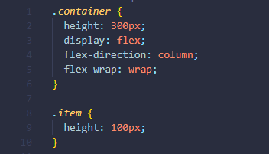
.
1
4
7
2
5
3
6

Slide 26
flex-flow shorthand At this point it is worth noting that a shorthand exists for flex-direction and flex-wrap — flex-flow. So for example, you can replace flex-direction: row; flex-wrap: wrap; with flex-flow: row wrap;

Slide 27
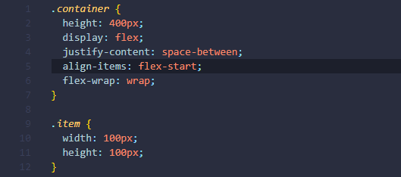
align-item vs align-content

Slide 28
1
2
3
4
5
6
7

Slide 29
align-content It helps to align a flex container's lines within it when there is extra space in the cross-axis, similar to how justify-content aligns individual items within the main-axis. Note, this property has no effect when the flexbox has only a single line.

Slide 30
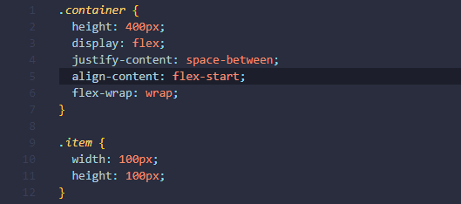
/

Slide 31
1
2
3
4
5
6
7

Slide 32
align-content · flex-start · flex-end · center · space-between · space-around · stretch(default)

Slide 33
flex-basis sets the initial main size of a flex item (affects the size of elements along the main axis)

Slide 34
flex-grow The flex-grow CSS property sets the flex grow factor of a flex item main size. It specifies how much of the remaining space in the flex container should be assigned to the item (the flex grow factor). The main size is either width or height of the item which is dependent on the flex-direction value.
width: 100px;
flex-grow: 1;
width: 100px;
flex-grow: 2;
width: 100px;
flex-grow: 1;

Slide 35
flex-shrink The exact opposite to flex-grow
width: 100px;
flex-shrink: 1;
width: 100px;
flex-shrink: 2;
width: 100px;
flex-shrink: 0;
width: 100px;
flex-shrink: 1;
1
2
0
1

Slide 36
flex shorthand for flex-grow, flex-shrink, flex-basis (by default 0, 1, auto)
flex: 2 1 300px;
flex: 1 2 300px;
flex: 2 1 300px;
flex: 1 2 300px;

Slide 37
order The order property specifies the order of the flex items. The order value must be a number, default value is 0.
1
2
3
4

Slide 38

Example
4
3
1
2

Slide 39
Example
4
3
1
2

Slide 40
Links 1. https://developer.mozilla.org/en-US/docs/Learn/CSS/CSS_layout/Flexbox 2. https://css-tricks.com/snippets/css/a-guide-to-flexbox/ 3. https://html5.by/blog/flexbox/ 4. http://flexboxfroggy.com/

