Slide 1
Per-node-depth GNN: using centrality measures to classify optimal depth
Niv Kook 211873468
Rotem Ben Zion 211324975

Slide 2
Motivation
Graph Neural Networks (GNNs) perform poorly with high depths, which means distant information can’t be used for tasks such as node classification
In this project we explore per-node-depth, which allows performing node classification using individual depths, by training a classifier for each message-passing layer in the network
This alleviates the implicit assumption that the number of message-passing steps should be equal for all nodes in the graph

Slide 3
Project’s goal
We wish to answer the following research question:
We do so by creating a new dataset, where each data point corresponds to a node:
The features are precalculated centrality measures
The label is the layer index with minimal loss
Can the optimal GNN embedding depth of a given node be derived from its centrality measures in the graph?

Slide 4
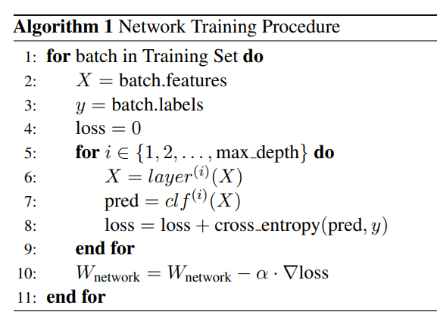
The method
We train a GNN for node-classification on the “obgn-arxiv” dataset. The loss for training is the sum of losses of the classifiers at each layer

Slide 5
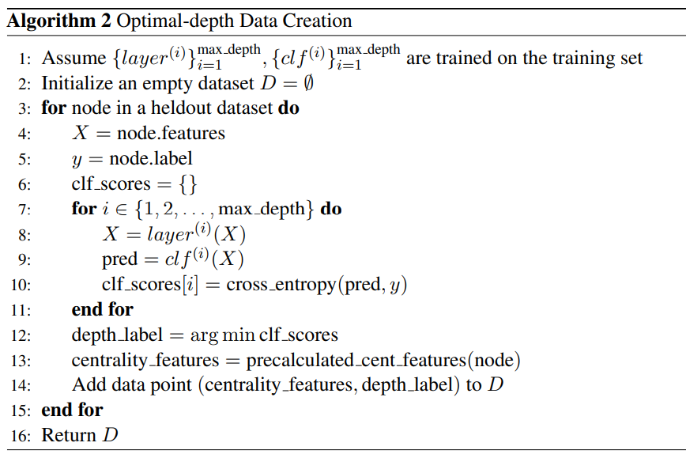
The method
We use the trained GNN and classifiers to generate a dataset, where features are centrality measures and labels are optimal depths, given by loss comparison of the classifiers

Slide 6
The method
The centrality measures we have decided to use are:
In-degree
Out-degree
PageRank
Hubs
Authorities
Katz centrality
Perculation
Eigenvector centrality

Slide 7
The method
We train a classifier (“depth classifier”) to classify the optimal depth based on the centrality features, using the new dataset
The experiments test this model’s performance and generalization, and analyze the new dataset

Slide 8
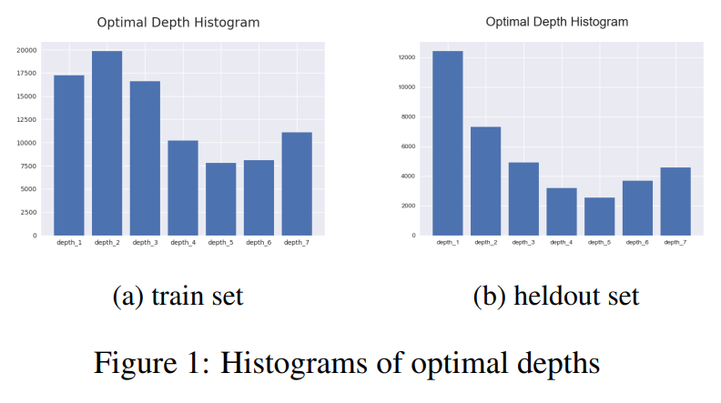
Experiments
Distribution of Optimal Depth
Visible distribution shift. Possible explanation: the data split is done temporally

Slide 9
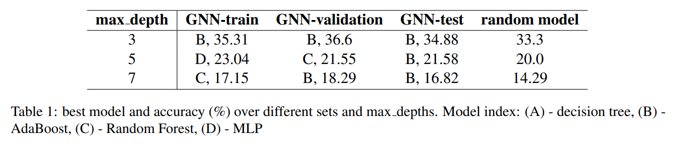
Experiments
Performance and Generalization of the Depth Classifier
No significant gains over the random model’s accuracy.

Slide 10
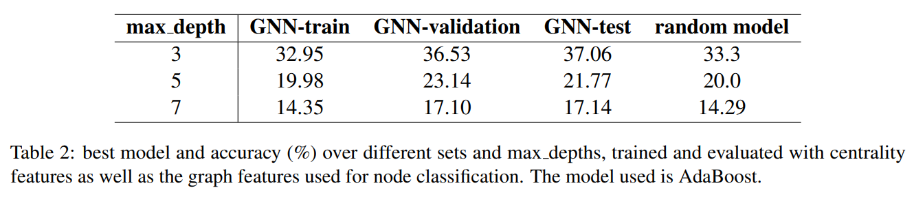
Experiments
Performance and Generalization of the Depth Classifier
In this table, the initial node features from the ogbn-arxiv dataset are appended to the centrality features before training the ML model. Similar trend to the previous result.

Slide 11
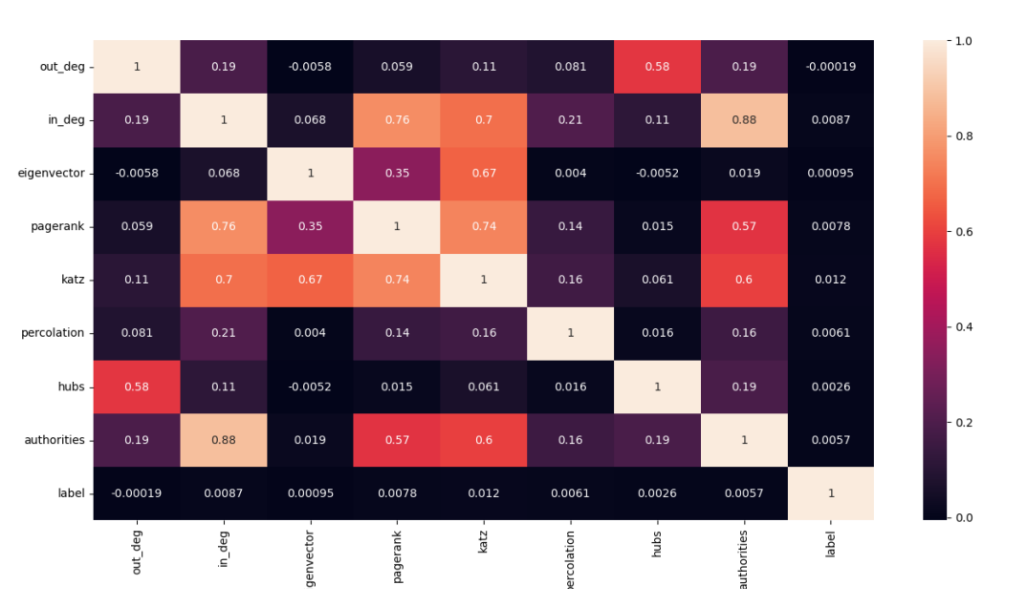
Experiments
Correlation heatmap
There is no correlation between any of the centrality features with the label.

Slide 12
Discussion
The results negate our hypothesis that centrality information is enough to determine optimal depth.
The results may be different for other types of graphs or be caused by insufficient training and numerical limitations.
Predicting the optimal depth may be even more difficult than solving the node classification problem. Thus, it will not be a simple function of centrality measures.

Slide 13
Future work
Future work may investigate the following questions:
Can we find a connection between optimal depth and the hidden node embeddings throughout the network’s forward pass?
What is the effect of homophilic vs heterophilic input graph on the correctness of our hypothesis?
What is the effect of the input graph’s size on the correctness of our hypothesis?
Can per-node-depth be succesfully applied to DL methods in other areas?

