Slide 1
Ada-STFT
A deep learning course final project
By Noam Elata and Rotem Idelson

Slide 2
The Mission
Classify audio files to 10 music genres
Dataset: GTZAN
10 classes, 100 audio samples per class
Genres: classical, country, disco, hip-hop, jazz, metal, pop, reggae, rock, blues

Slide 3
Previous work
Since 1D music classifying is a tough assignments, many have approached this task with 2D image classifiers, on the audio file spectrogram
Many solutions to genre classification use a variety of 2D features and augmentation.
We have decided to focus on improving the STFT feature and use only augmentations that do not drastically change the STFT.

Slide 4
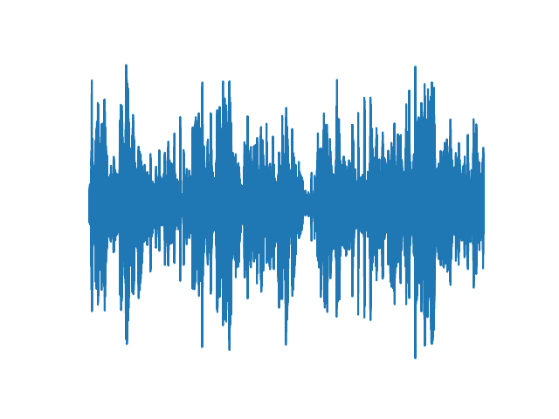
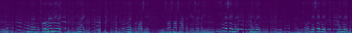

Spectrogram
A spectrogram is a visual representation of the spectrum of frequencies of a signal as it varies with time
A Spectrogram is computed using the short-time Fourier transform:
$$Spectrogram\left(t,w\right)={\left|STFT\left(t,w\right)\right|}^{2}$$
1D Audio file
2D Spectrogram

Slide 5

STFT
$$STFT\left(t,w\right)=\sum_{n=−∞}^{∞}{x\left[n\right]w\left[n−m\right]e^{−jwn}}$$
$w[n]$ are the window coefficients, and $e^{−jwn}$ are the DFT kernel coefficients

Slide 6
Our Method: Adaptive STFT
We trained a classifier on the audio files spectrogram
we used resnet-18 as our classifier
Then, we tried to learn the STFT window coefficients and DFT kernel coefficients (together and apart) to see if our accuracy improves

Slide 7
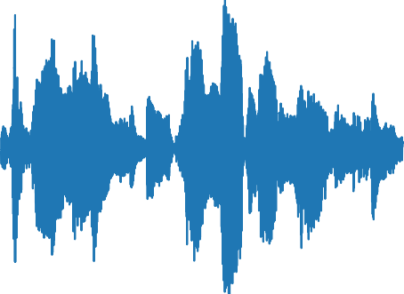
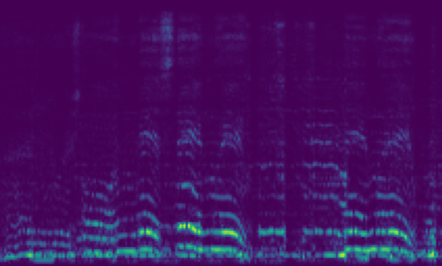
Our Model
1D Audio file
2D Spectrogram
STFT Layer
Resnet
Genre

Slide 8
Data set: GTZAN
To enlarge the data set, each sample was split into equal parts
Each epoch, we cut a random part from each sample
For evaluation, the prediction for the complete sample was decided by major vote for each part’s prediction
Audio augmentations: Noise, Gain, Delay

Slide 9
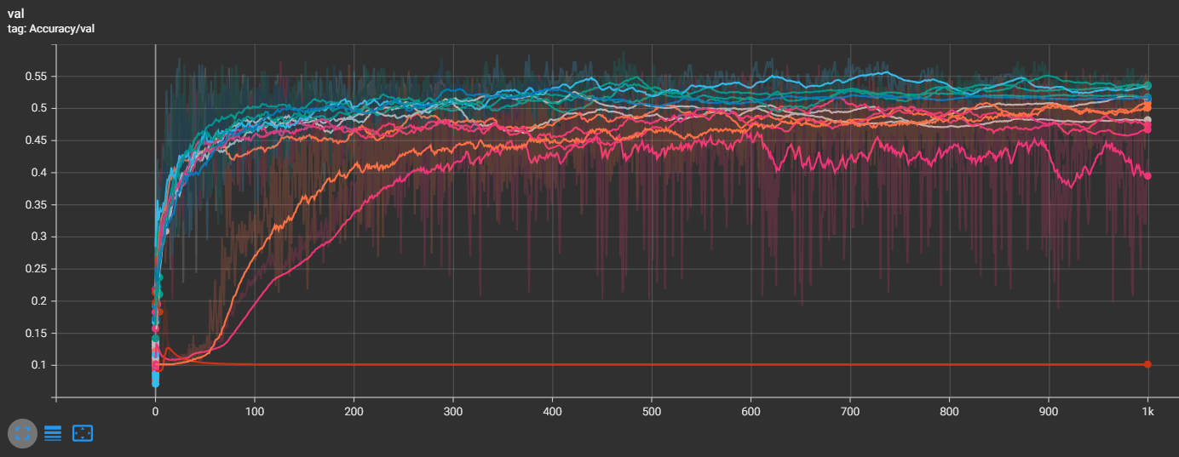
Hyper-parameter tuning
We used the Optuna library to tune the following hyper-parameters: optimizer algorithm, learning rate, exponential decay scheduler’s gamma, number of parts to split each sample, whether to use augmentations

Slide 10
Train settings
We split each sample to 12 parts
We used audio augmentations
We used AdamW optimizer and an exponential decay scheduler’s
We used Cross Entropy loss as our criterion
We kept track on our trials using the tensorboard library

Slide 11
Our Trials
To test our learnable STFT module performance, we conducted the following trials:
Basic run – with no STFT learning
Learning the STFT’s window coefficients
Learning the STFT’s DFT’s kernel coefficients
Learning both the DFT’s kernel and window coefficients
Learning 3 different STFT’s: window coefficients only
Learning 3 different STFT’s: DFT’s kernel coefficients
Learning 3 different STFT’s: both DFT’s kernel and window coefficients

Slide 12
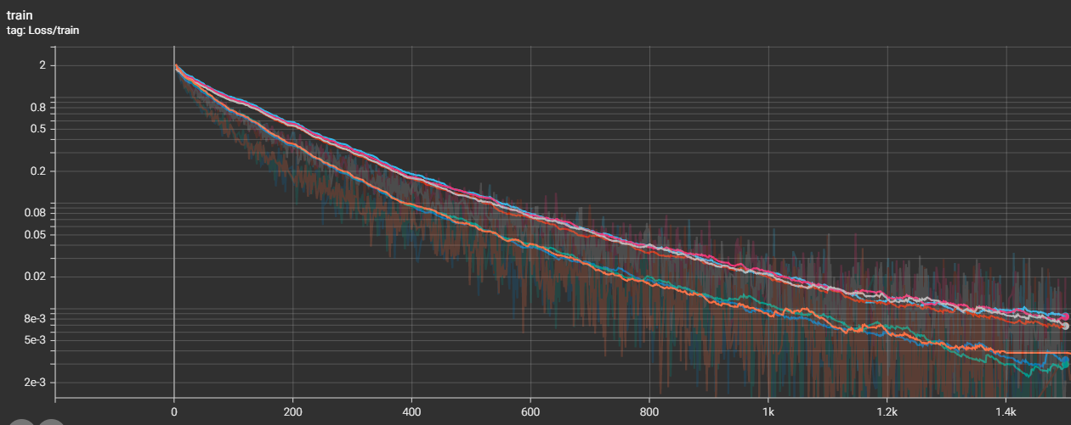
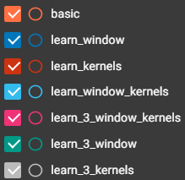
Our Results Train Loss

Slide 13
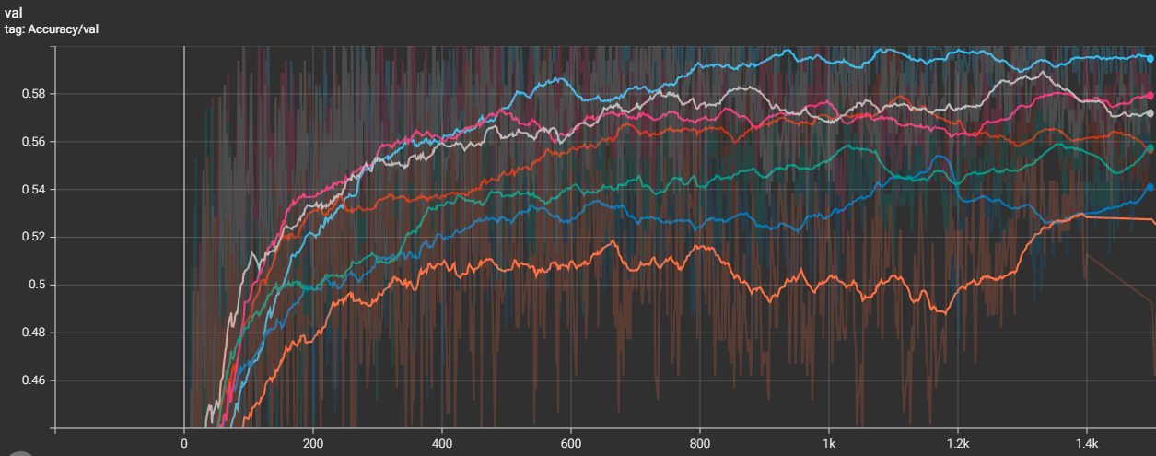
Our Results Validation Accuracy

Slide 14
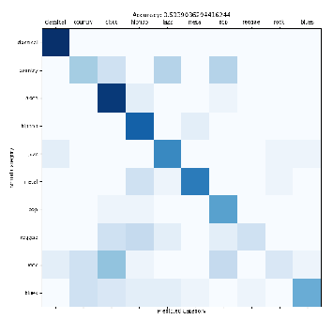
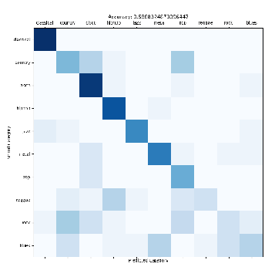
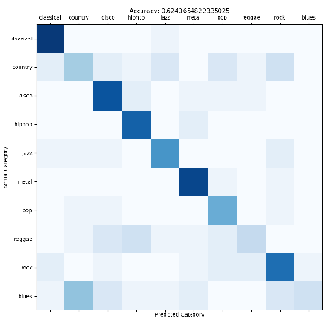
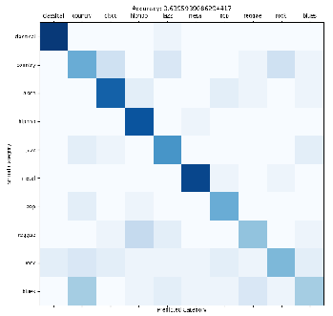
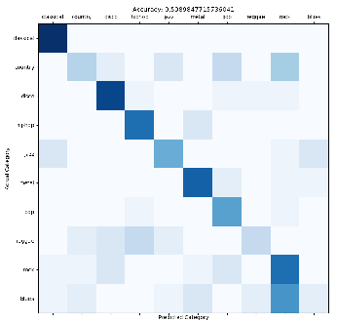
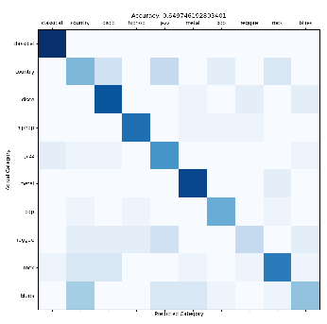
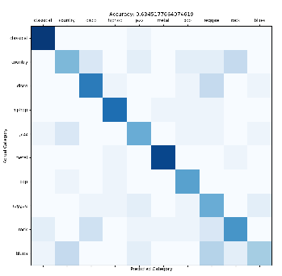
Our Results Validation Accuracy - best
Basic run – 0.59
Learn window – 0.59
Learn DFT – 0.62
Learn window and DFT – 0.64
Learn 3 windows – 0.6
Learn 3 DFTs – 0.65
Learn 3 windows and DFTs – 0.63

Slide 15
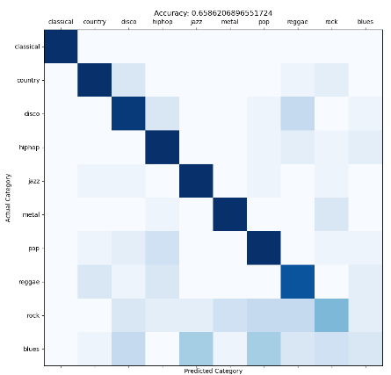
Our Results Test Accuracy
Learn window and DFT – 0.66

Slide 16
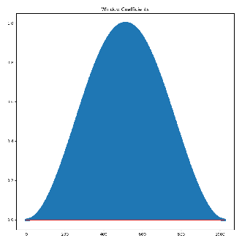
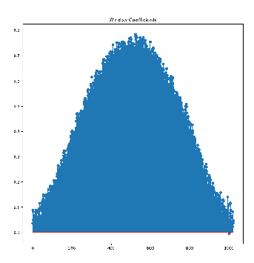
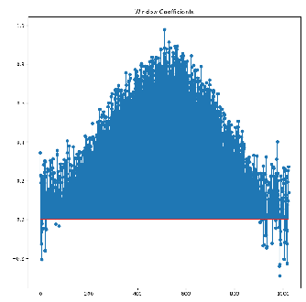
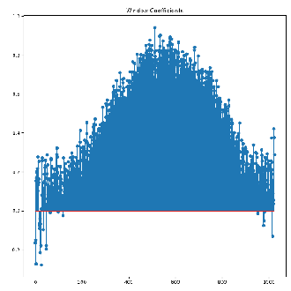
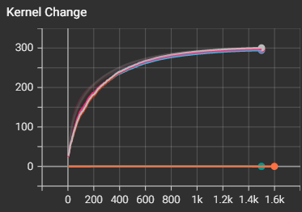
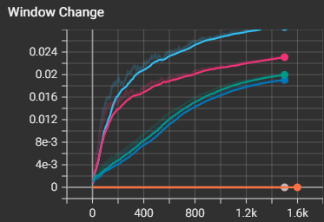
Our Results Some of the learnable windows
Initiated with Hann window
Learn window without DFT kernel
Learn window with DFT kernel
DFT’s kernel coefficients change
Window’s coefficients change

Slide 17
Conclusion and future work
Ada-STFT might be useful in those type’s of 1D tasks
If we have had more time for this project, we would have worked more on hyper-parameter tuning
In order to further explore the capabilities of Ada-STFT, it would be interesting to test this method on other compatible 1D datasets with more samples
It would be interesting to mathematically analyze the learned window and kernel coefficients

Slide 18
Thanks for listening!

