Slide 1
A deep learning course final project
By: Noam Elata and Rotem Idelson

Slide 2
The Mission
Classify audio files to 10 music genres
Dataset: GTZAN
Genres: classical, country, disco, hip-hop, jazz, metal, pop, reggae, rock, blues
Since 1D music classifying is a though assignments, many have approached this task with 2D image classifiers, on the audio file spectrogram

Slide 3
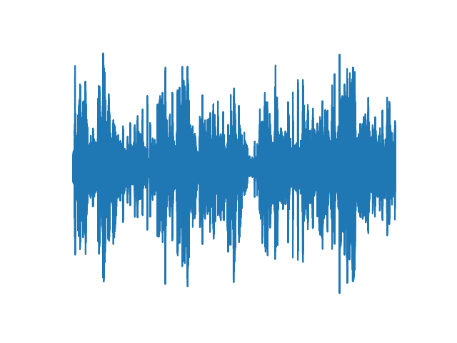
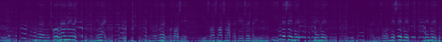

Spectrogram
A spectrogram is a visual representation of the spectrum of frequencies of a signal as it varies with time
A Spectrogram is computed using the short-time Fourier transform:
$$Spectrogram\left(t,w\right)={\left|STFT\left(t,w\right)\right|}^{2}$$
1D Audio file
2D Spectrogram

Slide 4

STFT
$$STFT\left(t,w\right)=\sum_{n=−∞}^{∞}{x\left[n\right]w\left[n−m\right]e^{−jwn}}$$
$w[n]$ are the window coefficients, and $e^{−jwn}$ are the DFT kernel coefficients

Slide 5
Our Method: Adaptive STFT
We trained a classifier on the audio files spectrogram
we used resnet-18 as our classifier
Then, we tried to learn the STFT window coefficients and DFT kernel coefficients (together and apart) to see if our accuracy improves

Slide 6
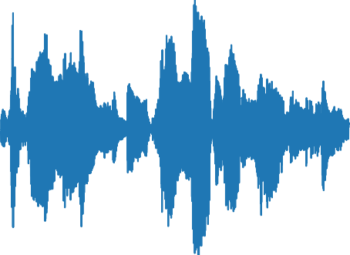
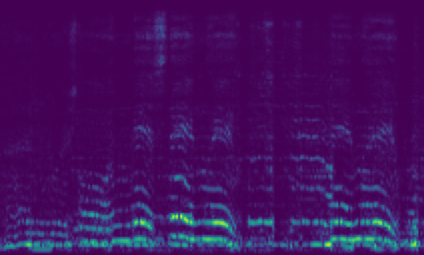
Our Model
1D Audio file
2D Spectrogram
STFT Layer
Resnet
Genre

Slide 7
Train settings
Given a 30 seconds audio files, we split them to _ parts
Inference is done using splitting the file and preform major vote
Training is done each time on a random part of the whole file
We preform random audio augmentations: Noise, Gain, Delay
We used Optuna Library to tune the following parameters:
Parts to split, Optimizer, Learning rate, Scheduler gamma, Using augmentation
We used Cross Entropy loss as our criterion
We kept track on our trials using the tensorboard library

