Slide 1
A deep learning course final project
By: Noam Elata and Rotem Idelson

Slide 2
The Mission
Classify audio files to 10 music genres
Dataset: GTZAN
Genres: classical, country, disco, hip-hop, jazz, metal, pop, reggae, rock, blues

Slide 3
Previous work
Since 1D music classifying is a tough assignments, many have approached this task with 2D image classifiers, on the audio file spectrogram
Many solutions to genre classification use a variety of 2D features and augmentation.
We have decided to focus on improving the STFT feature and use only augmentations that do not drastically change the STFT.

Slide 4
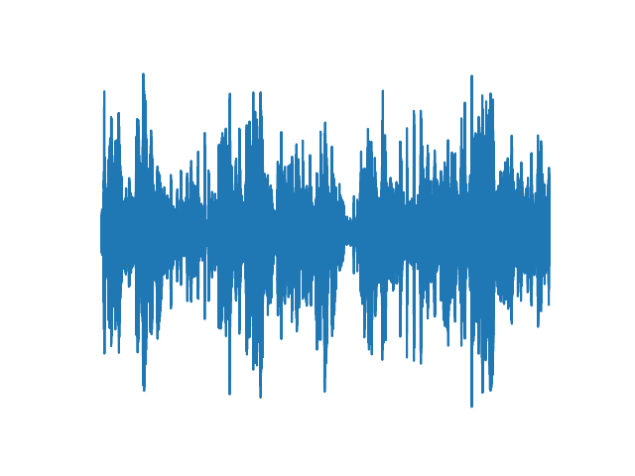


Spectrogram
A spectrogram is a visual representation of the spectrum of frequencies of a signal as it varies with time
A Spectrogram is computed using the short-time Fourier transform:
$$Spectrogram\left(t,w\right)={\left|STFT\left(t,w\right)\right|}^{2}$$
1D Audio file
2D Spectrogram

Slide 5

STFT
$$STFT\left(t,w\right)=\sum_{n=−∞}^{∞}{x\left[n\right]w\left[n−m\right]e^{−jwn}}$$
$w[n]$ are the window coefficients, and $e^{−jwn}$ are the DFT kernel coefficients

Slide 6
Our Method: Adaptive STFT
We trained a classifier on the audio files spectrogram
we used resnet-18 as our classifier
Then, we tried to learn the STFT window coefficients and DFT kernel coefficients (together and apart) to see if our accuracy improves

Slide 7
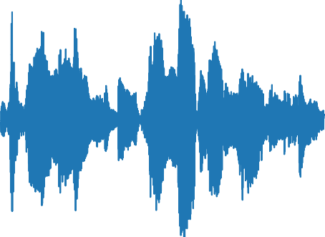
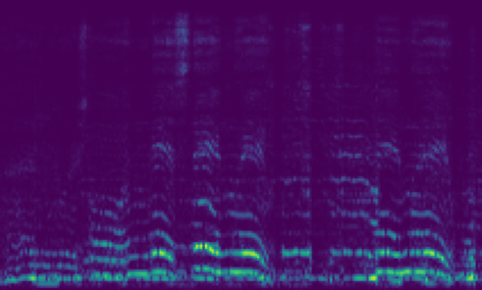
Our Model
1D Audio file
2D Spectrogram
STFT Layer
Resnet
Genre

Slide 8
Data set: GTZAN
10 classes, 100 audio samples per class
To enlarge the data set, each sample was split into equal parts
For evaluation, the prediction for the complete sample was decided by major vote for each part’s prediction

Slide 9
Train settings
Given a 30 seconds audio files, we split them to _ parts
Inference is done using splitting the file and preform major vote
Training is done each time on a random part of the whole file
We preform random audio augmentations: Noise, Gain, Delay
We used Optuna Library to tune the following parameters:
Parts to split, Optimizer, Learning rate, Scheduler gamma, Using augmentation
We used Cross Entropy loss as our criterion
We kept track on our trials using the tensorboard library

