Slide 1

DEPARTMENT OF ARTIFICIAL INTELLIGENCE AND DATA SCIENCE
Artificial Neural Networks and Deep Learning: 21ADG64
LA1 - Seminar
“BERT”
Presented By
Rotem Cohen
[1NT21AD043]
Name of the Course Instructor Dr Meenakshi

Slide 2

CONTENTS
Introduction and Motivation
Methodology and Approach
Results and Analysis
Conclusion and Future Recommendations
Demo video of code
Github link of PPT and Code
References

Slide 3
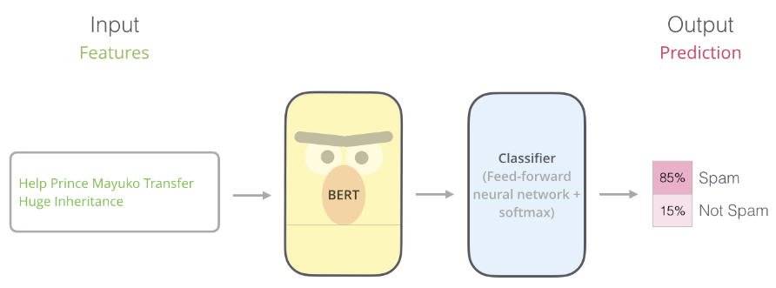

INTRODUCTION
BERT
BERT, which stands for Bidirectional Encoder Representations from Transformers, is based on transformers, a deep learning model in which every output element is connected to every input element, and the weightings between them are dynamically calculated based upon their connection.
BERT is pretrained on two different but related NLP tasks: masked language modeling (MLM) and next sentence prediction (NSP).
The most straight-forward way to use BERT is to use it to classify a single piece of text.
BERT

Slide 4
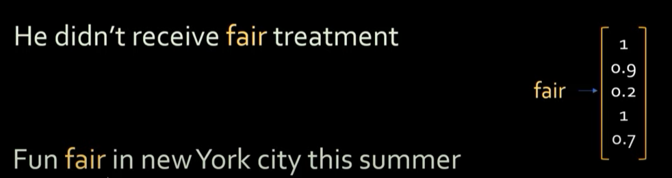
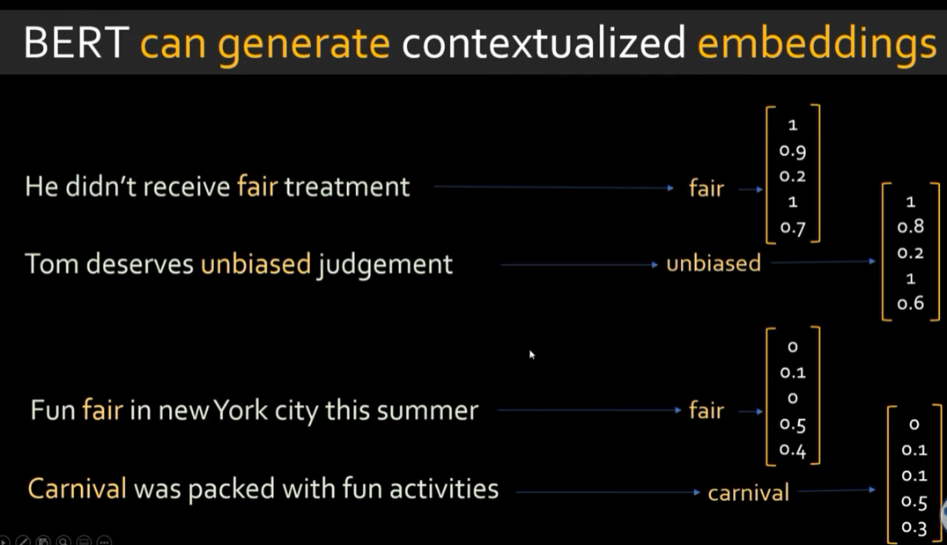

word2vec
BERT

Slide 5
USED FOR
Google uses BERT to optimize the interpretation of user search queries.
Sequence-to-sequence language generation tasks such as:
Question answering.
Abstract summarization.
Sentence prediction.
Conversational response generation.
NLU tasks such as:
Polysemy and coreference resolution. Coreference means words that sound or look the same but have different meanings.
Word sense disambiguation.
Natural language inference.
Sentiment classification.

Slide 6
DIFFERENT BERT MODELS
PatentBERT. This BERT model is fine-tuned to perform patent classification tasks.
DocBERT. This model is fine-tuned for document classification tasks.
BioBERT. This biomedical language representation model is for biomedical text mining.
VideoBERT. This joint visual-linguistic model is used in unsupervised learning of unlabeled data on YouTube.
SciBERT. This model is for scientific text.
G-BERT. This pretrained BERT model uses medical codes with hierarchical representations through graph neural networks and then fine-tuned for making medical recommendations.
TinyBERT by Huawei. This smaller, "student" BERT learns from the original "teacher" BERT, performing transformer distillation to improve efficiency. TinyBERT produced promising results in comparison to BERT-base while being 7.5 times smaller and 9.4 times faster at inference.

Slide 7
METHODOLOGY AND APPROACH
BERT was pretrained using only a collection of unlabeled, plain text, namely the entirety of English Wikipedia and the Brown Corpus.
It continues to learn through unsupervised learning from unlabeled text and improves even as it's being used in practical applications such as Google Search.
From there, BERT can adapt to the ever-growing body of searchable content and queries, and it can be fine-tuned to a user's specifications. This process is known as transfer learning.
BERT has multiple other aspects it relies on to function as intended, including the following:
Transformers: The transformer is the part of the model that gives BERT its increased capacity for understanding context and ambiguity in language.
Masked Language Modelling: BERT uses an MLM method to keep the word in focus from seeing itself, or having a fixed meaning independent of its context.
Self-attention mechanisms: BERT also relies on a self-attention mechanism that captures and understands relationships among words in a sentence.
Next sentence prediction: NSP is a training technique that teaches BERT to predict whether a certain sentence follows a previous sentence to test its knowledge of relationships between sentences.

Slide 8
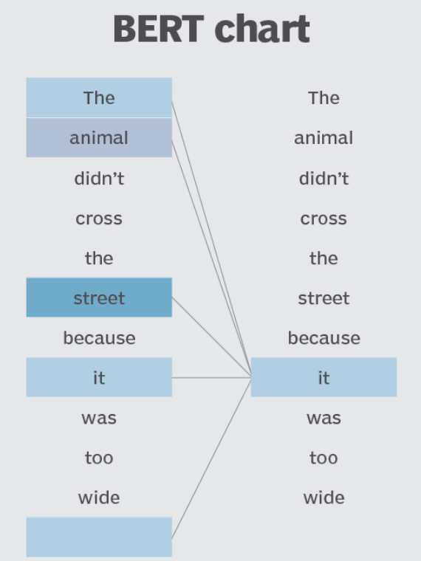

Slide 9
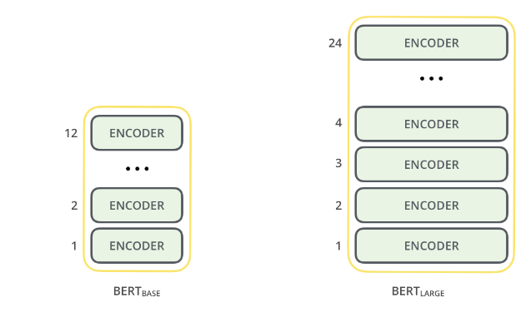
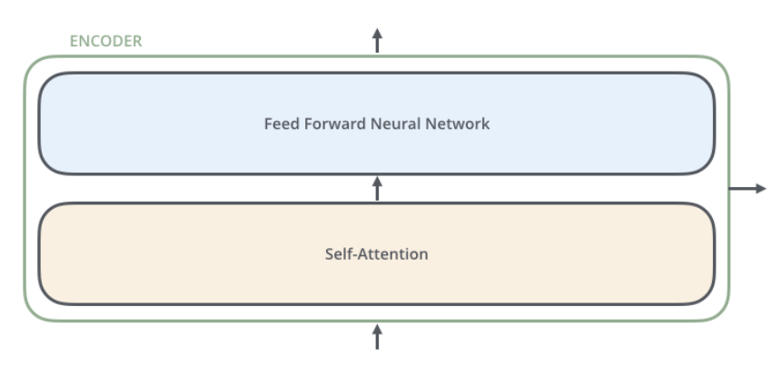
RESULT AND ANALYSIS
Model Architecture
Both BERT model sizes have a large number of encoder layers

Slide 10
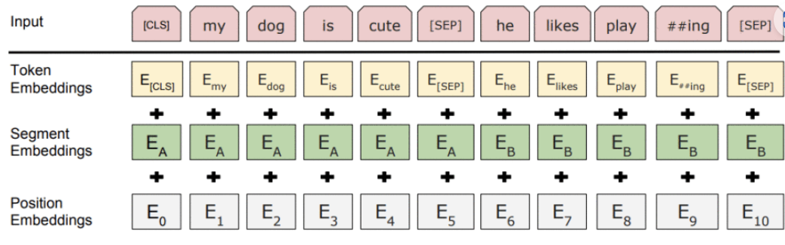
Model Input
The input to the encoder for BERT is a sequence of tokens, which are first converted into vectors and then processed in the neural network. But before processing can start, BERT needs the input to be massaged and decorated with some extra metadata:
Token embeddings: A [CLS] token is added to the input word tokens at the beginning of the first sentence and a [SEP] token is inserted at the end of each sentence.
2.Segment embeddings: A marker indicating Sentence A or Sentence B is added to each token. This allows the encoder to distinguish between sentences.
3.Positional embeddings: A positional embedding is added to each token to indicate its position in the sentence.

Slide 11
BERT MODEL IN NLP
Classification Task
BERT can be used for classification task like sentiment analysis, the goal is to classify the text into different categories (positive/ negative/ neutral)
2. Question Answering
In question answering tasks, where the model is required to locate and mark the answer within a given text sequence, BERT can be trained for this purpose.
3. Named Entity Recognition (NER)
BERT can be utilized for NER, where the goal is to identify and classify entities (e.g., Person, Organization, Date) in a text sequence.
TOKENSIZE AND ENCODE TEXT USING BERT
we will be using the ‘transformer’ library in Python.
We will load the pretrained BERT tokenize with a cased vocabulary using BertTokenizer.from_pretrained(“bert-base-cased”).
tokenizer.encode(text) tokenizes the input text and converts it into a sequence of token IDs.
print(“Token IDs:”, encoding) prints the token IDs obtained after encoding.
tokenizer.convert_ids_to_tokens(encoding) converts the token IDs back to their corresponding tokens.
print(“Tokens:”, tokens) prints the tokens obtained after converting the token IDs

Slide 12
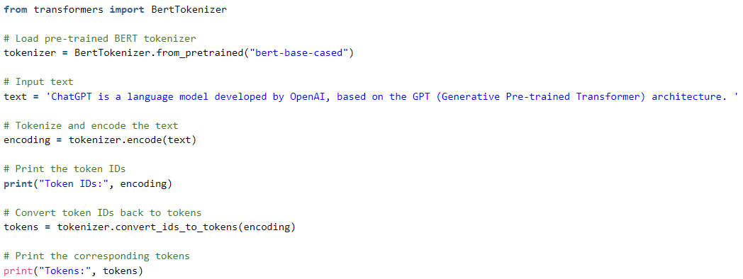
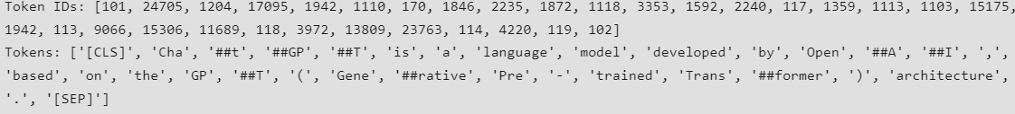
BERT MODEL IN NLP

Slide 13
CONCLUSION AND FUTURE REOMMENDATIONS
BERT (Bidirectional Encoder Representations from Transformers) is a pre-trained language model developed by Google that has revolutionized natural language processing tasks by capturing bidirectional context in text data.
Its ability to generate contextually rich embeddings has led to significant advancements in various NLP applications, such as sentiment analysis, question answering, and text classification.
Looking ahead, future recommendations could involve enhancing BERT's capabilities through more efficient training strategies, leveraging larger datasets, and exploring techniques to adapt BERT to specific domains or languages, thereby extending its applicability and performance in diverse real-world scenarios.

