Slide 1
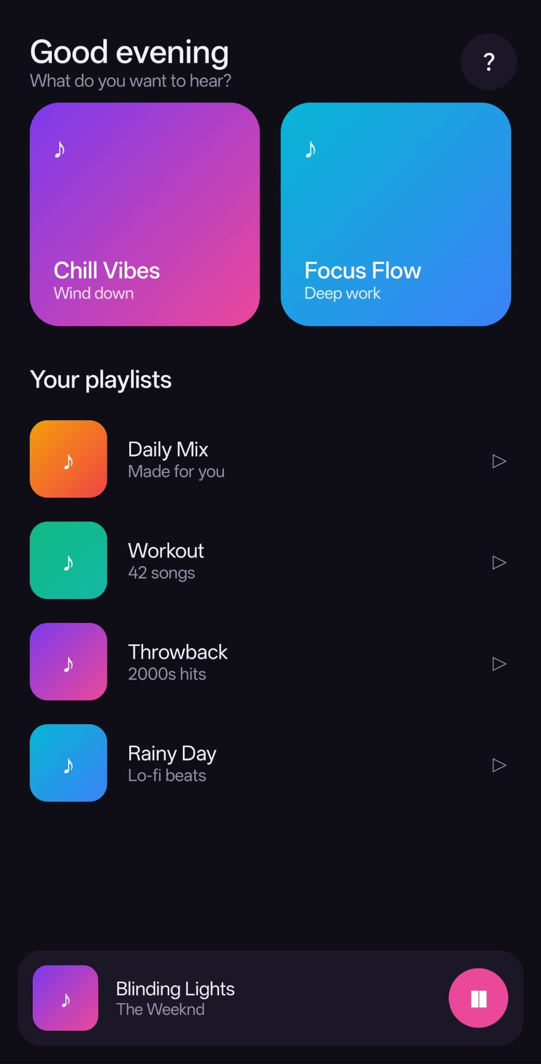
THE PROBLEM
Your best feature is useless if no one finds it.
Notes:
Your app's best feature is worthless if nobody finds it. Most new users open an app, feel lost, and never come back.

Slide 2
THE OLD WAY
Changing a tutorial meant shipping a whole new app release.
Notes:
The usual answer is a built-in tutorial. But the moment you want to change it, you're shipping a new app release, waiting on review, and hoping users update.

Slide 3

GuideFlow
Interactive in-app tutorials, updated over the air.
Notes:
GuideFlow changes that. Build your in-app tutorials once, publish them from a portal, and update them live, with no app-store release.

Slide 4
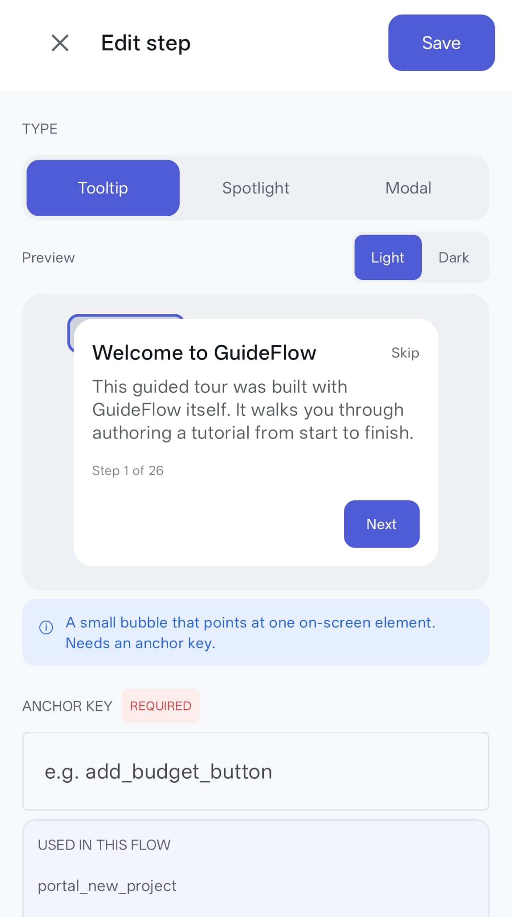
WHAT IT IS
An SDK for your app, plus a portal to design the tours.
Notes:
It's two parts: a lightweight Android SDK you drop into your app, and a portal where you design the tutorials. The app just renders whatever you've published.

Slide 5
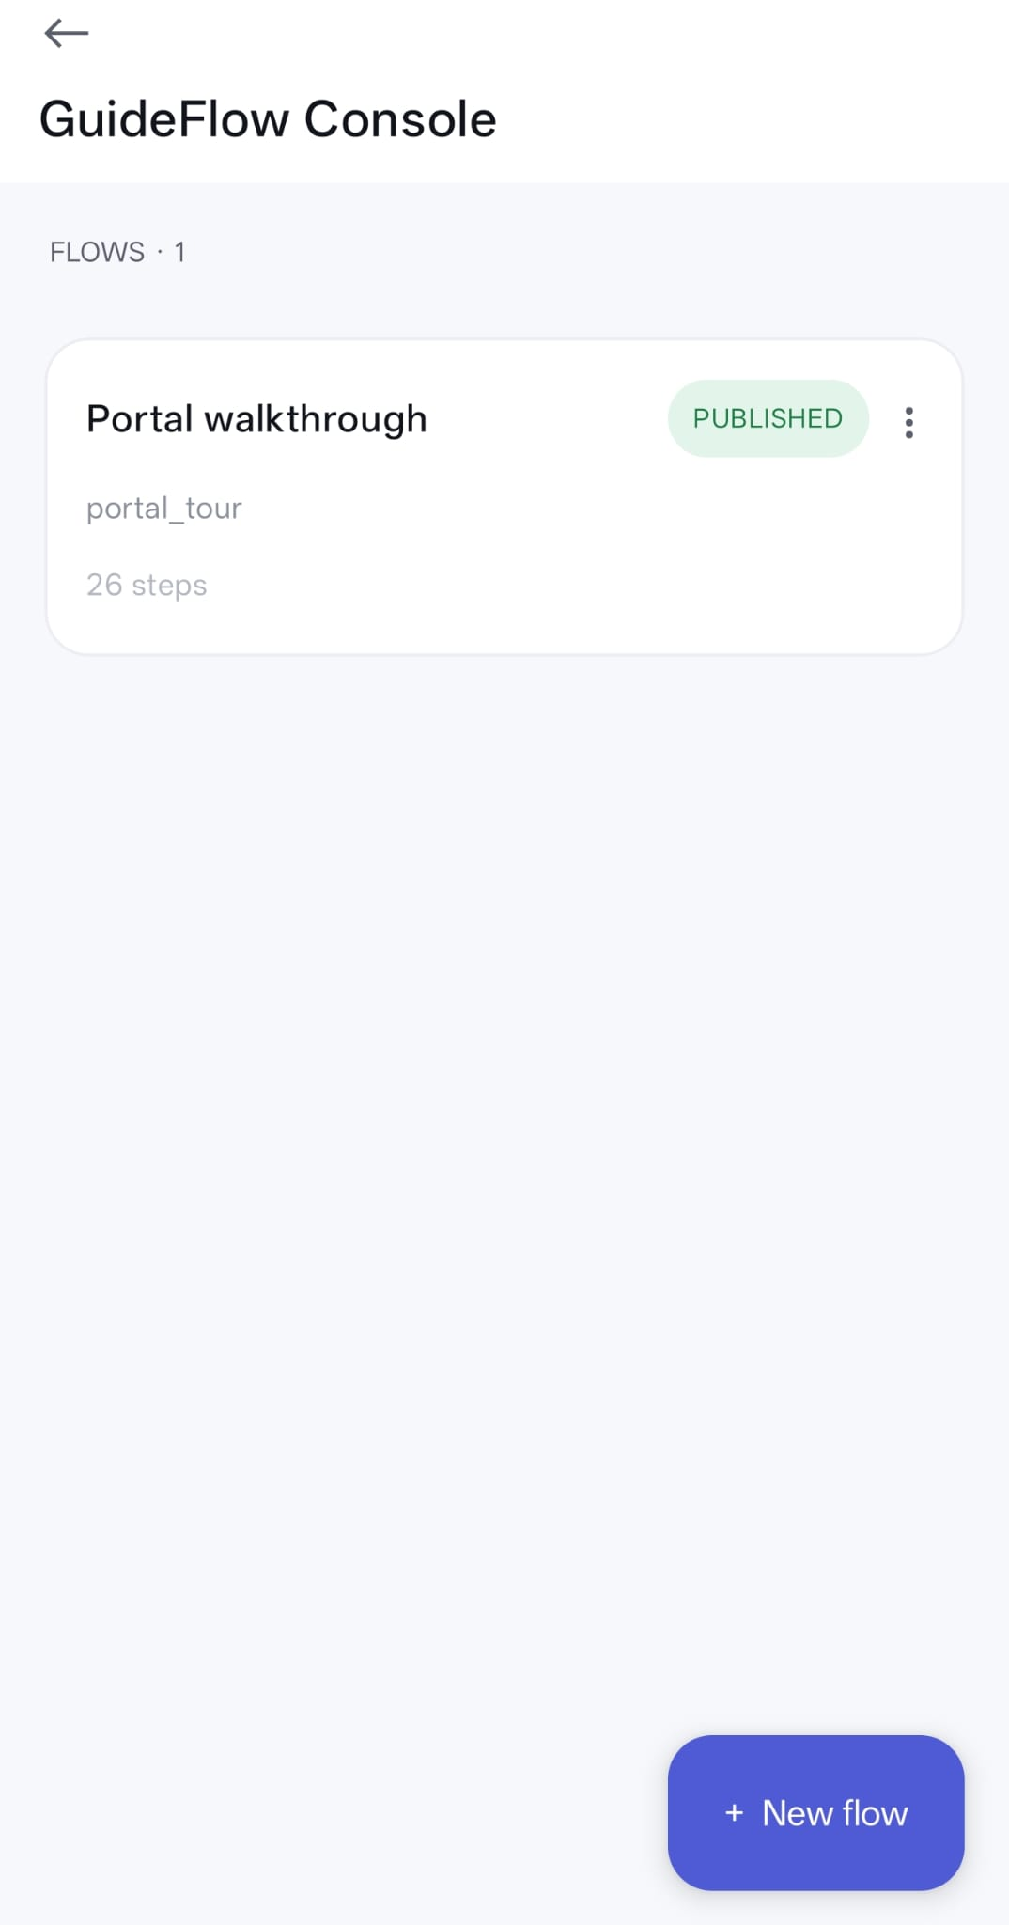
HOW IT WORKS
Author -> Publish -> live on every app.
Notes:
The flow is simple. You author a tour in the portal, press publish, and every app carrying your project key downloads it on the next launch.

Slide 6
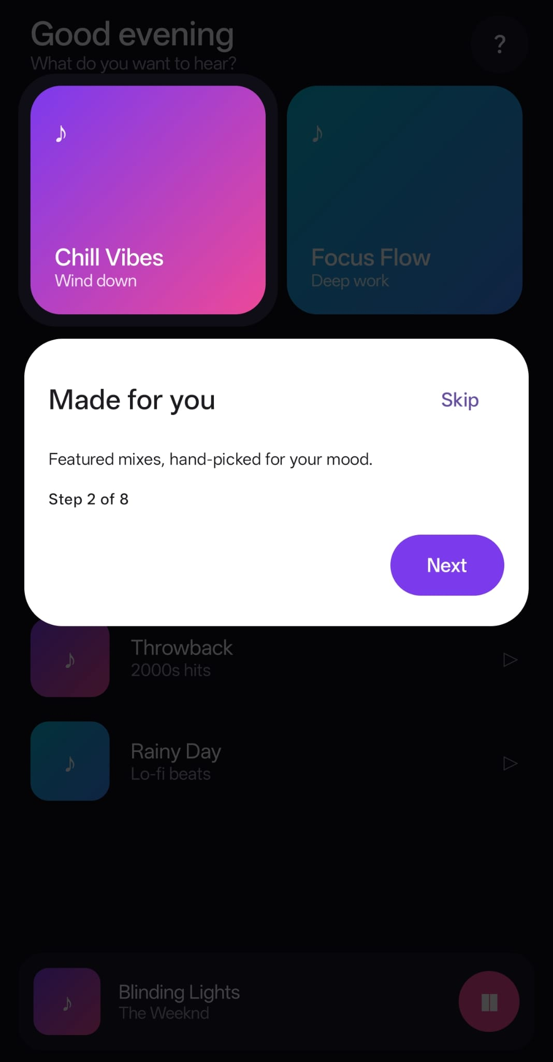
THE MAGIC
Edit. Publish. Live in seconds.
Notes:
That's the magic. Edit a step, publish, and it's live in seconds. No rebuild, no review queue, no waiting for users to update.

Slide 7
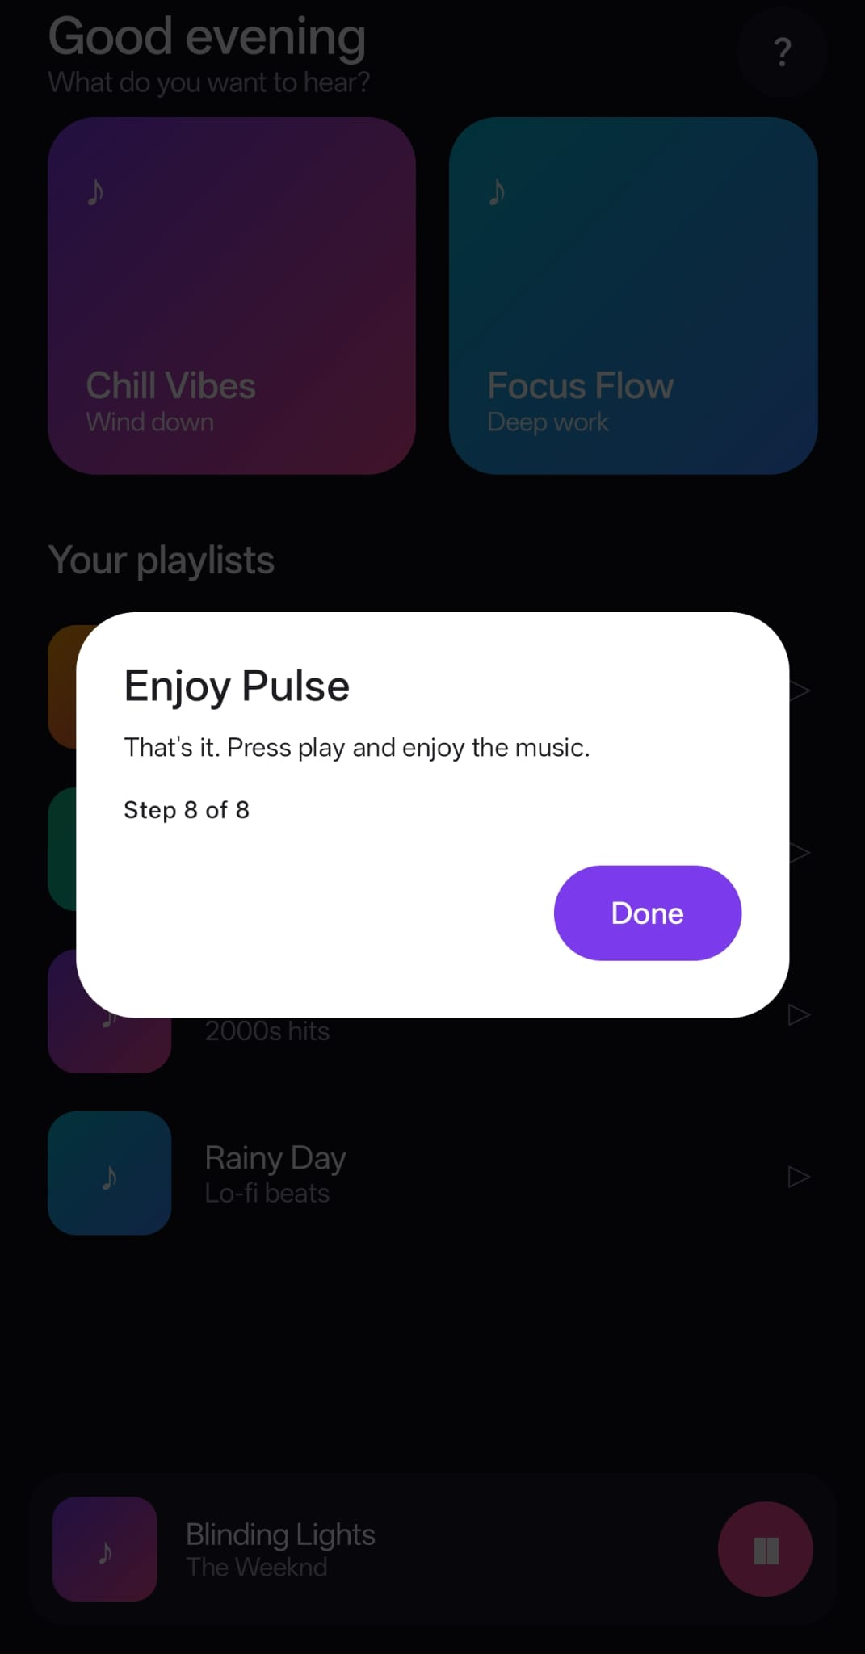
THE FORMATS
Guidance where users already are.
Notes:
And it guides users gently, right where they are: a spotlight to focus attention, a tooltip on a button, or a full-screen message when needed.

Slide 8
WHY IT HELPS
Fix onboarding today. Launch features guided. No release required.
Notes:
So confusing onboarding becomes a same-day fix. A new feature gets a walkthrough the moment it ships. You guide users without shipping code every time.

Slide 9
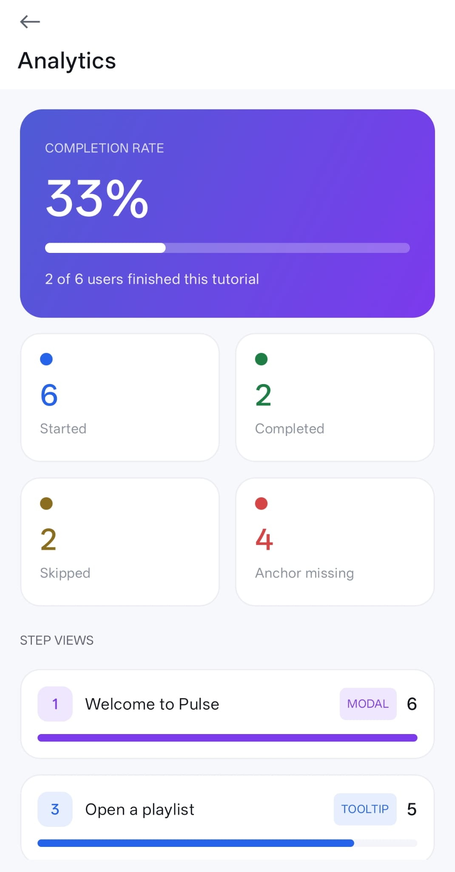
MEASURE
Never guess: see who finishes and who drops off.
Notes:
And you're never guessing. Built-in analytics show how many people start, finish, or drop off, step by step.

Slide 10
Onboard users. Launch features.
Three steps to integrate. Published on JitPack.
github.com/RotemBar18/GuideFlow
Notes:
It's tiny to adopt, three steps and it's running, and it's published on JitPack. GuideFlow: onboard users, launch features, and never ship a release just to change a tutorial.

