Slide 1





ECG Arrhythmia Classification with Real-time Hospital Monitoring
Powered by RhythmNet AI Technology
Advanced Machine Learning Workshop: From Research to Clinical Implementation
Real-time Monitoring
AI-Powered
98.54% Accuracy

Slide 2






Introduction: The Clinical Problem
Global Burden of Cardiac Arrhythmias
15-20%
Critical Impact Areas
of global deaths
Sudden cardiac arrest - leading cause
Cardiac arrhythmias contribute to deaths worldwide, primarily through sudden cardiac arrest
Emergency department overload
1-5 min
Limited cardiologist availability
per patient
Time-critical diagnosis requirements
Manual ECG interpretation time in busy clinical settings, creating bottlenecks

Slide 3



Introduction: The Clinical Problem
Interpretation Challenges & Urgency
> 30
10-15%
Critical
ECGs Daily
Misinterpretation
V-Tach Detection
Emergency departments handle massive volumes with limited specialist coverage
Error rates in non-specialist settings, especially dangerous for critical arrhythmias
Ventricular tachycardia requires immediate detection - delays directly impact survival
The Urgency Factor
Every Second Counts
Critical arrhythmias like ventricular tachycardia require immediate detection
Delays directly impact survival rates

Slide 4




Business Motivation & Market Impact
Market Opportunity & Healthcare Costs
$10B+
Hundreds of Billions
Annual Market
Global CV care costs
Significant portion from diagnostic delays and inefficiencies
Global cardiac monitoring device market with rapid growth trajectory
Rural Hospitals
Market Drivers
Coverage gaps
• Aging population demographics
• Increasing cardiovascular disease prevalence
Lack 24/7 cardiologist coverage, creating diagnostic gaps
• Technology adoption in healthcare
Key Insight
AI-powered diagnostic assistance represents major market opportunity for healthcare cost reduction

Slide 5






Business Motivation & Market Impact
AI's Role in Addressing Critical Gaps
Current Challenges
AI-Powered Solution
False Negatives
Intelligent Assistance
Life-threatening delays and malpractice liability
24/7 diagnostic support for all healthcare settings
Alert Fatigue
Cost Reduction
High false positive rates in current systems
Major market opportunity for healthcare efficiency
Coverage Gaps
Patient Safety
Rural hospitals lack 24/7 specialist availability
Reduced diagnostic errors and improved outcomes
The AI Opportunity
Bridge the Gap
Transform cardiac care with intelligent, real-time diagnostic assistance
Technology meets clinical need

Slide 6



Our Proposed Solution: RhythmNet
Core Features & Performance
98.54%
47
Smart
Accuracy
Patients
Alerts
High Precision
Simultaneous Monitoring
Clinical Decision Support
Real-time ECG arrhythmia classification with <1 second processing time
Continuous tracking with intelligent alert prioritization system
Interpretable AI outputs with confidence scores and smart alerting
Performance Breakthrough
< 1s
• Sub-second processing time for real-time analysis
• Intelligent alert algorithm reduces false alarms
Processing Time
• Seamless integration with existing hospital infrastructure
Real-time clinical decision support

Slide 7



Our Proposed Solution: RhythmNet
Advanced Capabilities
Live Visualization
Interpretability
Patient Prioritization
Continuous monitoring without workflow disruption, seamless clinical integration.
Interpretable AI outputs providing clinical decision support with transparency.
Abnormal patients automatically moved to top of clinical dashboard with visual highlighting.

Slide 8



Development Philosophy & Methodology
Clinical-First Approach
Advanced Class Balancing
Comprehensive Comparison
Prioritizing sensitivity and specificity over raw accuracy metrics for patient safety.
SMOTE techniques specifically optimized for rare but critical arrhythmia detection.
Traditional ML and state-of-the-art deep learning approaches for robust validation.

Slide 9



CRISP-DM Methodology Framework I
Phases 1-3: Foundation & Preparation
Systematic Data Science Approach
CRISP-DM
Industry-standard methodology ensuring rigorous research and development
6-Phase Framework
Phase 1
Phase 2
Phase 3
Business Understanding
Data Understanding
Data Preparation
Clinical Needs Assessment
MIT-BIH Analysis
Advanced Preprocessing
• Literature-based assessment of unmet clinical needs in ECG interpretation
• Dataset structure analysis
• SMOTE class balancing
• Quality assessment
• Feature engineering
• Clinical workflow analysis
• Clinical relevance validation
• Quality validation
• Requirements definition
• Distribution exploration

Slide 10



CRISP-DM Methodology Framework II
Phases 4-6: Modeling to Deployment
Phase 4
Phase 5
Phase 6
Modeling
Evaluation
Deployment
Systematic Evaluation
Rigorous Validation
Real-time Implementation
• 5 different architectures
• Clinical metrics focus
• Hospital system integration
• Traditional ML to transformers
• Sensitivity & specificity
• Clinical interface design
• RhythmNet development
• Per-class performance
• Performance validation
• Cross-validation testing
• Real-world testing
Complete Implementation
• Research to production pipeline
✓
• Clinical validation in real environment
• Continuous performance monitoring

Slide 11
















Technical Pipeline Architecture
Research & Production Workflows
Research Phase
Production Pipeline
MIT-BIH Dataset
Live ECG Streams
Signal Preprocessing
Real-time Processing
Feature Engineering
AI Classification Engine
Model Training
Smart Alert Generation
Performance Optimization
Clinical Dashboard
End-to-End Solution
Seamless Flow
From raw ECG data to actionable clinical insights
Research to Reality

Slide 12



Technical Pipeline Architecture
Integration & Quality Assurance
Hospital ECG Machines
Direct integration with existing ECG monitoring infrastructure
Real-time AI Engine
Local processing with RhythmNet model for instant ECG classification
Patient Management
Integrated clinical decision support interface

Slide 13



MIT-BIH Arrhythmia Database
Gold Standard Dataset Overview
47
87,554
187
Patients
Samples
Values
Patient Population
Training Data
Signal Structure
Diverse demographics with various cardiac conditions and noise levels
Expert cardiologist annotations following AHA guidelines
ECG values per heartbeat (1.496s windows at 125Hz)
Gold Standard Quality
🏆
• Zero missing values in dataset
• Pre-normalized signal amplitudes
Industry Standard
• Consistent temporal alignment around R-peaks
Trusted by researchers worldwide
• Expert cardiologist validation

Slide 14
MIT-BIH Arrhythmia Database
Classification Categories & Validation
N
S
V
F
Q
Normal
Supraventricular
Ventricular
Fusion
Unclassifiable
Regular QRS complexes, consistent PR intervals, stable rhythm
Premature atrial contractions requiring monitoring
Potentially life-threatening premature ventricular contractions
Rare overlapping electrical activity, clinically significant
Noisy or ambiguous signals challenging for experts
Clinical Validation
5
• Expert cardiologist annotations
• American Heart Association guidelines
Classification Categories
• Representative patient demographics
Comprehensive arrhythmia coverage
• Various cardiac conditions included

Slide 15
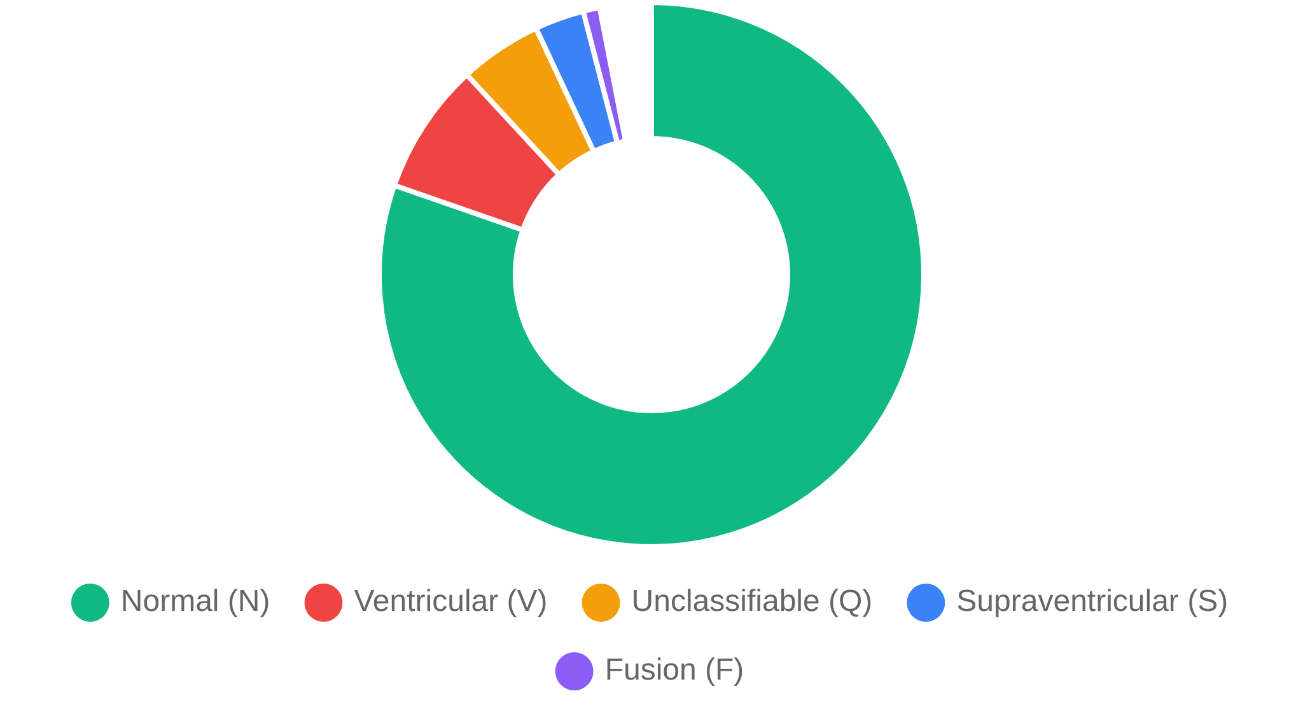

Class Distribution Challenge
Real-World Clinical Imbalance
Sample Distribution
N
Normal
82%
~72,000 samples - majority class representing healthy rhythm
V
Ventricular
8%
~7,000 samples - potentially life-threatening PVCs
Q
Unclassifiable
5%
~4,700 samples - noisy or ambiguous signals
S
Supraventricular
3%
~3,000 samples - premature atrial contractions
Critical Clinical Implication
Missing minority classes can result in life-threatening diagnostic errors
1%
F
Fusion
~800 samples - rare overlapping electrical activity

Slide 16



Class Balancing Strategy & SMOTE Implementation
Addressing Critical Diagnostic Bias
Core Problem
Implementation & Validation
82% Normal beats vs 3% Supraventricular vs 8% Ventricular creates severe learning bias
K-Nearest Neighbors
Missing rare arrhythmias = life-threatening diagnostic errors
Interpolated samples preserving morphological characteristics
Stratified Validation
Original distribution preserved in evaluation sets
SMOTE Solution
Synthetic Minority Oversampling Technique generating realistic synthetic ECG patterns
K-nearest neighbors approach preserving class characteristics
Performance Improvement
86.76% → 90.54%
Sensitivity significantly enhanced while maintaining overall accuracy
Sensitivity

Slide 17






Advanced Feature Engineering
Multi-Domain Signal Analysis
Statistical
Morphological
Temporal
• Mean amplitude
• R-peak detection
• RR interval variability
• Standard deviation
• QRS width measurement
• Rhythm regularity
• Skewness
• P-wave identification
• Sequence patterns
• Kurtosis
• T-wave analysis
• Signal distribution
• Waveform shape
Frequency
Entropy
Wavelet
• FFT components
• Sample entropy
• Multi-resolution decomposition
• Power spectral density
• Approximate entropy
• Time-frequency analysis
• Dominant frequency
• Permutation entropy
• Wavelet coefficients
• Spectral analysis
• Signal complexity
• Scale-based features
• Frequency bands
• Irregularity measures
• Localized patterns
Clinical Relevance
6
Each feature corresponds to specific cardiac electrophysiology principles used by cardiologists
• Comprehensive signal characterization
Feature Categories
• Multi-domain analysis approach
Comprehensive signal analysis
• Clinical knowledge integration

Slide 18








RhythmNet Architecture
Hybrid CNN-Attention Architecture
Multi-Scale
Multiple kernel sizes for comprehensive feature extraction
CNN Local Patterns
Attention Global Context
Convolutional layers for local feature extraction and pattern recognition
Self-attention mechanism for global temporal modeling
Long-Range
Captures dependencies across entire heartbeat sequence
P-QRS-T Detection
Interpretable Output
Automated detection of cardiac waveform components
Attention maps provide clinical explanations
Adaptive
Channel attention emphasizes discriminative features
Efficient
Optimized for real-time clinical deployment
Technical Innovation
RhythmNet
Combining CNN local pattern recognition with attention-based global context modeling
Best of both worlds

Slide 19





RhythmNet Architecture Visualization
Input Layer
187-sample ECG window
↓
CNN Layers
Attention Layers
Local pattern extraction for QRS detection and morphology analysis
Global context understanding and temporal dependencies
Convolutional filters capture local ECG features
Self-attention mechanisms for sequence modeling
Channel Attention
Classification Head
Adaptive filter importance for optimal feature selection
Final decision layer for arrhythmia classification
Dynamic weighting of feature channels
Dense layers with softmax activation
↓
5-Class Output
N
S
V
F
Q
Hybrid Innovation
RhythmNet combines the best of CNN and Transformer architectures: CNNs excel at local pattern recognition (QRS complexes, wave morphology) while attention mechanisms capture global temporal dependencies and long-range relationships in ECG signals.

Slide 20












RhythmNet Architecture Deep Dive
Core Components & Processing Flow
Input Processing
CNN Blocks
Self-Attention
• 187 ECG samples
• Multiple 1D CNN layers
• Multi-head attention
• 1.496-second windows
• Varying kernel sizes
• Global context modeling
• 125Hz sampling rate
• Multi-scale features
• Temporal dependencies
• R-peak alignment
• Local pattern recognition
• Clinical relevance focus
• Signal normalization
• P-QRS-T detection
• Interpretable weights
Transformer Layer
Channel Attention
Classification
• Enhanced sequence processing
• Adaptive feature weighting
• Dense layers
• Temporal dependency modeling
• Discriminative emphasis
• Softmax activation
• Context integration
• Arrhythmia-specific features
• 5-class probability
• Long-range relationships
• Feature map optimization
• Confidence scores
• Pattern understanding
• Clinical relevance
• Clinical output
→
→
→
→
→
Input
CNN
Attention
Transformer
Channel Attn
Classification

Slide 21







Comprehensive Model Comparison
Architecture Evaluation Framework
RhythmNet (Hybrid)
Evaluation Framework
CNN feature extraction + attention-based temporal modeling
Clinical Metrics Priority
ViT-1D Transformer
Sensitivity, specificity, and per-class performance over raw accuracy
Vision transformer adaptation applying self-attention to 1D ECG sequences
Cross-Validation
5-fold stratified validation ensuring robust performance estimation
XGBoost + SMOTE
Patient Populations
Traditional machine learning with gradient boosting and manually engineered features
Diverse demographics and cardiac conditions representation
Engineered Features
Key Insight
Deep learning architectures superior for complex temporal pattern recognition in ECG signals
Comparing raw signal input vs manually crafted statistical and morphological features

Slide 22




Detailed Model Performance Comparison
Comprehensive Metrics Analysis
Model Architecture
Overall Accuracy
Macro F1-Score
Sensitivity
Specificity
Training Time
98.54%
92.33%
91.03%
98.89%
550.5 seconds
RhythmNet (Hybrid)
98.28%
91.47%
89.99%
98.70%
577.7 seconds
ViT-1D Transformer
98.29%
90.66%
90.54%
98.70%
210.8 seconds
XGBoost + SMOTE
98.29%
90.66%
86.76%
98.34%
470.3 seconds
Engineered Features
Clinical Relevance
🏆
• RhythmNet achieves optimal balance of accuracy and efficiency
• Deep learning superior for complex sequential pattern recognition
Key Insight
• Clinical metrics prioritized over raw accuracy
RhythmNet: Best overall performance

Slide 23






Clinical Performance Validation
Real-World Performance Metrics
98.54%
98.89%
Per-Class Sensitivity
Overall Accuracy
Specificity
Normal beats:
99.5%
Substantially exceeding business requirement of >90% accuracy threshold
Excellent false positive control essential for preventing alert fatigue
Ventricular ectopic:
94.6%
Unclassifiable:
98.7%
Clinical Safety
Business Criteria
Doctor Interface
Minimized false negative rates for life-threatening arrhythmias ensuring patient safety
All defined success metrics exceeded including sensitivity, specificity, and processing time
Clinical dashboard with real-time patient monitoring and abnormal pattern review system

Slide 24










Future Directions
Research Extensions
System Scalability
Prospective Clinical Validation
Cloud Deployment
Large-scale prospective studies with diverse patient populations to validate real-world clinical effectiveness.
Scalable cloud infrastructure for hospital networks and healthcare systems with auto-scaling capabilities.
Multi-site randomized controlled trials and outcome studies
AWS, Azure, and GCP deployment with global availability
Multi-center Hospital Trials
Edge Computing
Collaborative research across multiple hospital systems to assess generalizability and clinical impact.
Edge deployment for real-time processing with minimal latency and reduced bandwidth requirements.
International collaboration and diverse healthcare settings
Local processing for critical care environments
Vital Signs Integration
International Standards
Combining ECG analysis with blood pressure, oxygen saturation, and other vital signs for comprehensive monitoring.
Compliance with international medical device standards (ISO 13485, IEC 62304) for global deployment.
Multimodal AI for holistic patient assessment
CE marking, Health Canada, and other regulatory approvals
Predictive Analytics
Federated Learning
Developing predictive models for cardiac events and risk stratification based on ECG patterns.
Privacy-preserving federated learning for model improvement across institutions without data sharing.
Early warning systems and preventive care strategies
Collaborative AI while maintaining patient privacy
Advancing Cardiac Care Science
Global Healthcare Impact
Expanding research frontiers in AI-powered cardiovascular medicine
Scaling AI-powered cardiac monitoring to healthcare systems worldwide

Slide 25



Thank You!
Questions & Discussion
Real-time ECG Arrhythmia Classification Project
From CRISP-DM methodology to clinical deployment, we've successfully developed and implemented a comprehensive AI solution that bridges the gap between research innovation and real-world healthcare applications.
98.54%
< 1 sec
5
24/7
Model Accuracy
Processing Speed
Arrhythmia Classes
Real-time Operation
Questions & Discussion
We welcome your questions about our methodology, technical implementation, clinical validation, or future research directions.
Project Team
Rotem Even Zur • Nevo Levi • Guy Kalati
Project Group 25 - Data Science in Industry

