Slide 1


MedMeet
AR & VR Medical Team Meeting Platform
"We believe the future of healthcare isn't in a waiting room - it's in virtual reality."
Final Year Project · Kinneret Academic College · 2025 - 2026

Slide 2








About MedMeet
MedMeet reimagines what a remote medical consultation can be. Instead of a flat video call, doctors and patients meet in a fully immersive VR environment - personal, professional, and present.
Over 3 sprints we built a complete platform with AI transcription, sign language translation, interactive 3D anatomy, surgical simulations, laser annotation, document sharing, session recording, people analytics, and an AI smart assistant.
This isn't just a tool - it's a new standard for how medicine meets technology.
Built by students. Designed for the future of healthcare.
MedMeet
'Best Team' Company
Immersive VR/AR
AI Transcription
Surgery Simulation
3D Anatomy
Sign Language
Doc Sharing
Recording
Social Impact

Slide 3


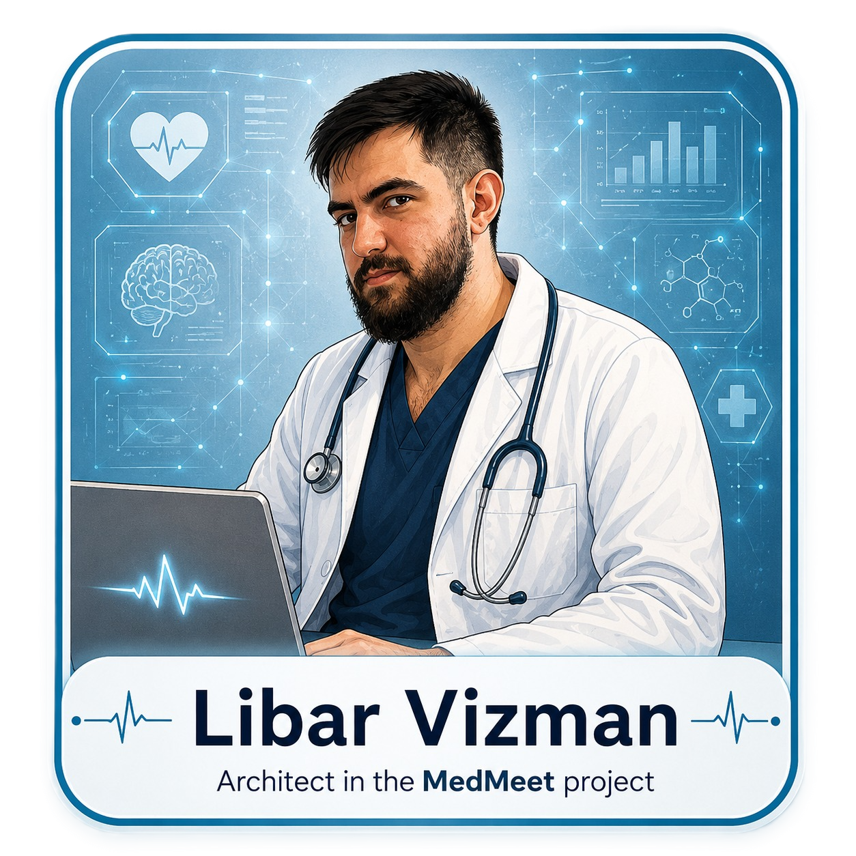

Meet the Team
The people behind MedMeet
Lidor Ben Simon
David Ran Cohen
Libar Vizman
Rotem Swisa
Product Owner
Scrum Master
Architect
Quality Owner
Defined the vision and priorities of MedMeet, ensuring every feature delivers real value to doctors and patients.
Kept the team aligned across 3 full sprints, turning every milestone into a step toward a better product.
Designed the VR/AR technical backbone, making complex medical interactions feel seamless and intuitive.
Ensured every feature met the highest standards so doctors and patients can trust every virtual session.

Slide 4
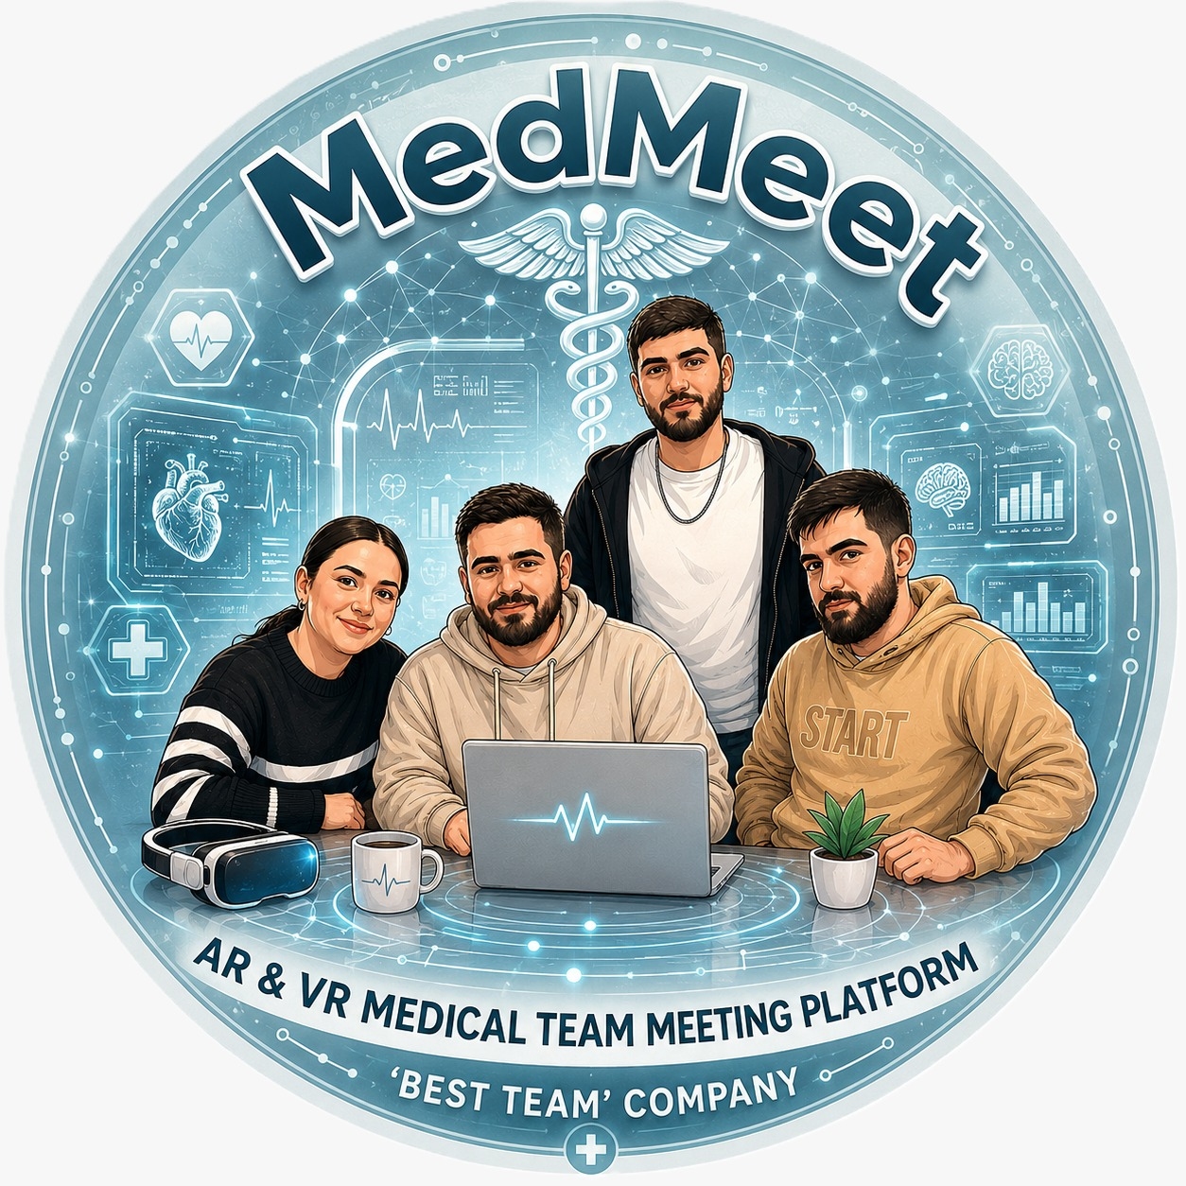
'Best Team' Company
AR & VR Medical Team Meeting Platform · Kinneret Academic College

Slide 5






Sprint 1 - Foundation
Oct–Dec 2025 · ~270 hours · MVP: Basic VR Medical Meeting
Goal: Present a basic VR medical meeting with avatars, voice communication, a shared 3D medical model and automatic session logging by Dec 10, 2025.
VR Meeting Room
Avatar System
Real-Time VoIP
Session Management
Full immersive virtual meeting room for up to 5 simultaneous participants on Meta Quest.
Every participant visually represented as a 3D avatar (male/female) visible to all others in the room.
Voice communication via Vivox/Photon - mute/unmute button, visual highlight of active speaker.
Join/leave meeting with username, live participant list, join/leave notifications in real time.
Shared 3D Model
Attendance Logging
Integration & QA
Technical Documentation
One medical model (heart/brain/lungs) loaded at room center - synchronized and visible to all participants.
Automatic logging of every join/leave event with timestamps, duration per participant, exported to CSV.
End-to-end testing: 4 concurrent users, stable VoIP for 10 min, avatar rendering, log export verified.
Architecture diagrams, user guide, demo script, and sprint retrospective prepared for presentation.

Slide 6




Sprint 2 - Advanced Features (Part 1 of 2)
Dec 2025–Jan 2026 · ~280 hours · MVP: AI + 3D Interaction + Collaboration
Goal: Present a fully interactive VR system with multi-room navigation, advanced 3D model tools, real-time collaboration, medical image sharing and AI transcription by Jan 21, 2026.
Multi-Room System
360° Model Interaction
Room selection at login screen with real-time status (available/full). Interactive doors between 3+ rooms with smooth transitions.
Rotate, zoom (pinch/thumbstick) and switch between 4+ medical models (heart, lungs, brain + more). Gallery selection panel synchronized across all users.
Laser Pointer & Annotations
Medical Image Display
Laser pointer for each user (unique color). Persistent paint markings on models. Shared text annotations with author name. Screenshot tool.
Upload PNG/JPG/X-Ray from PC or preloaded in VR. Shared gallery view with zoom/drag. Gallery mode to switch between images. All users see the same image.

Slide 7



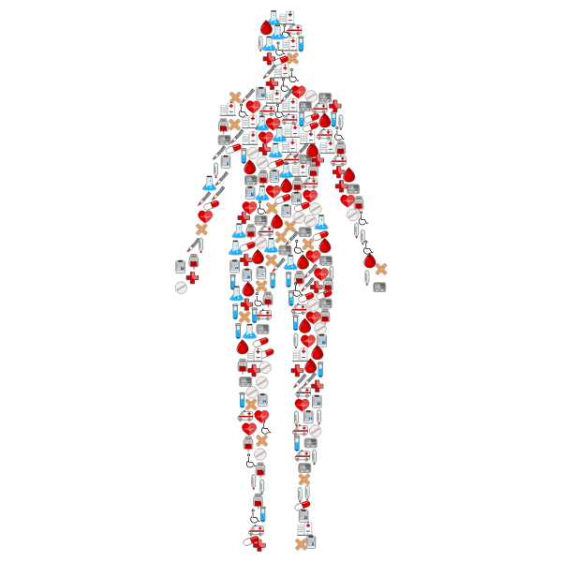


Sprint 2 - Advanced Features (Part 2 of 2)
Dec 2025–Jan 2026 · Continued from previous slide
AI Transcription
People Analytics
3D Session Recording
Session auto-transcribed using Whisper/Google/Azure API. Speaker diarization, real-time display, export to TXT/PDF. UI for managing transcription.
Voice detection to measure talk-time per participant. Participation percentage calculated and exported to extended CSV. Dashboard visualization.
Record all avatar movements, positions and audio in sync. Save as replay file, play back in Unity. Formats: position/rotation/actions.
Avatar Improvements
AR Mode (Stretch Goal)
Synchronization
Male/female avatar selection at login. Fixed avatar floating - now anchored to floor. Basic hand tracking (IK). Walk/stand animations. Lip-sync stretch goal.
Quest 3 Passthrough mode - overlay medical models on the real world. Switch AR↔VR with a button. Model anchor placement in real space.
All model interactions, annotations, images and avatar movements synchronized across all participants using Normcore in real time.

Slide 8
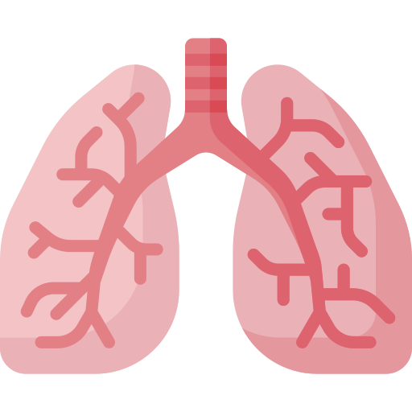
Sprint 3 - Innovation & Polish (Part 1 of 3)
Mar–Jun 2026 · ~280 hours · MVP: Accessibility + Medical Training + Simulations
Goal: Transform MedMeet into a comprehensive medical platform - training, accessibility, simulations, AI assistant, voice control, movement sync and full system polish by Jun 3, 2026.
Sign Language System
Training Room Navigation
Real-time sign language avatar (corner of screen, like a TV interpreter). Speech recognition maps spoken words to medical sign language animations. Supports Hebrew + English.
Lobby/menu screen with 3 training room options (Heart / Lungs / Brain). Teleportation to selected room. Back button to main menu. Smooth scene-switching animations.
Heart Surgery Room
Lung & Brain Surgery Rooms
3D heart model with step-by-step surgery animation tutorial. Forward/backward playback controls. Step-by-step UI guide panel. Optimized for VR rendering.
Dedicated rooms for lung and brain surgeries - each with 3D model, surgery step animations and tutorial UI. Step-by-step learning experience for medical students.

Slide 9


Sprint 3 - Innovation & Polish (Part 2 of 3)
Anatomy Explorer + Surgery Simulation + AI + Voice
Interactive Human Body
Surgery Simulation - Chest
Full human body model in VR. Click on any organ to highlight and display a 3D information panel with name, function and medical details. Grab and physically remove the organ from the body, examine it up close, then return it to its exact position.
Use a virtual scalpel to cut open a human chest step-by-step. Watch the chest open to reveal internal organs (heart, lungs, ribs). Interactive and realistic - designed for medical student training in a safe virtual environment.
AI Smart Assistant
Voice Commands
AI assistant panel in the meeting room. Ask medical questions by voice or text (Whisper + GPT/Grok API). Answers displayed on a scrollable screen with text-to-speech playback. Available to all participants during the session.
Hands-free control of the system using voice. Open/close menus, navigate to rooms (Main, Patients, Training) by saying commands. Supports Hebrew & English. Fallback message for unrecognized commands.

Slide 10




Sprint 3 - Innovation & Polish (Part 3 of 3)
Learning Center + Movement Sync + Social Impact + System Polish
Medical Learning Center
Basic Medical Simulations
Avatar Movement Sync
Dedicated learning room with multiple interactive knowledge panels. Browse medical articles, presentations and images in VR. Flip/scroll content with hand gestures. Links to medical sources and references.
Blood draw simulation: syringe, vein, step-by-step insertion logic. Throat exam simulation: tongue depressor, open mouth, step-by-step check. Visual feedback for correct/incorrect steps. Scoring system.
Full hand and gesture movement synchronized across all users (Normcore + IK). Head direction and walking movement synced in real time. IK rig for natural arm movement. Mirror in room to see your own avatar.
Social Impact Showcase
System Polish & Stability
Dedicated room displaying the platform's social contribution: CO₂ and travel savings, multilingual support (Hebrew/Arabic/English), sign language accessibility data, infographic dashboard and MedMeet vision wall.
Comprehensive bug fixing across all epics. Full integration testing. Performance optimization for all 3D models. Code review before every merge. All features stable and demo-ready for final presentation Jun 3, 2026.

Slide 11

MedMeet · Complete Feature Overview
Everything we built across 3 sprints
VR/AR Meeting Rooms
Sign Language
Interactive Anatomy
Surgery Simulation
Multi-room immersive consultations with avatars & spatial VoIP.
Real-time sign language avatar for deaf & hard-of-hearing users.
Click, remove & examine any organ on a full human body model.
Scalpel chest incision - explore internal organs in 3D VR.
Surgery Training Rooms
AI Transcription
AI Smart Assistant
Laser & Annotations
Step-by-step heart, lung & brain surgery tutorial rooms.
Auto-transcribe sessions with speaker diarization & PDF export.
Voice/text Q&A with GPT/Grok - instant medical answers in-session.
Laser pointer + paint markings on 3D models - shared in real time.
Medical Image Sharing
3D Session Recording
People Analytics
Social Impact
Upload & display X-rays, scans & images - synchronized gallery.
Record avatars & audio; replay the full session in Unity.
Talk-time tracking, participation % & CSV export per session.
CO₂ savings, accessibility metrics & sustainability showcase room.

Slide 12
Sprint Journey
1
2
3
4
Sprint 1
Sprint 2
Sprint 3
Sprint 4
Foundation
Advanced Features
Innovation & Polish
Simulation & closure
~270 hrs · Oct–Dec 2025
~280 hrs · Dec 2025–Jan 2026
~280 hrs · Mar–Jun 2026
2026 · Last sprint
VR meeting room · Avatars · VoIP voice · Session management · Shared 3D models · Attendance logging · Integration testing · Technical documentation
Multi-room system · 360° model interaction · Laser & annotations · Medical image sharing · AI transcription · People analytics · 3D recording · Avatar improvements · AR Mode
Sign language AI · Interactive human body · Chest surgery simulation · Surgery training rooms · Medical learning center · Procedure simulations · AI assistant · Voice commands · Movement sync · Social impact showcase · Full system polish
Surgery simulation: cutting the chest with a knife, the body opens and reveals the organs · Interactive human body: clicking on each organ displays its name and medical explanation - possible · Comprehensive UI improvement · Closing edges in all existing features

Slide 13
Thank You
Try MedMeet - Experience the Future of Healthcare
"Built by students - designed for the future of healthcare."
Lidor Ben Simon · David Ran Cohen · Libar Vizman · Rotem Swisa

