Slide 1

Vue.js and Typescript Introduction

Slide 2

Progressive
Single Page Application
Framework

Slide 3
Progressive
Single Page Application
Framework

Slide 4
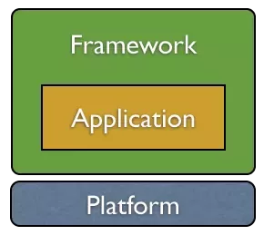
What is a Framework?

Slide 5
Progressive
Single Page Application
Framework

Slide 6
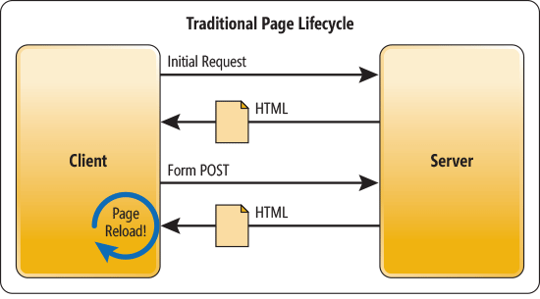
Click Button – Send Page – Page Reload
Imagesource: https://msdn.microsoft.com/en-gb/magazine/dn463786.aspx?f=255&MSPPError=-2147217396

Slide 7
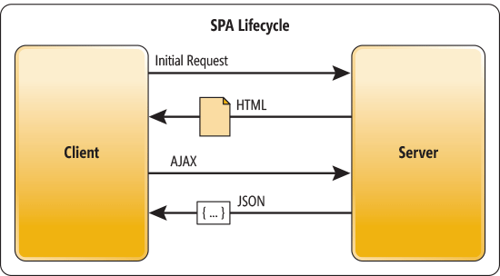
Click Button – Send Data – Rerender
Imagesource: https://msdn.microsoft.com/en-gb/magazine/dn463786.aspx?f=255&MSPPError=-2147217396

Slide 8

Server Side Rendered with Nuxt

Slide 9
Progressive
Single Page Application
Framework

Slide 10
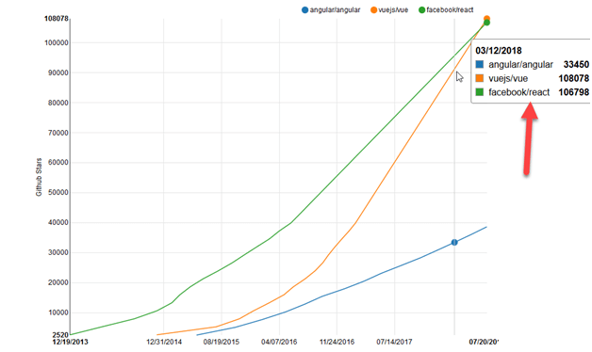
Developers love Vue.js

Slide 11
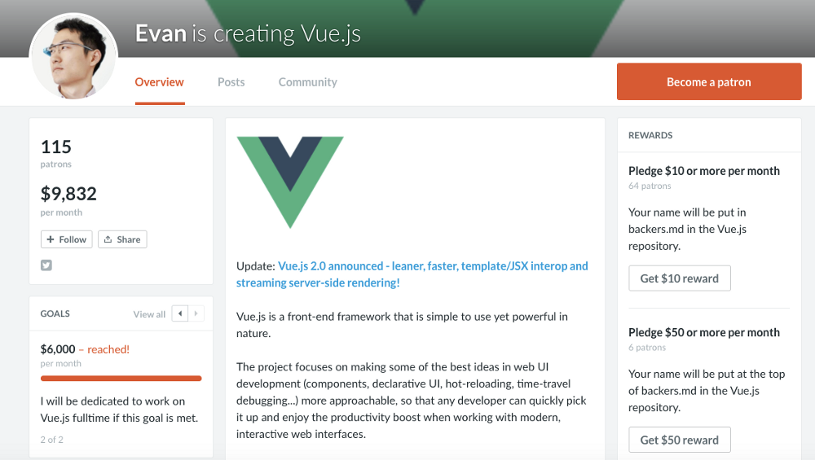
Vue is a community project
Independent from ‘big’ companies

Slide 12
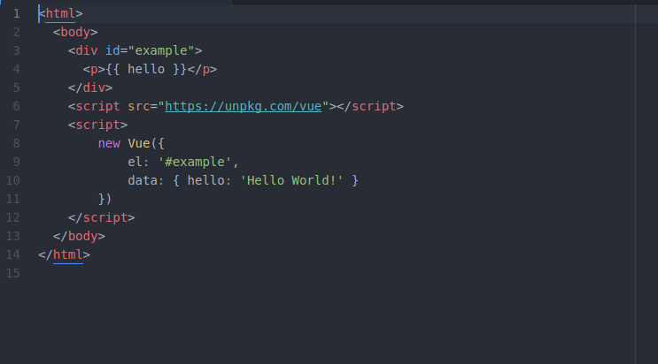
Let’s see some Code!

Slide 13
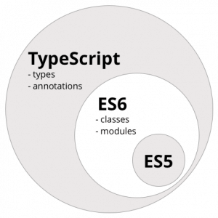
TypeScript is a superset of JavaScript

Slide 14
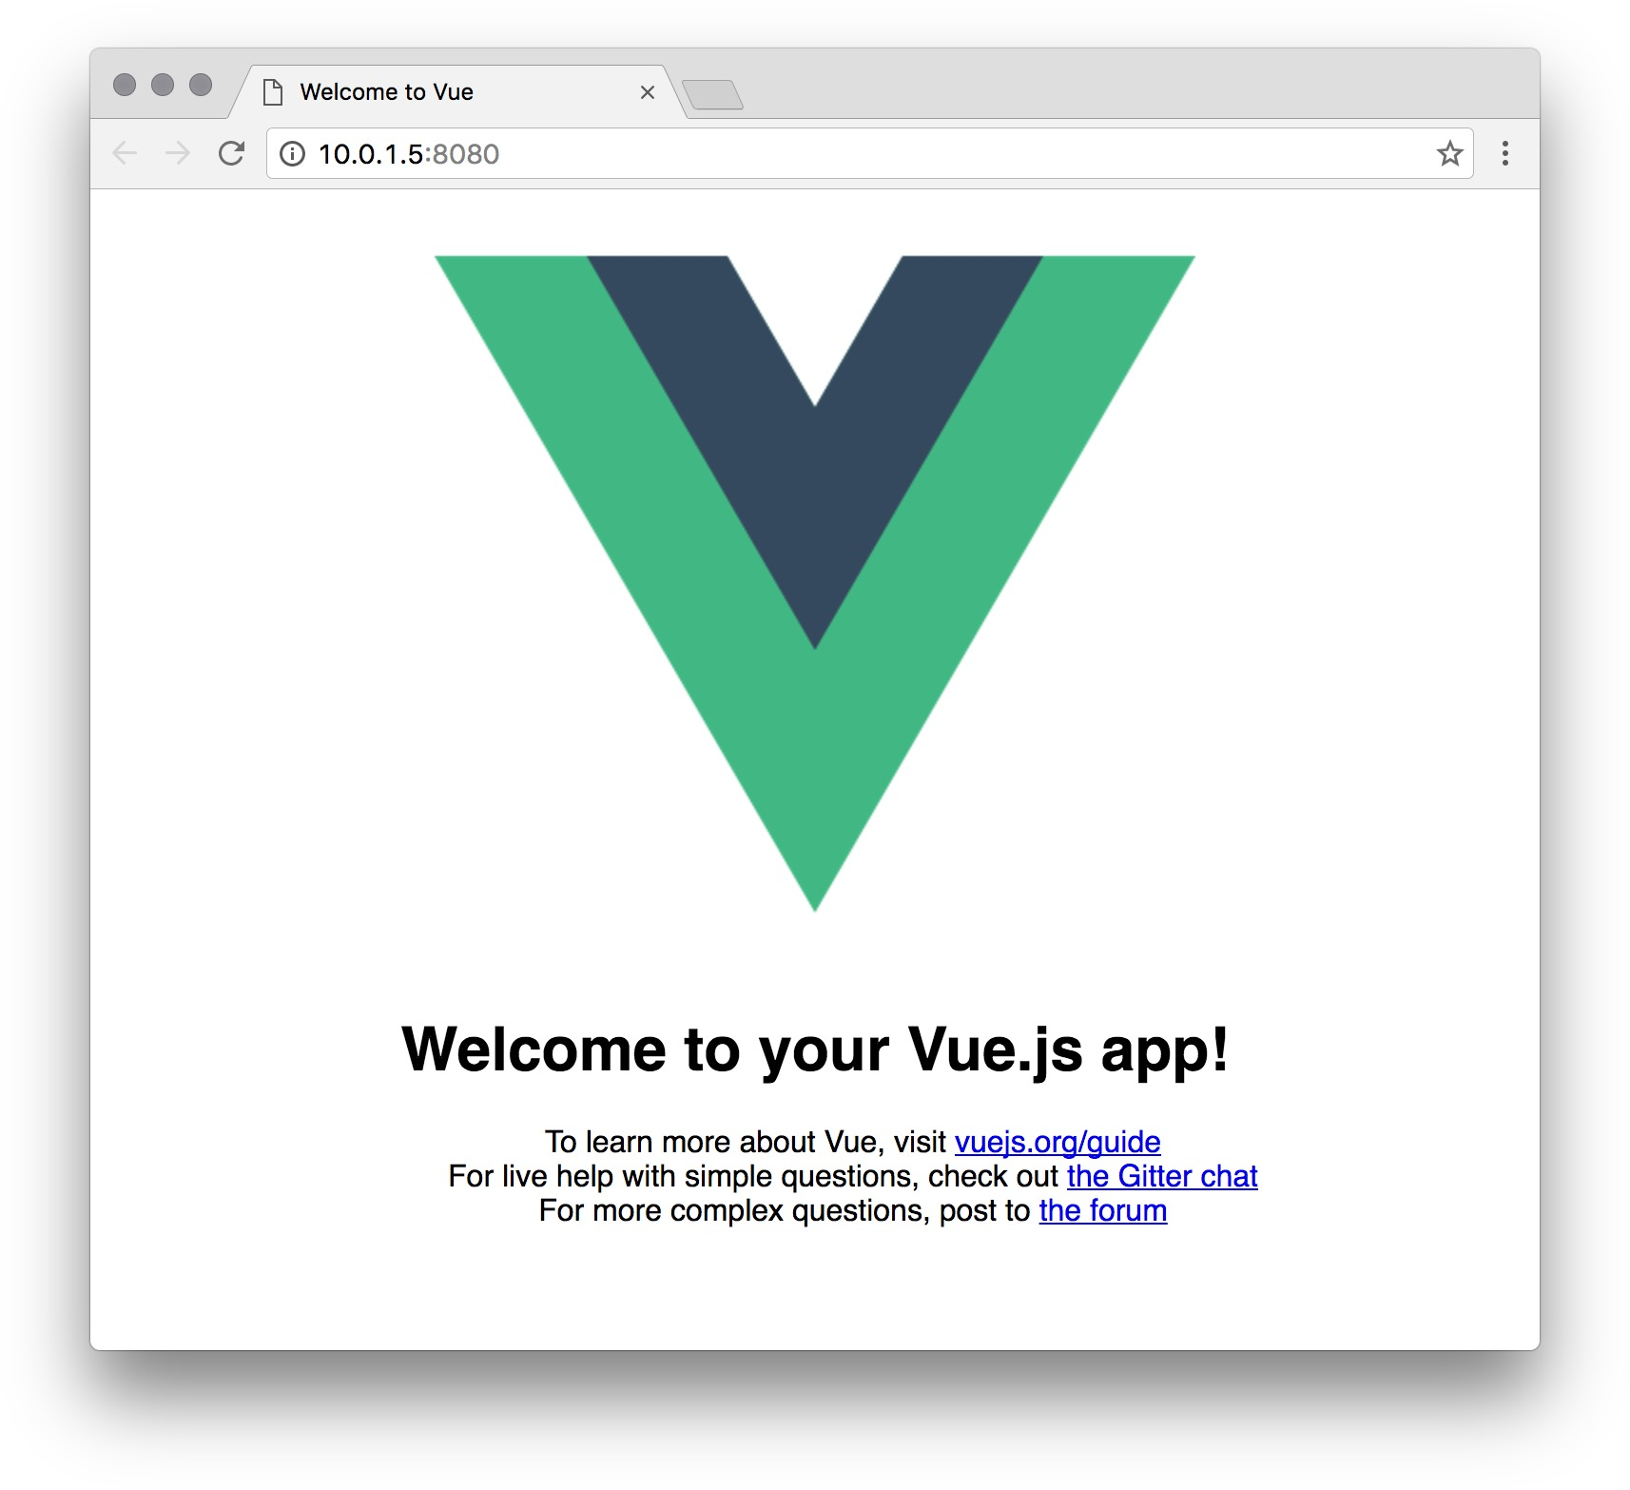
Let’s Livecode: The Watchlist App

