Slide 1
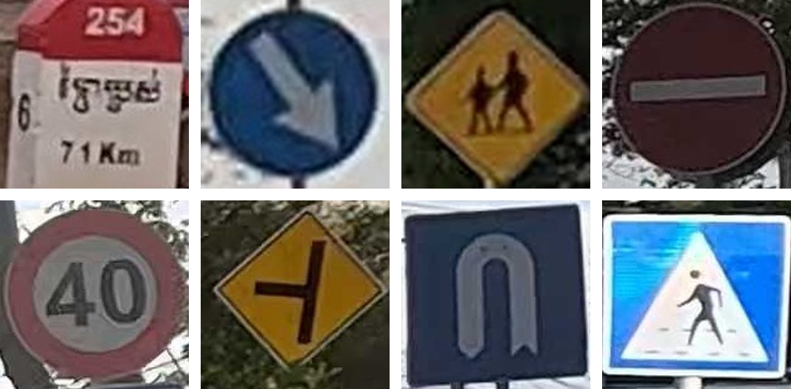
Road Sign Recognition
Using Deep Learning
Classifying 26 Cambodian traffic signs: a CNN trained from scratch vs. ResNet-18 transfer learning
Presenter: Tes Sothyroth
Student ID: 1702250028
Course: Deep Learning
Lecturer: Him Soklong
School: Kirirom Institute of Technology
Date: ____________
Real test-set crops, all classified correctly by the final model
98.70%
26
final test accuracy
sign classes
Notes:
Introduce yourself and the project: classifying cropped Cambodian traffic signs into 26 classes, comparing three deep-learning approaches on the same data. The final model is a fully fine-tuned ResNet-18 at 98.70% test accuracy.

Slide 2
Table of Contents
01
Problem, dataset & split
06
Why random splits can be optimistic
02
Three approaches & setup
07
Grouped evaluation by drive
03
Results & tuning
08
Cross Road vs. Priority Road
04
Why fine-tuning wins
09
Extension: YOLO detection
05
Error analysis
10
Demo, limitations & conclusion
Notes:
Quick overview of the talk structure.

Slide 3
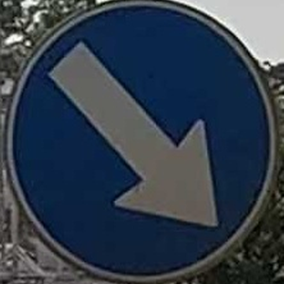
Problem & Motivation
Image classification: one cropped traffic sign in, one of 26 classes out
Task definition
Input: an RGB image of one traffic sign, cropped from a street photo and resized to 224 × 224
Output: one of 26 Cambodian sign classes
Problem type: supervised multi-class image classification
CNN classifier
Why it is interesting
Traffic-sign recognition supports driver assistance and road-safety systems
Cambodian signs include country-specific classes, e.g. kilometre posts with Khmer text
Several look-alike signs (left vs. right bend, speed limits) and a small, imbalanced dataset
Input crop
KEEP_RIGHT
Predicted class (1 of 26)
Notes:
Define the task precisely: input is a cropped sign image, output is one of 26 classes. Motivation: road safety, Cambodia-specific signs, and the challenge of look-alike classes and imbalance.

Slide 4
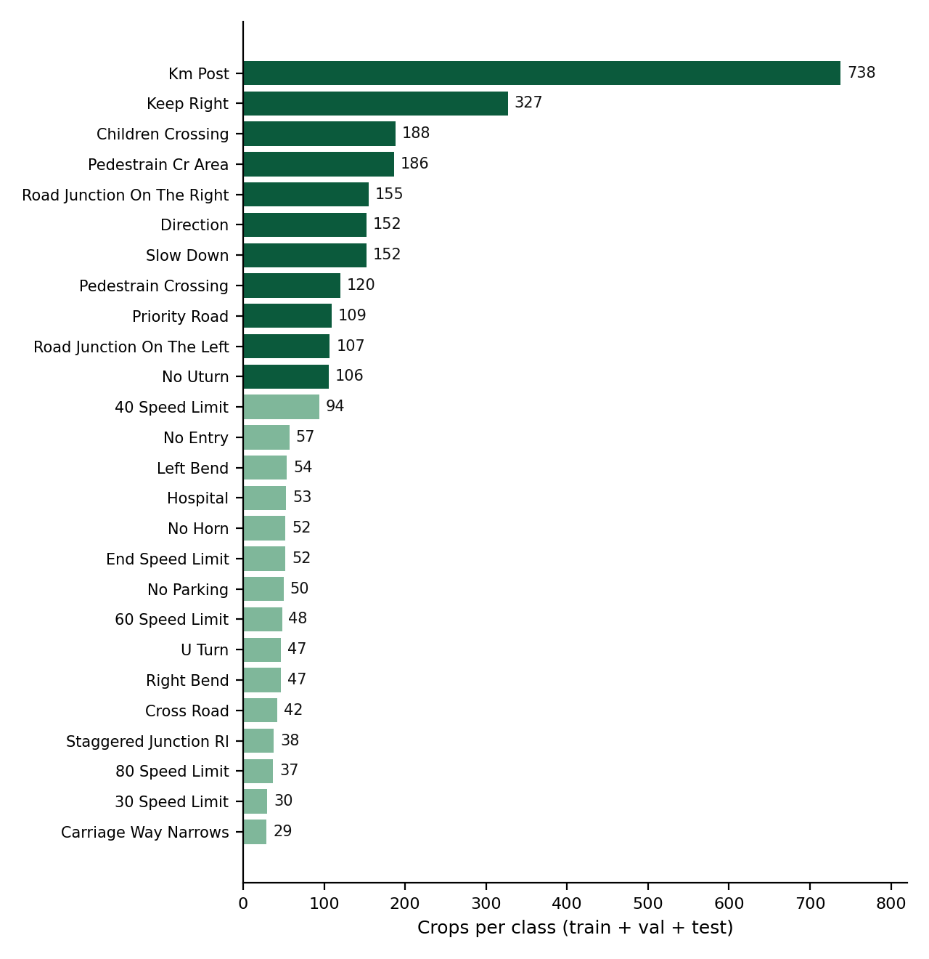
Dataset
Cambodia Traffic Signs Dataset (Kaggle, Sophal Ratitya) · License: Apache 2.0
2,766
3,490
3,070
street-scene photos
annotated signs
crops used (26 classes)
From raw annotations to classification crops
Bounding boxes cropped from each photo (VIA JSON annotations)
Only the 26 target classes kept; 117 UNDEFINED annotations excluded
Strong class imbalance: 738 crops (KM_POST) down to 29 (CARRIAGE_WAY_NARROWS)
Macro F1 is therefore reported next to accuracy
Notes:
Public Kaggle dataset under Apache 2.0. Explain the crop pipeline and the 117 excluded UNDEFINED annotations. Point out the imbalance: KM_POST has 738 crops, the rarest class only 29. That is why macro F1 matters.

Slide 5
Leak-Free Train / Validation / Test Split
Split by source photo before cropping, so no photo appears in two splits
Why it matters
Train: 2,153 crops · 1,766 photos
627 raw photos contain several signs. A random split of crops could put signs from the same photo (same light, camera, background) into both training and test data, which inflates test scores.
2,523 source photos
split 70 / 15 / 15, seed 42
Validation: 454 crops · 378 photos
Test: 463 crops · 379 photos
0
Fixed split saved as manifests (dataset/splits/*.csv) and used unchanged by every approach
Test set used once per model, only after the model was selected on validation data
photos shared between splits
Notes:
This is the key methodological choice. Because many photos contain several signs, I split by source photo, then cropped. Every approach uses the same committed manifests. Zero photo overlap, and the test set is only used once after selection.

Slide 6
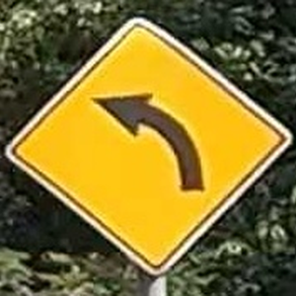
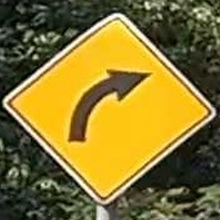
Preprocessing & Augmentation
Same test-time preprocessing for every approach
Training images
Validation & test images
Why no horizontal flip?
Resize to 224 × 224
Random rotation ±10°
Colour jitter (brightness 0.15, contrast 0.15, saturation 0.10)
ImageNet normalisation
Resize to 224 × 224
ImageNet normalisation
No randomness: identical for all three approaches
LEFT_BEND (real crop)
Flipped: looks like RIGHT_BEND
A mirrored sign can show a different class, so flipping would create wrongly labelled training images.
Notes:
Mild augmentation for training only. ImageNet normalisation because two approaches use ImageNet-pretrained weights. Explain the no-flip decision with the left-bend example: flipping changes the meaning.

Slide 7
Three Deep-Learning Approaches
Different architecture and different training strategy, compared on identical data
1
SmallCNN from scratch
2
ResNet-18, frozen backbone
3
ResNet-18, fully fine-tuned
3 conv blocks (32 / 64 / 128 filters) + BatchNorm, ReLU, max-pool
Global average pooling → FC 256 → dropout 0.5 → 26 classes
Random initialisation, no pretrained weights
ImageNet-pretrained ResNet-18 (IMAGENET1K_V1)
Backbone frozen, BatchNorm statistics kept fixed
Only the new Linear(512 → 26) layer is trained
Same ImageNet weights and new Linear(512 → 26)
Every layer is trained on the traffic signs
Later tuned: learning rate × weight decay
133,178
13,338
11,189,850
trainable parameters
trainable parameters
trainable parameters
increasing use of transfer learning
Notes:
Three distinct approaches, following the rubric example: from scratch, linear probe, full fine-tuning. Highlight trainable parameters: 133K, 13K, 11.2M. The frozen model keeps BatchNorm statistics fixed so the backbone is truly frozen.

Slide 8
Experimental Setup
One shared training protocol, so only the model changes
Optimiser
Adam, learning rate 1e-3, weight decay 1e-4
Evaluation metrics
Loss / batch
Cross-entropy, batch size 32
Accuracy
Macro precision, recall and F1 (every class counts equally)
Weighted F1
Confusion matrix and per-class F1
Trainable parameters and training time
Schedule
Up to 40 epochs; ReduceLROnPlateau (×0.5, patience 3)
Model selection
Early stopping (patience 10), best-validation checkpoint
Reproducibility
Seed 42 for Python, NumPy and PyTorch; deterministic cuDNN
Hardware
Google Colab, NVIDIA Tesla T4, PyTorch 2.11.0 (CUDA 13.0)
The test set is used once per model, after selection on validation data.
Notes:
Identical protocol for every approach, so the comparison is fair. Seeds fixed. Same metrics everywhere; macro F1 because of the imbalance. Test set touched once per model.

Slide 9
Results: Same 463-Image Test Set
All approaches evaluated once on the identical held-out test set
Approach | Test accuracy | Macro F1 | Trainable parameters | Training time
1. SmallCNN from scratch | 70.19% | 50.78% | 133,178 | 8.1 min
2. ResNet-18, frozen backbone | 92.44% | 88.37% | 13,338 | 5.5 min
3. ResNet-18, fine-tuned (untuned baseline) | 98.06% | 96.80% | 11,189,850 | 4.0 min
3. ResNet-18, fine-tuned + tuned (FINAL MODEL) | 98.70% | 98.47% | 11,189,850 | 5.5 min
457 / 463
+22.25 pp
+8.43 pp
test images correct (final model)
accuracy: scratch → frozen
macro F1: frozen → fine-tuned
Notes:
Read the table top to bottom: each step of transfer learning helps. Biggest jump is from scratch to frozen pretrained features. Fine-tuning mostly helps macro F1, i.e. rare classes. Final model: 98.70% accuracy, 98.47% macro F1, 457 of 463 correct. Training time is on one Tesla T4.

Slide 10
Hyperparameter Tuning (Approach 3)
2 × 2 grid: learning rate × weight decay, selected on validation data only
weight decay 1e-4
weight decay 1e-3
What happened
lr 1e-3
Config A
val acc 99.78%
(453 / 454)
val loss 0.0290
Config B ✓ selected
val acc 99.78%
(453 / 454)
val loss 0.0280
All four configurations tied at 99.78% validation accuracy (453 of 454)
Config B selected by the pre-defined tie-break: lowest validation loss at its best epoch (0.02796)
Test set evaluated once, after the choice: 98.06% → 98.70% (+0.65 pp = 3 more correct images)
Single run per configuration with one seed: the difference may be within run-to-run variation
lr 1e-4
Config C
val acc 99.78%
(453 / 454)
val loss 0.0330
Config D
val acc 99.78%
(453 / 454)
val loss 0.0324
Notes:
Be honest here: tuning did not separate the configurations on validation accuracy; all tied. B won the pre-defined tie-break on validation loss. On the untouched test set it was 3 images better than the baseline, which is small and from a single seed, so I do not claim it is reliably better.

Slide 11
Why Fine-Tuning ResNet-18 Performed Best
Explained with course concepts
1
Transfer learning
2
Adapting the features
ImageNet features (edges, shapes, colours) cannot be learned well from 2,153 images. Frozen features alone lift accuracy from 70.19% to 92.44%.
A frozen backbone only re-weights fixed features. Fine-tuning adapts every layer to Cambodian signs, which mostly helps rare and similar classes: macro F1 88.37% → 96.80%.
3
Capacity vs. data
4
Regularisation
SmallCNN underfits (limited capacity, trained from scratch). The 11.2M-parameter ResNet starts from good weights, so it fits without memorising.
Pretrained initialisation, augmentation, weight decay, early stopping and the best-validation checkpoint keep overfitting mild.
Notes:
Tie the result to course concepts: transfer learning, feature adaptation, capacity versus data size, and regularisation.

Slide 12
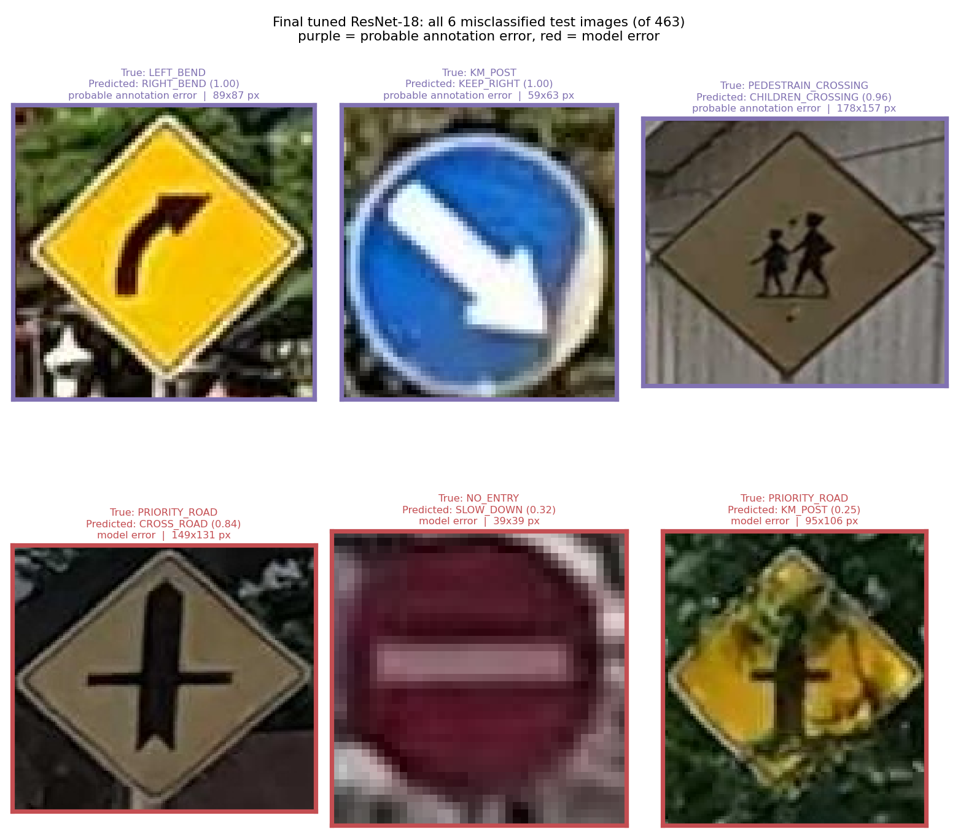
Error Analysis: Final Model
All 6 misclassified test images (of 463)
457 / 463
16 / 26
test images correct
classes with perfect F1
3 probable annotation errors (purple)
These examples appear to be annotation errors based on visual inspection and comparison with the original dataset annotations: the model predicted the sign that is visible. Metrics are not adjusted.
3 model errors (red)
Priority road → cross road: visually similar symbols (confidence 0.84)
Tiny, blurred no-entry sign: 39 × 39 px (confidence 0.32)
Priority road covered by branches (confidence 0.25)
Notes:
Only 6 errors, no confusion repeated. Three look like dataset annotation errors: a right bend labelled left bend, a keep-right sign labelled KM post, and a children-crossing sign labelled pedestrian crossing. I only inspected these 6, so I make no claim about the rest of the dataset. The genuine errors are small, occluded or similar-looking signs, mostly with low confidence.

Slide 13
Why Random Photo Splits Can Be Optimistic
Most photos are video frames: the same sign can appear in training and test a moment apart
Original split (photo-level, seed 42)
Grouped evaluation by drive
20 drive clusters from file names + near-identical frames (no EXIF data)
5 folds of whole clusters; every cluster is a test fold exactly once
Same final configuration, 3 seeds (42, 43, 44): 15 runs, no tuning
84 / 463
test crops (18.1%) with a same-class training frame from the same video ≤ 2 s away
Accuracy on those 84: 98.81%; on the other 379: 98.68%
So they do not explain the 98.70%, but the test set is not fully independent of training
Near-duplicate ≠ proof of memorisation
Test
fold k
Validation
fold k+1
Train
other 3 folds
Validation fold: best epoch and early stopping only. Test fold: evaluated once per run. All 26 classes appear in every training, validation and test split.
Notes:
Most photos are frames of GoPro videos. Splitting by photo does not separate neighbouring frames: 84 of 463 test crops, 18 percent, have a same-class training frame from the same video at most 2 seconds away. They are not why the score is high, accuracy is about the same with or without them, but the test set is not fully independent. So I re-evaluated the final configuration by drive: 20 drive clusters, 5 folds, each fold is the test set once, the next fold is used only for early stopping, and 3 seeds, so 15 runs, without any new tuning.

Slide 14
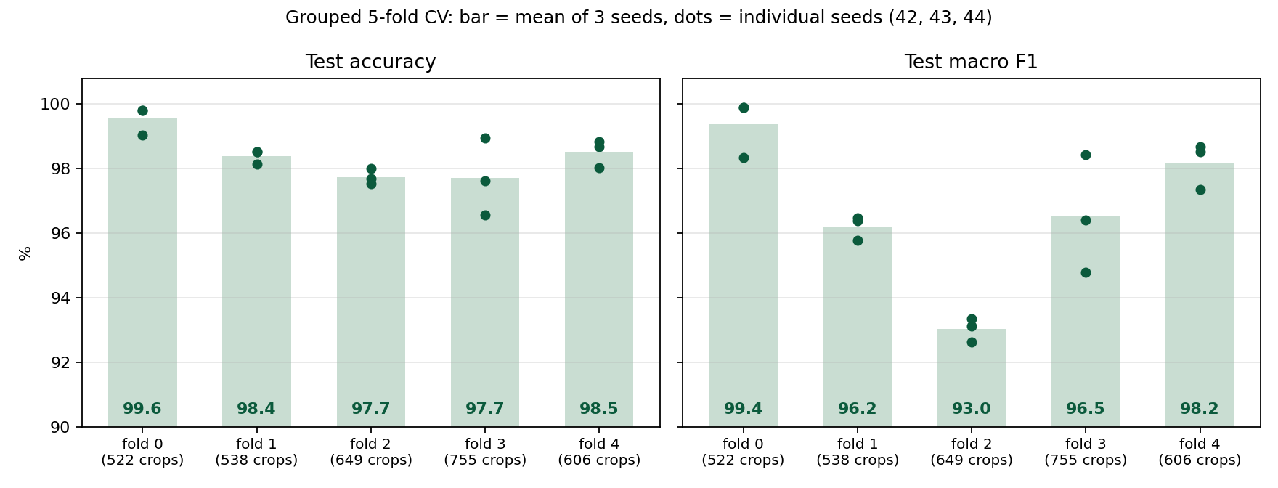
Grouped Evaluation Results
Pooled over all 3,070 crops, each tested on a drive its model never saw (mean ± std over 3 seeds)
98.31% ± 0.20
97.24% ± 0.68
97.92% ± 0.19
96.87% ± 0.89
accuracy
macro F1
macro precision
macro recall
Accuracy per fold: 97.7% – 99.6%
Macro F1 drops to 93.0% on fold 2: some classes are much harder on some drives
15 runs: 55 min in total on an RTX 4060
Different protocol from the 98.70% (one model, one random-photo test set): not a before/after comparison.
Notes:
Pooled over all folds, the configuration reaches 98.31 percent accuracy, plus or minus 0.2 over seeds, and 97.24 percent macro F1. The chart shows that drives differ: accuracy stays between about 97.7 and 99.6 percent, but macro F1 falls to 93 percent on fold 2. Important: this is not a before-and-after comparison with 98.70. That number is one model on one random-photo test set; this is 15 models tested on whole unseen drives, which is the more trustworthy estimate for new drives on these roads.

Slide 15
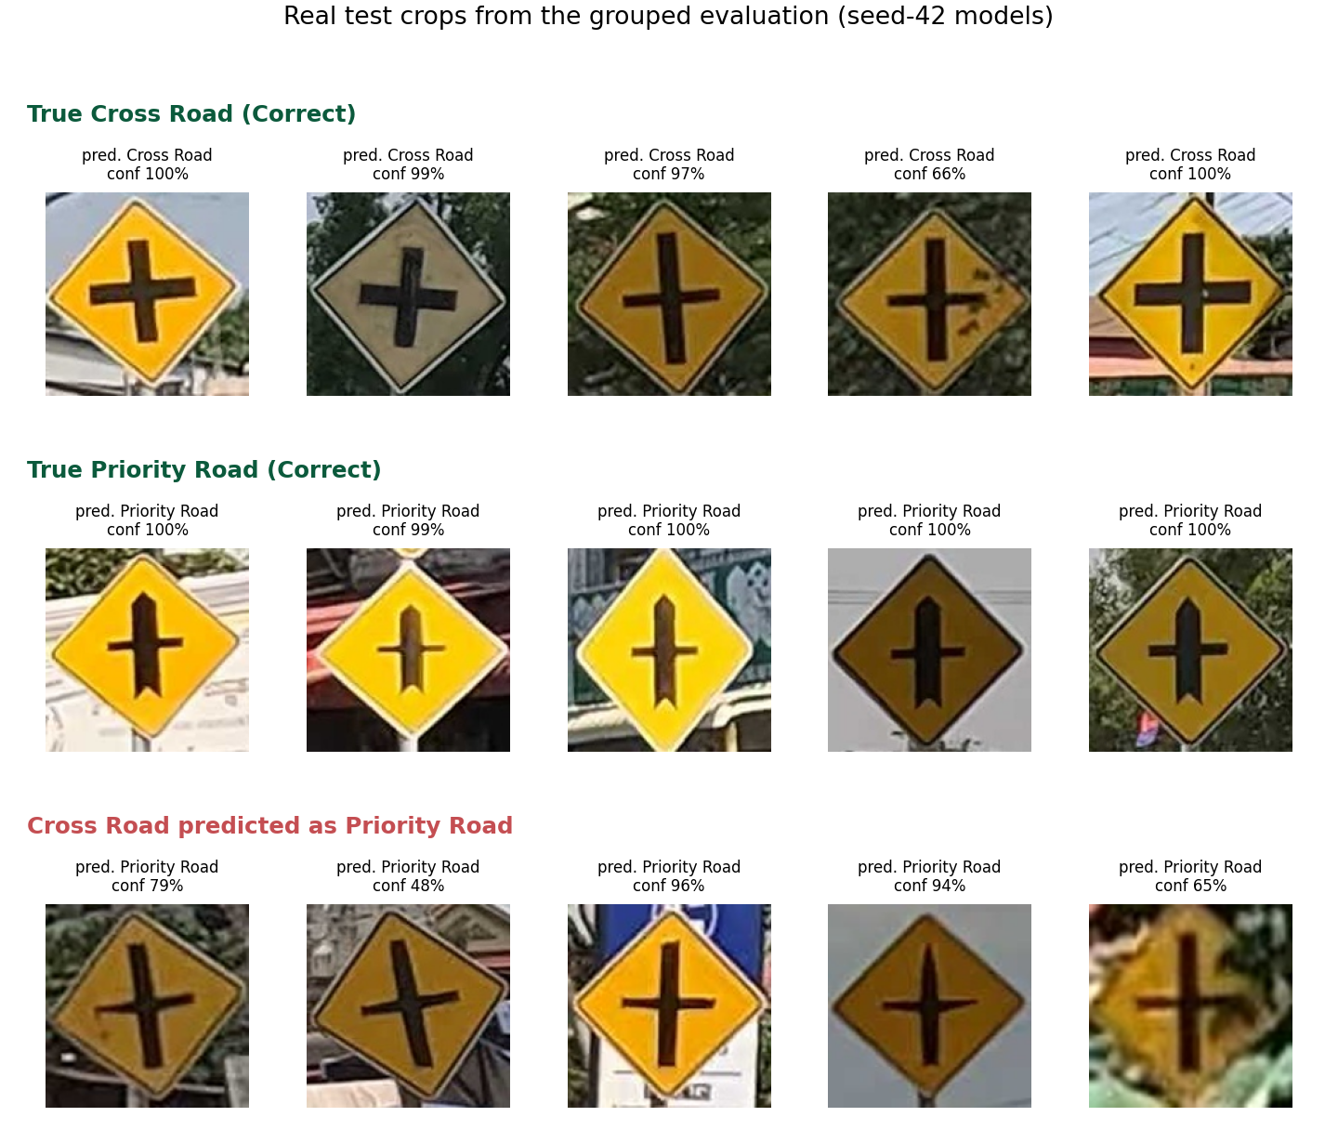
Hardest Case: Cross Road vs. Priority Road
Grouped evaluation, pooled over all folds and seeds
0.81
25
Cross Road F1 (recall 72%, only 42 crops)
Cross Road → Priority Road (summed over 3 seeds)
Both are yellow diamonds with a black cross
Priority Road: thick bar with a pointed top, thinner crossbar
Tilted or blurred Cross Road signs are read as Priority Road
Other confusions: Priority Road → Pedestrian Crossing (10), Cross Road → Junction Right (9)
Some errors look like the Priority Road symbol: possible label noise, not verified
Notes:
The weakest class is Cross Road, F1 0.81 with recall 72 percent, and it has only 42 crops. It is mostly confused with Priority Road: both are yellow diamonds with a black cross, but Priority Road has a thicker, pointed vertical bar. Tilted or blurry Cross Road signs get read as Priority Road. A few errors actually look like Priority Road, so label noise may play a role, but I did not verify that.

Slide 16
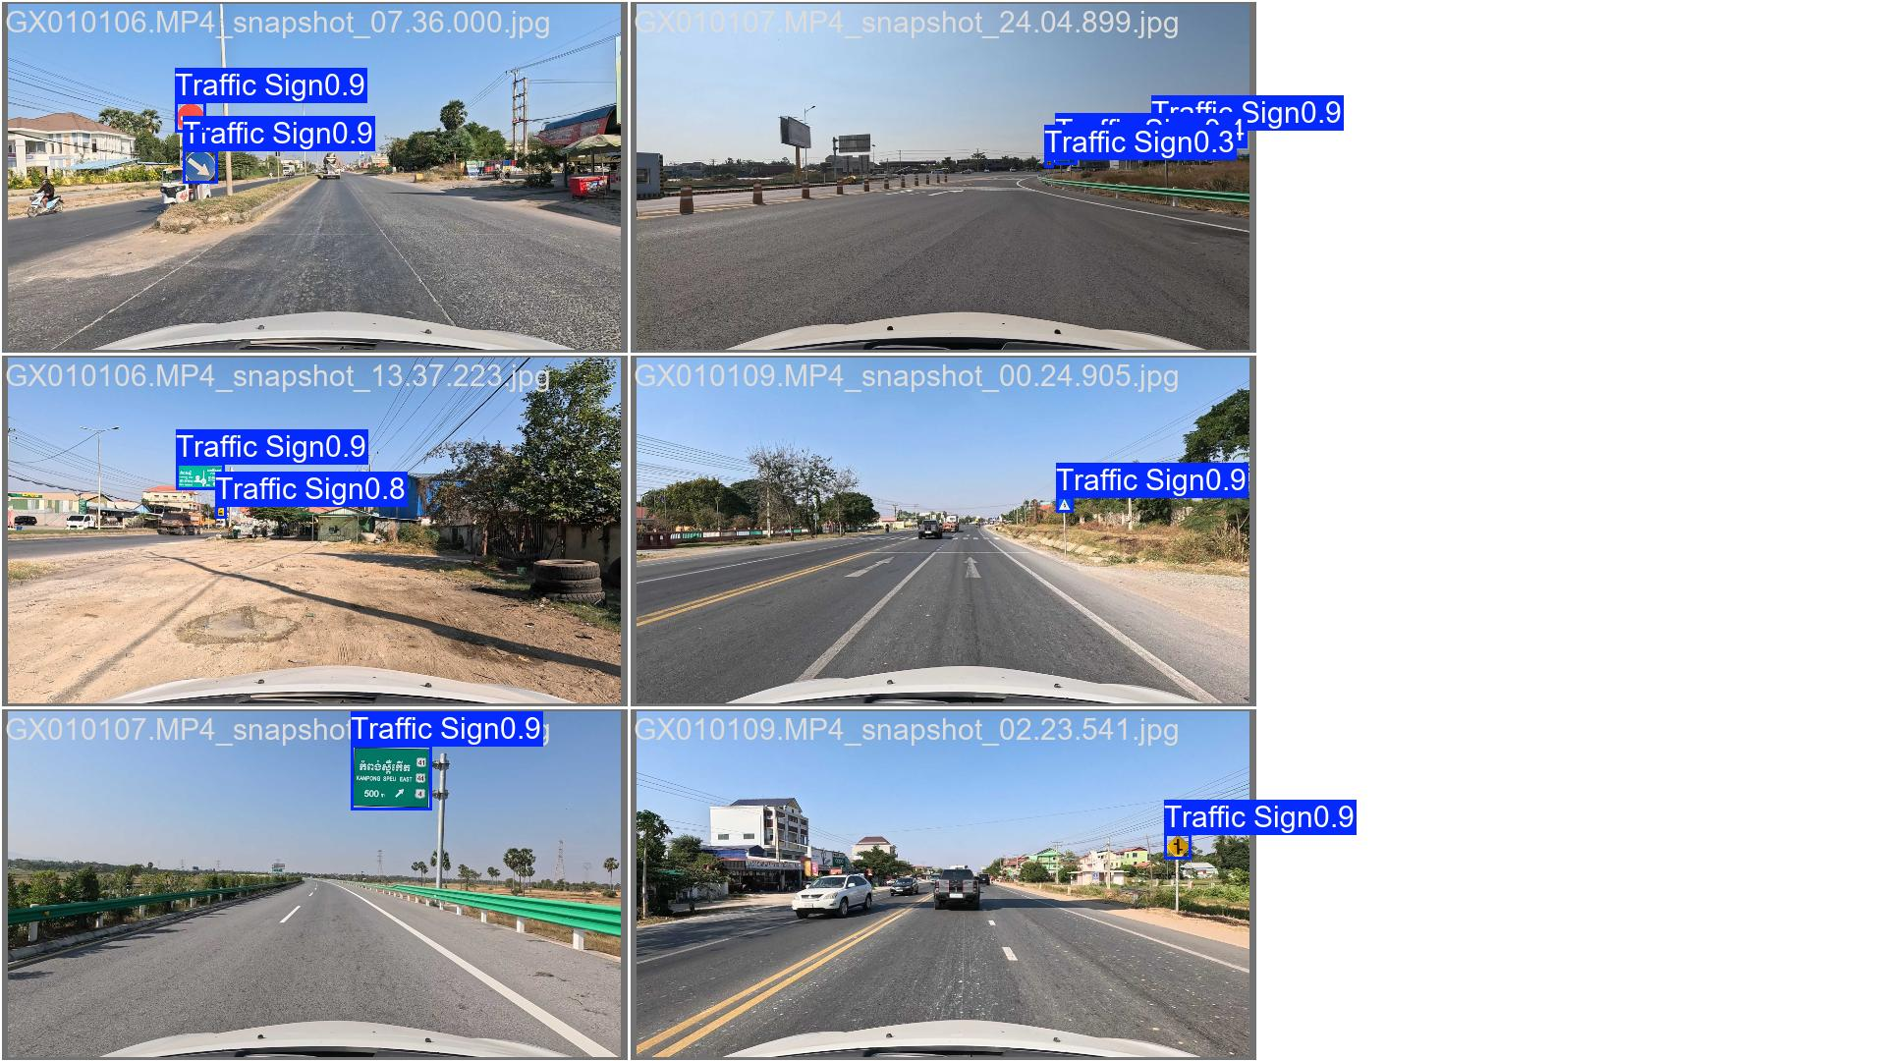
Extension: Detecting All Signs in a Street Photo
Separate YOLOv8 detector + the same ResNet-18 classifier: detection results, not classification accuracy
Street photo
full 4K image
YOLOv8 detector
1 class: "Traffic Sign"
Crop each box
full resolution
ResNet-18
1 of 26 classes
95.6% / 96.3%
0.978
detector precision / recall (379 test photos, 493 signs)
detector mAP@50
445 / 463
Same photo split as the classifier; trained 74 min on an RTX 4060
Missed: small, blurred or hidden signs; 5 Direction boards
Extra boxes: mostly real but unannotated signs (visual check)
Signs outside the 26 classes still get the closest label
test signs found AND correctly classified (96.1%)
Detector predictions on test photos (Ultralytics evaluation plot)
Notes:
The classifier needs a tight crop. To handle full street photos I added a separate YOLOv8 detector with one class, traffic sign, trained on the dataset's box labels with the same photo split. On the 379 test photos it reaches 95.6 percent precision and 96.3 percent recall. The full pipeline finds and correctly names 445 of the 463 test signs, 96.1 percent. These are detection results, a different task from the classification accuracy. Most extra boxes are real signs the dataset did not annotate, so precision is probably underestimated.

Slide 17
Demo
Classifying a traffic-sign image with the trained final model
Input image
a cropped traffic-sign photo
Final model
ResNet-18 fine-tuned + tuned (best checkpoint)
Prediction
class name + confidence
[Demo format to be finalised: e.g. live notebook cell or web app, with screenshots of real predictions added here]
Notes:
Placeholder: replace with the final demo (live run or screenshots of real predictions with confidence).

Slide 18
Limitations & Future Work
Honest scope of the study and what to do next
Limitations
Future work
Approach comparison and tuning: one split, seed 42 (grouped re-evaluation covers the final configuration only)
Original split: 18.1% of test crops are near-duplicate video frames of training crops
Grouped evaluation is independent by drive, not by location: the same physical sign can appear on another trip (197 strong matches)
Only 20 drive clusters; rare classes have few crops (Cross Road 42, F1 0.81)
Classifier knows only 26 classes; detector is a single run on the original split
Some label noise in the dataset (misclassified images, unannotated signs)
Split by location (GPS or a sign map), not only by drive
Grouped evaluation also for the approach comparison and the detector
More Cross Road and rare-class data; review annotations with the dataset author
Add the unannotated signs and more Direction boards to the detector labels
Handle signs outside the 26 classes (an "other sign" class)
Robustness on small, blurred, occluded signs; other architectures
Notes:
Main limitations: the approach comparison and tuning are still single-split, single-seed. The original split contains near-duplicate video frames. The grouped evaluation separates drives but cannot guarantee separate locations, because the same roads were driven more than once. Few drive clusters and very few Cross Road images. Each future-work item answers one of these limitations.

Slide 19
Conclusion
Key engineering takeaways
98.70%
98.31%
+22.25 pp
final model on the original random-photo test set (98.47% macro F1)
± 0.20: same configuration, grouped by drive, 15 runs (97.24% macro F1); a different protocol
accuracy gained from transfer learning alone (scratch → frozen)
Transfer learning matters most on a small dataset; full fine-tuning adds the most on rare and similar classes
Grouping by drive confirms about 98% accuracy on unseen drives, but shows variation between drives and a Cross Road weakness
Extension: with a YOLO detector, 96.1% of test signs in full street photos are found and correctly classified
Notes:
Three takeaways: transfer learning is the biggest factor; the result holds up at about 98 percent when tested on whole unseen drives, with honest caveats about locations and the Cross Road class; and the detector extension makes the system work on full street photos. Fine-tuned ResNet-18 is the best approach.

Slide 20
Thank you
Questions & answers
Code, results and README
github.com/RothRothRoth/DeepLearning_CNN
Notes:
Thank the audience and invite questions. Backup slides follow.

Slide 21
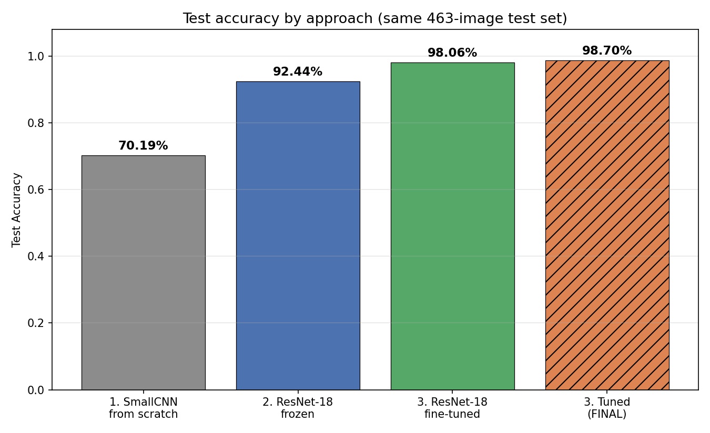
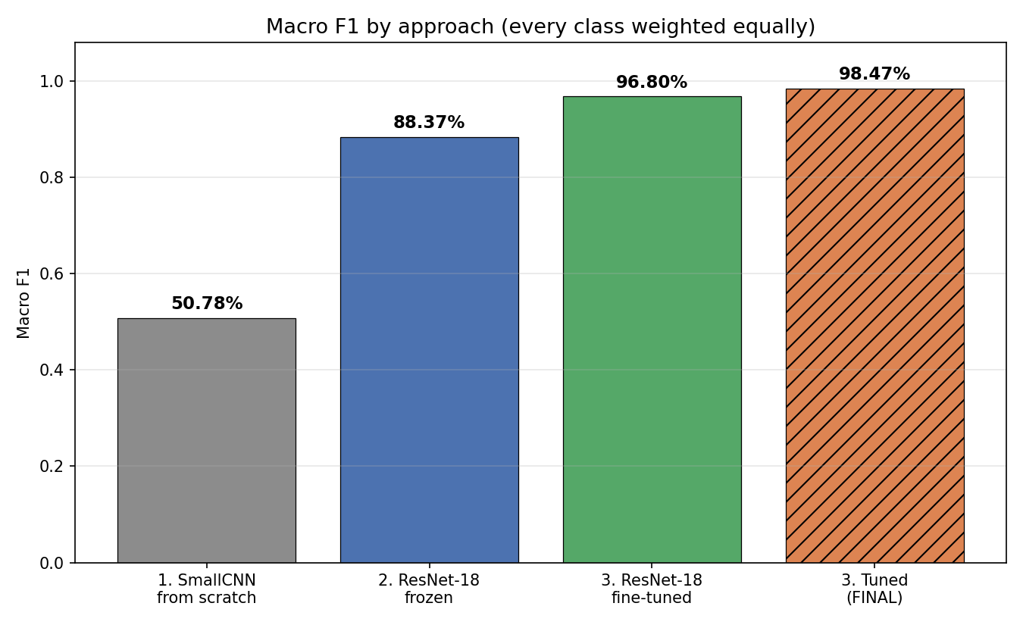
Backup: Comparison Figures
Final model highlighted in orange
Macro F1 shows the gap more clearly than accuracy: SmallCNN reaches 70.19% accuracy but only 50.78% macro F1, because it fails on rare classes.
Notes:
Accuracy and macro F1 side by side. Point out that SmallCNN's macro F1 is much lower than its accuracy: it does well on big classes like KM_POST but poorly on rare ones.

Slide 22
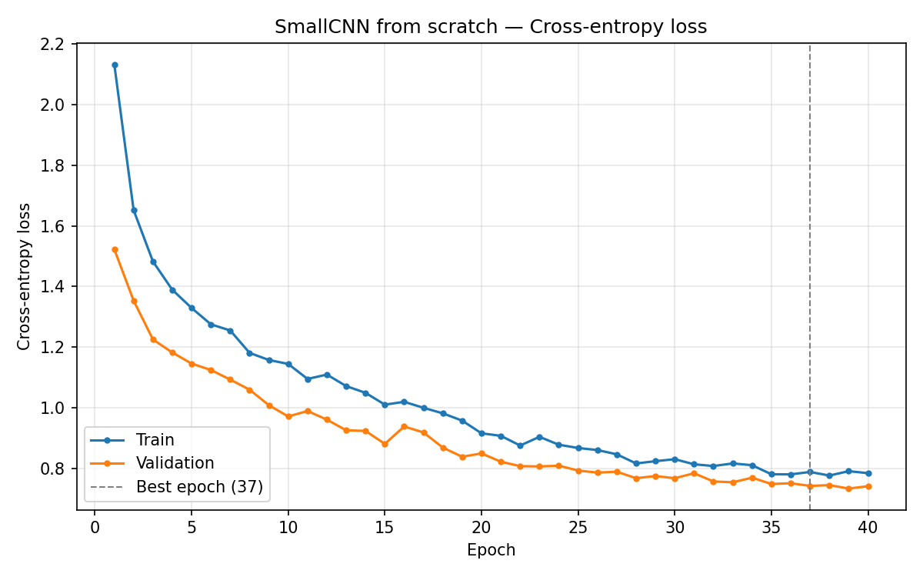
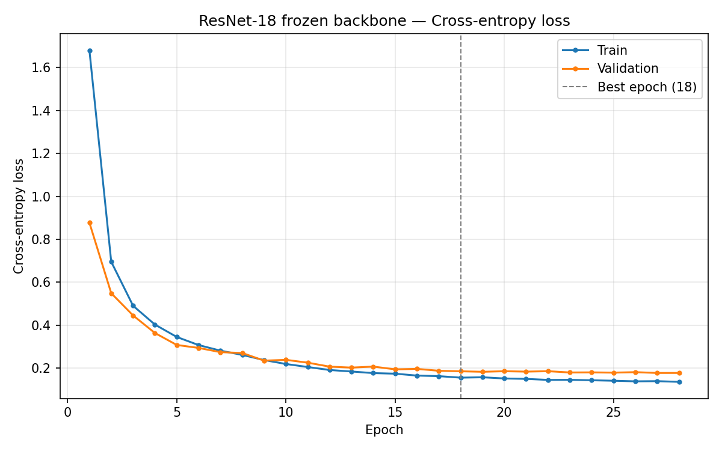
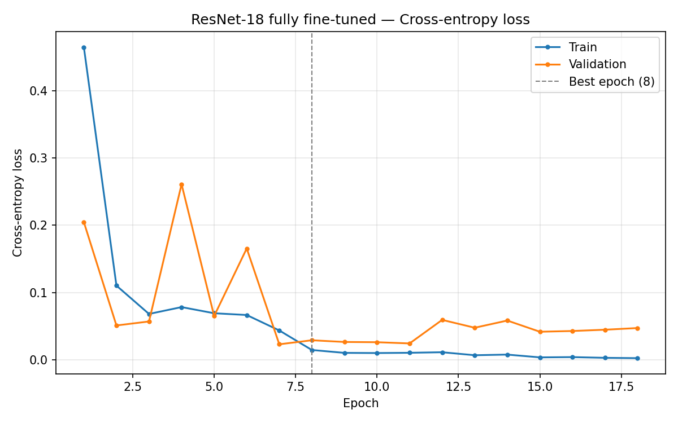
Backup: Learning Curves: Training vs. Validation Loss
Signs of underfitting and overfitting for each approach
SmallCNN: underfitting
Frozen: good fit
Fine-tuned: mild overfitting in the loss
Train ≈ 73%, val ≈ 74–75% accuracy; still improving at epoch 40 (best 37)
Train ≈ 97% vs. val 95–96%; gap grows from +0.8 to +2.3 pp
Train loss → 0.002; val loss rises from 0.023 to 0.042–0.059; best checkpoint kept (epoch 8)
Notes:
SmallCNN underfits: it has not even fitted the training data, so capacity and data are the limit. Frozen fits well with a small growing gap. Fine-tuned fits training data almost perfectly; validation loss rises after epoch 7, a mild overfit in confidence, contained by early stopping and keeping the best checkpoint.

Slide 23
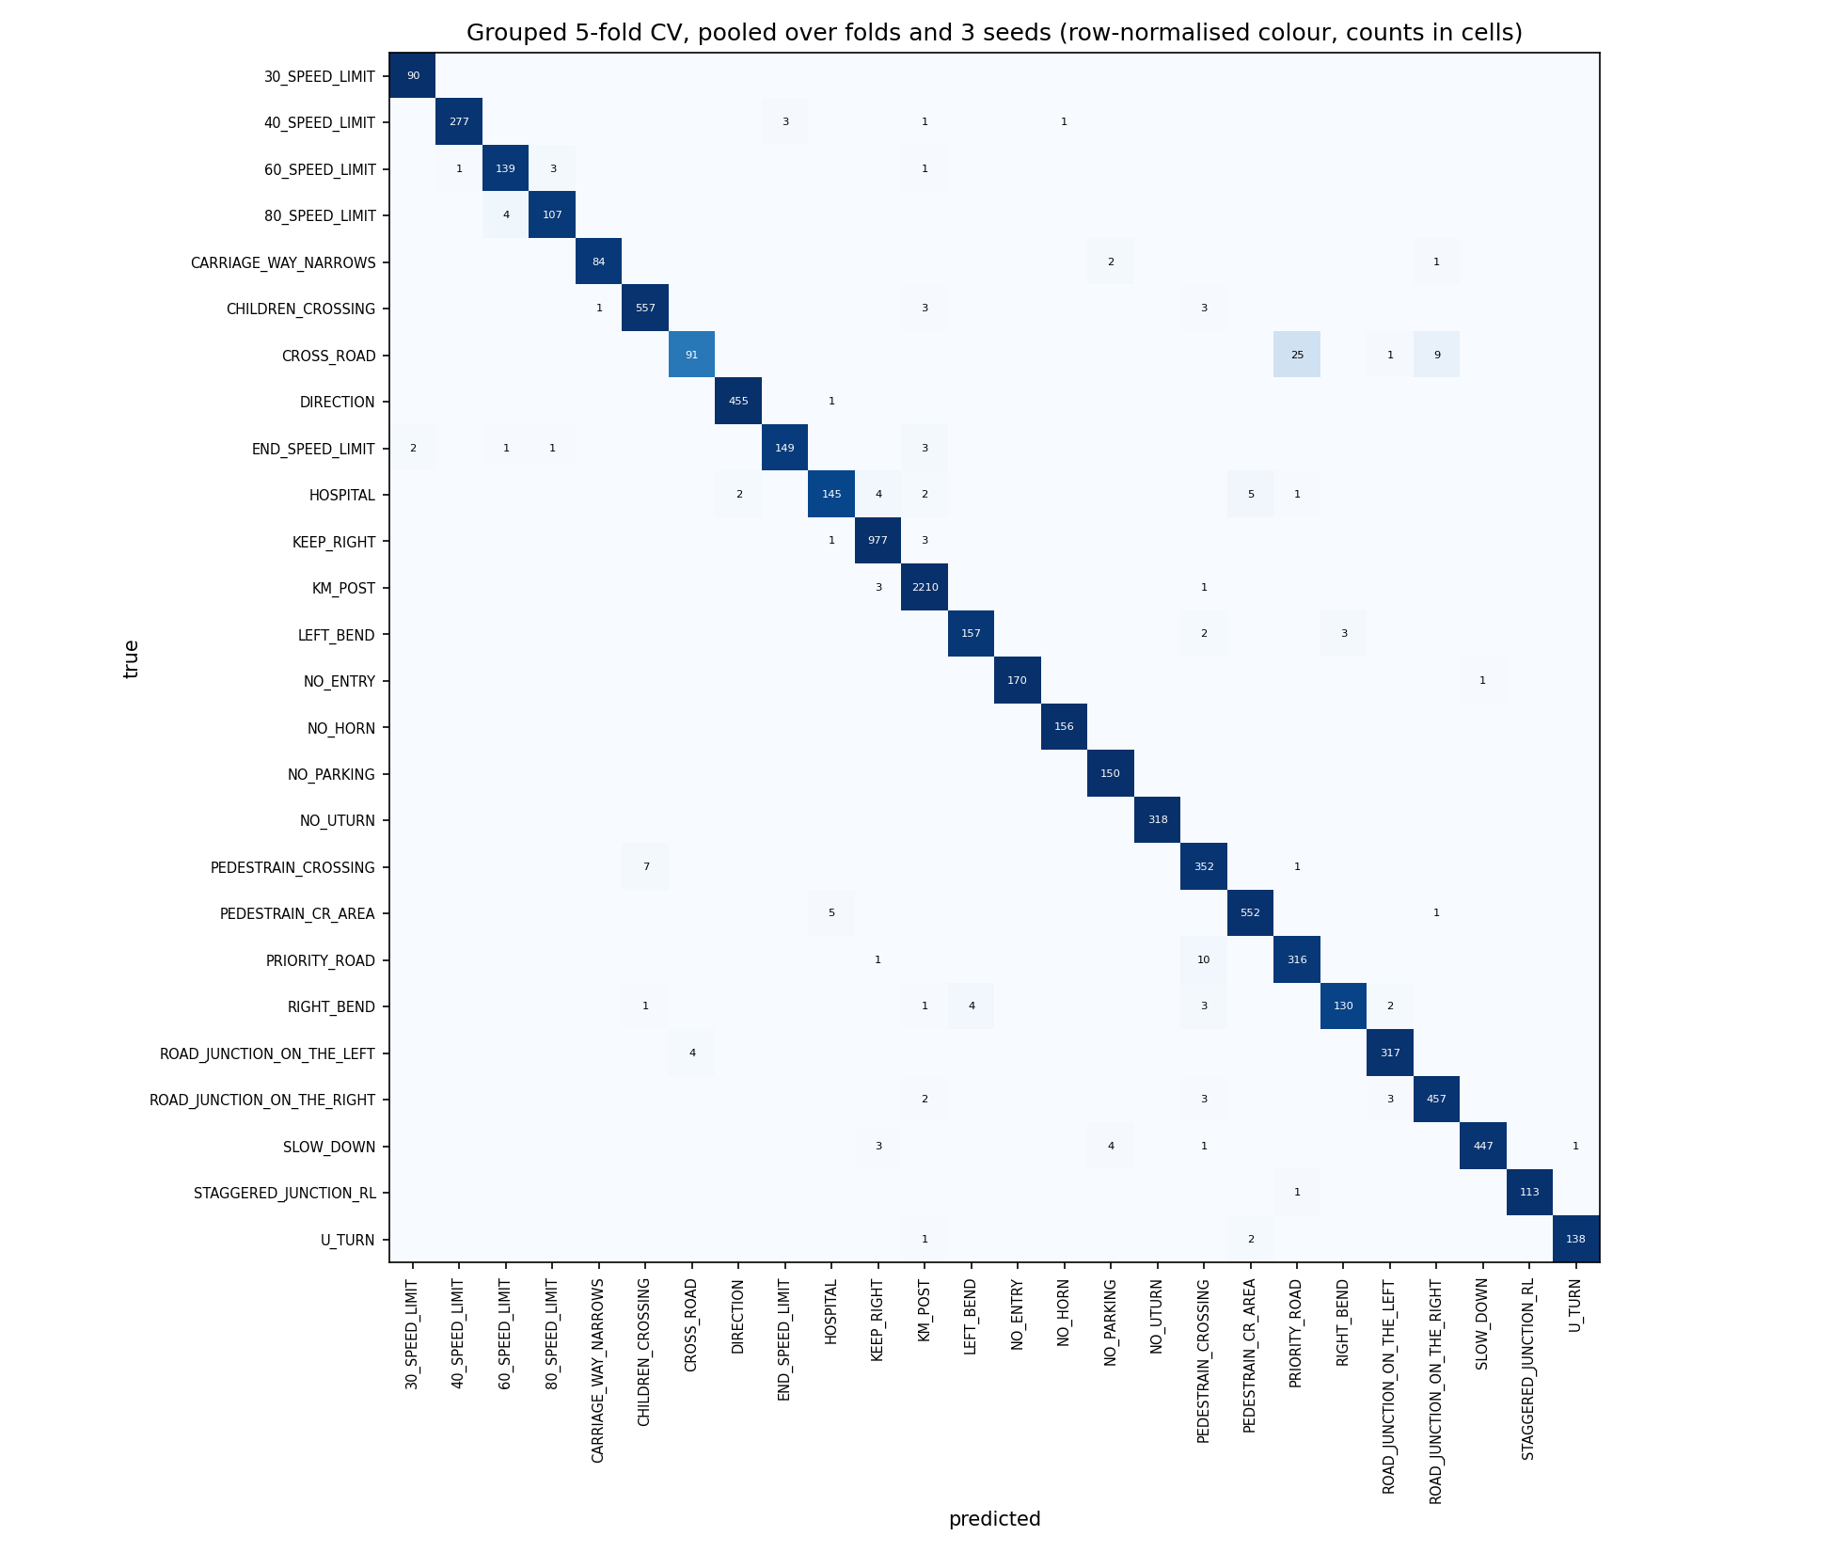
Backup: Grouped Evaluation Confusion Matrix
Pooled over 5 folds and 3 seeds (row-normalised colour, counts in cells)
Notes:
Backup for Q&A: all confusions of the grouped evaluation, summed over the three seeds.

Slide 24
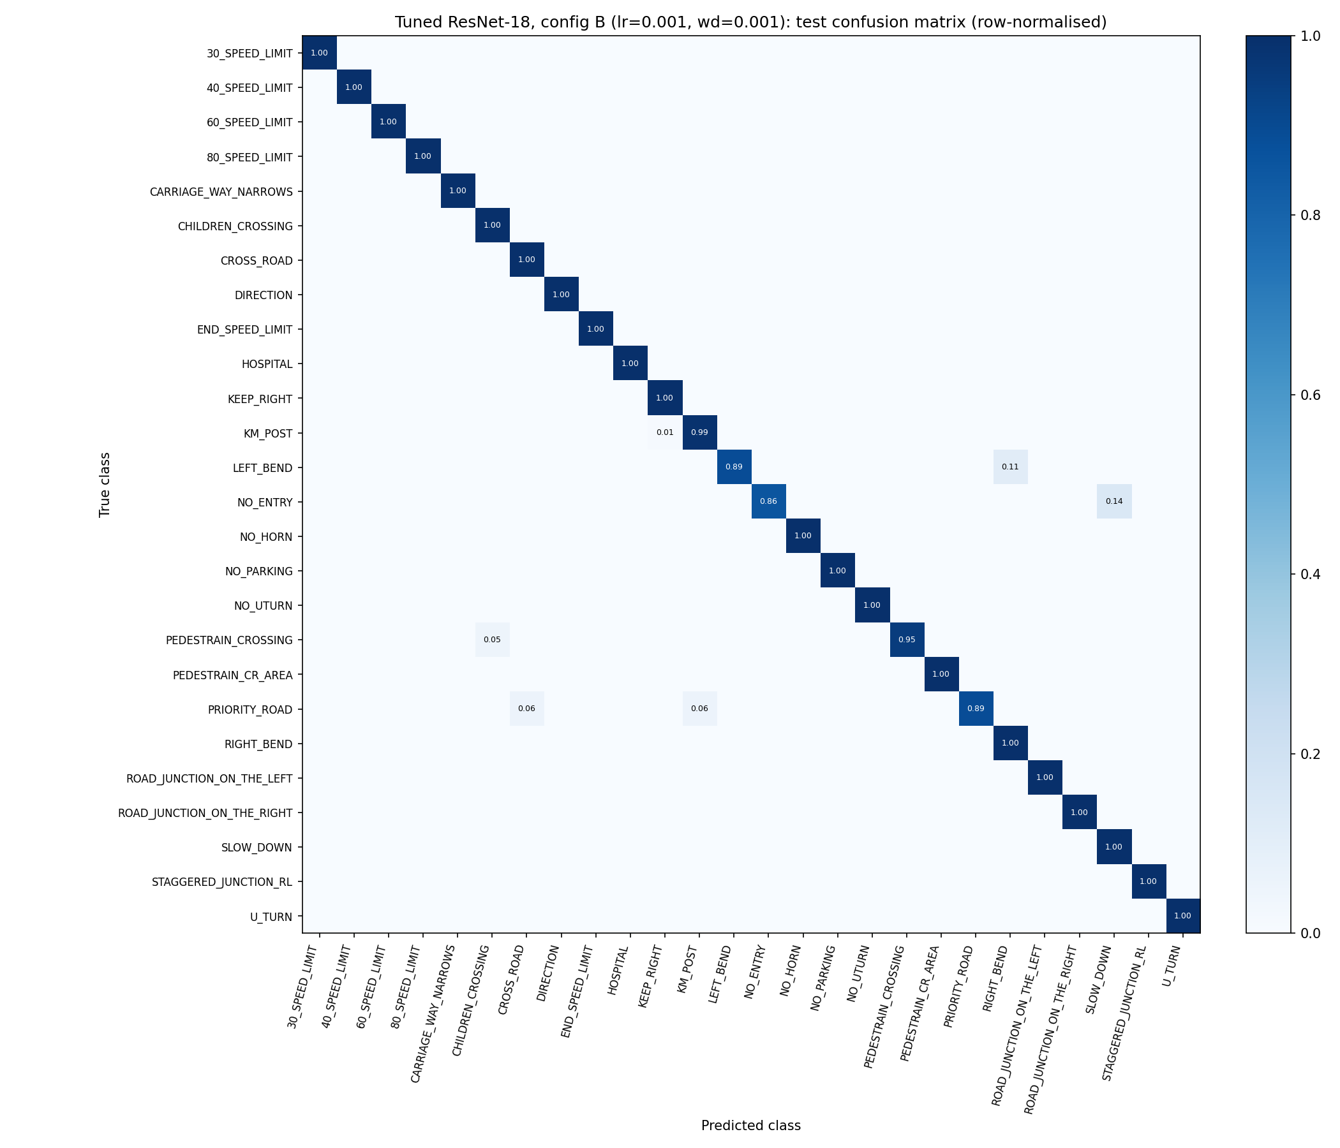
Backup: Final Model Confusion Matrix
Row-normalised (recall per class) on the 463-image test set
Notes:
Backup for Q&A: per-class recall of the final model.

Slide 25
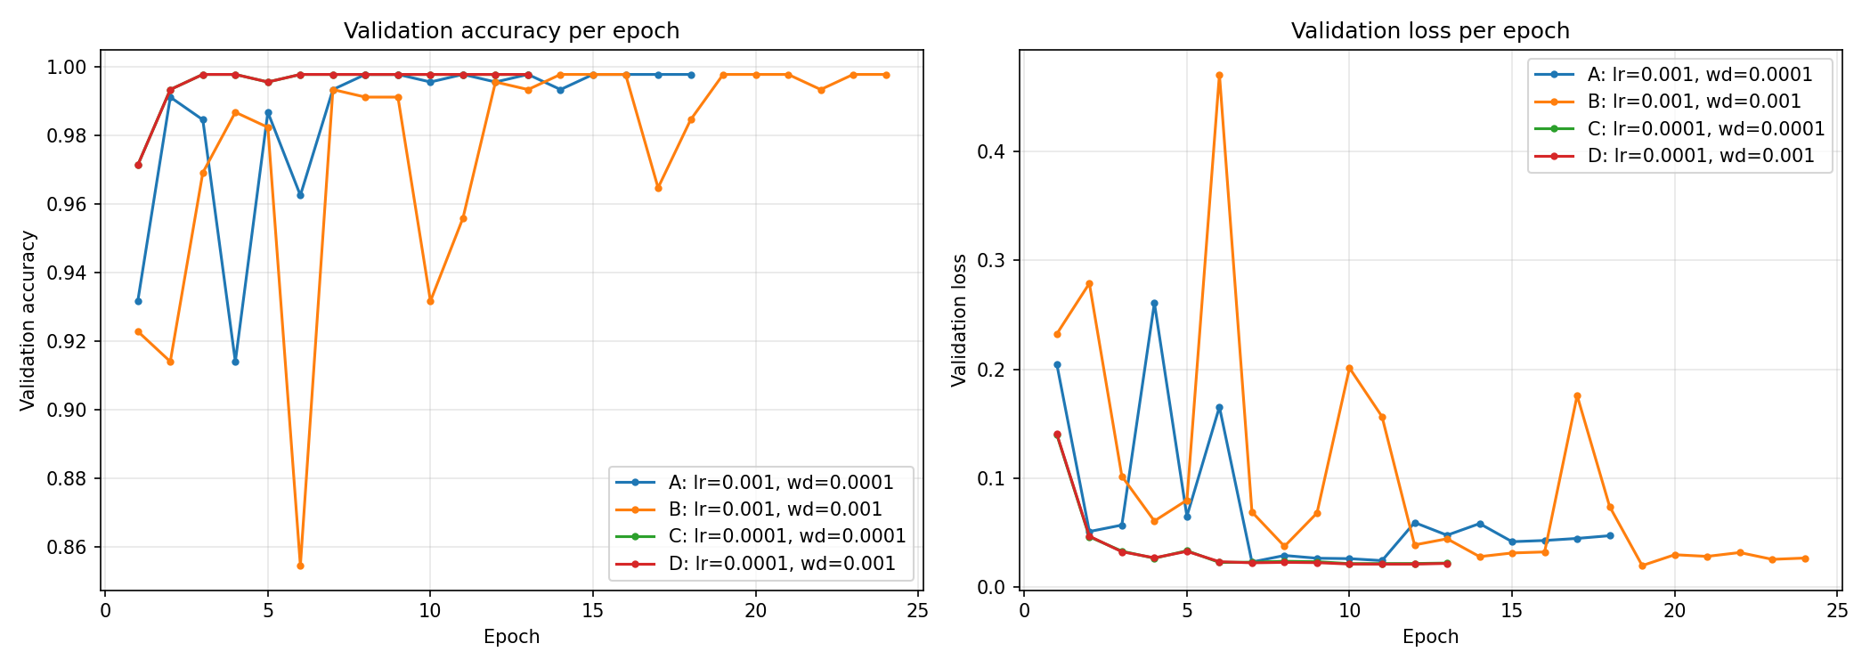
Backup: Tuning Validation Curves
Validation accuracy and loss per epoch for configurations A–D
Best epochs: A 8, B 14, C 3, D 3 · training time: A 3.9, B 5.5, C 2.9, D 3.0 min · all reached 99.78% validation accuracy
Notes:
Backup for Q&A: the four tuning runs.

Slide 26
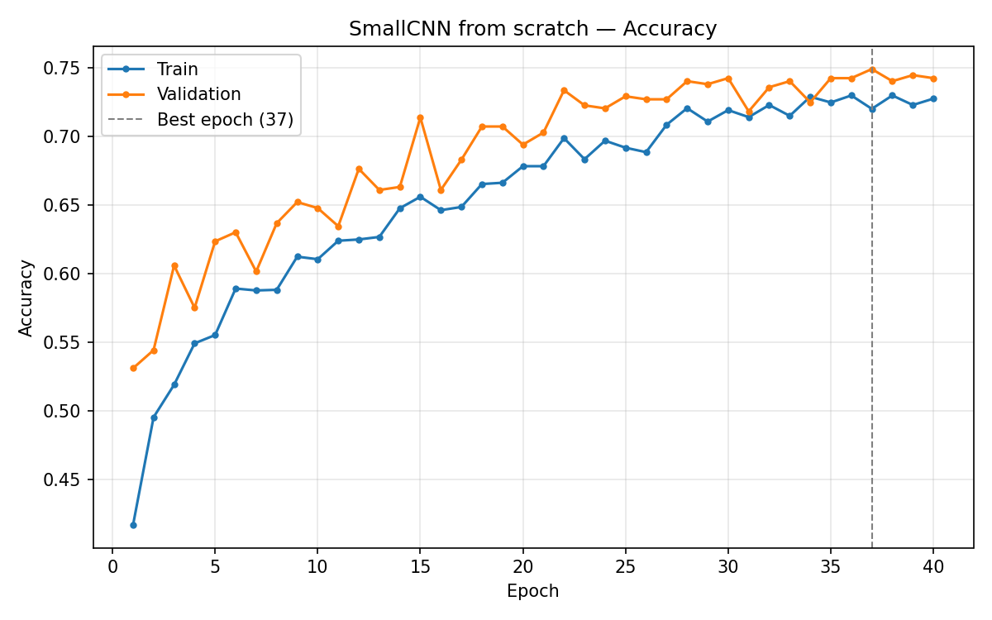
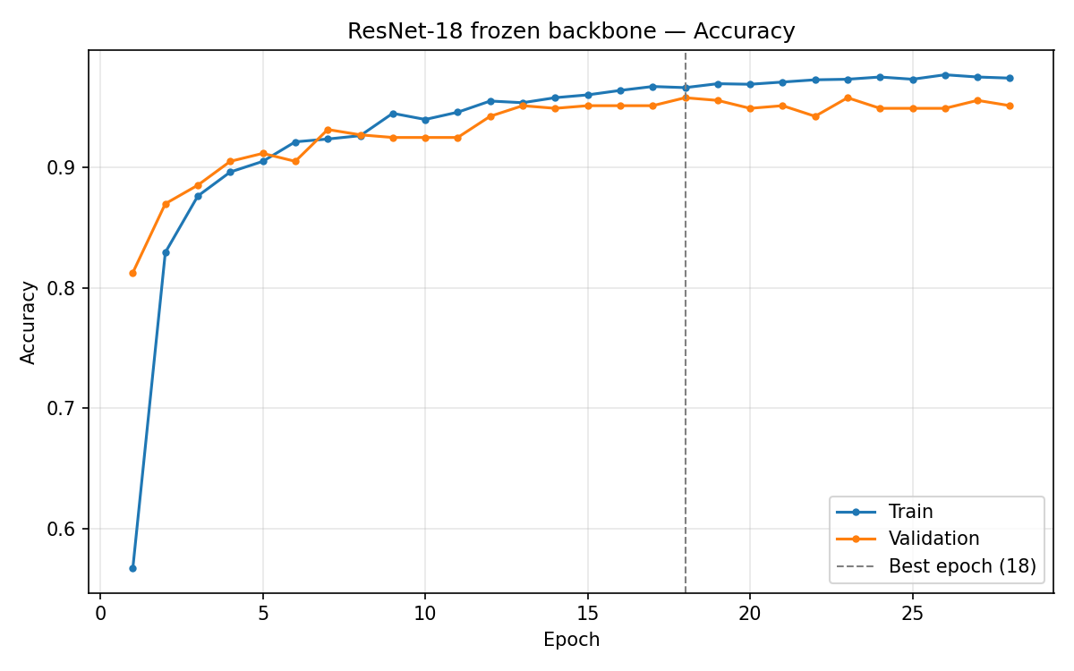
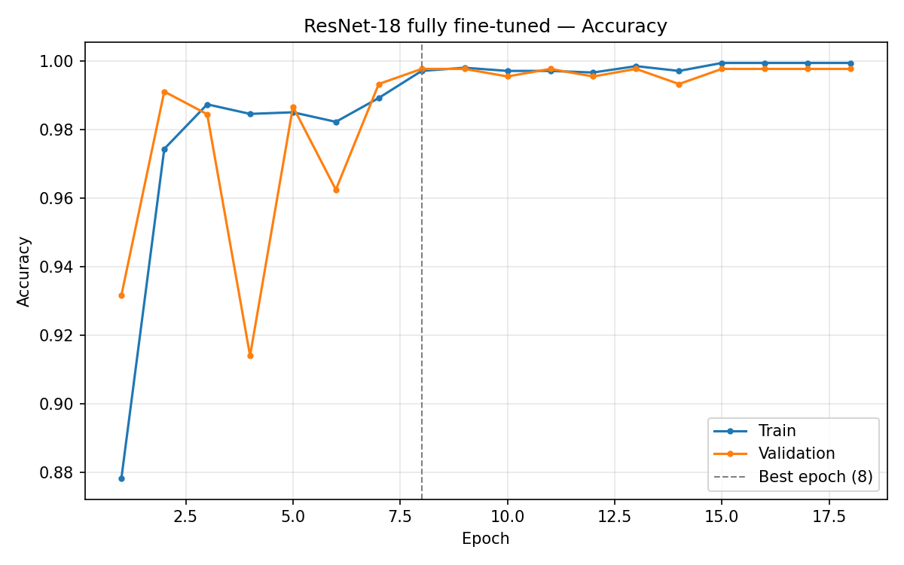
Backup: Training vs. Validation Accuracy
Accuracy curves for the three approaches
SmallCNN from scratch
ResNet-18 frozen
ResNet-18 fine-tuned
Notes:
Backup for Q&A: accuracy curves.

