Slide 1
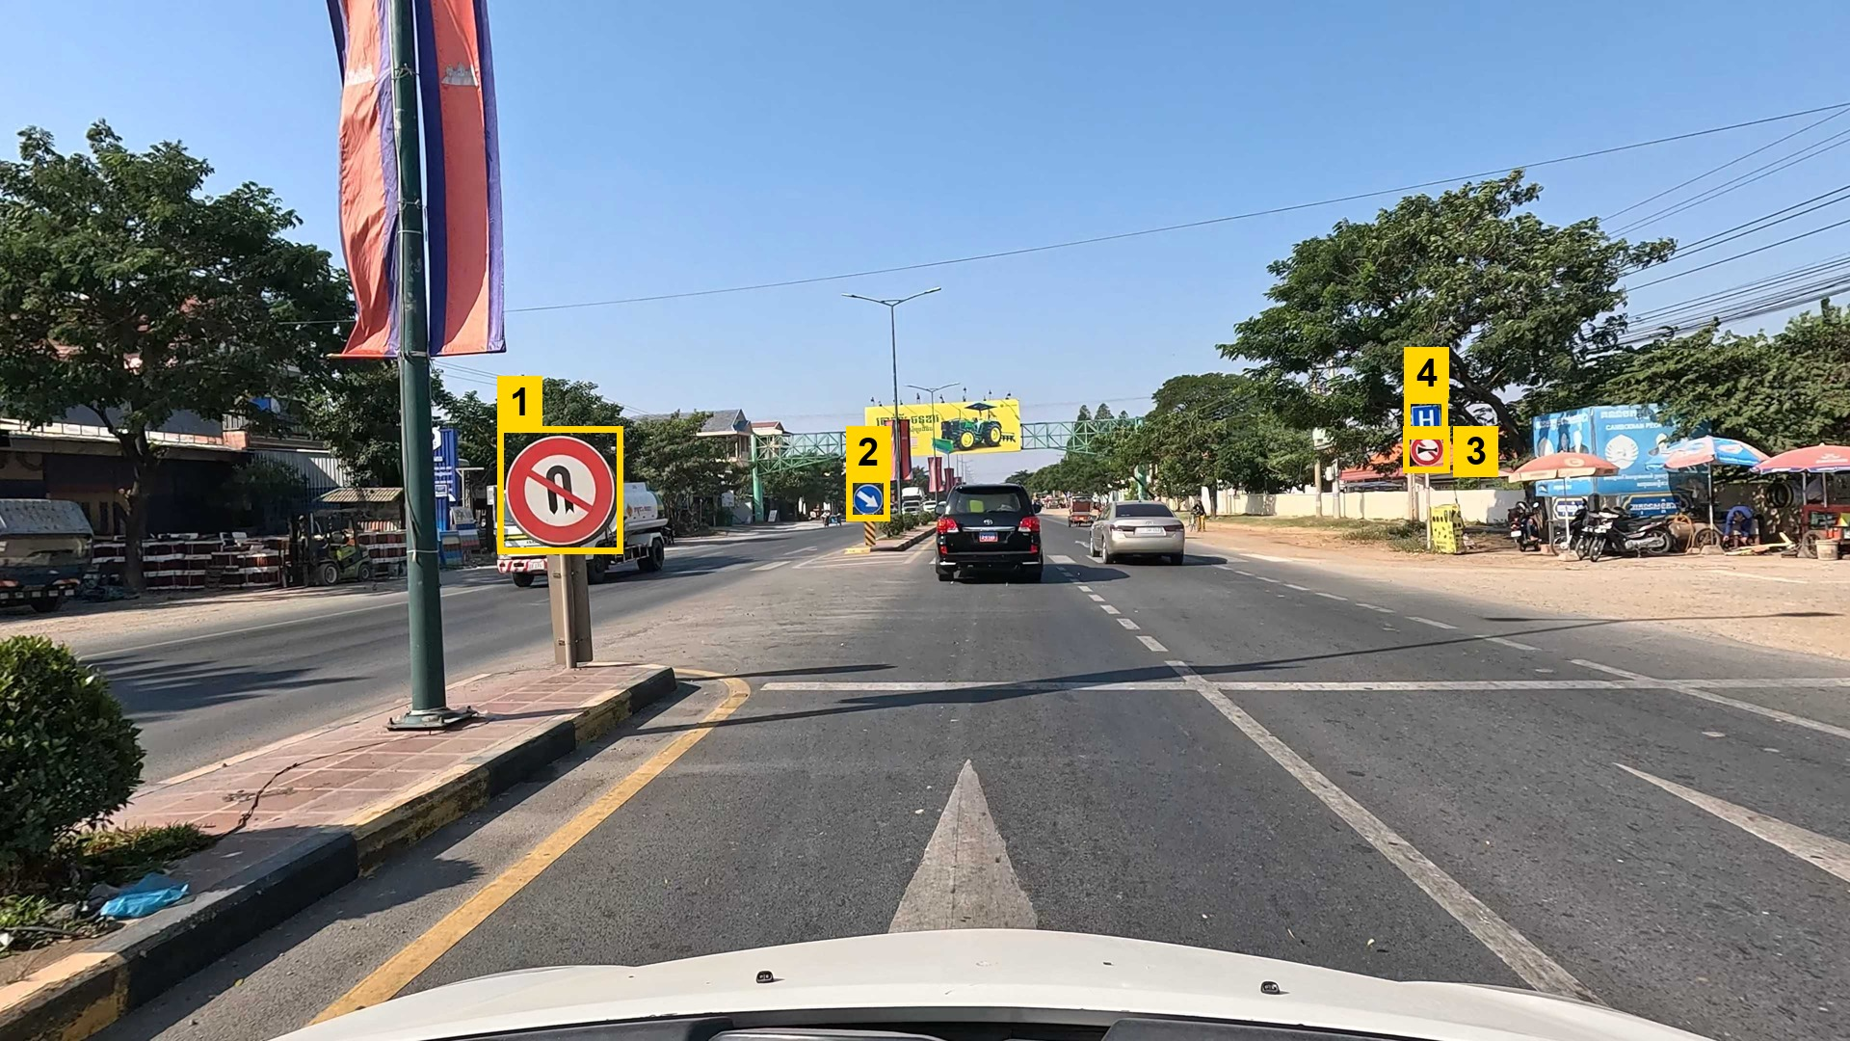
Cambodian Traffic Sign Recognition
Deep learning with CNN and ResNet-18, plus YOLOv8 to find signs in street photos
Presenter: Tes Sothyroth
Student ID: 1702250028
Course: Deep Learning · Lecturer: Him Soklong
Kirirom Institute of Technology
Date: [presentation date]
A real test photo: YOLOv8 finds 4 signs (yellow boxes), ResNet-18 names all 4 correctly.
Notes:
Hello, I am Tes Sothyroth. My project recognises Cambodian traffic signs. A classifier names a cropped sign as one of 26 types; I compared three deep-learning approaches for it. I then added a YOLOv8 detector so the system also works on full street photos, like this real test photo where all four signs are found and named correctly.

Slide 2
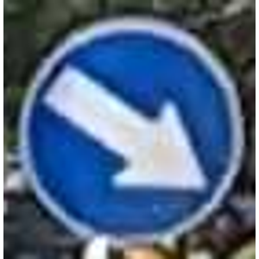
The Problem
Given an image of a traffic sign, which of 26 Cambodian sign types is it?
Why it is hard
Classifier
deep neural network
26 classes, many look alike: left vs. right bend, 30 / 40 / 60 / 80 speed limits
Unbalanced data: from 29 to 738 images per class
Cambodia-specific signs, e.g. kilometre posts with Khmer text
Real roads: small, blurred or partly hidden signs
Keep Right
confidence 99.8%
Notes:
The task is image classification: one picture of a sign in, one of 26 sign types out. It is hard because several signs look almost the same, the classes are very unbalanced, some signs are specific to Cambodia, and real road photos are often small or blurry.

Slide 3
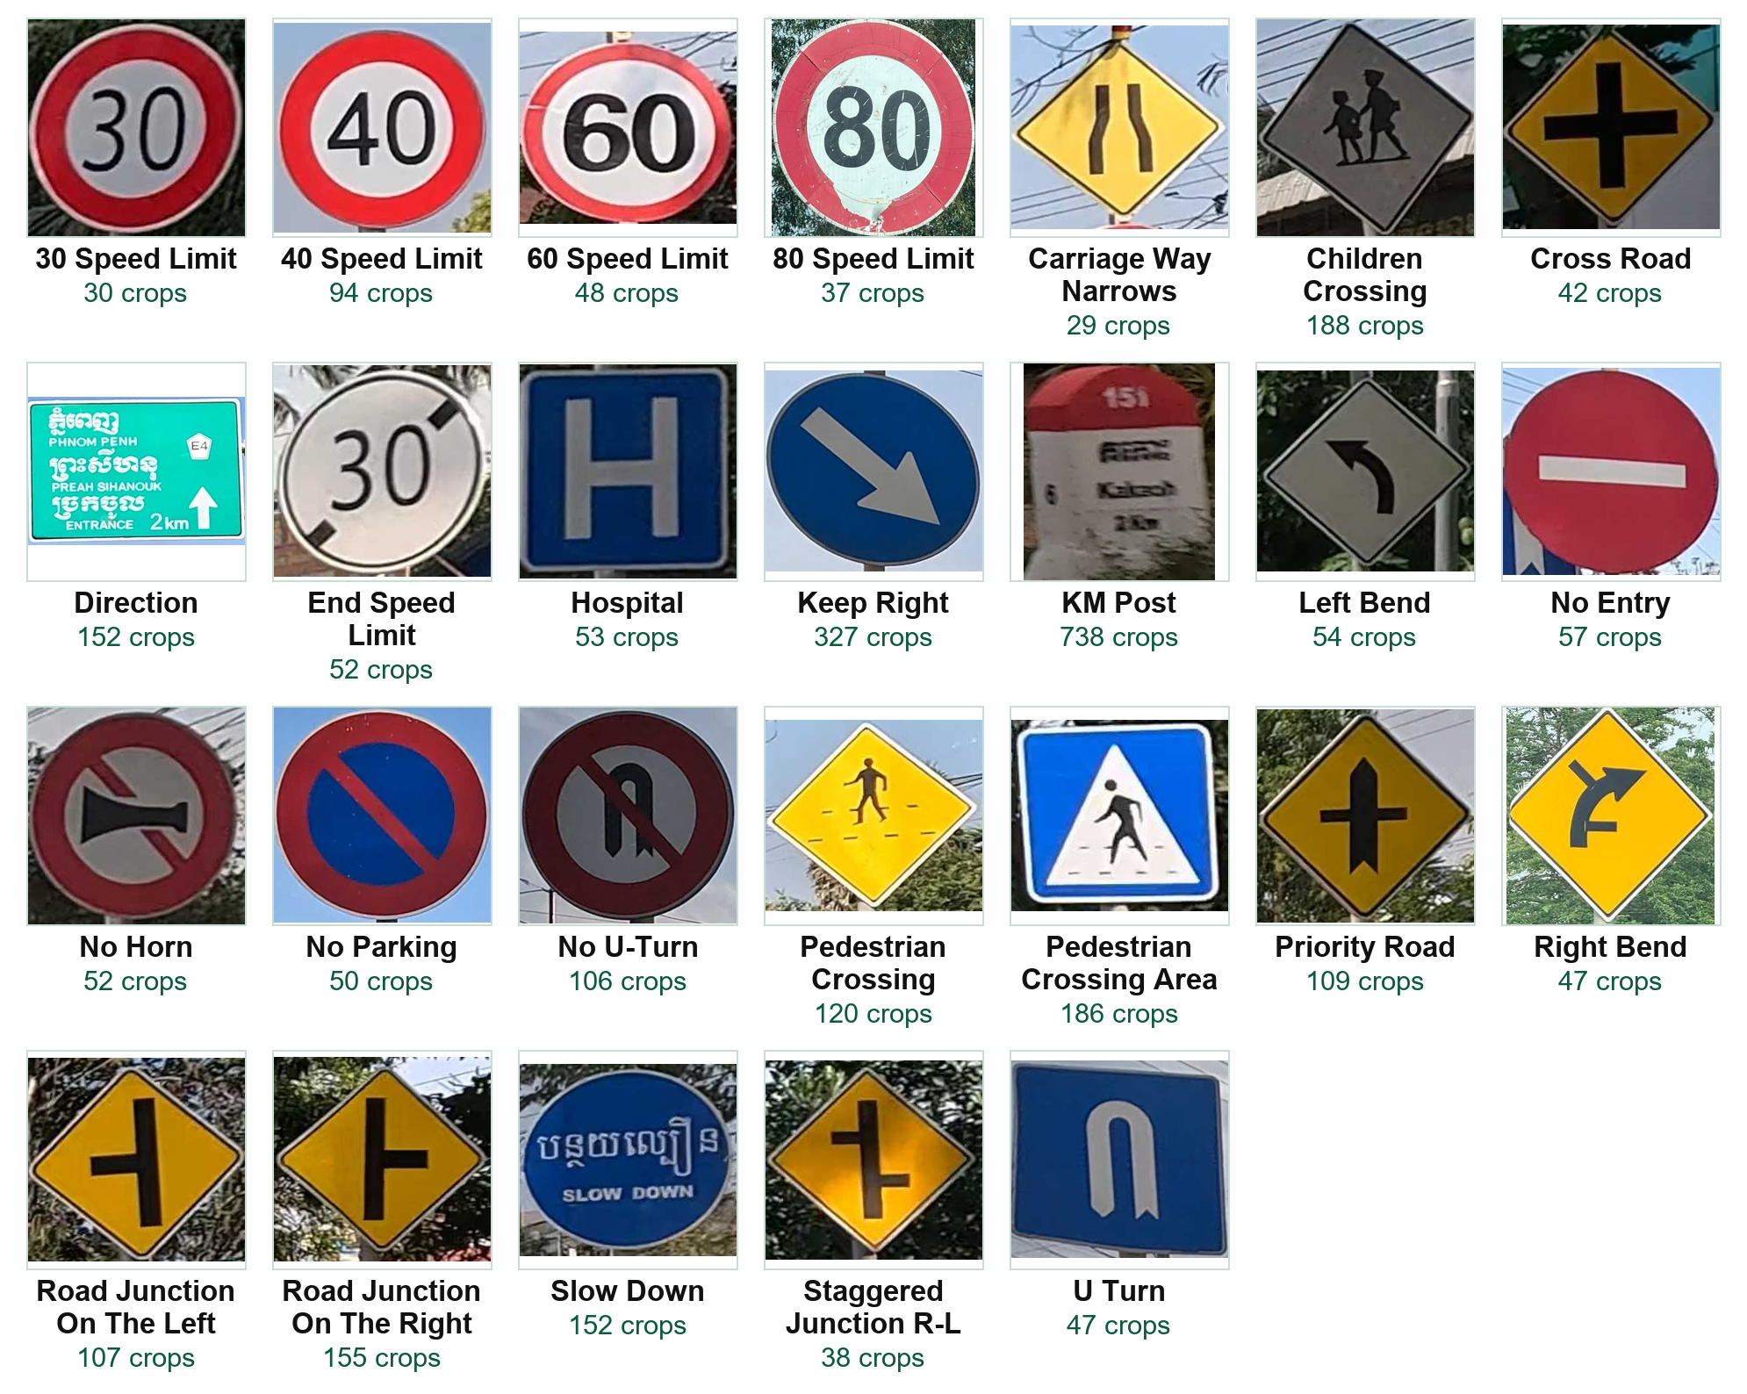
Dataset: 26 Real Cambodian Sign Classes
2,766
street photos from car-mounted cameras
3,070
cropped signs used (26 classes)
Source
Cambodia Traffic Signs Dataset (Kaggle)
Open the dataset on Kaggle
Author: Sophal Ratitya · License: Apache 2.0
Notes:
These are real images from the dataset: one example per class with its number of crops. 2,766 street photos, 3,070 cropped signs in 26 classes. Notice the imbalance: KM posts have 738 crops, carriage-way-narrows only 29. The dataset is public on Kaggle under Apache 2.0; the link is on the slide.

Slide 4
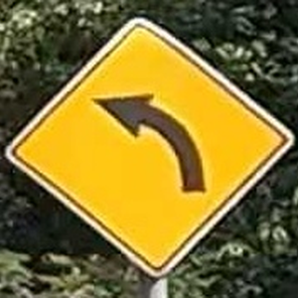
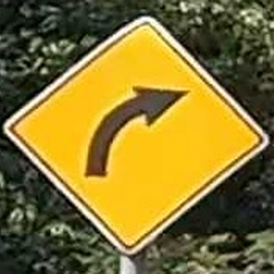
Data Split and Preprocessing
Split by photo (seed 42): signs from one photo never appear in two splits
Split | Photos | Cropped signs
Train | 1,766 | 2,153
Validation | 378 | 454
Test | 379 | 463
Total | 2,523 | 3,070
Preprocessing
All images: resize to 224 × 224, ImageNet normalisation
Training only: small rotation (±10°) and colour changes
No horizontal flip: it changes the meaning
Test set: used only once, at the very end.
Left Bend
flipped = looks like Right Bend
Notes:
I split by photo, not by crop, so two signs from the same photo cannot be in training and test. The test set is used only once. All images are resized to 224 by 224; training images get small rotations and colour changes. I do not flip images, because a flipped left bend looks like a right bend.

Slide 5
System Flow
Two ways to use the system: a full street photo, or one cropped sign
Path A
Full street photo
4K road image
YOLOv8 detector
WHERE are the signs?
Crop each sign
full resolution
ResNet-18 classifier
WHICH of 26 signs?
Label + confidence
e.g. Keep Right 99.8%
Web app
boxes on the photo + results table
Upload one cropped sign
Path B
YOLOv8 = WHERE. Finds every sign in the photo (one class: "Traffic Sign").
ResNet-18 = WHICH. Names each sign as one of the 26 classes.
Notes:
Path A, for a full street photo: YOLOv8 finds where the signs are, each sign is cropped at full resolution, ResNet-18 decides which of the 26 signs it is, and the web app shows boxes and a results table. Path B: if the user already has a cropped sign, it goes straight to ResNet-18. So YOLO answers where, ResNet-18 answers which.

Slide 6
Classification vs. Detection
They answer different questions, so the system uses both
 | ResNet-18 classifier | YOLOv8 detector
Question | What type of sign is this crop? | Where are the signs in this photo?
Input | one cropped sign (224 × 224) | full street photo
Output | 1 of 26 classes + confidence | boxes labelled "Traffic Sign"
Trained on | 2,153 sign crops, 26 labels | 2,009 photos with sign boxes
Why not YOLO alone?
The course task is to compare CNN classifiers, so classification of cropped signs is the core; the detector was added to handle full photos
YOLO can also be trained to classify all 26 signs; I did not test that option, so I do not claim my design is better
Notes:
Classification and detection are different jobs. The classifier answers what sign this is; the detector answers where the signs are. My detector only learns the general class traffic sign, and the classifier names the sign. YOLO can also be trained to classify all 26 classes directly, and the dataset author's own paper did detection with YOLOv8, but I did not test a 26-class YOLO, so I do not claim my two-stage design is better. My reason is that the course task compares classifiers, and the detector extends it to full photos.

Slide 7
Model Architectures
Approach 1: SmallCNN, trained from scratch
Input
224 × 224 × 3
Conv block
32 filters
Conv block
64 filters
Conv block
128 filters
Global pool
Dense 256
+ dropout 0.5
Output
26 classes
Conv block = 3×3 convolution → batch norm → ReLU → 2×2 max-pool · 133,178 trainable weights
Approaches 2 and 3: ResNet-18, pretrained on ImageNet (1.2 million photos)
Input
224 × 224 × 3
Stem
7×7 conv, 64
Stage 1
64 · 2 residual blocks
Stage 2
128 · 2 blocks
Stage 3
256 · 2 blocks
Stage 4
512 · 2 blocks
New output
512 → 26
Approach 2, frozen: blue-grey layers keep their ImageNet weights; only the orange output layer learns (13,338 weights).
Approach 3, fine-tuned (final): every layer keeps learning on our signs (11,189,850 weights).
Notes:
Approach 1 is a small CNN I built: three convolution blocks, a pooling layer and two dense layers, trained from random weights. Approaches 2 and 3 use ResNet-18, which already learned edges, shapes and colours on 1.2 million ImageNet photos; that is transfer learning. In approach 2 the pretrained layers are frozen and only the new output layer learns. In approach 3, fine-tuning, every layer keeps learning on the traffic signs.

Slide 8
Training Approach and Test Results
Original split: same 463 test crops for every approach, each model tested once
Approach | Starts from | What is trained | Trainable weights | Training time | Test accuracy | Macro F1
1. SmallCNN | random weights | everything | 133,178 | 8.1 min | 70.19% | 50.78%
2. ResNet-18 frozen | ImageNet | output layer only | 13,338 | 5.5 min | 92.44% | 88.37%
3. ResNet-18 fine-tuned | ImageNet | all layers | 11,189,850 | 4.0 min | 98.06% | 96.80%
3. Fine-tuned + tuned ★ FINAL | ImageNet | all layers | 11,189,850 | 5.5 min | 98.70% | 98.47%
Same for every approach: Adam optimiser, batch 32, up to 40 epochs, stop early when validation stops improving, keep the best-validation checkpoint
Final settings (learning rate 0.001, weight decay 0.001) were chosen on validation data only (next slide)
Macro F1 averages all 26 classes equally, so it shows the rare classes
Notes:
This table is the main result. Every approach used the same data and settings and was tested once on the same 463 test crops. Transfer learning gives the biggest jump: 70 to 92 percent. Fine-tuning all layers raises it to 98 percent, and tuning the learning rate and weight decay on validation data gives the final model: 98.70 percent accuracy and 98.47 percent macro F1. Times are on one Tesla T4 GPU in Colab.

Slide 9
Hyperparameter Tuning (Final Model)
Chosen on validation data only; the test set was not used
Config | Learning rate | Weight decay | Best val. accuracy | Val. loss | Best epoch | Time
A | 0.001 | 0.0001 | 99.78% | 0.0290 | 8 | 3.9 min
B ★ chosen | 0.001 | 0.001 | 99.78% | 0.0280 | 14 | 5.5 min
C | 0.0001 | 0.0001 | 99.78% | 0.0330 | 3 | 2.9 min
D | 0.0001 | 0.001 | 99.78% | 0.0324 | 3 | 3.0 min
All four tied on validation accuracy (453 / 454); B won the pre-set tie-break (lowest validation loss). On test it was 3 images better than the untuned baseline (98.06% → 98.70%), a single-seed difference.
Notes:
To tune the fine-tuned ResNet-18, I tried 4 combinations of learning rate and weight decay and compared them only on validation data. All four reached the same validation accuracy, 453 of 454, so a rule fixed in advance chose the one with the lowest validation loss: config B. On the test set it was 3 images better than the untuned baseline, which is a small, single-seed difference, so I do not over-claim it.

Slide 10
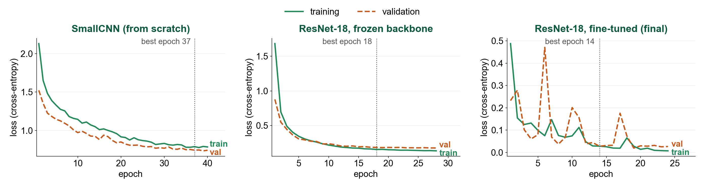
Training vs. Validation Loss
Real curves from the saved training history (lower = better)
Underfitting
Both losses still high at epoch 40: a small network trained from scratch learns too little.
Good fit
Training and validation loss stay close; only the last layer can learn.
Very low loss
Validation is noisy early; the best checkpoint (epoch 14) is kept.
Notes:
These are the real training and validation loss curves from my saved runs. SmallCNN underfits: both losses are still high after 40 epochs. The frozen ResNet fits well: the two curves stay close. The fine-tuned final model reaches a very low loss; its validation loss is noisy in early epochs, so training keeps the checkpoint with the best validation result, epoch 14.

Slide 11
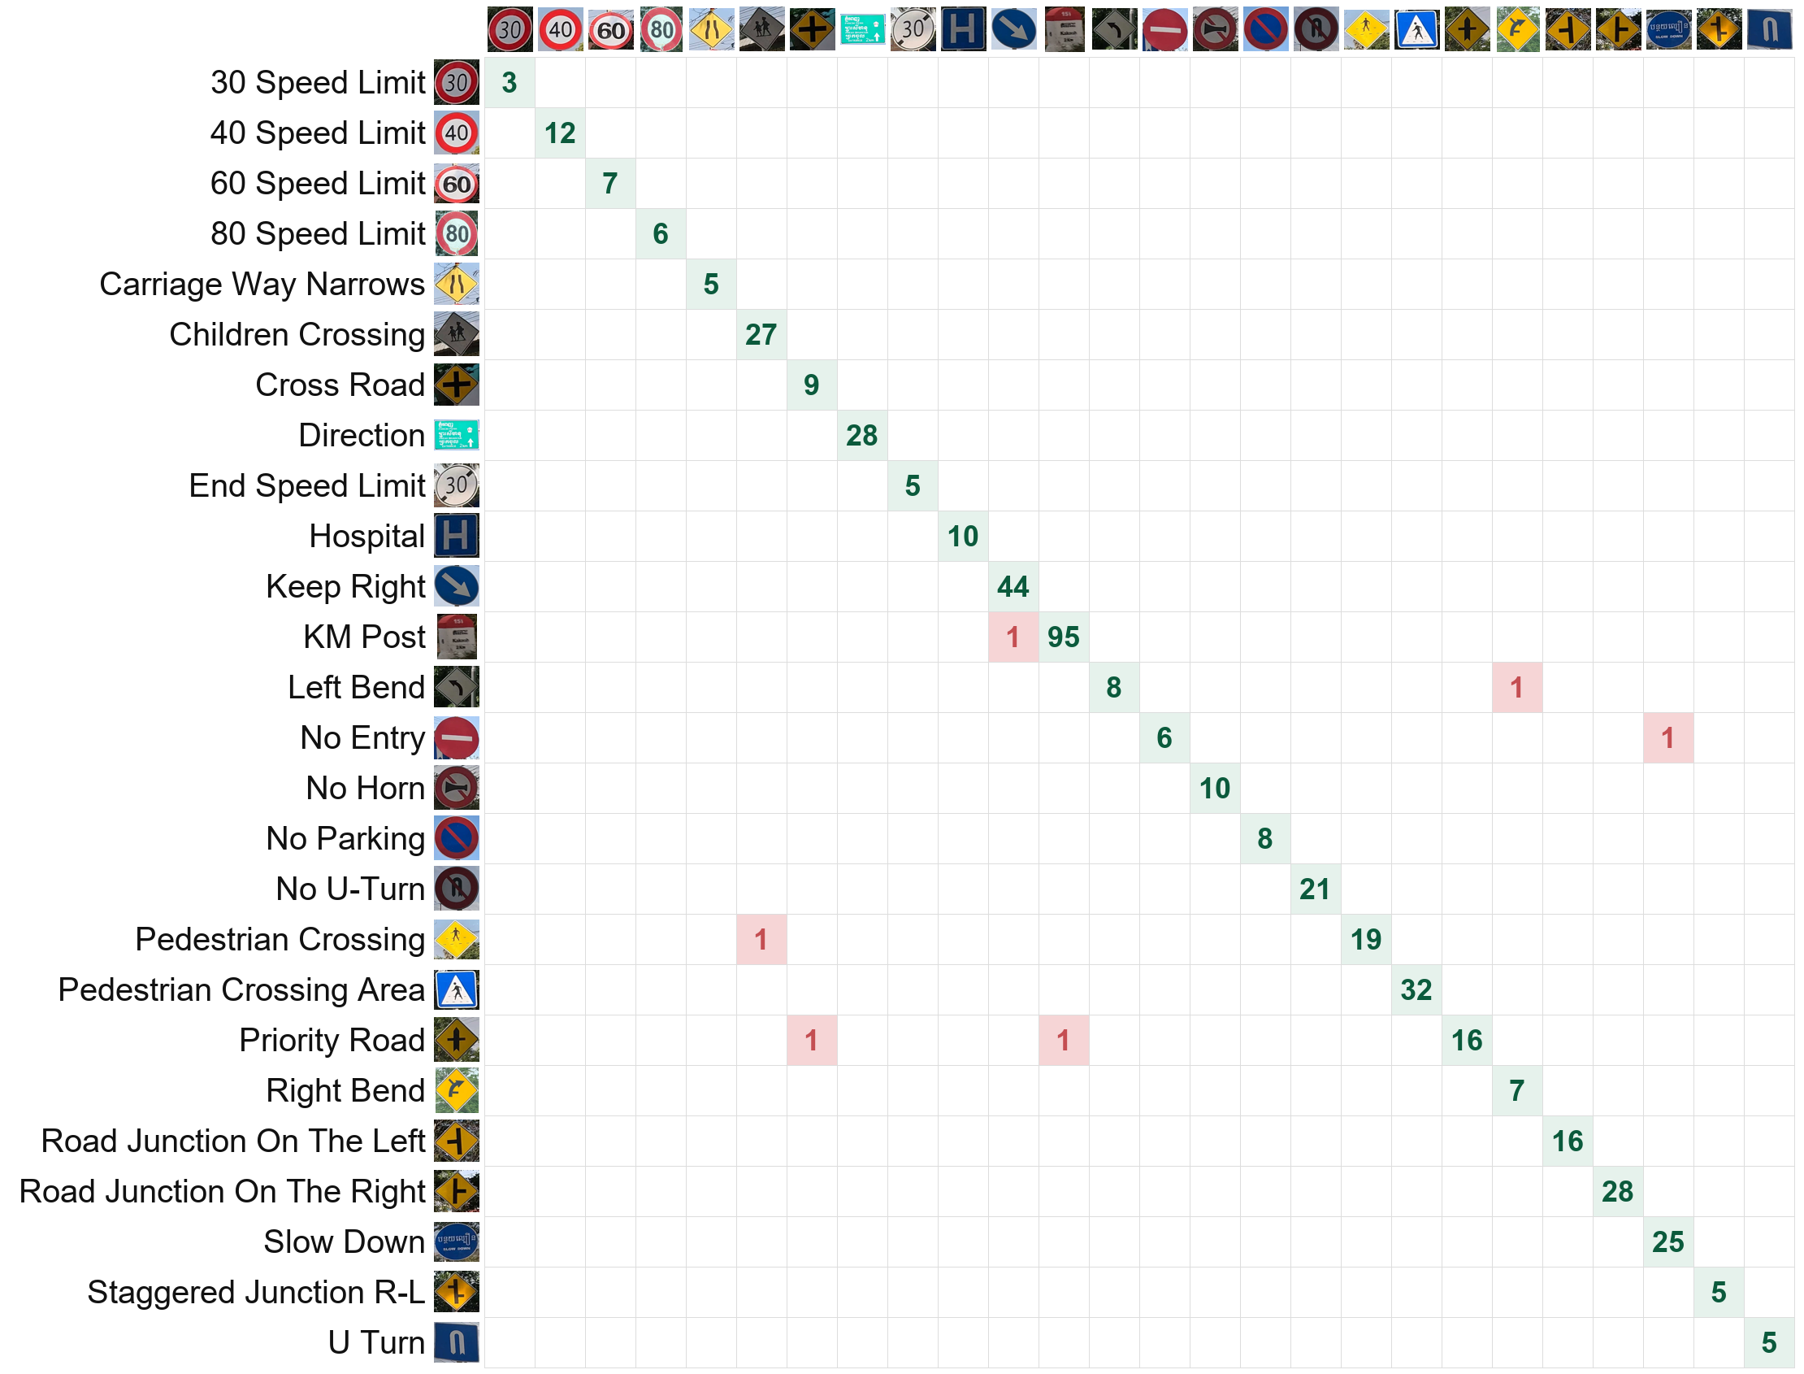
Confusion Matrix (Final Model)
457 / 463
test images correct
Rows: true sign. Columns: predicted sign
Green diagonal: correct
Red cells: the 6 mistakes
No mistake happens twice; 16 of 26 classes are perfect
Notes:
This is the confusion matrix of the final model, with a picture of each sign. Rows are the true sign, columns the prediction. Green numbers on the diagonal are correct; red cells are mistakes. 457 of 463 test images are correct, there are only 6 mistakes, and no mistake repeats.

Slide 12
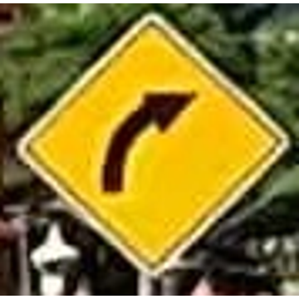
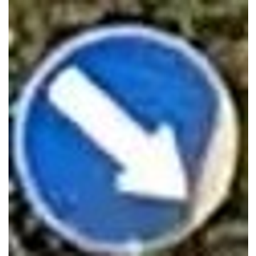
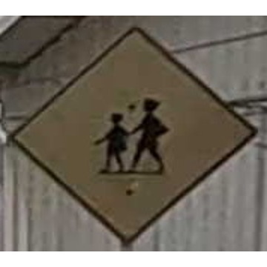
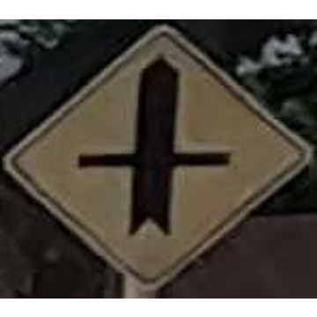

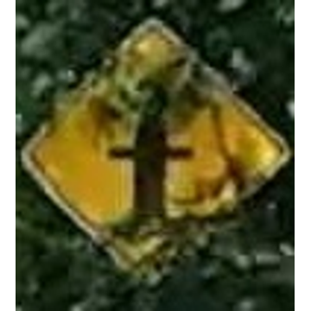
The 6 Mistakes, with Real Images
True label vs. what the final model predicted
True: Left Bend
Predicted: Right Bend
confidence 100%
True: KM Post
Predicted: Keep Right
confidence 100%
True: Pedestrian Crossing
Predicted: Children Crossing
confidence 96%
probable annotation error
probable annotation error
probable annotation error
True: Priority Road
Predicted: Cross Road
confidence 84%
True: No Entry
Predicted: Slow Down
confidence 32%
True: Priority Road
Predicted: KM Post
confidence 25%
model error
model error
model error
Purple: the model predicted the sign that is actually visible; the dataset label looks wrong. Metrics are not adjusted.
Notes:
Here are all six mistakes as real images. In the purple ones the model predicts the sign that is really visible, so the dataset label looks wrong; I did not change the metrics for that. The red ones are real model errors: a priority road confused with a cross road, a tiny blurred no-entry sign, and a priority road hidden by branches. The last two have low confidence.

Slide 13
YOLOv8 + ResNet-18 on Full Street Photos
Detection results on 379 test photos: a separate task from the classifier accuracy
YOLOv8 detector | First | Retrained ★
Precision | 95.6% | 93.8%
Recall | 96.3% | 96.6%
mAP@50 | 97.8% | 98.5%
mAP@50–95 | 87.3% | 87.5%
463 test signs | First | Retrained ★
Found | 97.0% | 97.2%
Found + named | 96.1% | 95.9%
Real test photo, retrained detector: 1 No U-Turn 100% · 2 Keep Right 99.9% · 3 No Horn 100% · 4 Hospital 98.8% (all correct)
About equal on normal photos; the retrained one also handles close-ups (next slide). Single run.
Notes:
This is the extension. The YOLOv8 detector learns one general class, traffic sign, and ResNet-18 names each box. I trained it twice. On the 379 normal test photos both versions are about equal: the retrained one finds 450 of 463 signs and names 444 correctly, 95.9 percent, against 449 found and 445 named, 96.1 percent, for the first one; its precision is a little lower and its recall a little higher. The reason for retraining is the next slide. These numbers are from this test set only, from a single run.

Slide 14
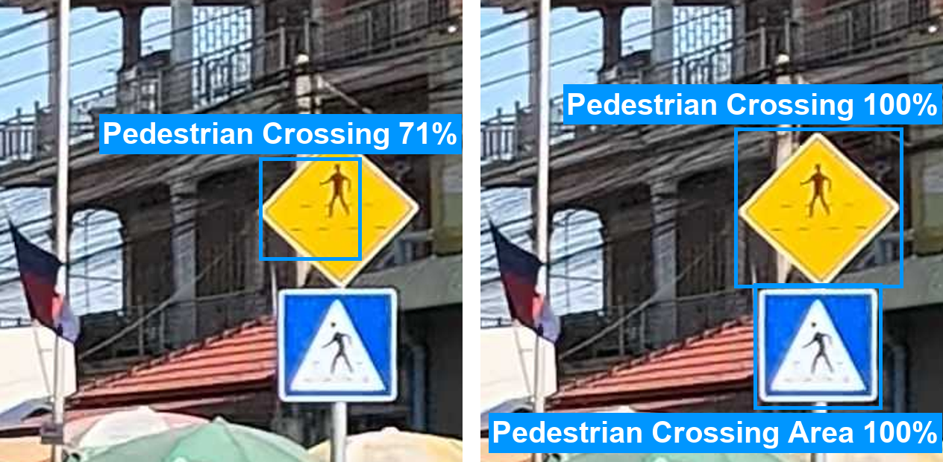
Fixing Close-Ups: Retrained Detector
The first detector only learned small, far-away dashcam signs
First detector: half a box
Retrained: both signs
Signs found AND named correctly (test split only)
Test images | First | Retrained
Close-ups from test photos (191 signs) | 27.7% | 96.9%
Signs pasted on plain backgrounds (447) | 26.0% | 99.1%
Normal dashcam photos (463 signs) | 96.1% | 95.9%
Close-up from a test photo; real model outputs.
Added to training: 2,000 zoomed close-ups + 1,500 signs pasted on plain backgrounds (from training photos only)
Retrained 30 epochs from the first detector; classifier unchanged
Test close-ups are simulated from test photos, not real phone photos
Notes:
While testing the app, close-up photos failed: the first detector had only seen small signs far down the road, so it missed big signs or boxed only their inside, and the classifier then saw half a sign. I added 2,000 zoomed close-ups and 1,500 signs pasted on plain backgrounds to the training data, using training photos only, and retrained the detector. On close-ups made from test photos, signs found and named correctly went from 27.7 to 96.9 percent, and on pasted signs from 26.0 to 99.1 percent, while normal photos stayed about the same. These close-ups are simulated from test photos, not real phone photos.

Slide 15
Is 98.70% Too Optimistic? Unseen Drives
The concern
Test fold | Crops | Accuracy | Macro F1
All folds pooled | 3,070 | 98.31% ± 0.20 | 97.24% ± 0.68
Fold 0 | 522 | 99.55% | 99.38%
Fold 1 | 538 | 98.39% | 96.21%
Fold 2 | 649 | 97.74% | 93.03%
Fold 3 | 755 | 97.70% | 96.54%
Fold 4 | 606 | 98.51% | 98.19%
Photos are video frames. 84 of 463 test crops (18%) have a training frame of the same sign ≤ 2 s away.
The check
Group photos into 20 drives
5 folds: always test on drives the model never saw
3 seeds → 15 training runs, same final settings
± = variation over 3 seeds. Different test protocol from 98.70%, so not a before/after comparison. Independent by drive, not guaranteed by location.
Per-fold values: mean of 3 seeds.
Notes:
Because most photos are video frames, some test crops are almost copies of training frames. To check this, I grouped the photos into 20 drives and tested five times, each time on drives the model never saw, with three seeds: 15 runs. Pooled accuracy is 98.31 percent and macro F1 97.24 percent. It is a different test from the 98.70 percent, so it is not a before-and-after comparison. Separating drives does not guarantee separate locations, because some roads were driven twice.

Slide 16
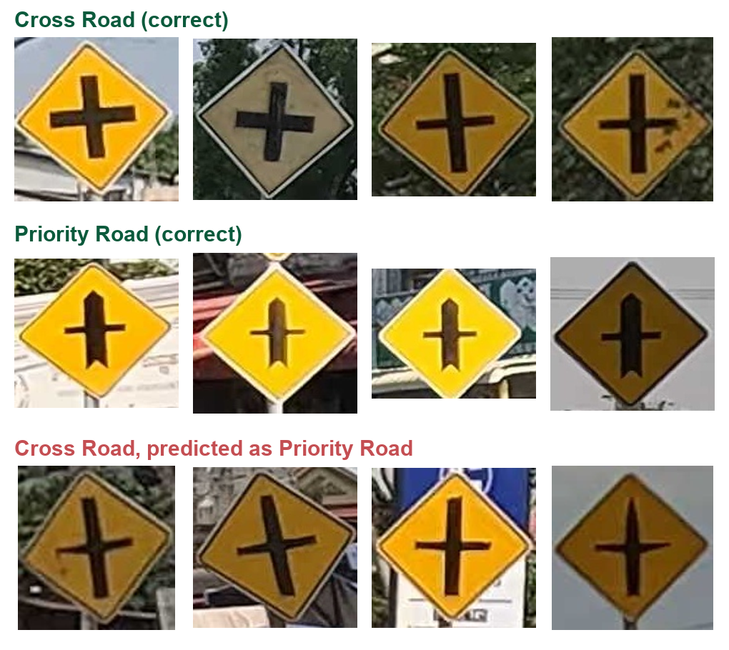
Hardest Pair: Cross Road vs. Priority Road
From the grouped evaluation (all folds and seeds)
0.81
25
Cross Road F1 (only 42 images)
times read as Priority Road (summed over 3 seeds)
Both are yellow diamonds with a black cross
Priority Road: thicker vertical bar with a pointed top
Tilted or blurred Cross Road signs are misread
Some errors look like Priority Road: possible label errors (not verified)
Notes:
The hardest pair is Cross Road versus Priority Road. Both are yellow diamonds with a black cross; Priority Road has a thicker, pointed vertical bar. Cross Road has only 42 images and an F1 of 0.81; 25 times it was predicted as Priority Road. Some of those images look like Priority Road, so label errors may play a role, but I have not verified that.

Slide 17
Live Demo: Local Web App (Gradio)
Runs on this laptop at http://127.0.0.1:7860 · not deployed online
Tab 1 · Classify a cropped sign
Tab 2 · Detect all signs in a street photo
Pick a real test street scene, e.g. Left Bend
Classify → Left Bend, 99.66%, marked correct
Try the whole uncropped photo → wrong, low confidence: this is why we crop
Pick the test photo from slide 1
Detect & Classify → 4 boxes: No U-Turn, Keep Right, No Horn, Hospital
A results table lists every sign with its confidence
Uses the retrained detector, so close-ups work too
Before presenting: start the app, check the banner says "Checkpoint verified". Backup: notebooks/07_demo.ipynb.
Notes:
Now a live demo of the local web app. In tab 1 I pick a real test scene, classify the cropped sign, and then show that the whole uncropped photo fails, which is why cropping matters. In tab 2 I run the retrained detector on the street photo from slide 1 and all four signs are found and named. If the app fails, the backup is the demo notebook.

Slide 18
Limitations and Future Work
Limitations
Future work
Original split has near-duplicate video frames (18% of test crops)
Grouped test separates drives, but the same sign can appear on another trip
Few images for some signs (Cross Road: 42)
Only 26 classes: other signs (e.g. STOP) get the closest label
Close-up fix tested on simulated close-ups only
Split by location (needs GPS data)
More images of rare and look-alike signs; fix label errors
Add an "other sign" class
Grouped evaluation for the detector too
Test on real phone close-up photos
Notes:
Limitations: the original split contains near-duplicate video frames; the grouped test separates drives but not necessarily locations; some signs have very few images; and the model only knows 26 classes, so a STOP sign gets the closest label. The close-up fix was tested on simulated close-ups, not real phone photos. Future work answers each of these.

Slide 19
Conclusion
98.70%
98.31%
95.9%
classifier on the original test set (98.47% macro F1)
same classifier recipe, tested on unseen drives (15 runs)
full photos: signs found AND correctly named (retrained YOLOv8 + ResNet-18)
Transfer learning was the biggest gain: 70.19% → 92.44% → 98.70% test accuracy.
Thank you! Questions?
Code and README: github.com/RothRothRoth/DeepLearning_CNN
Dataset: Cambodia Traffic Signs Dataset on Kaggle
Notes:
To conclude: the fine-tuned ResNet-18 reaches 98.70 percent on the original test set; tested on unseen drives, the same recipe reaches 98.31 percent; and with the retrained YOLOv8 detector, 95.9 percent of signs in full street photos are found and named correctly. Transfer learning was the biggest gain. Thank you; I am happy to take questions.

Slide 20
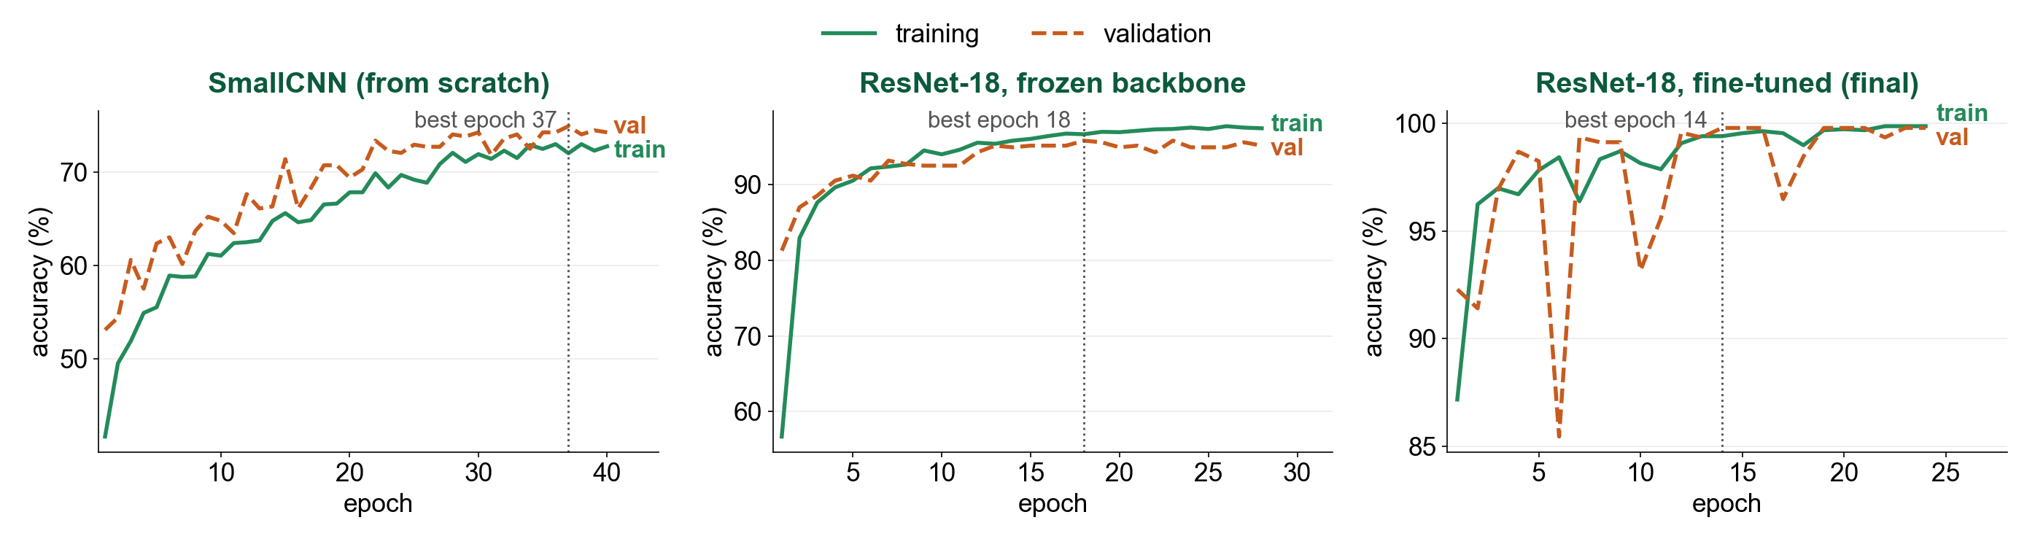
Backup: Training vs. Validation Accuracy
Same runs as the loss curves
Notes:
Backup: accuracy curves for the three approaches.

Slide 21
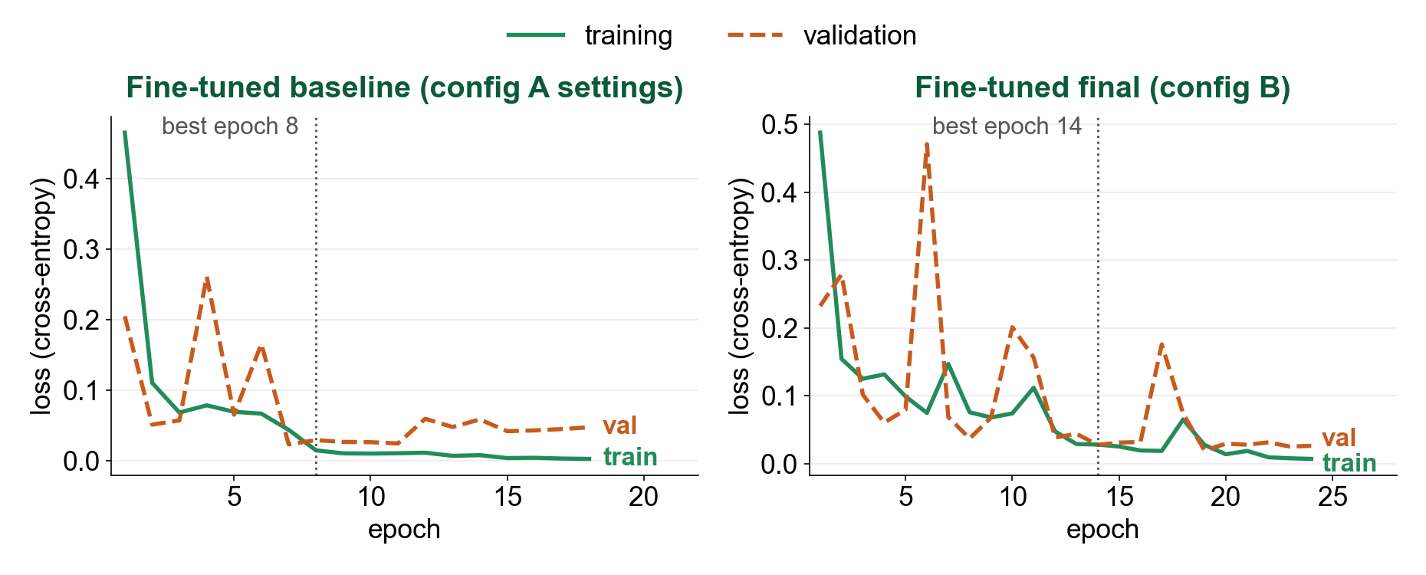
Backup: Fine-Tuned Baseline vs. Final (Loss)
Weight decay 0.0001 (baseline) vs. 0.001 (final)
Notes:
Backup: the baseline's validation loss rises after epoch 7, while the final model's stays lower, consistent with stronger weight decay (single run).

Slide 22
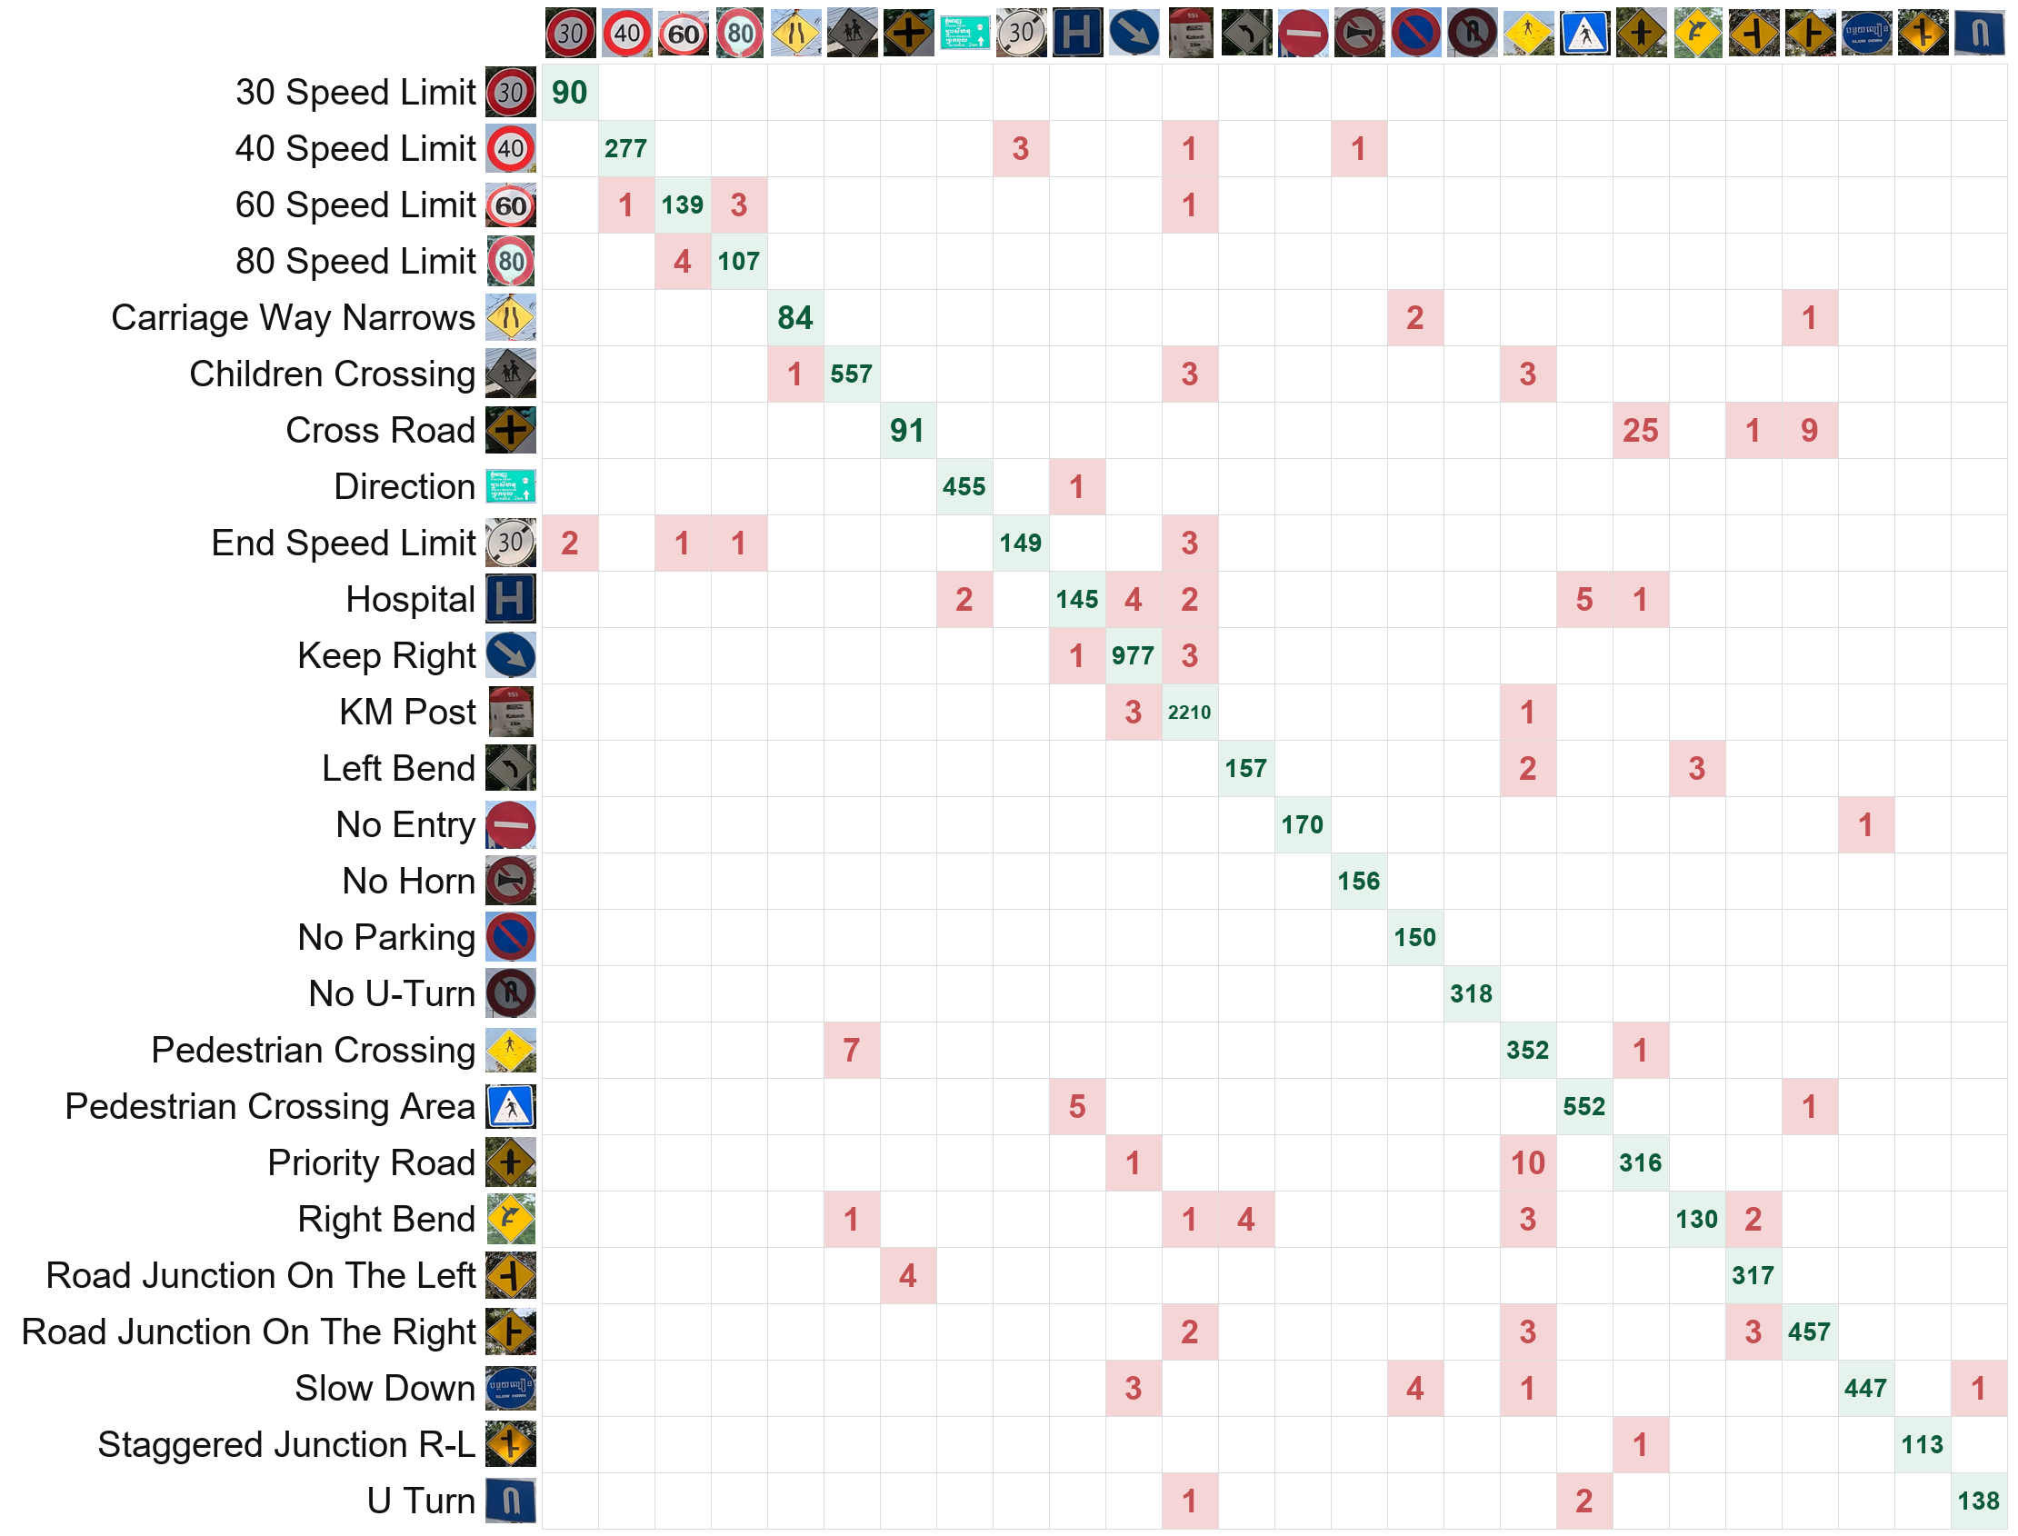
Backup: Grouped Evaluation Confusion Matrix
All 3,070 crops, summed over 3 seeds
Rows: true sign; columns: predicted sign
Green: correct · red: mistakes
Biggest: Cross Road → Priority Road (25)
Notes:
Backup: all confusions of the grouped evaluation, summed over the three seeds.

Slide 23
Backup: Weakest Classes (Grouped Evaluation)
Pooled over folds; mean over 3 seeds
Class | F1 | Recall | Precision | Images
Cross Road | 0.81 ± 0.15 | 0.72 | 0.96 | 42
Hospital | 0.93 ± 0.02 | 0.91 | 0.95 | 53
Priority Road | 0.94 ± 0.04 | 0.97 | 0.92 | 109
Right Bend | 0.95 ± 0.02 | 0.92 | 0.98 | 47
Pedestrian Crossing | 0.96 ± 0.02 | 0.98 | 0.94 | 120
Top confusions (3 seeds)
Cross Road → Priority Road: 25
Priority Road → Pedestrian Crossing: 10
Cross Road → Junction Right: 9
Pedestrian → Children Crossing: 7
Notes:
Backup: per-class results of the grouped evaluation.

Slide 24
Backup: First Detector's Threshold Check
Done for the first detector (before the close-up retrain); rule on validation photos, test used once
Setting | Photos | Found and correctly named | Missed signs | Extra boxes
1280 px, conf 0.25 (default) | validation | 97.36% | 16 | 52
1600 px, conf 0.30 (rule's choice) | validation | 98.02% | 12 | 51
1280 px, conf 0.25 (default) ★ kept | test | 96.11% | 15 | 43
1600 px, conf 0.30 | test | 95.46% | 15 | 51
The validation gain did not carry over to test, so the default was kept. Most "extra boxes" are real signs that the dataset did not label (visual check), so precision is probably underestimated.
Notes:
Backup: threshold and image-size check, done for the first detector before the close-up retrain. The retrained detector uses the same default, 1280 pixels and confidence 0.25.

Slide 25
Backup: Shared Training Settings
Setting | Value
Optimiser / loss | Adam · cross-entropy
Batch size / max epochs | 32 · 40
Learning rate schedule | ReduceLROnPlateau (×0.5 after 3 epochs without improvement)
Model selection | early stopping (patience 10), best-validation checkpoint
Reproducibility | seed 42 for Python, NumPy, PyTorch; deterministic cuDNN
Hardware | Google Colab, NVIDIA Tesla T4 (classifiers); RTX 4060 laptop (YOLOv8, grouped runs)
Notes:
Backup: training settings shared by all approaches.

