Slide 1
Functional Genome Annotation
Creating Genomic Networks with Ondex
Keywan Hassani-Pak

Slide 2
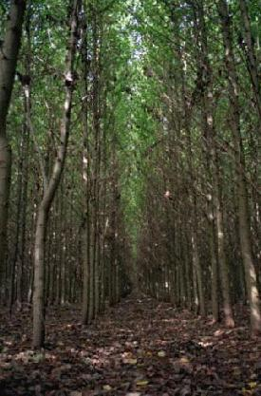
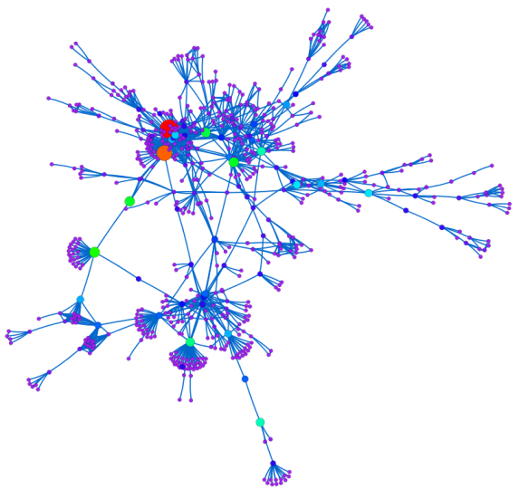
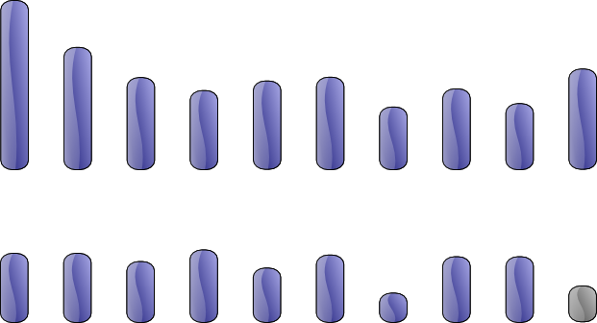
Populus trichocarpa (Poplar)
First tree with fully sequenced genome
Model plant for bioenergy crops such as Willow
4x larger genome than Arabidopsis
19 Chromosomes
45,555 predicted genes
Chromosomes and QTLs
Phenotypes
Underlying Networks
Notes:
Poplar of high interest for bio-energy research. Understanding plant architecture related to yield improvement (e.g. branching process)

Slide 3
Re-Annotation of the Poplar genome
Data Integration
UniProtKB, Pfam
GO, GOA, EC
MEDLINE
Method Integration
Sequence Similarity
Domain Analysis
Text Mining
Automatic function prediction with different levels of evidence
Poplar Genome
Sequence
Homology
Domain
Analysis
Sequence
DB
ProteinFamily
DB
Referenced
Publications
GOA Files
Mapping Files
GO
GO
GO
Based on integrative text mining
Based on sequence homology
Based on
protein domain analysis
Notes:
How did Jgi derive its annotations. Can we rebuild the pipeline and improve it?

Slide 4

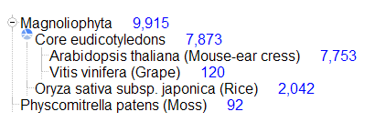
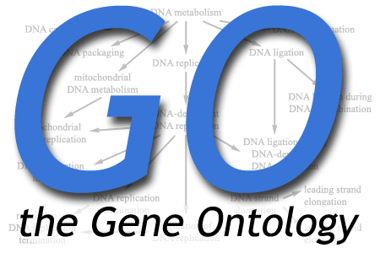


Integrating Poplar data with…
Pfam 23.0 (July 2008, 10340 families)
26976 terms, 98.7% with definitions
MEDLINE 2009 contains 17,764,826 records

Slide 5
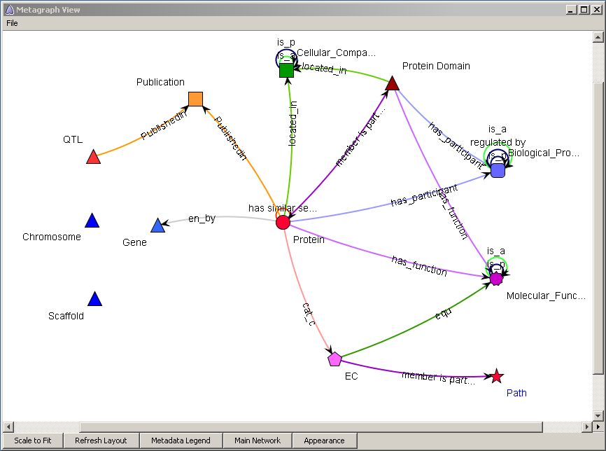
Integrated Poplar Network
Genes, QTLs enriched with positional information
Proteins
Annotated with GO, EC, KEGG and Publications
Based on Comparative genomics to
Arabidopsis, Rice, Moss, Grape
And domain analysis
Data integration was done in Ondex

Slide 6
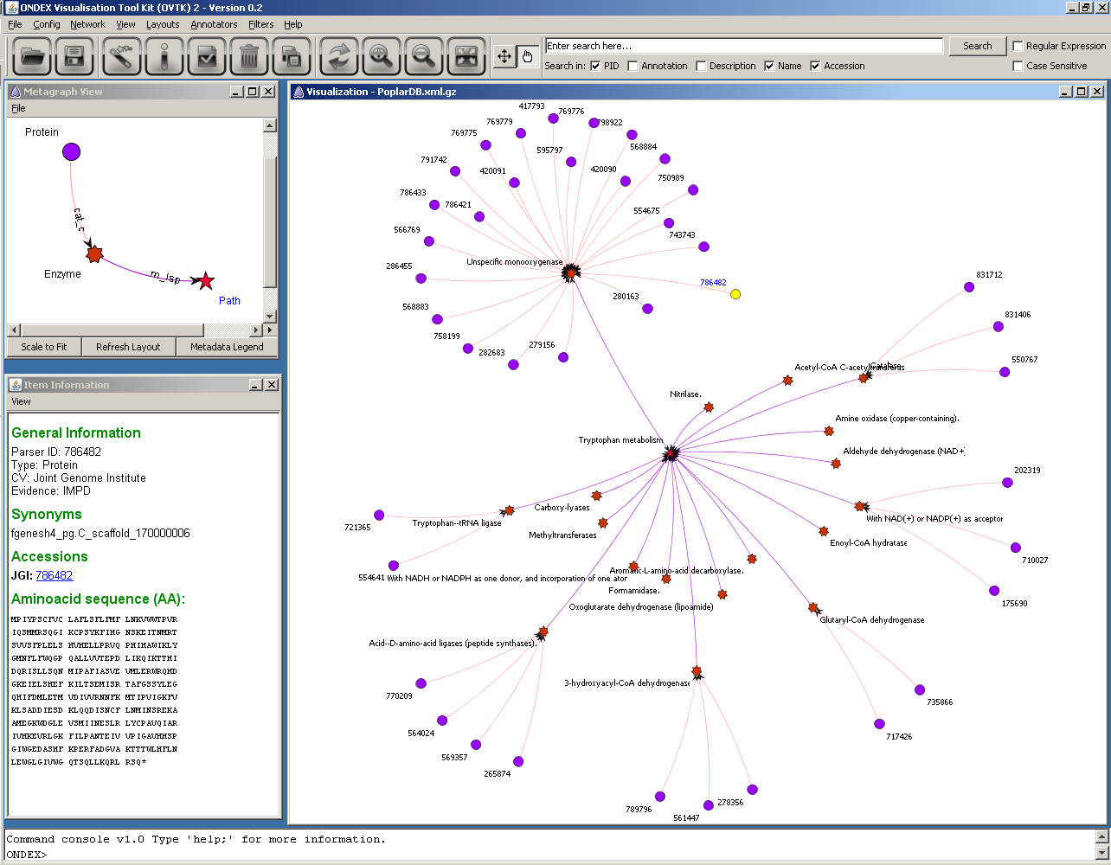
Context Filter
Poplar proteins involved in Tryptophan metabolism
Example1
Notes:
JGI provides mappings between proteins of Poplar and enzymes in KEGG
KEGG pathway (Tryptophan) is in the centre of the graph, contains relations to all enzymes occurring in this pathway
Mappings between Poplar proteins and enzymes exists in some cases
We will try to improve JGI’s KEGG annotations…

Slide 7
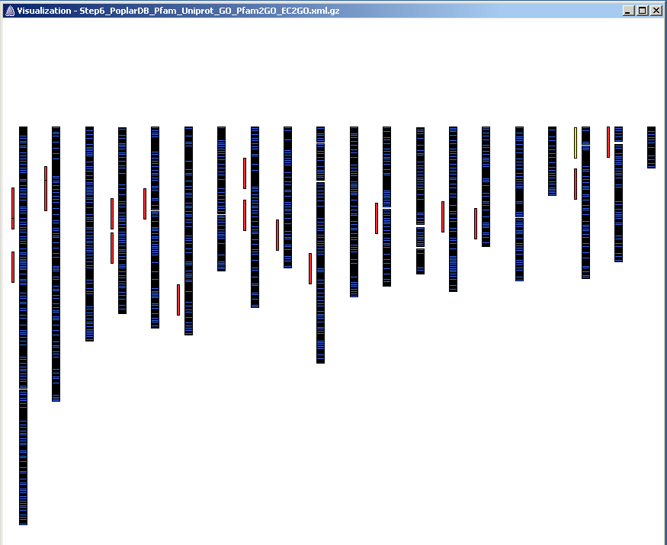
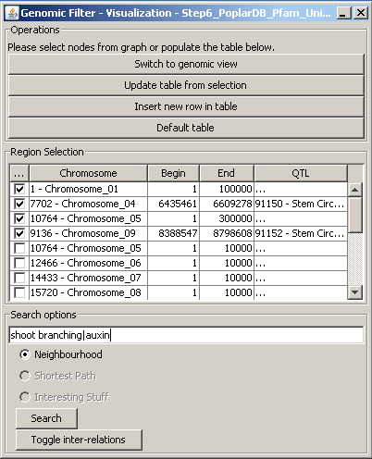
Genomic View in OVTK
Genomic Layout displays chromosomes, genes and QTLs
Chromosomal regions and QTLs can be selected
Example 2 and 3

Slide 8
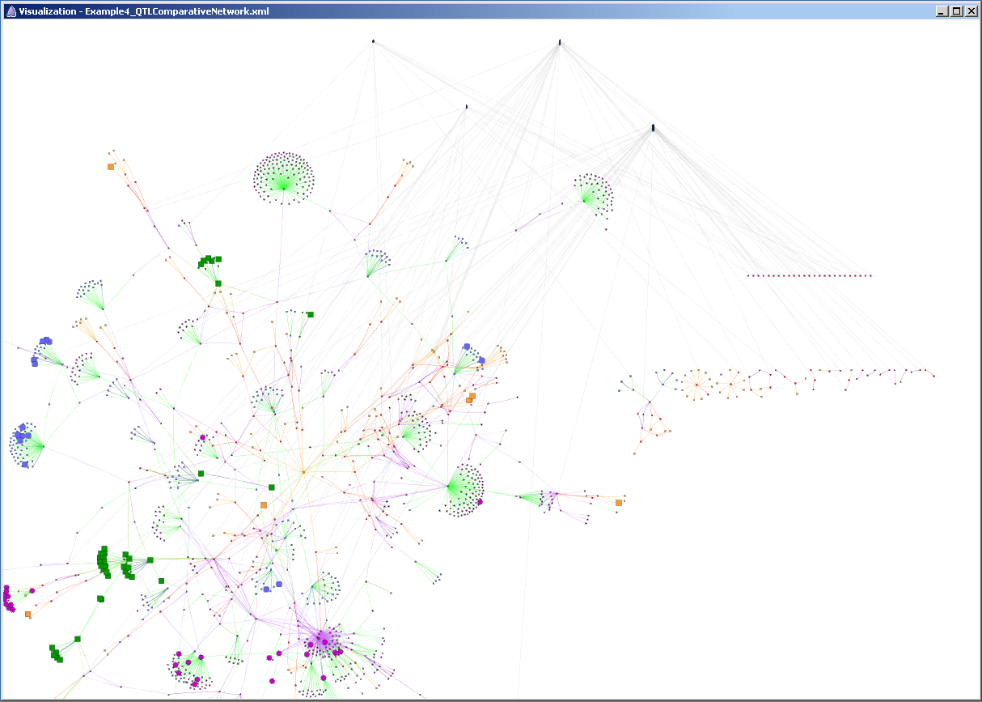
Network View in OVTK
Genes of interest
Enriched protein annotation network

Slide 9
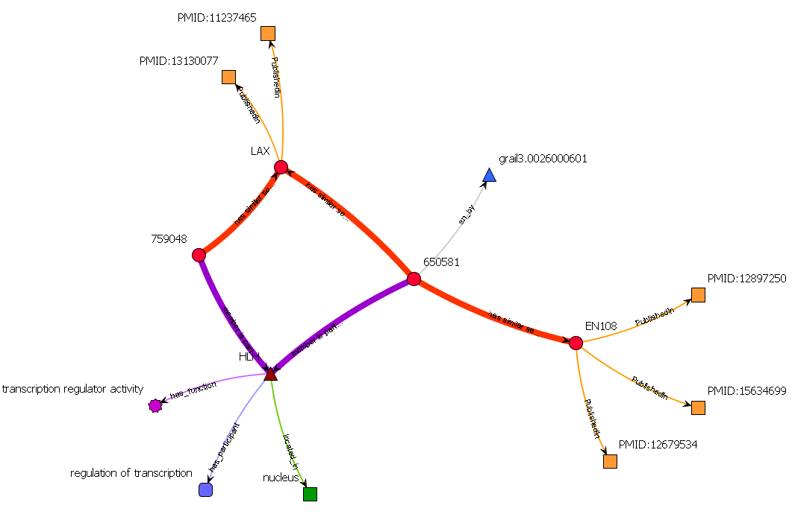
Exploring protein neighbourhoods
Blast 650581 – LAX
E-Value: 3.4E-17
Score: 83.57
Coverage: 27%
Blast 650581 – EN108
E-Value: 9.4E-7
Score: 48.91
Coverage: 20%
PMID:13130077
“LAX and SPA: major regulators of shoot branching in rice.”
HMMer: 650581 – HLH
E-Value: 3.4E-7
Score: 30.0
Poplar protein JGI:650581 has no annotations from JGI We identified two remote homologs in Rice (LAX) and in Arabidopsis (EN108),
as well as one protein domain HLH
The LAX homolog contains evidence to be a major regulator of shoot branching
→ Hypothesis generation

Slide 10
Mining GO annotations with different evidences
Assigning functional terms to query sequences from the pool of GO terms gathered in the mapping step
Take into consideration:
Sequence similarity
The GO evidence
Structure of GO DAG
Evaluation of different annotation methods
has_function
GO
Protein
involved_in
is_sim
located_in
pub_in
Query
is_r
GO
m_isp
Publication
m_isp
GO
Protein Family

