Slide 1
Practical data integration for systems biology using the Ondex system
The Ondex project
contact@ondex.org

Slide 2
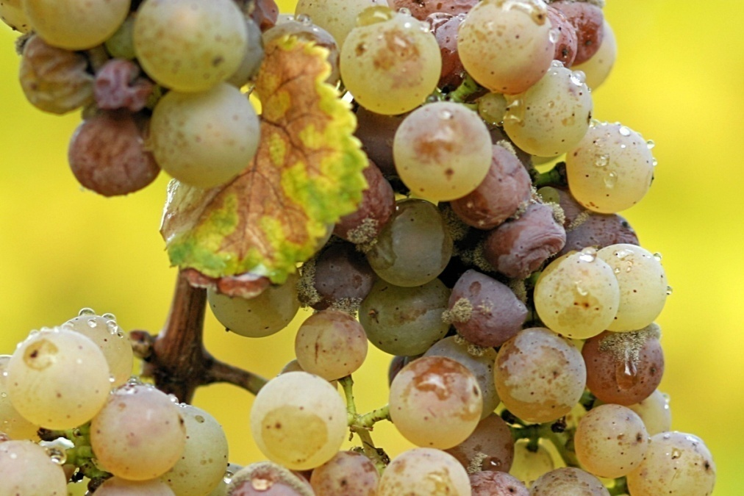
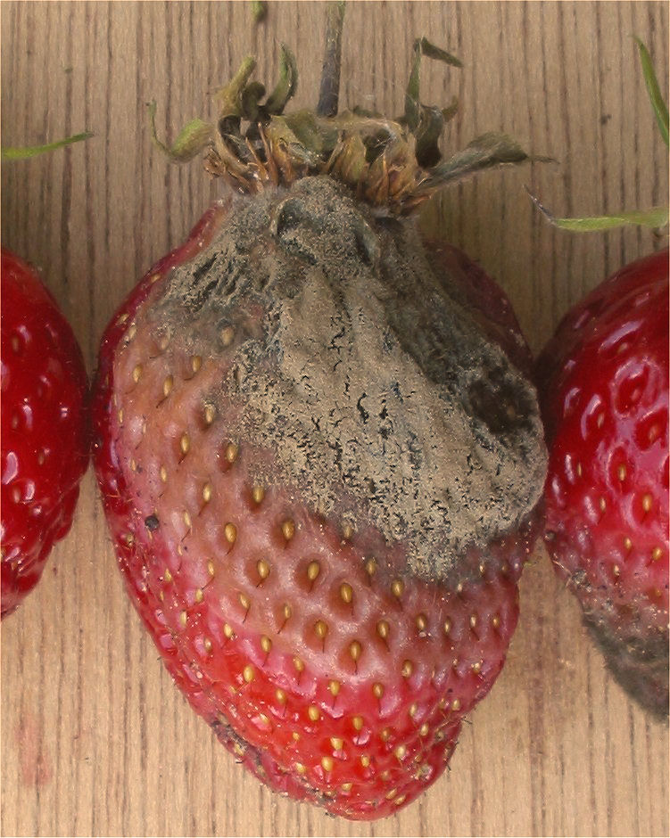
Botrytis cinerea
Genomic data available
BUT no phenotypic data
Notes:
Botrytis cinerea is a necrotrophic fungus that affects many plant species, although its most notable hosts may be wine grapes.

Slide 3
PHI-base
Reference database of virulence and patho-genicity genes validated by gene disruption experiments
Literature mining
Manual curation
http://www.phi-base.org/

Slide 4
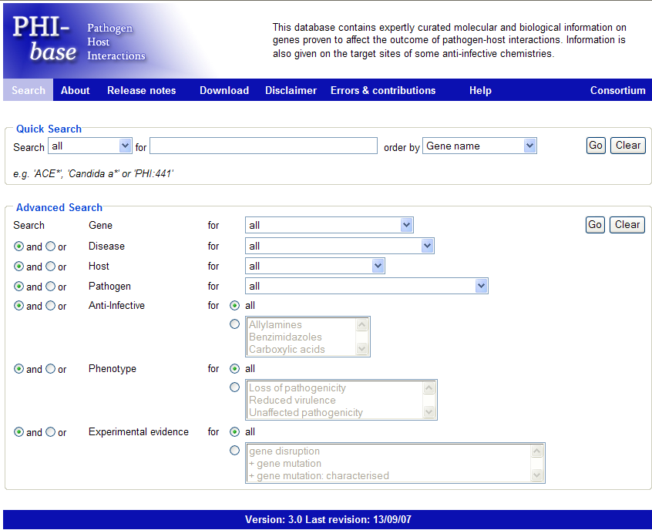
http://www.phi-base.org/
List of “hot” target genes curated from literature
Loss of pathogenicity
Reduced virulence
Only genes validated by gene disruption experiments

Slide 5



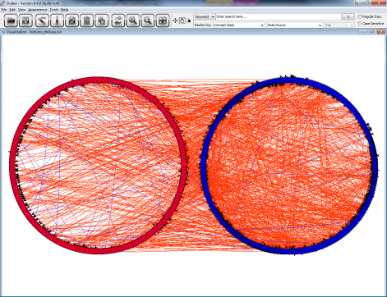

PHI-base & Botrytis integration
Botrytis Cinerea
(grey mould)
genome
OXL
FASTA
Inparanoid
mapping
ONDEX
OXL
clusters of orthologs and paralogs between entries of PHI-base and Botrytis Cinerea

Slide 6
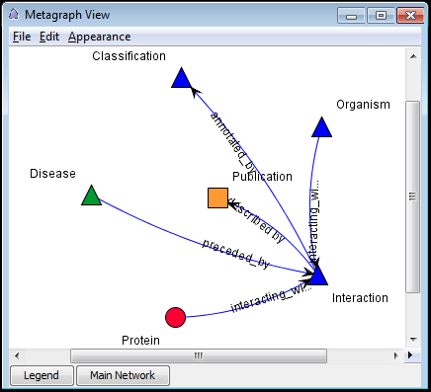
PHI-base in Ondex

Slide 7
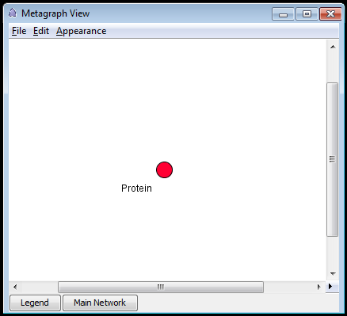
Botrytis genome in Ondex

Slide 8
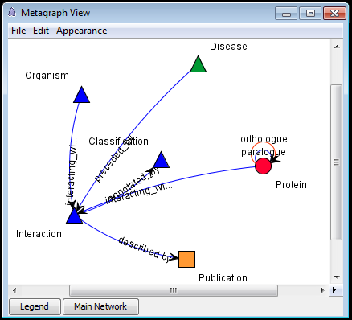
Results of Inparanoid Mapping

Slide 9
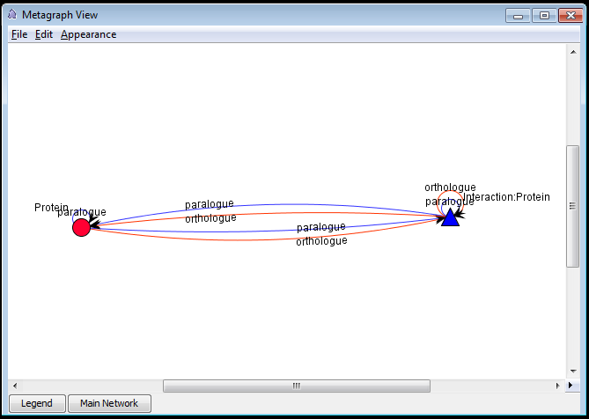
Intermediate results

Slide 10
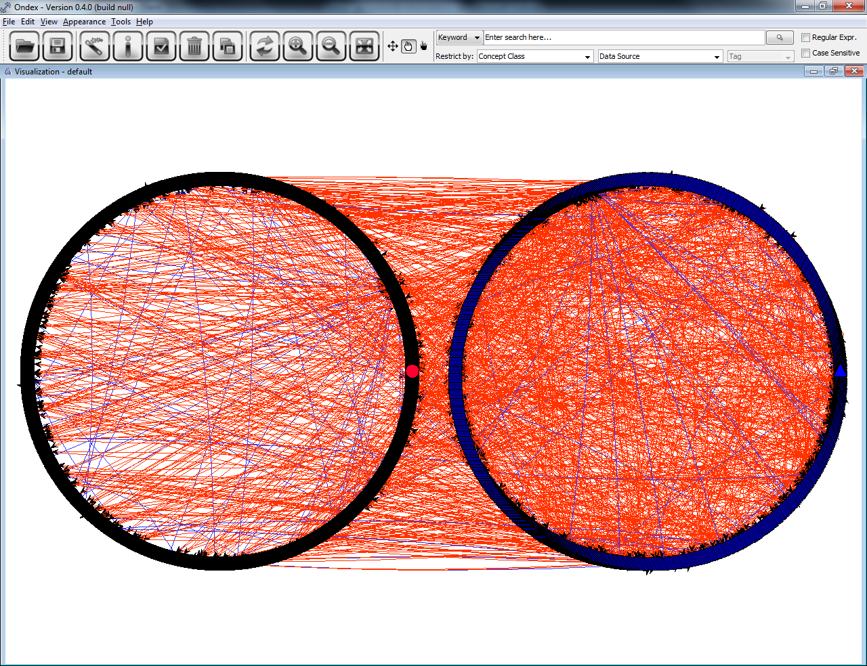
Need to filter out unconnected proteins in the network

Slide 11
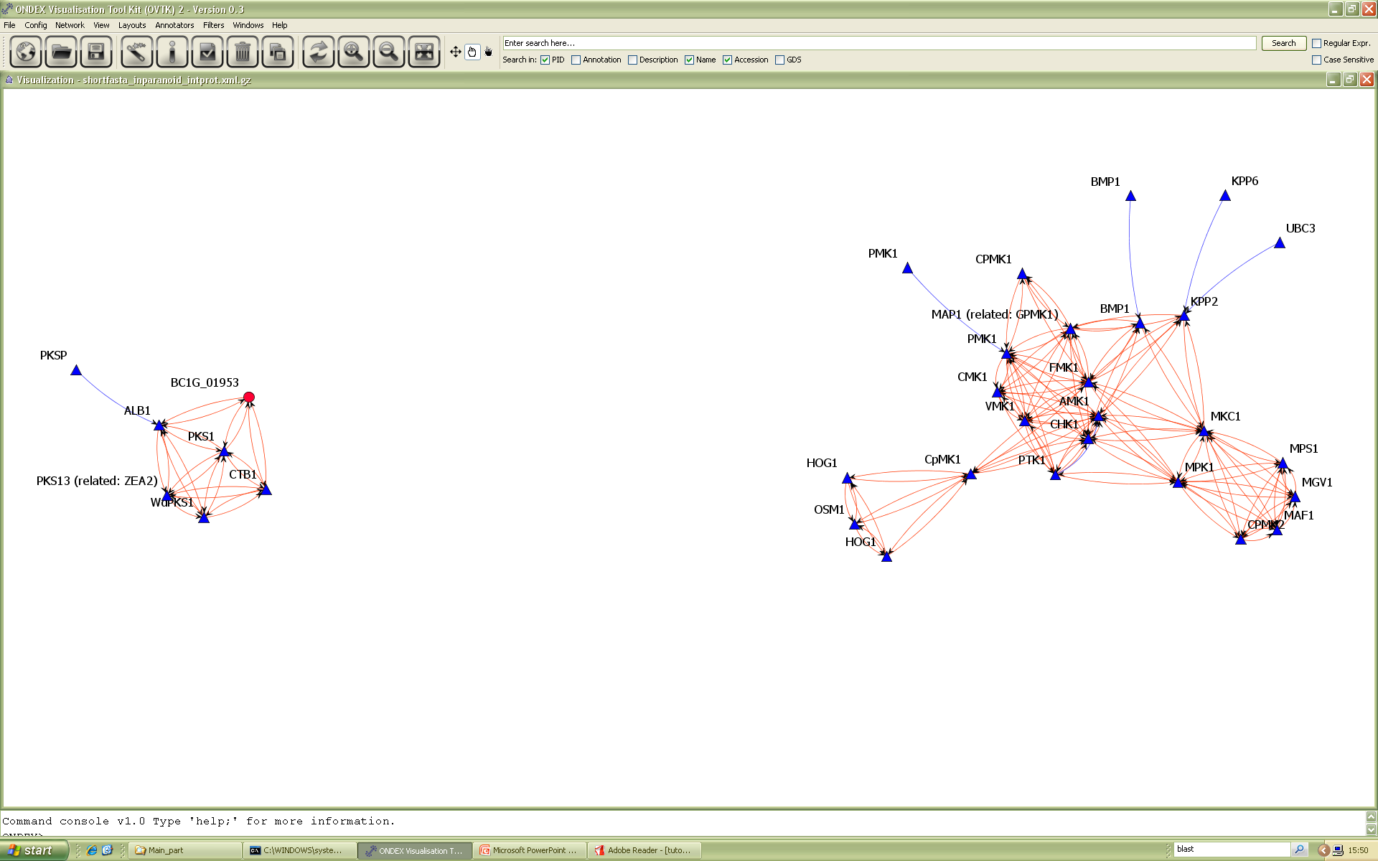
Need to keep clusters including botrytis proteins only
Notes:
GEM layout → group of homologs

Slide 12
Acknowledgements
Newcastle members:
Simon Cockell
James Dewar
Eva Holstein
Katherine James
Philip Lord
David Lydall
Matthew Pocock
Jochen Weile
Darren Wilkinson
Anil Wipat
Rothamsted members:
Catherine Canevet
Keywan Hassani-Pak
Stephen Hanley
Matthew Hindle
Angela Karp
Shao Chih Kuo
Artem Lysenko
Chris Rawlings
Mansoor Saqi
Andrea Splendiani
Jan Taubert
Manchester members:
Sophia Ananiadou
Paul Dobson
Paul Fisher
Carole Goble
Gina Levow
Pedro Mendes
Raheel Nawaz
Georgina Moulton
Robert Stevens
David Withers
Katy Wolstencroft
Biological collaborators:
Kim Hammond-Kosack
Martin Urban
Dimah Habash
David Wild
Katherine Denby
Roxane Legaie
Former members:
Jacob Köhler
Rainer Winnenberg
Edinburgh members:
Igor Goryanin
Andrew Millar
Luna De Ferrari

