Slide 1
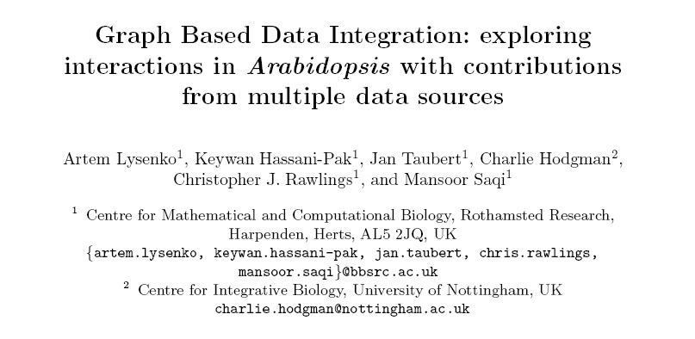
Exploring interactions in Arabidopsis

Slide 2
Integration of 3 PPI networks
IntAct
4625 protein interactions (data derived from literature curation or direct user submissions)
TAIR (The Arabidopsis Information Resource) – 1143 interactions
genome sequence, gene structure, gene product information, metabolism, gene expression, DNA and seed stocks, genome maps, genetic and physical markers, publications

Slide 3
Integration of 3 PPI networks
BioGrid (General Repository for Interaction Datasets)
collections of protein and genetic interactions from major model organism species
1223 interactions for Arabidopsis derived from high-throughput studies and conventional focused studies

Slide 4
Ondex Accession-based mapping
IntAct
TAIR
BioGRID
→ Mapping the 3 databases based on TAIR accessions

Slide 5
Adding 3 sources of evidence
co-expression
sequence similarity
co-occurrence in scientific literature
→ facilitate the identification of functionally related groups of proteins

Slide 6
Co-expression evidence
ATTED II (Arabidopsis thaliana trans-factor and cis-element prediction database)
provides co-regulated gene relationships in Arabidopsis to estimate gene functions
gives the Pearson correlation coefficients of co-expressed genes in Arabidopsis calculated from available microarray data
→ Mapping using TAIR accessions
Notes:
publicly available microarray data
Collected by AtGenExpress (multinational effort to uncover Arabidopsis transcriptome)

Slide 7
Sequence similarity evidence
NCBI PSI-BLAST
identify similarities between our reference set of proteins
Matching against Arabidopsis subset of UNIPROT

Slide 8
Evidence from the literature
Co-occurrence of protein names
25,900 Medline abstracts related to Arabidopsis Thaliana
Integrated Lucene-based mapping method

Slide 9
Integrated Arabidopsis PPI
Nodes are connected if there is evidence from
Interaction
co-expression
sequence similarity
co-occurrence

Slide 10
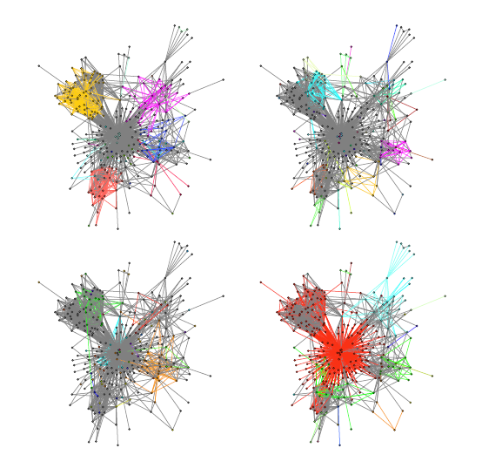
Evidence networks in isolation
Sequence
similarity
Co-occurrence
Co-expression
Protein
interaction
Notes:
Figure shows how this large cluster is broken up into the smaller ones if each of the evidence networks is considered in isolation and clustered with the same parameters. Each of the images is coloured according to distinct clusters found.

Slide 11
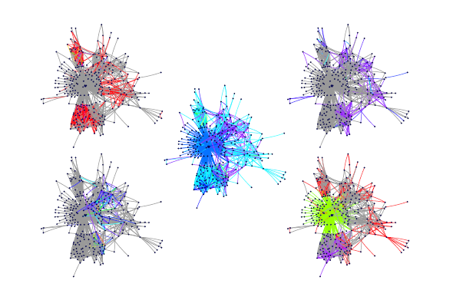
Relations colour = strength of evidence
Sequence
similarity
Co-occurrence
Combined
Protein
interaction
Co-expression
Notes:
Figure shows the sources of evidence associated with the edges where the strength of the edges is indicated by the colour coding.

Slide 12
Added attributes to nodes/edges
Network stats
Betweenness centrality (BWC)
→ How influential (bridge)
Degree centrality (DC)
→ Hub likeness
Markov Clustering
Identifies strongly connected groups of proteins in the network

Slide 13
three_ppi_added_evidence.xml.gz / ABA_cluster.xml.gz (only 1 cluster)
Example 1:
Ann → Scale/Colour Relations by Numerical Value (BLAST weight) (size min 4 max 4) [only BLAST network left]
Ann → Colour Concepts by General Attribute (BLAST Cluster)
Example 2:
Ann → Scale/Colour Relations by Numerical Value (interaction weight) (size min 4 max 4)
Filter → More → Threshold, relations (interaction EBWC)
Example 3:
Ann → Scale/Colour Relations by Numerical Value (interaction weight) (size min 4 max 4)
Ann → Scale/Colour Concepts by Numerical Value (Combined DC) (size min 4 max 100)

