Slide 1
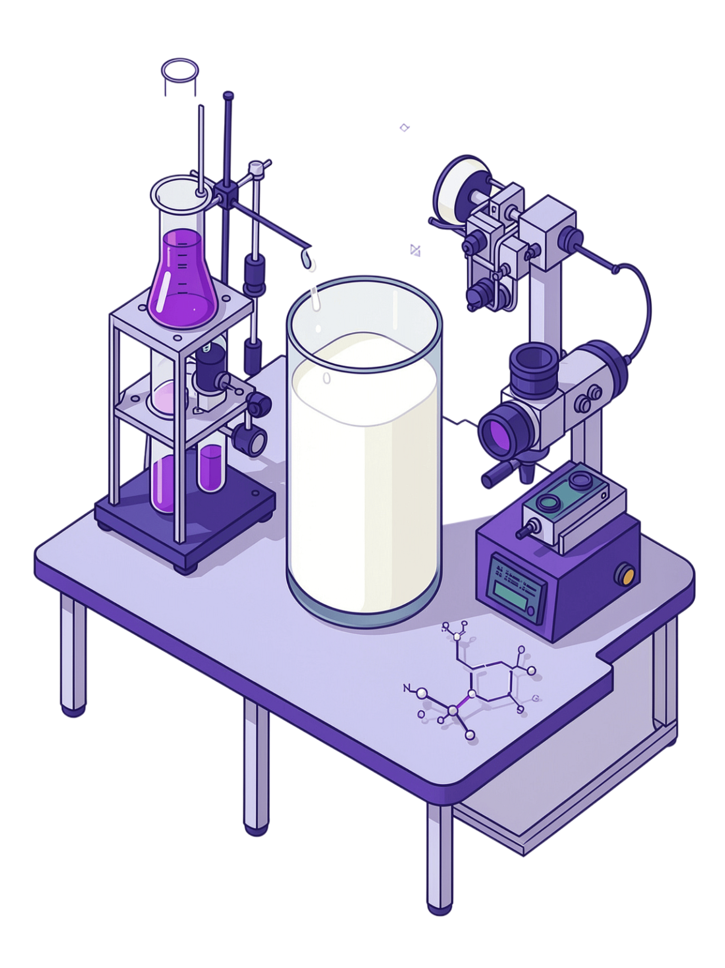
Milk Quality Assessment Using Spectroscopy and Machine Learning
Presented by: Md. Abu Rayhan | Department: Computer Science & Engineering | Supervisor: Md. Toukir Ahmed

Slide 2



Why Use Spectroscopy for Milk Analysis?
Conventional Limitations
Conventional milk analysis can require laboratory testing and chemical procedures.
System Workflow
Rapid & Non-Destructive
Spectroscopy provides rapid and non-destructive analysis without consuming the sample.
Milk Sample
Information-Rich Spectra
Spectral Measurement
A single spectrum contains information related to multiple chemical components simultaneously.
Data Processing
Real-Time Monitoring
Spectroscopy can potentially support real-time or on-farm milk quality monitoring.
ML/Chemometric Model
ML & Chemometrics
Machine learning and chemometrics are used to extract useful information from spectral data.

Slide 3
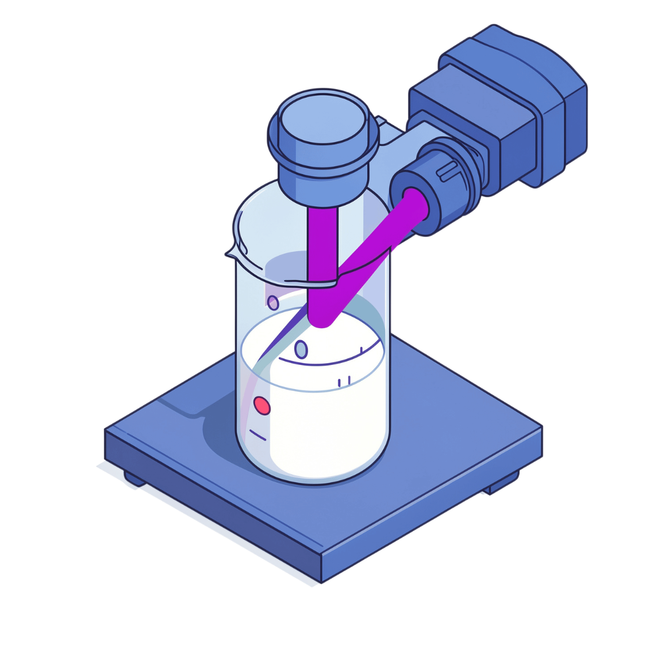
What Can Be Determined from Milk Spectra?
Parameter | Possible Application
Fat | Quantitative prediction
Protein | Quantitative prediction
Lactose | Quantitative prediction
Total Solids | Quantitative prediction
SNF | Milk composition assessment
Urea | Concentration estimation / adulteration screening
Water Adulteration | Adulteration detection
Melamine | Adulteration detection
Sucrose | Adulteration detection
Milk Powder Adulteration | Authenticity assessment
Somatic Cell Count (SCC) | Milk/udder-health related monitoring
NIR and MIR/FTIR spectroscopy are particularly useful for major milk components, while FTIR has also been investigated for adulteration detection.

Slide 4
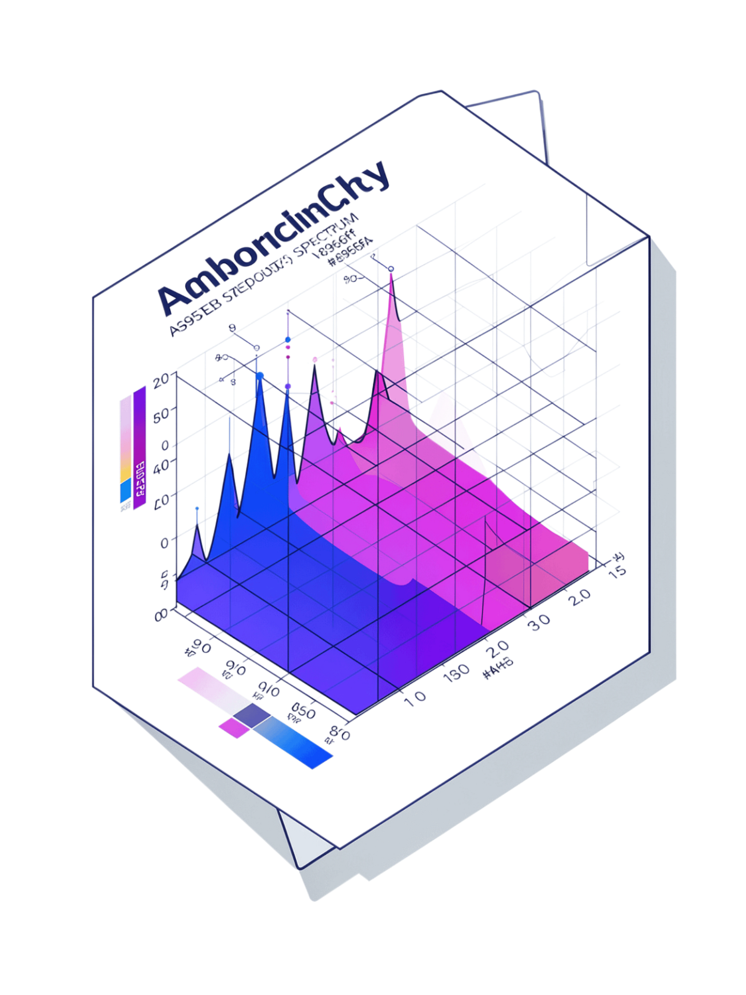
Spectroscopic Techniques
Near-Infrared Spectroscopy (NIR)
Mid-Infrared / FTIR
Provides strong information about molecular vibrations
Widely investigated for milk composition and adulteration
Chemometric models extract quantitative and qualitative information from FTIR spectra
Commonly used for rapid milk composition analysis
Typical regions: ~700–1100 nm and 1100–2400 nm
Useful for predicting fat, protein and lactose
Raman / Fluorescence
Also investigated for milk composition and quality assessment
Often combined with multivariate statistical models

Slide 5
Spectral Data Preprocessing
Common Preprocessing Methods
SNV
Standard Normal Variate
MSC
Multiplicative Scatter Correction
S-G
Savitzky–Golay smoothing
1st Deriv.
First derivative
2nd Deriv.
Second derivative
Norm.
Normalization
Baseline
Baseline correction

Slide 6


Machine Learning / Chemometric Models
For Quantitative Prediction
For Classification
PLSR
PLS-DA
Partial Least Squares Regression — particularly common in milk spectroscopy research
Partial Least Squares Discriminant Analysis
SVM
PCR
Support Vector Machine
Principal Component Regression
Random Forest
SVR
Ensemble classification
Support Vector Regression
Neural Networks
Random Forest Regression
Deep and shallow architectures
Ensemble tree-based method
SVM, RF and ANN are increasingly being investigated alongside the established PLSR approach.
ANN
Artificial Neural Networks

Slide 7

Research Opportunity & Conclusion
Possible Research Objectives
Composition Prediction
Proposed Research Workflow
Predict fat, protein and lactose from milk spectra.
Adulteration Detection
Investigate urea/adulteration detection using spectral signatures.
Model Comparison
Compare PLSR, SVM, Random Forest and ANN.
Preprocessing Optimization
Milk Samples
NIR/FTIR Spectra
Preprocessing
Feature Selection
PLSR & ML Models
Identify the most useful spectral preprocessing method.
Assessment Framework
Develop a rapid, non-destructive milk quality assessment framework.

