Slide 1
Software Design and Architecture
Vasilij Savin
VU MIF ruduo 2024
Notes:
https://www.youtube.com/watch?v=RqfaTIWc3LQ
https://blog.bytebytego.com/p/ep114-7-must-know-strategies-to-scale
https://blog.bytebytego.com/p/ep110-top-5-strategies-to-reduce
https://blog.bytebytego.com/p/ep109-top-6-tools-to-turn-code-into
https://blog.bytebytego.com/p/how-uber-uses-integrated-redis-cache
https://blog.bytebytego.com/p/a-crash-course-in-api-versioning
https://blog.bytebytego.com/p/how-paypal-serves-350-billion-daily
https://blog.bytebytego.com/p/ep107-top-9-architectural-patterns
https://blog.bytebytego.com/p/ep105-the-12-factor-app
https://blog.crushingtecheducation.com/p/design-a-live-video-streaming-platform
https://blog.bytebytego.com/p/ep99-what-is-the-best-way-to-learn
https://blog.bytebytego.com/p/how-to-design-a-good-api
https://blog.crushingtecheducation.com/p/design-a-distributed-priority-queue
https://blog.bytebytego.com/p/ep102-encoding-vs-encryption-vs-tokenization
https://blog.bytebytego.com/p/ep100-polling-vs-webhooks
https://martinfowler.com/articles/feature-toggles.html
https://blog.bytebytego.com/p/100x-scaling-how-figma-scaled-its

Slide 2
Before we start data modelling

Slide 3
General design considerations
Things to keep in mind when designing a larger and complex system

Slide 4
Hardest things to change
Backend
Data Model
API Contracts
External dependencies
Data migration
Notes:
Things only get harder as your business and user base grows.
The more customers you have, the more painful it is to break API compatibility
The longer your business runs, the more painful it is to do a data migration to a new DBMS or DB structure

Slide 5
Tips and suggestions
Decide early on fat vs thin client, where will your business logic reside
Decide on operation granularity
Respect Law of Demeter (need-to-know principle)
Keep in mind SOLID principles, especially SRP
Always thing about API backwards compatibility
It is a good practice to maintain Semantic Versioning for your system
Notes:
A word on SOLID principles, for many years I was putting a lot of attention to follow them and spent considerable time going in more details for each of them.
However not all of those principles aged well. I would say SRP (Single Responsibility) is probably one of the KEY principles that should be followed pretty religiously.
Rest are more niche as long as you keep the API contract from breaking, they mostly cover how not to break backwards compatibility and what to do instead

Slide 6
Decide early on fat vs thin client, where will your business logic reside
Keep in mind release and business cycles.
How often does your business logic change?
How quickly do you need to respond to change?
Usually early on, backend is easier and faster to change. As time goes by, it becomes more and more calcified and harder to change to avoid breaking things.

Slide 7
Decide on operation granularity
More fine-grained operations expose data model to clients, increase coupling while keep API more generic (e.g. basic CRUD operations)
More coarse-grained are better business-aligned but can reduce API reusability by making each API endpoint tailor-made to specific business case and have less expected side effects (e.g. sending SMS or email each time you call an operation)

Slide 8
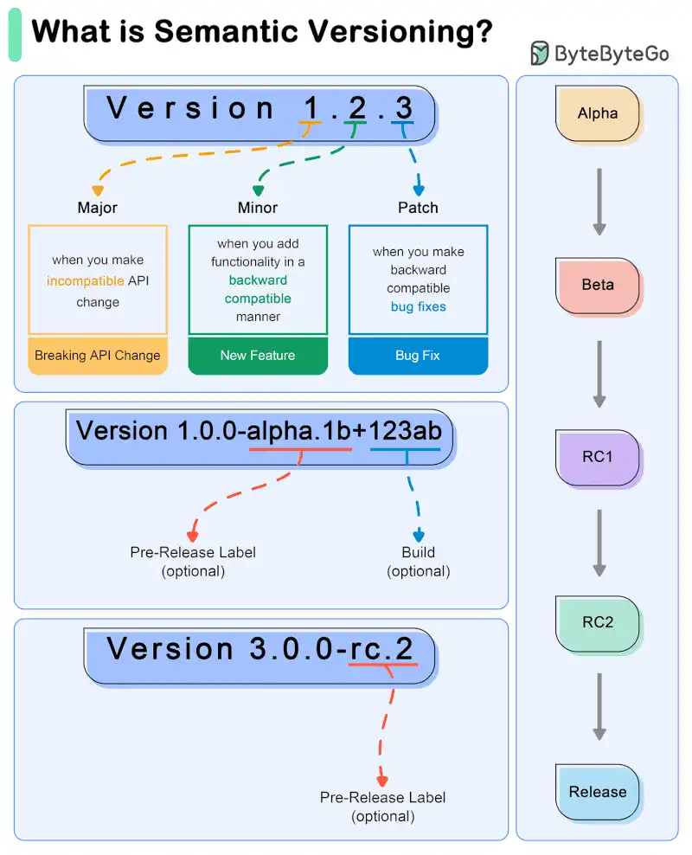

Slide 9
Domain data modelling

Slide 10
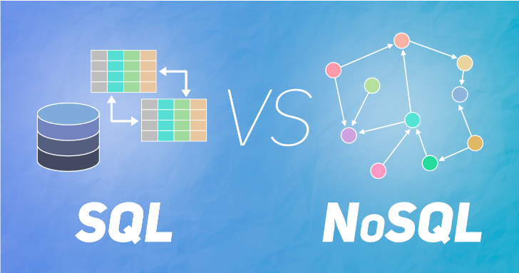

Slide 11
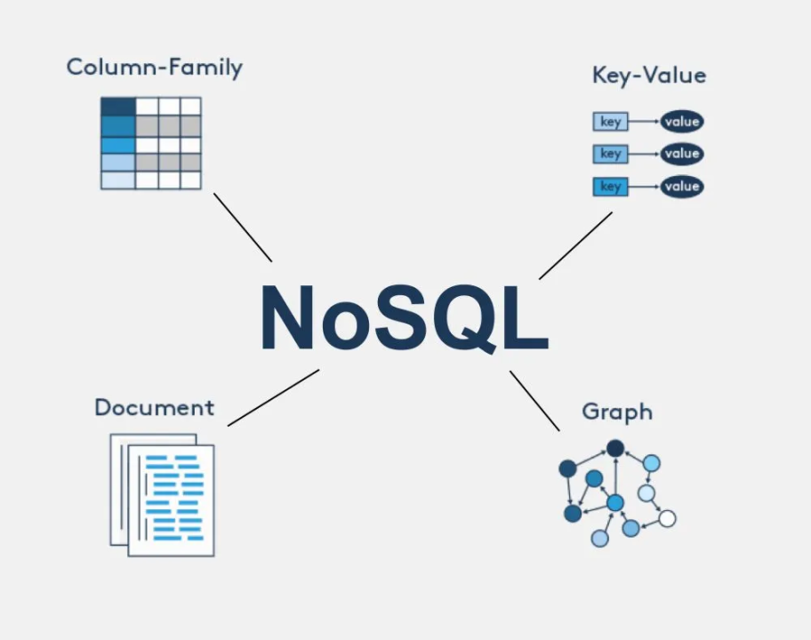

Slide 12
My personal take
Err on the SQL side unless you really know what you are doing
SQL gives you robust model that has been proven for more than 40 years
Querying and aggregating data is simple and easy
Products are mature, stable and usually free for small-scale operations
It is ‘relatively’ easier to migrate when you are forced to
Performance is usually good enough until you hit really high level of usage

Slide 13
Steps in Domain data modelling
Define the purpose and business context of the model you are building
Gather business requirements and constraints
Design DB table structure
Normalise the DB structure (eliminate duplicatation)
Notes:
What is business flow?
A set of operations that change state and culminate in successful business transaction

Slide 14
DB Design Recommendations
Always seek to identify business constraints and rules
Can the field be null or negative?
Avoid using calculatable fields in the DB
Adopt insert-only DB update strategy
Consider business case needs when normalising DB structure
How many joins will you need to do to extract data you want

Slide 15
GDPR and Privacy by Design
Notes:
https://termly.io/resources/articles/gdpr-in-the-us/

Slide 16
GDPR principles
Lawfulness, fairness, transparency (requiring explicit consent)
Purpose limitation (Specified, explicit legitimate business interests)
Data minimisation (only required by legitimate interests data is collected)
Accuracy (data kept up to date)
Storage limitation (data expiration)
Integrity, confidentiality (access controls and non-tampering)
Notes:
Source: https://gdpr-info.eu/art-5-gdpr/

Slide 17
Personal Identifiable Information
Name
Email
Biometrics (retina or fingerprint)
Credit card data
Driving license number, passport number, SSN
Phone number
Address
Age or Date of Birth
Gender
Location

Slide 18
Special personal data
Racial/ethnic origin
Political opinions or affiliations
Religious or philosophical beliefs
Trade union membership
Genetic / medical information
Sex life or orientation
Criminal record (special conditions apply)
Notes:
https://gdpr-info.eu/art-9-gdpr/

