Slide 1
Game Playing

Slide 2
Today’s class
Game playing
  State of the art and resources
  Framework
Game trees
  Minimax
  Alpha-beta pruning
  Adding randomness

Slide 3
Why study games?
Clear criteria for success
Offer an opportunity to study problems involving {hostile, adversarial, competing} agents.
Historical reasons
Fun
Interesting, hard problems which require minimal “initial structure”
Games often define very large search spaces
  chess 35¹⁰⁰ nodes in search tree, 10⁴⁰ legal states

Slide 4
State of the art
How good are computer game players?
  Chess:
    Deep Blue beat Gary Kasparov in 1997
    Garry Kasparav vs. Deep Junior (Feb 2003): tie!
    Kasparov vs. X3D Fritz (November 2003): tie!
    http://www.thechessdrum.net/tournaments/Kasparov-X3DFritz/index.html
    Deep Fritz beat world champion Vladimir Kramnik (2006)
  Checkers: Chinook (an AI program with a very large endgame database) is the world champion and can provably never be beaten. Retired in 1995
  Go: Computer players have finally reached tournament-level play
  Bridge: “Expert-level” computer players exist (but no world champions yet!)
Good places to learn more:
  http://www.cs.ualberta.ca/~games/
  http://www.cs.unimass.nl/icga

Slide 5
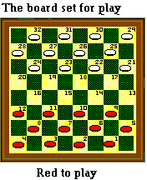
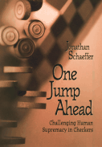
Chinook
Chinook is the World Man-Machine Checkers Champion, developed by researchers at the University of Alberta.
It earned this title by competing in human tournaments, winning the right to play for the (human) world championship, and eventually defeating the best players in the world.
Visit http://www.cs.ualberta.ca/~chinook/ to play a version of Chinook over the Internet.
The developers have fully analyzed the game of checkers, and can provably never be beaten (http://www.sciencemag.org/cgi/content/abstract/1144079v1)
“One Jump Ahead: Challenging Human Supremacy in Checkers” Jonathan Schaeffer, University of Alberta (496 pages, Springer. $34.95, 1998).

Slide 6
Typical case
2-person game
Players alternate moves
Zero-sum: one player’s loss is the other’s gain
Perfect information: both players have access to complete information about the state of the game. No information is hidden from either player.
No chance (e.g., using dice) involved
Examples: Tic-Tac-Toe, Checkers, Chess, Go, Nim, Othello
Not: Bridge, Solitaire, Backgammon, ...

Slide 7
How to play a game
A way to play such a game is to:
  Consider all the legal moves you can make
  Compute the new position resulting from each move
  Evaluate each resulting position and determine which is best
  Make that move
  Wait for your opponent to move and repeat
Key problems are:
  Representing the “board”
  Generating all legal next boards
  Evaluating a position

Slide 8
Evaluation function
Evaluation function or static evaluator is used to evaluate the “goodness” of a game position.
  Contrast with heuristic search where the evaluation function was a non-negative estimate of the cost from the start node to a goal and passing through the given node
The zero-sum assumption allows us to use a single evaluation function to describe the goodness of a board with respect to both players.
  f(n) >> 0: position n good for me and bad for you
  f(n) << 0: position n bad for me and good for you
  f(n) near 0: position n is a neutral position
  f(n) = +infinity: win for me
  f(n) = -infinity: win for you

Slide 9
Evaluation function examples
Example of an evaluation function for Tic-Tac-Toe:
  f(n) = [# of 3-lengths open for me] - [# of 3-lengths open for you]
  where a 3-length is a complete row, column, or diagonal
Alan Turing’s function for chess
  f(n) = w(n)/b(n) where w(n) = sum of the point value of white’s pieces and b(n) = sum of black’s
Most evaluation functions are specified as a weighted sum of position features:
  f(n) = w₁*feat₁(n) + w₂*feat₂(n) + ... + w_{n}*feat_{k}(n)
Example features for chess are piece count, piece placement, squares controlled, etc.
Deep Blue had over 8000 features in its evaluation function

Slide 10
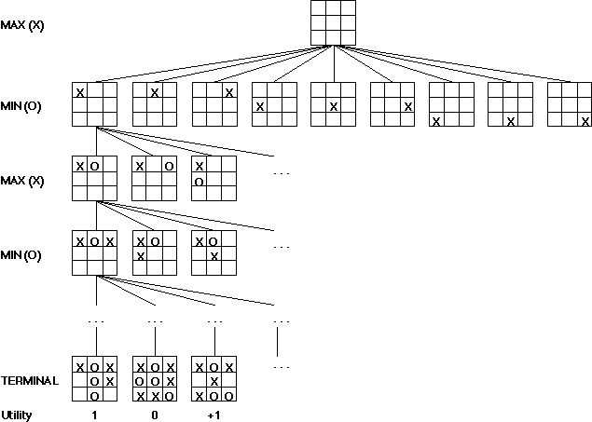
Game trees
Problem spaces for typical games are represented as trees
Root node represents the current
board configuration; player must decide the best single move to make next
Static evaluator function rates a board position. f(board) = real number with
f>0 “white” (me), f<0 for black (you)
Arcs represent the possible legal moves for a player
If it is my turn to move, then the root is labeled a "MAX" node; otherwise it is labeled a "MIN" node, indicating my opponent's turn.
Each level of the tree has nodes that are all MAX or all MIN; nodes at level i are of the opposite kind from those at level i+1

Slide 11
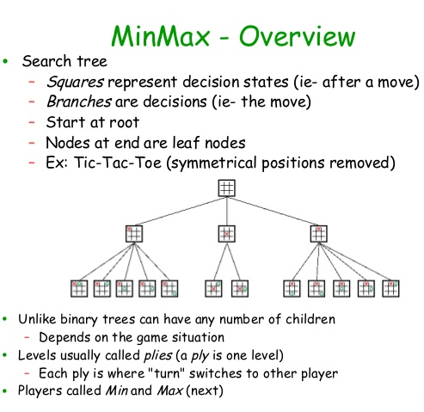


Slide 12
Minimax procedure
Create start node as a MAX node with current board configuration
Expand nodes down to some depth (a.k.a. ply) of lookahead in the game
Apply the evaluation function at each of the leaf nodes
“Back up” values for each of the non-leaf nodes until a value is computed for the root node
  At MIN nodes, the backed-up value is the minimum of the values associated with its children.
  At MAX nodes, the backed-up value is the maximum of the values associated with its children.
Pick the operator associated with the child node whose backed-up value determined the value at the root

Slide 13
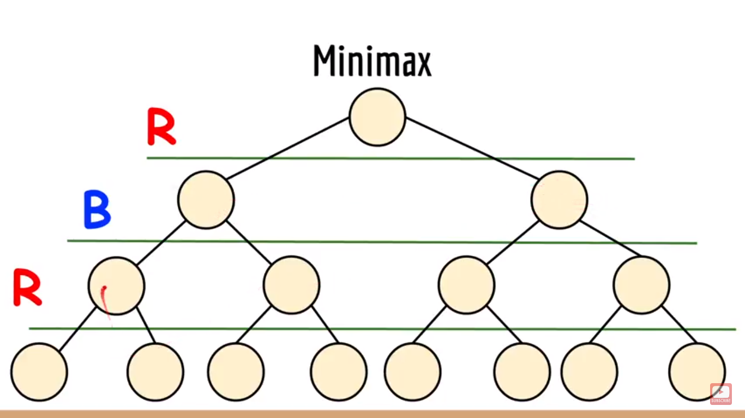

Slide 14
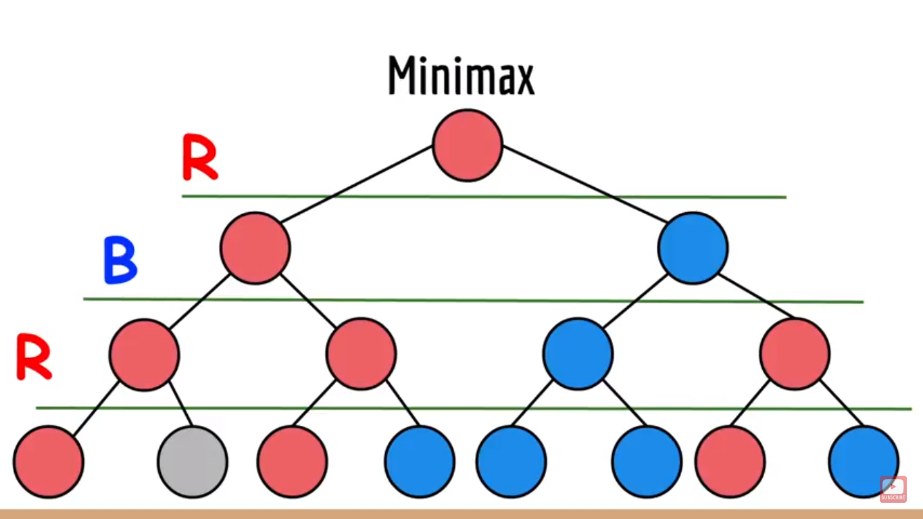

Slide 15
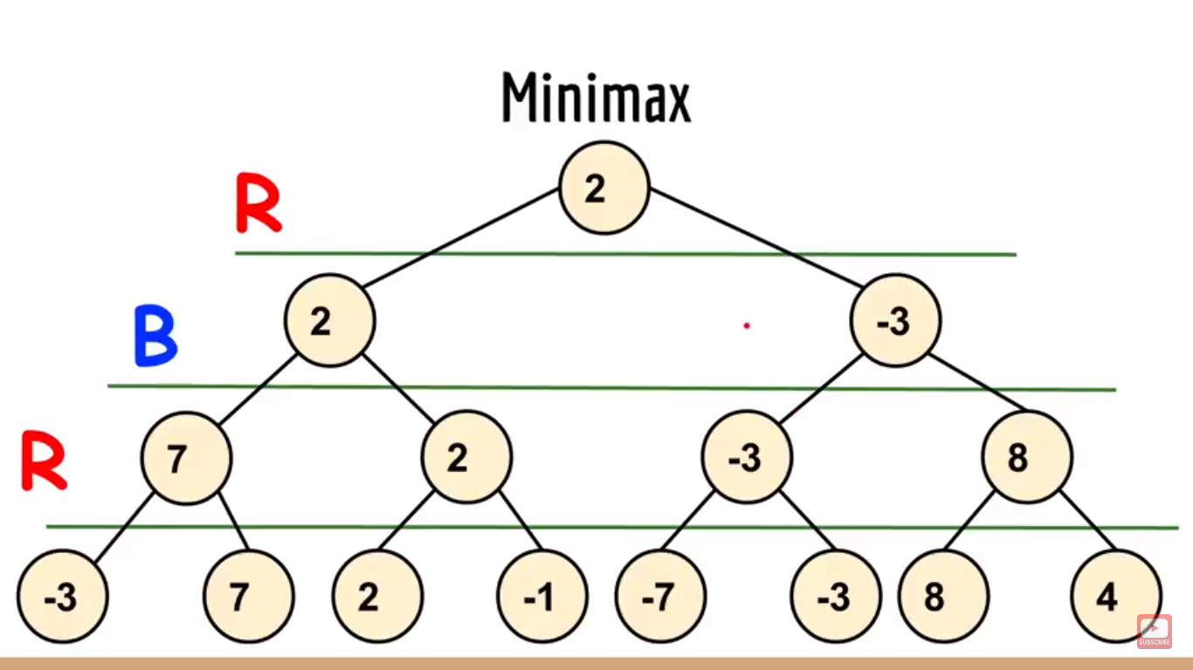

Slide 16
Minimax Algorithm
2
2
1
2
1
2
7
1
8
2
7
1
8
2
7
1
8
This is the move
selected by minimax
2
Static evaluator
value
2
1
MAX
MIN
2
7
1
8

Slide 17
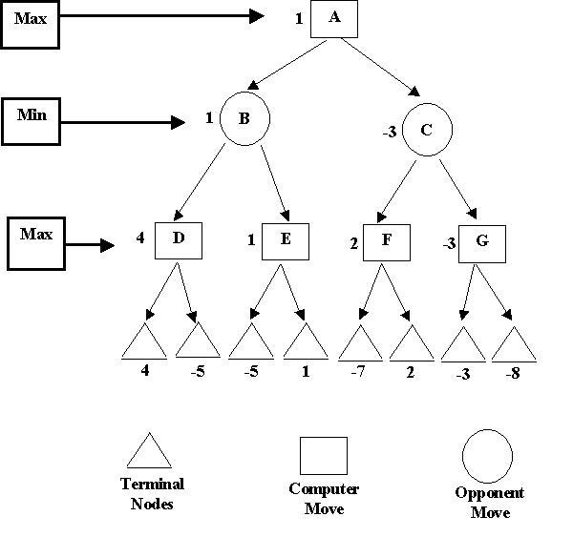

Slide 18
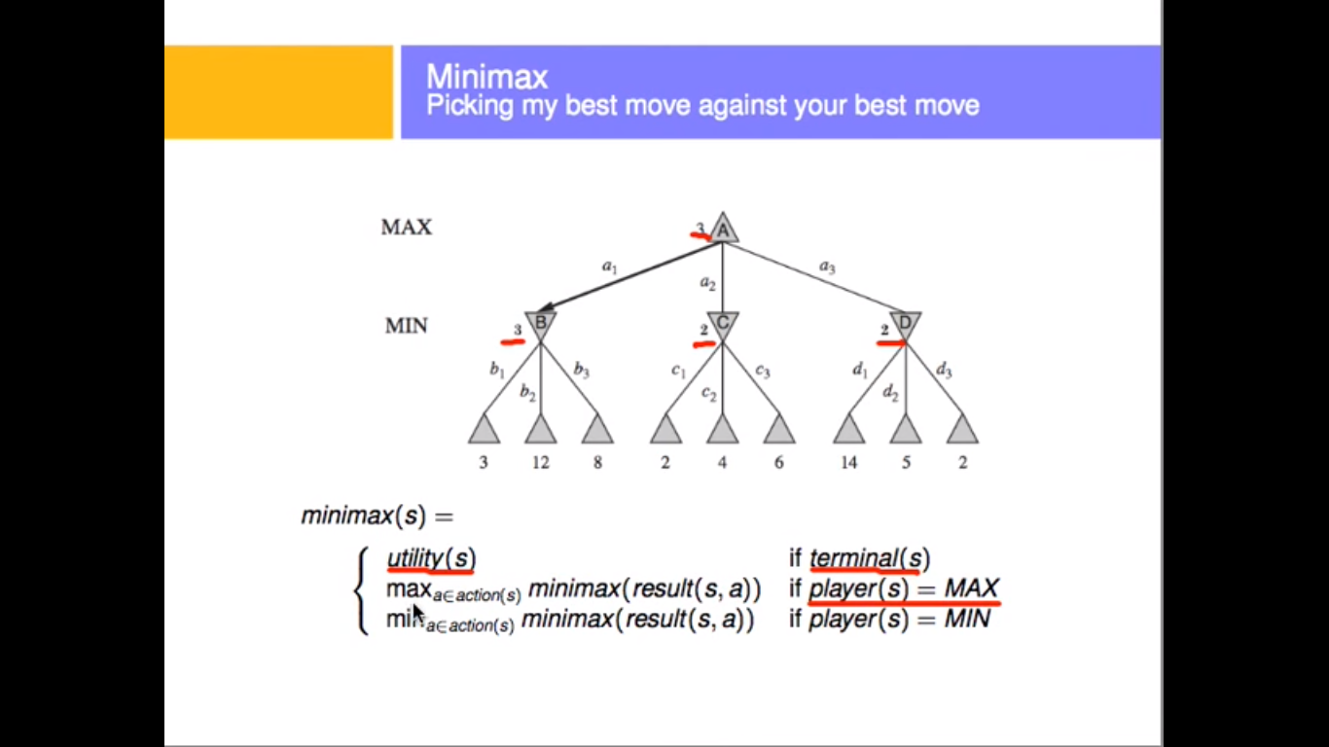

Slide 19
Partial Game Tree for Tic-Tac-Toe
f(n) = +1 if the position is a win for X.
f(n) = -1 if the position is a win for O.
f(n) = 0 if the position is a draw.

Slide 20
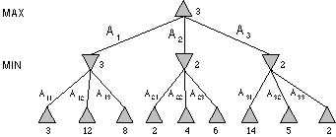
Minimax Tree
MAX node
MIN node
value computed
by minimax
f value

Slide 21
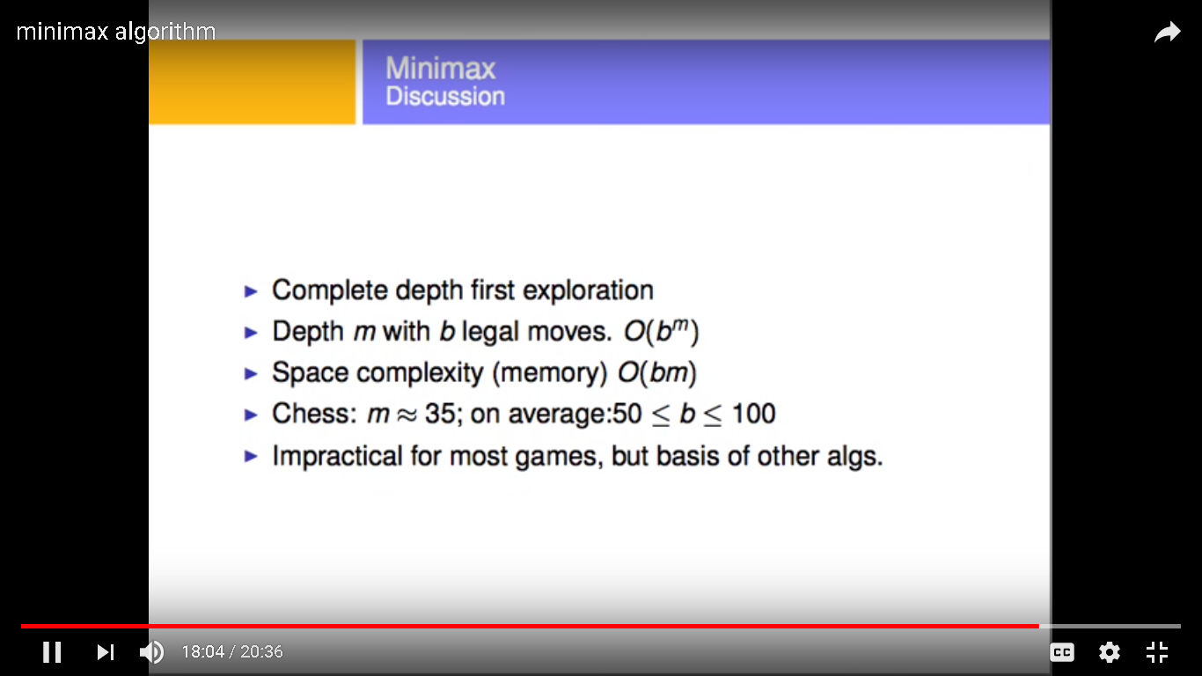

Slide 22
Nim Game Tree
Let us take an example of a simple game 5- stone Nim. So this game is played with two players and a pile of stones. Suppose we have 15 stones to start with. Each player removes either one or two stones from the pile and the player who removes the last stone wins the game. This is the description of the game of the 5-stone Nim where each player can remove one or two stones at a time. Let us draw the game tree of this game.

Slide 23
Alpha-beta pruning
We can improve on the performance of the minimax algorithm through alpha-beta pruning
Basic idea: “If you have an idea that is surely bad, don't take the time to see how truly awful it is.” -- Pat Winston
MAX
>=2
We don’t need to compute the value at this node.
No matter what it is, it can’t affect the value of the root node.
MIN
=2
<=1
MAX
2
7
1
?

Slide 24
Alpha-beta pruning
Traverse the search tree in depth-first order
At each MAX node n, alpha(n) = maximum value found so far
At each MIN node n, beta(n) = minimum value found so far
  Note: The alpha values start at -infinity and only increase, while beta values start at +infinity and only decrease.
Beta cutoff: Given a MAX node n, cut off the search below n (i.e., don’t generate or examine any more of n’s children) if alpha(n) >= beta(i) for some MIN node ancestor i of n.
Alpha cutoff: stop searching below MIN node n if beta(n) <= alpha(i) for some MAX node ancestor i of n.

Slide 25
Alpha-beta example
MAX
3
MIN
3
2 - prune
14
1 - prune
3
12
8
2
14
1

Slide 26
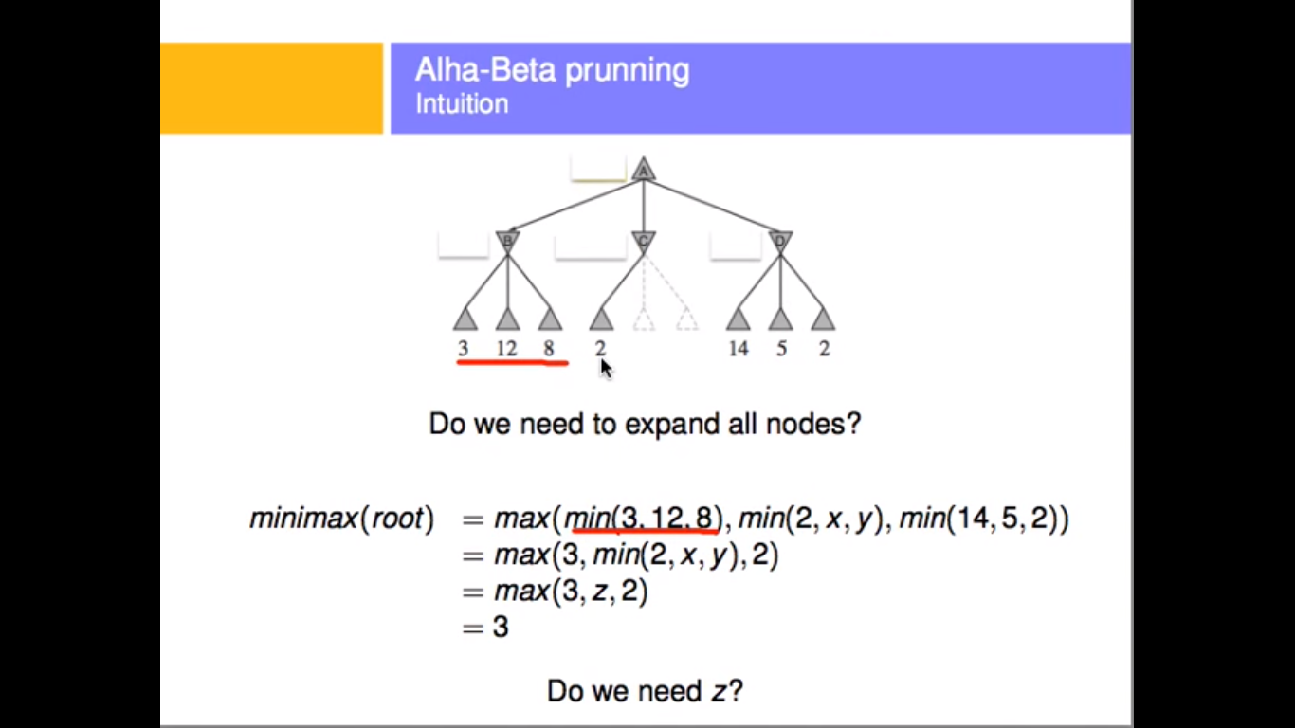

Slide 27
Alpha-beta algorithm
function MAX-VALUE (state, α, β)
;; α = best MAX so far; β = best MIN
if TERMINAL-TEST (state) then return UTILITY(state)
v := -∞
for each s in SUCCESSORS (state) do
v := MAX (v, MIN-VALUE (s, α, β))
if v >= β then return v
α := MAX (α, v)
end
return v
function MIN-VALUE (state, α, β)
if TERMINAL-TEST (state) then return UTILITY(state)
v := ∞
for each s in SUCCESSORS (state) do
v := MIN (v, MAX-VALUE (s, α, β))
if v <= α then return v
β := MIN (β, v)
end
return v

Slide 28
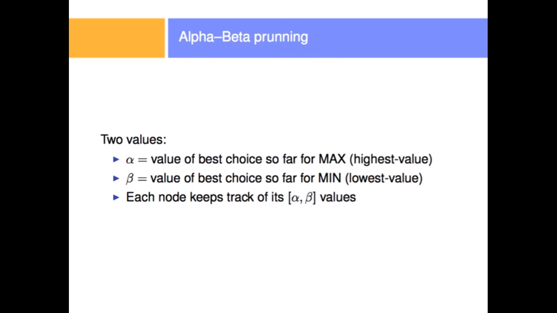

Slide 29
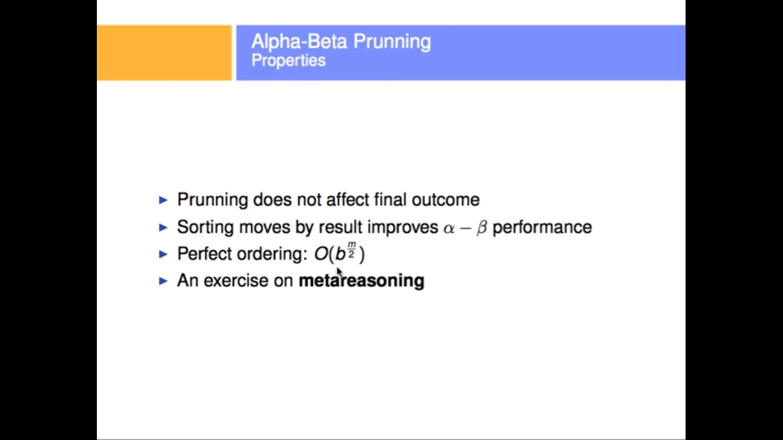

Slide 30
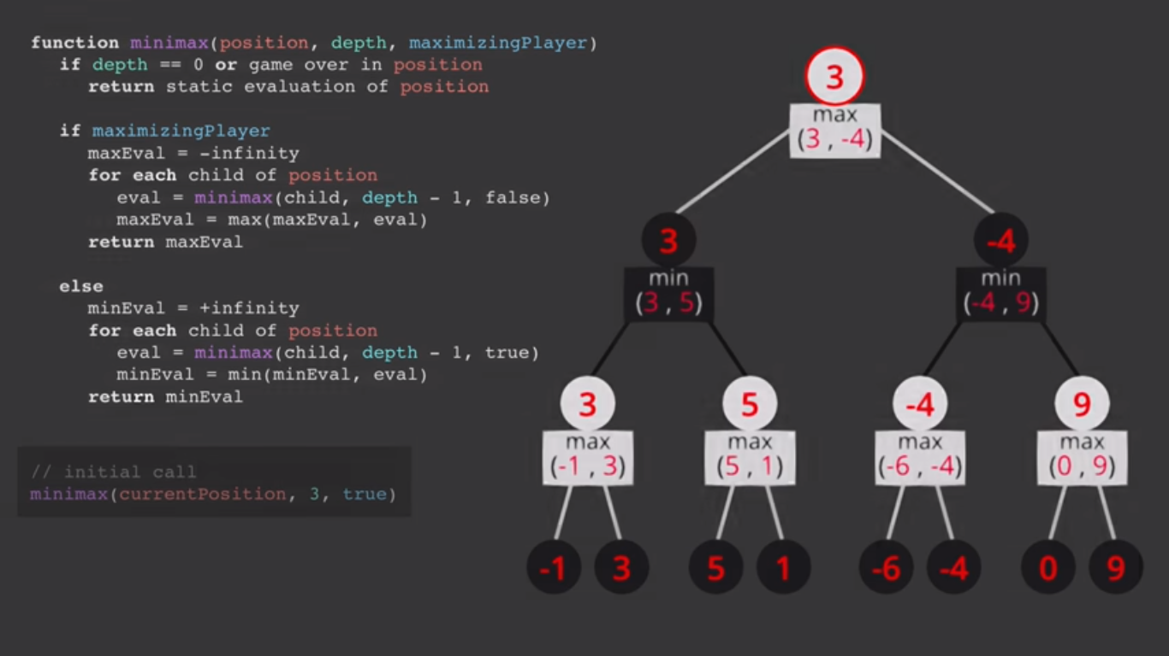

Slide 31
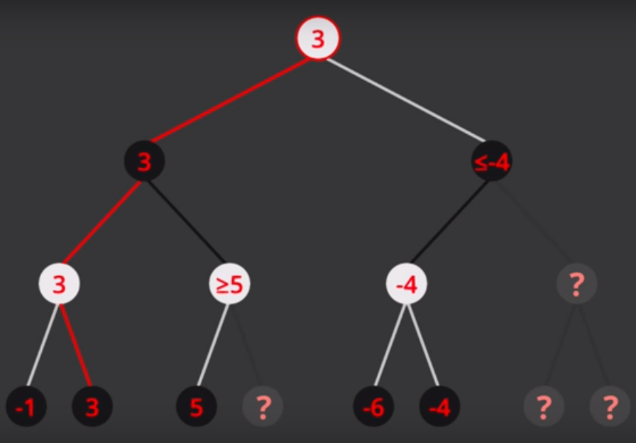

Slide 32
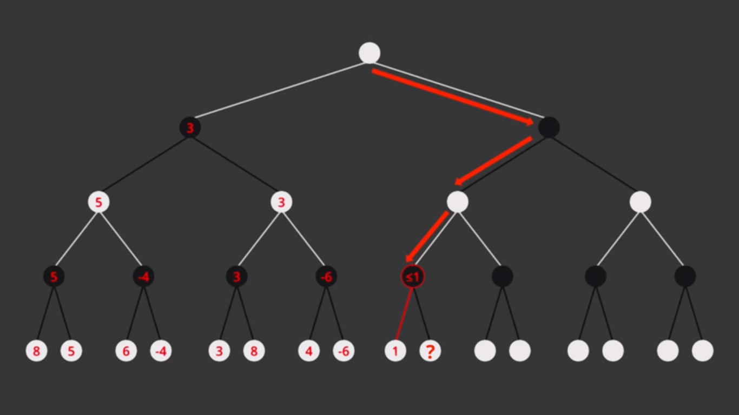

Slide 33
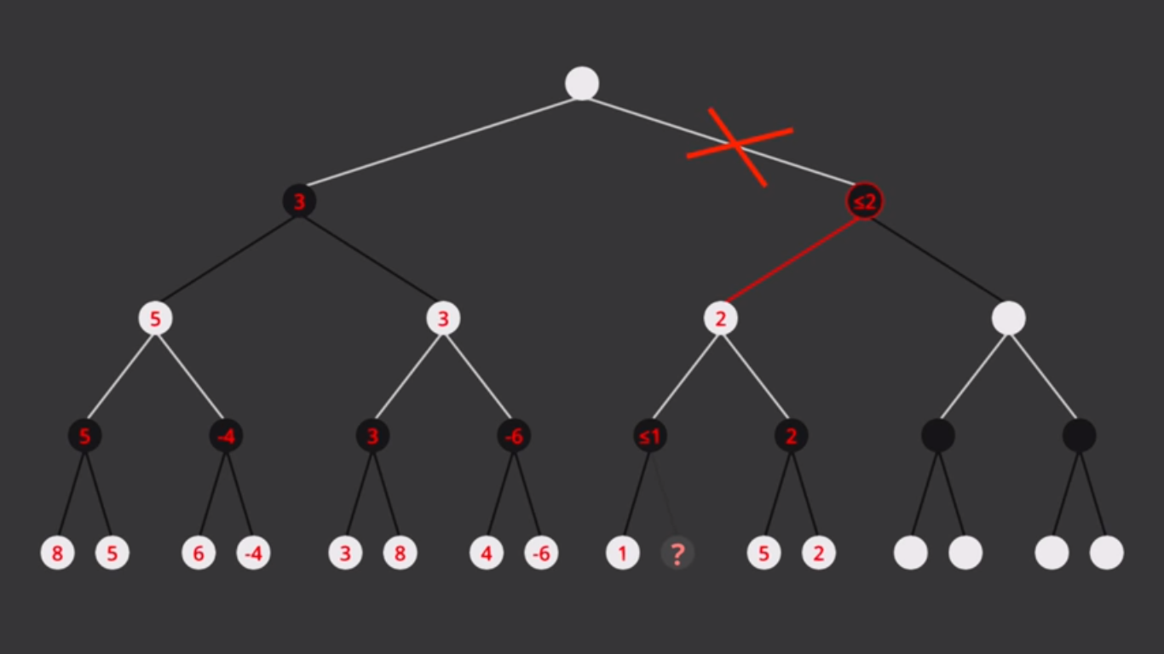

Slide 34
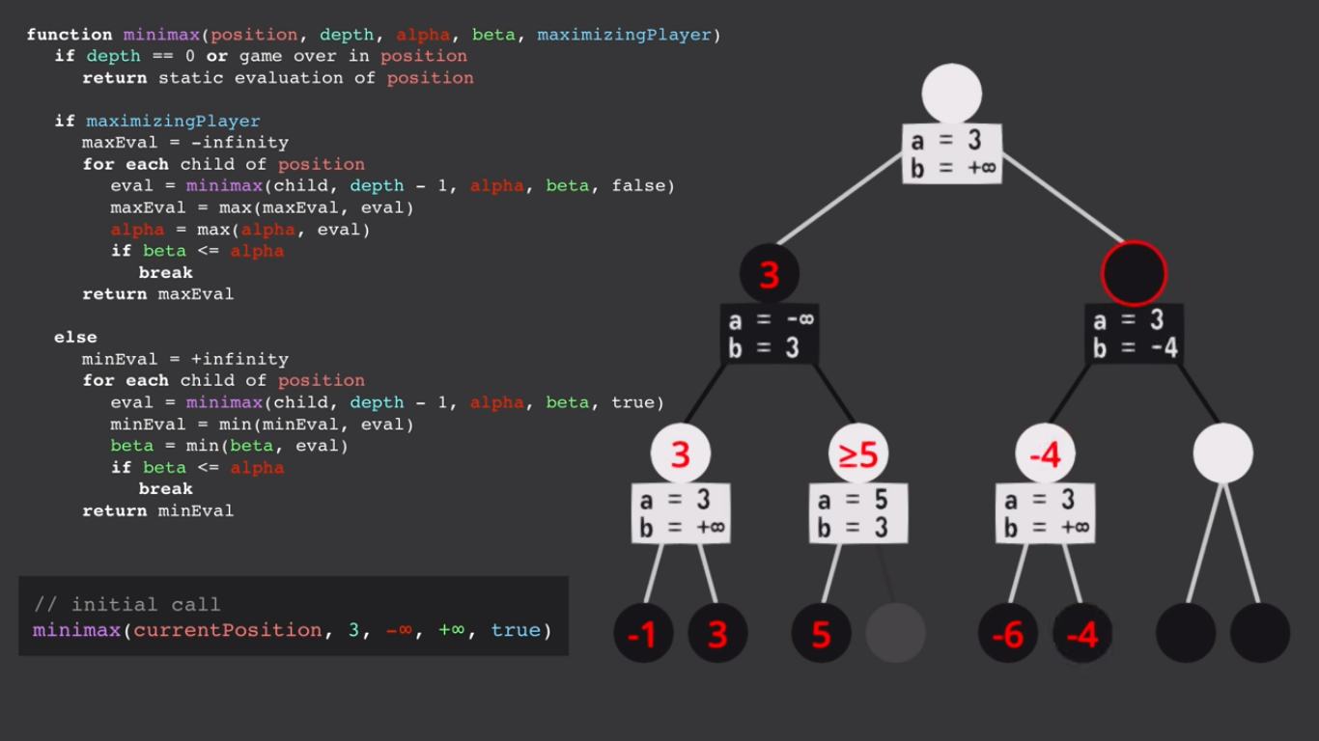

Slide 35
Effectiveness of alpha-beta
Alpha-beta is guaranteed to compute the same value for the root node as computed by minimax, with less or equal computation
Worst case: no pruning, examining b^{d} leaf nodes, where each node has b children and a d-ply search is performed
Best case: examine only (2b)^{d/2} leaf nodes.
  Result is you can search twice as deep as minimax!
Best case is when each player’s best move is the first alternative generated
In Deep Blue, they found empirically that alpha-beta pruning meant that the average branching factor at each node was about 6 instead of about 35!

Slide 36
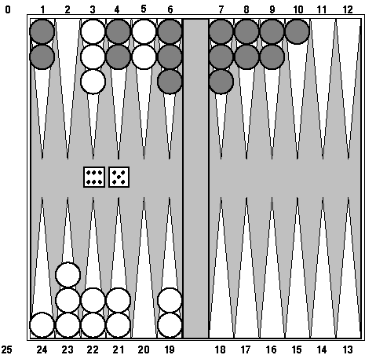
Games of chance
Backgammon is a two-player game with uncertainty.
Players roll dice to determine what moves to make.
White has just rolled 5 and 6 and has four legal moves:
  5-10, 5-11
  5-11, 19-24
  5-10, 10-16
  5-11, 11-16
Such games are good for exploring decision making in adversarial problems involving skill and luck.

Slide 37
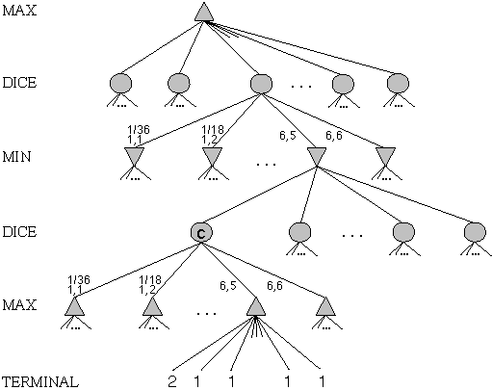
Game trees with chance nodes
Chance nodes (shown as circles) represent random events
For a random event with N outcomes, each chance node has N distinct children; a probability is associated with each
(For 2 dice, there are 21 distinct outcomes)
Use minimax to compute values for MAX and MIN nodes
Use expected values for chance nodes
For chance nodes over a max node, as in C:
expectimax(C) = ∑_{i}(P(d_{i}) * maxvalue(i))
For chance nodes over a min node:
expectimin(C) = ∑_{i}(P(d_{i}) * minvalue(i))
Min
Rolls
Max
Rolls

Slide 38
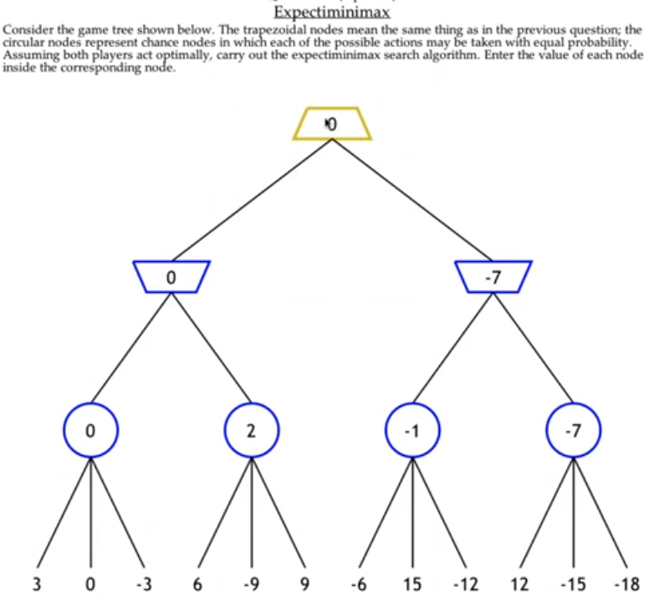

Slide 39
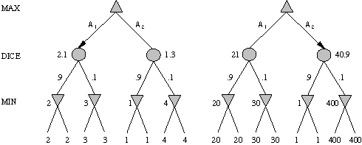
Meaning of the evaluation function
A1 is best move
A2 is best move
2 outcomes with prob {.9, .1}
Dealing with probabilities and expected values means we have to be careful about the “meaning” of values returned by the static evaluator.
Note that a “relative-order preserving” change of the values would not change the decision of minimax, but could change the decision with chance nodes.
Linear transformations are OK

Slide 40
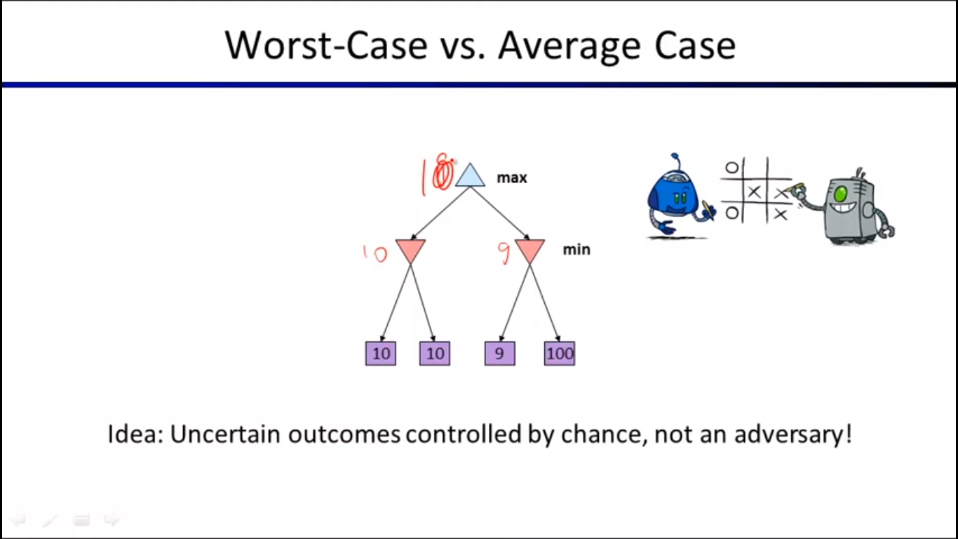

Slide 41
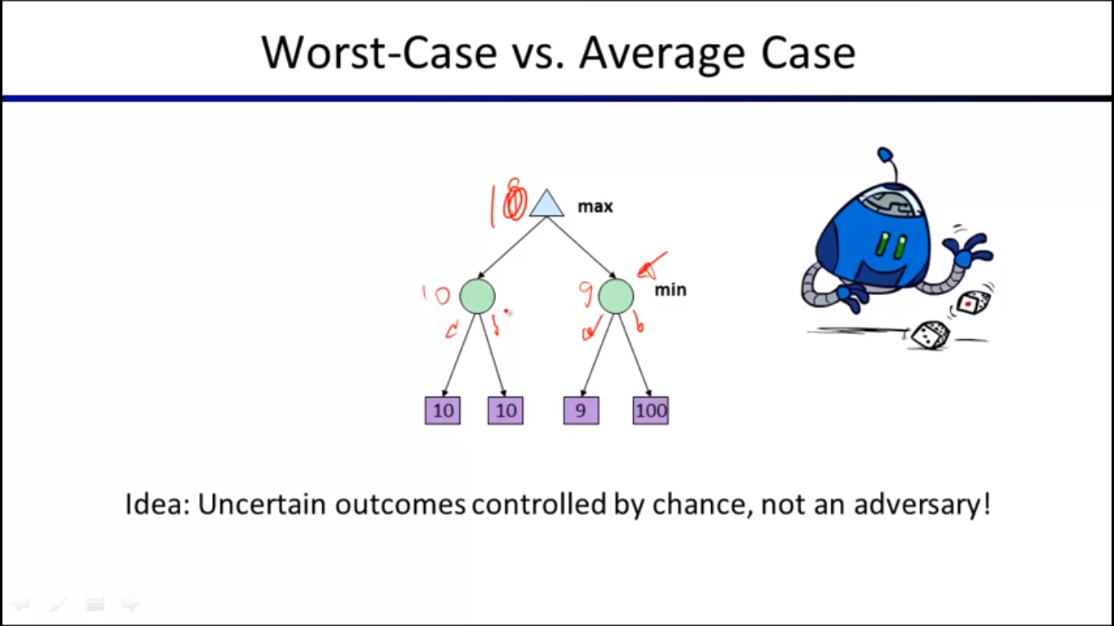

Slide 42
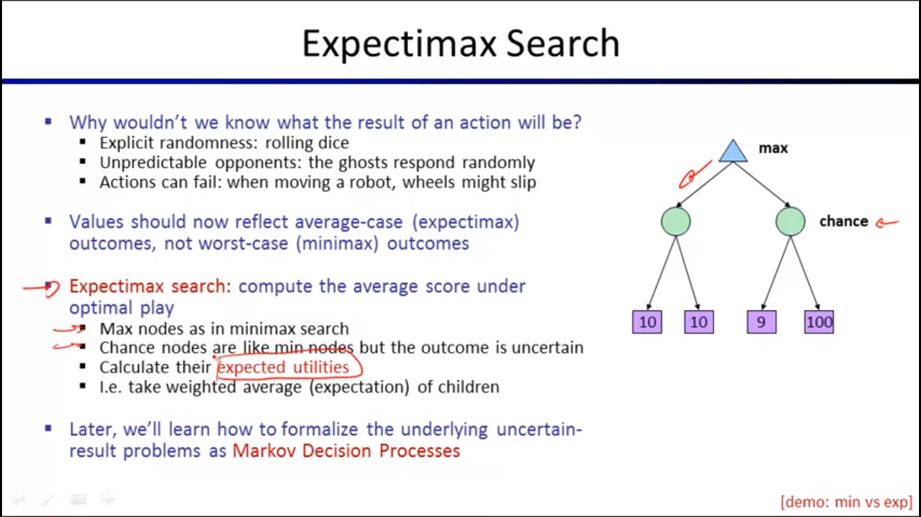

Slide 43
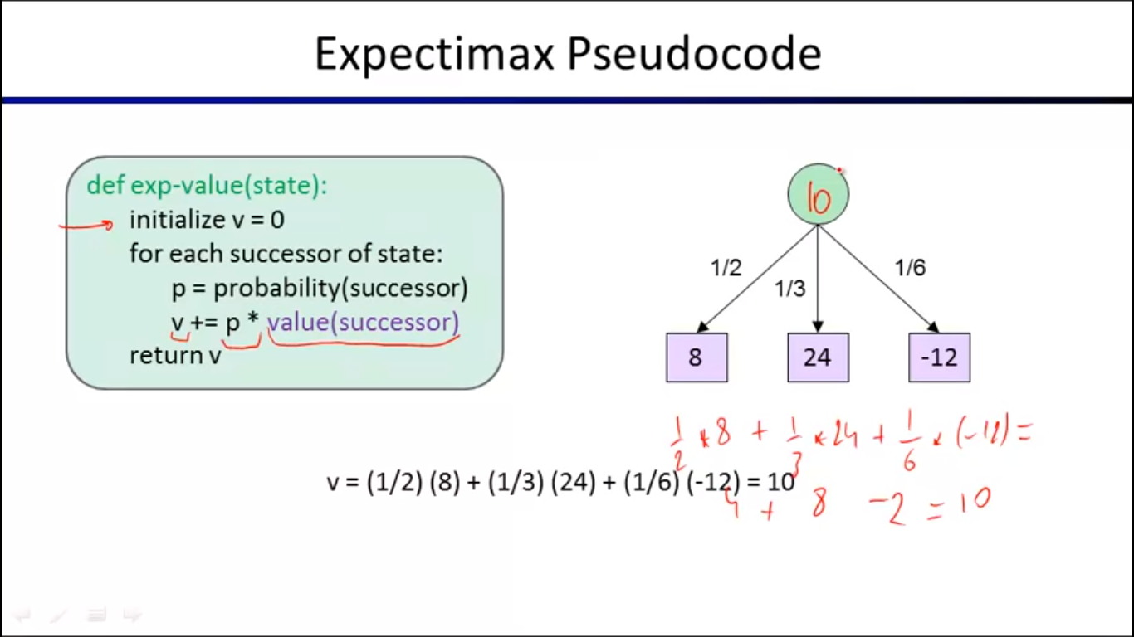

Slide 44
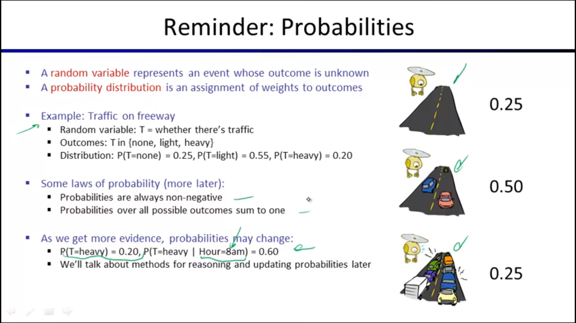

Slide 45


Slide 46
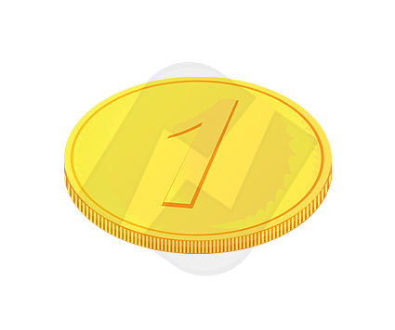
Example: Oopsy-Nim
Starts out like Nim
Each player in turn has to pick up either one or two objects
Sometimes (with probability 0.25), when you try to pick up two objects, you drop them both
Picking up a single object always works
Whoever picks up the last object loses
Question: Why can’t we draw the entire game tree?
Exercise: Draw the 2-ply game tree (2 moves per player)

