Slide 1
Welcome to My Presentation

Slide 2
A Report on My Fictional Company Samsung Electronic

Slide 3


Slide 4
Md Yamin
Department of Mathematics
University of Barishal
Batch 46

Slide 5


Slide 6
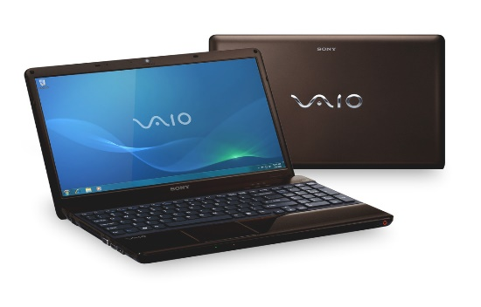
Laptop
SamsungVaio laptops are highly regarded for their blend of performance, portability, and affordability.

Slide 7
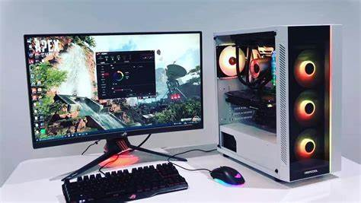
Desktops
Samsung desktops are synonymous with power and dependability

Slide 8
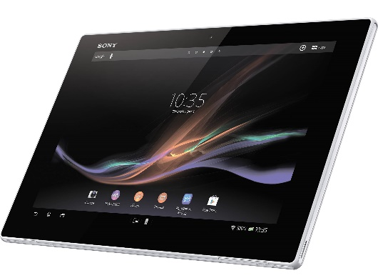
Tablets
Samsung tablets are celebrated for their versatility and innovative features

Slide 9
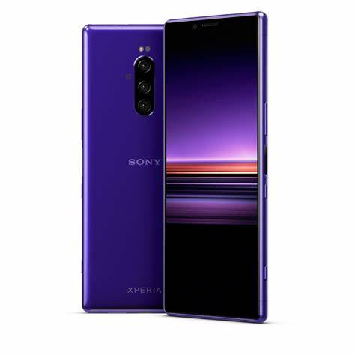
Smartphones
Samsung smartphones enjoy a stellar reputation for advanced features, including high-resolution cameras, fast processors, and 5G capabilities

Slide 10
Flow Chart of Business Plan Samsung Electronics
Sales Strategy
Distribution and Logistics
Customer Service
Financial Planning
Market Research
Product Development
Production Planning
Marketing Strategy
Monitoring and Evaluation

Slide 11

Statistics of sold products in the last 3 months ( January – March 2024)

Slide 12
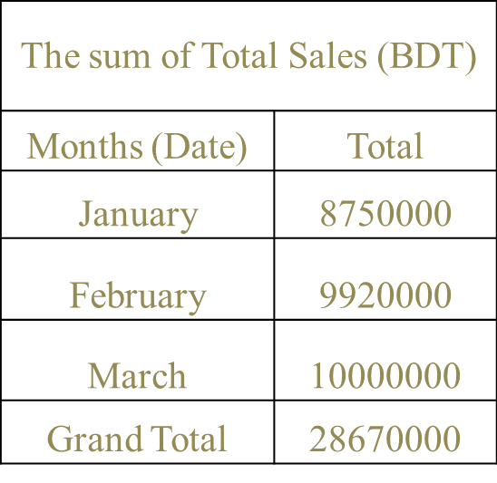
Sales Report of Samsung Electronic of the Month January – March 2024

Slide 13
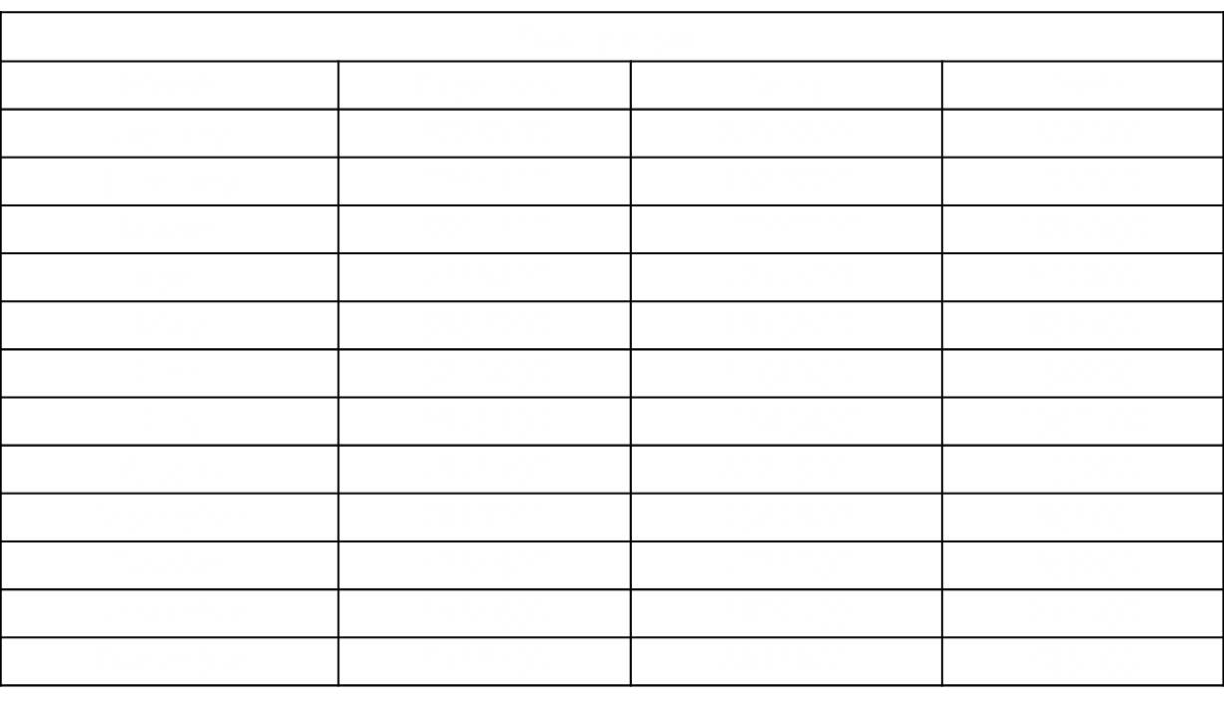
Yearly report of SONY Electronics

Slide 14
Yearly report of Samsung Electronics

