Slide 1
Programming with Java
Rouhallah Afsharpour & Luay Al-Jumaa

Slide 2
Groceries App

Slide 3
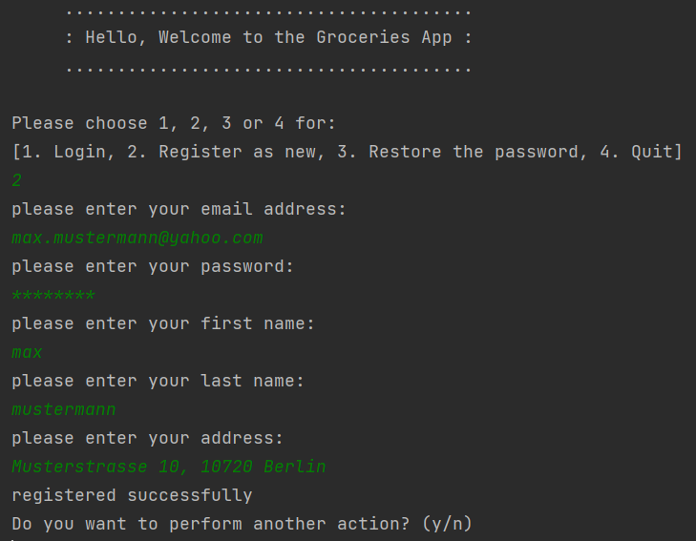
MAIN MENU AND REGISTRATION PART
Through the main menu the following options are provided:
Login
Register as a new user
Restore the password
Quit

Slide 4
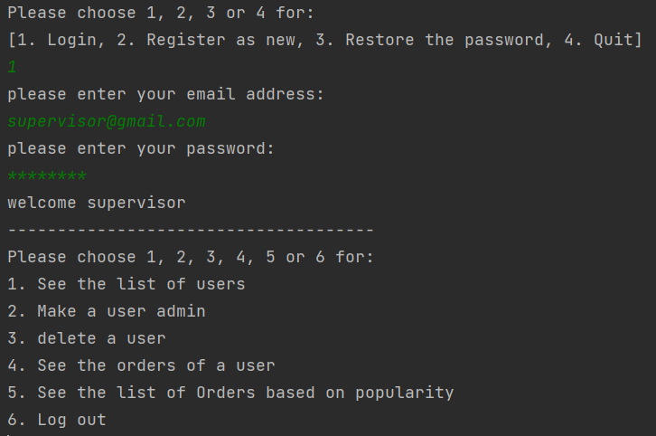
ADMIN AREA
Through the main menu an admin can login via email and password and choose:
See the list of users
Make a user admin
delete a user
See the orders of a user
See list of Orders based on popularity
Log out

Slide 5
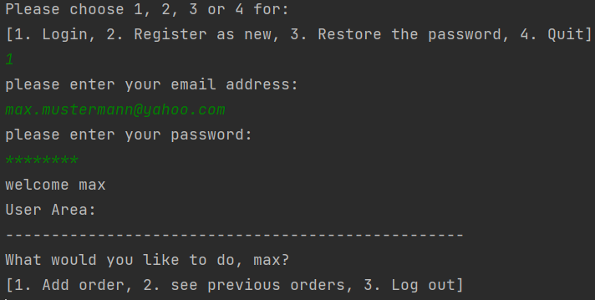
USER AREA
Through the main menu a user can login via email and password and choose:
Add order (presented later)
See previous orders
- all orders
- orders of a time period
Log out

Slide 6
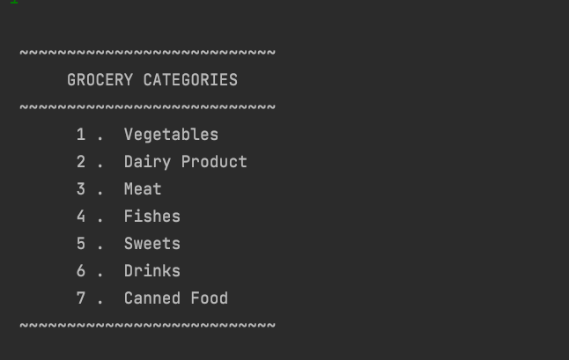
GROCERY CATEGORIES
Start buying Products
Choosing a Category

Slide 7
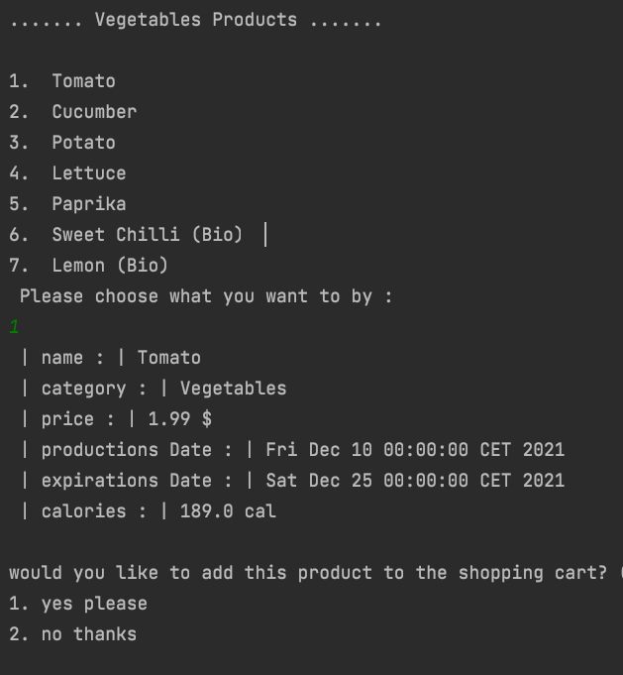
RUN A CHOSEN CATEGORY
Product Information
Buy or not

Slide 8
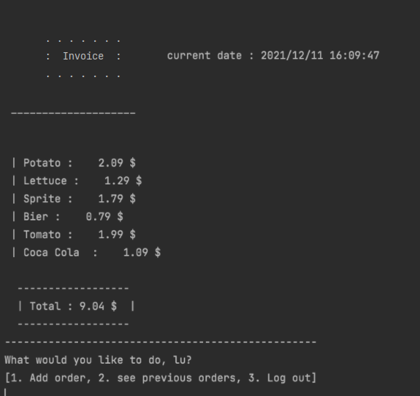
INVOICE
Show the chosen products
Total Price to pay
Current Date of Payment
Logout or Buy more

Slide 9
KEY LEARNINGS
Through this project the following aims were achieved:
How to collaboratively work on code through Github
Object-oriented programming (OOP)
Using Java collections framework
Storing data in files and read the information from them
Error handling, etc.

Slide 10

Thank you for your attention!
Any question?

