Slide 1
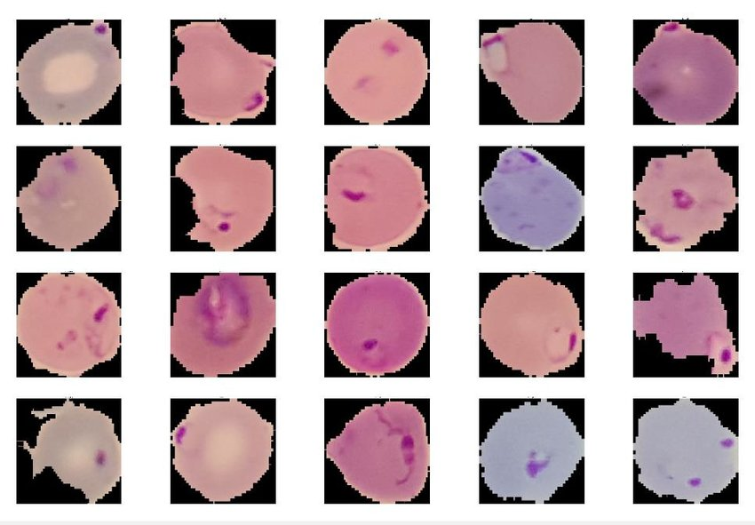
Malaria Detection
Roula Krayem
Notes:
Hello everyone, my name is Roula Krayem, Today we will talk about machine learning in detecting malaria

Slide 2
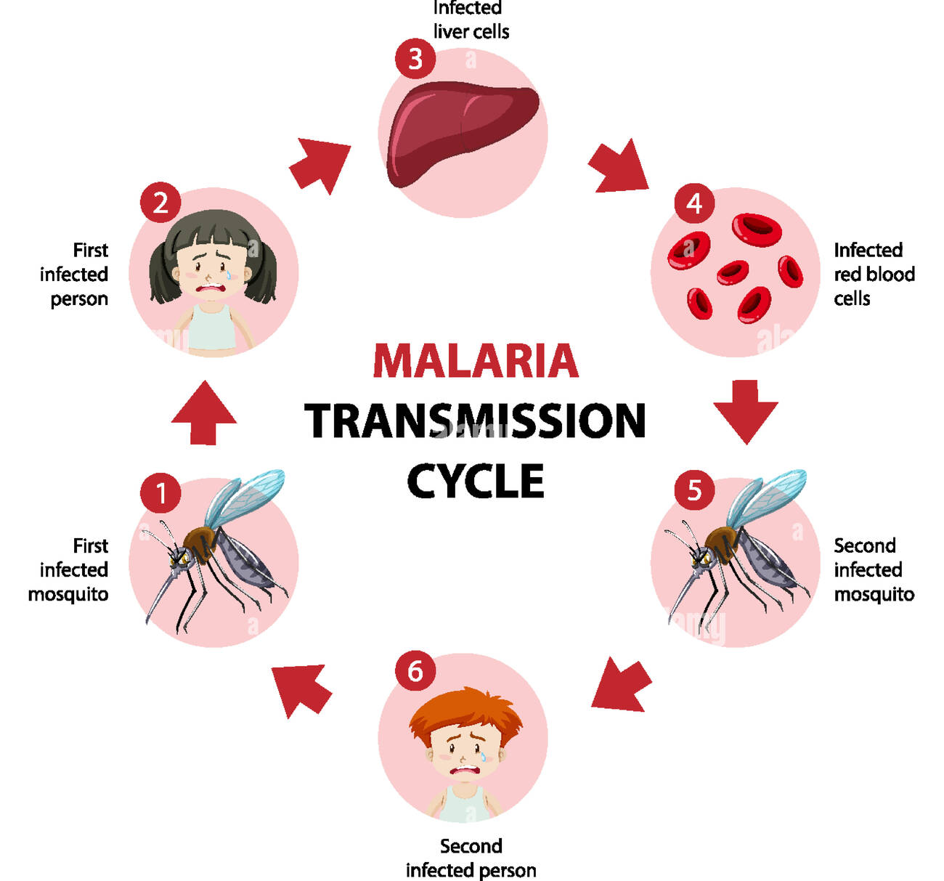
Introduction
What is Malaria?
Malaria caused 627000 deaths in 2020
Diagnoses methods including Blood Smear test
Microscopic images of Red Blood Cells (RBCs)
https://www.alamy.com/malaria-transmission-cycle-information-infographic-image444548497.html?imageid=D0BAED1C-4F8E-43D2-A932-04A6E64DD7E9&p=540308&pn=1&searchId=cb74d113acdde3fc17256d93a4d8b6e3&searchtype=0
Notes:
Malaria is a disease caused by plasmodium parasite, transmitted by the bite of infected mosquitoes.
The parasite grows and multiplies first in the human’s liver, then in the red blood cells
patients with Malaria present with symptoms such as fever, nausea, vomiting, and headaches. In severe cases, the loss of red blood cells can lead to kidney failure, coma, and death (1).
In 2020, 241 million cases of Malaria were reported, with 627,000 deaths. 95% of the deaths occurred in African regions
As I mentioned the parasite multiplies in the red blood cells. Therefore, physicians use microscopic images of the cells to diagnose malaria.

Slide 3
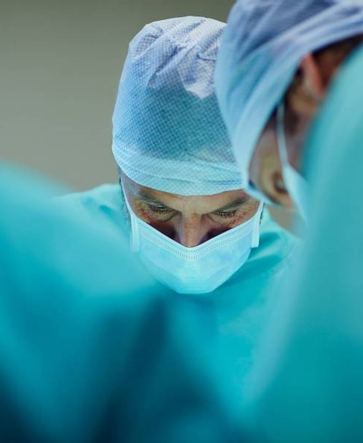
Problem Definition
Millions of Malaria cases and handers of thousands deaths annually
Providers study each RBCs sample individually under the microscope
Slow process that could delay treatment
Notes:
While millions get malaria and hundred of thousands die annually
Providers still have to study each red blood cell microscopic image individually
This process is slow and could result in delaying diagnoses and treatment.

Slide 4
Solution
Build a Neural Network model to expedite and facilitate Malaria detection
Step 1
Step 2
Step 3
Perform data Exploration and note key takeaways
Build and test multiple Neural Network models to reach the best performing Model
Select the best performing model and provide recommendations
Notes:
The solution we propose is to build a neural network model to expedite and facilitate malaria detection.
The process was divided into 3 steps
First perform data exploration and take key points
Second build and test multiple neural network models to find the best performing model
Lastly, select the best performing model and provide recommendations.

Slide 5
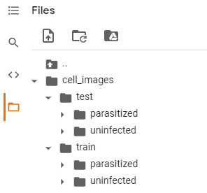
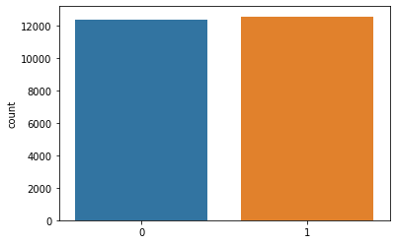
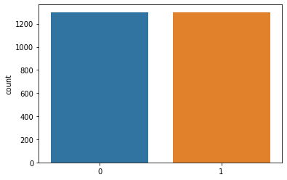
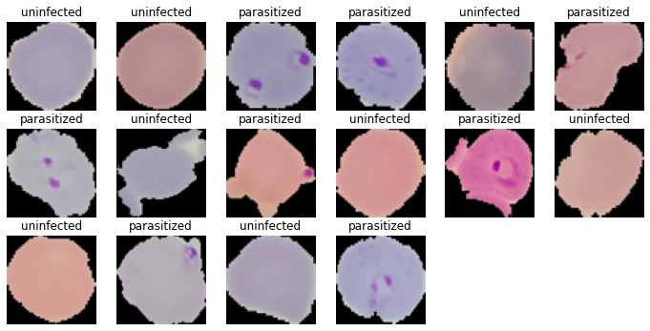
Data Exploration
12,376
12,582
1300
1300
Train Data
Test Data
Data Processing Techniques
Image resizing (64 x 64)
Normalization
One-Hot Encoding
Notes:
Starting with Data exploration
We can see the cell images file in the upper left corner,. the folder is divided into test and train subfolders with each one further divided into parasitized and uninfected.
From the two charts on the upper right corner, we see that train and test data are almost split in half between parasitized and uninfected.
Looking at the sample of the parasitized and uninfected images, we notice that only the parasitized cells contain a magenta or dark pink spots. Also, The cells have different shapes and positions.
The data processing, we performed were resizing the images to 64 by 64. Normalization To reduce the complexity of computing high numeric values
and one hot encoding to quantify categorical data

Slide 6
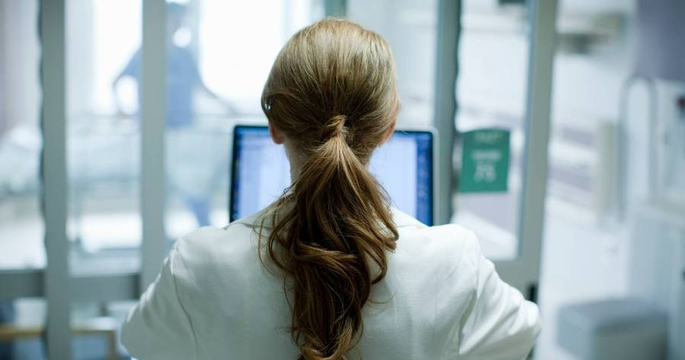
Model Conversation
Notes:
Lets start looking at the models we built

Slide 7
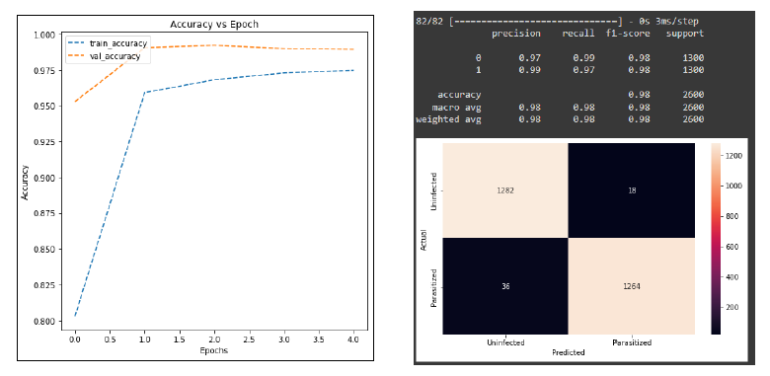
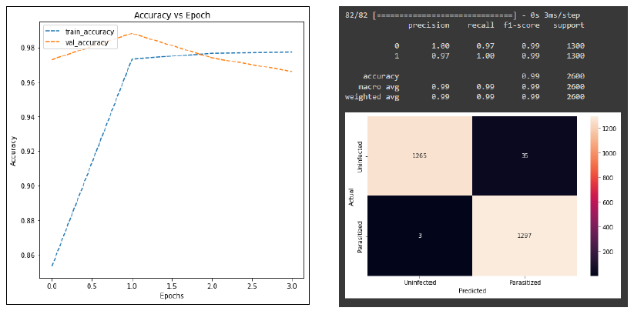
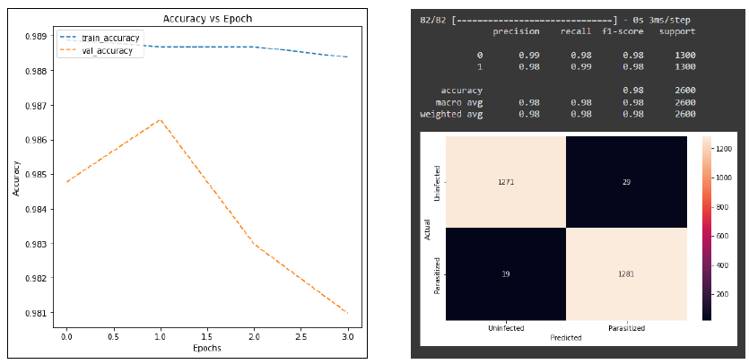
From Scratch
Base Model
First Model
Second Model
Notes:
We were provided with a base model that we used to build the first and second model
When testing the base model, it performed well with a 98% accuracy. 36 images of the parasitized cell were misclassified as uninfected, and 18 images of the uninfected were classified as parasitized.
With the addition of few more layers, we were able to create the first model that had a 99% accuracy. We had only 3 misclassified parasitized cells and 35 misclassified uninfected cells. This improvement is clinically meaningful as we want our model to do better in diagnosing patients with Malaria so they can start treatment sooner.
Then we tired to make further improvements on first model and created the second one. However, the accuracy dropped back to 98%

Slide 8
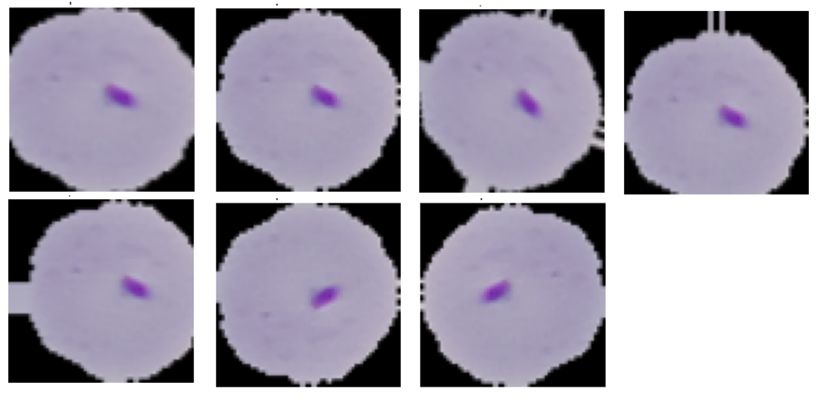

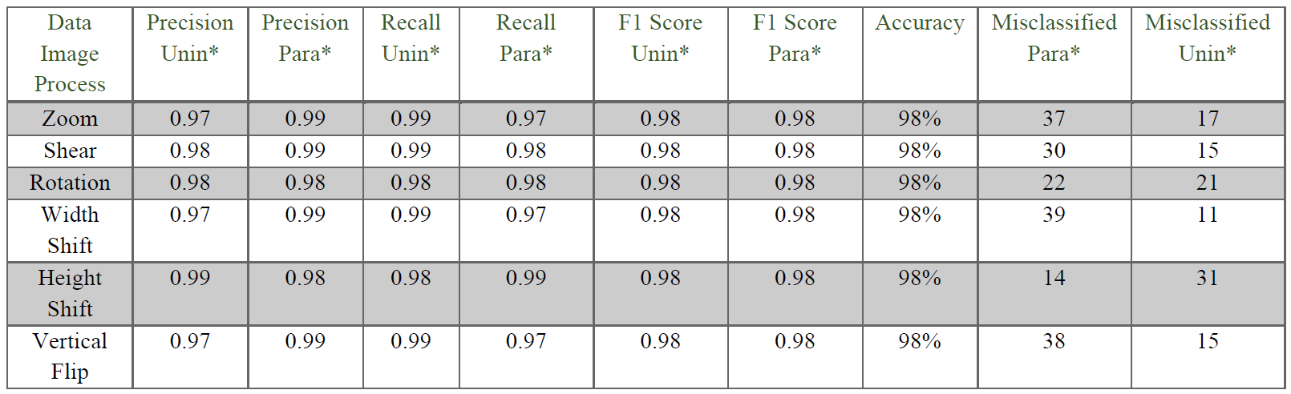

Data Augmentation
Notes:
To see if the second model can perform better, we used data augmentation techniques to increase differences among the images.
The techniques were zooming, sheering , rotation, width shift, height shift, vertical flip, and horizontal flip.
we can see how these changes look on one of our infected cells in the upper left corner
In the table we see that all techniques performed similarly with all of them having 98% accuracy

Slide 9
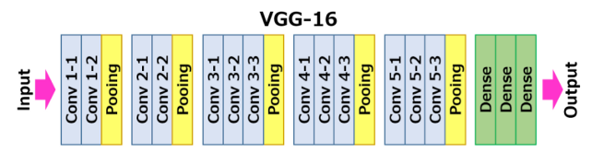
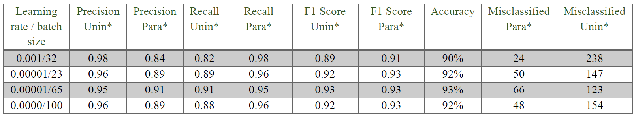
VGG16
Notes:
Going forward we used the VGG16 model, which is a pre-configured and trained model. We took the convolutional layers where the feature extracting happen, and we added final few layers to make the calcification decision.
Moreover, we did iterations of different learning rates and batch sizes to see how the model would perform.
As we can see in the table, the highest results were for the third iteration. that yielded a 93% accuracy. The results are mush lower than what we have already reached in previous models.

Slide 10
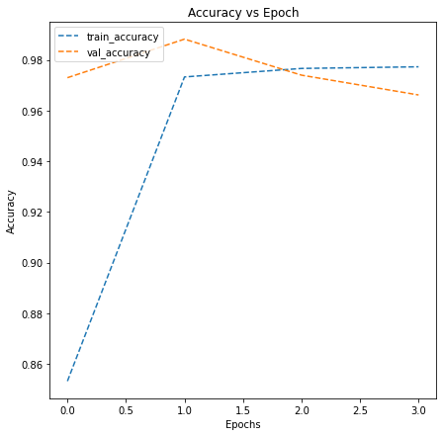
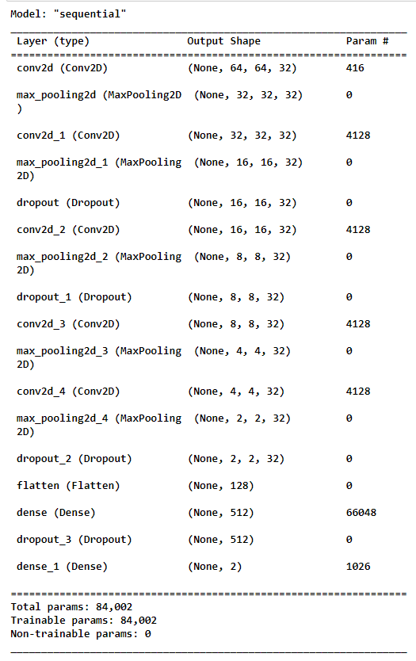
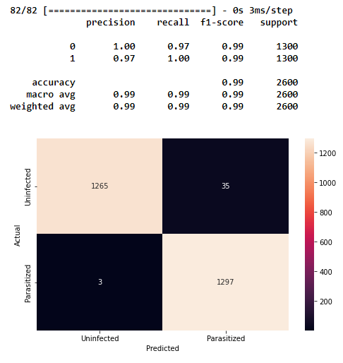
Best Model
Model (1)
Notes:
Therefore, we decided that the first model with 99% correct predictions is what we will adopt.

Slide 11
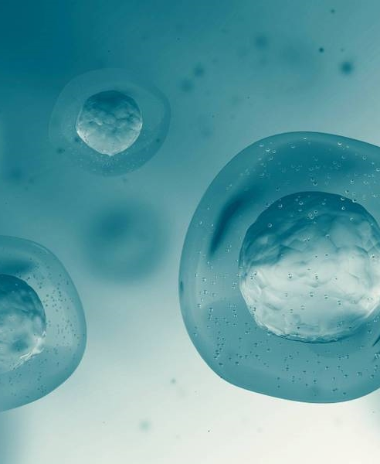
Recommendations
Model Future Improvements
Try different learning rates and batch-size when fitting the second model using the data image generator.
Use the Ensemble technique with multiple weak models to improve the results.
Policymakers
Adopting the first model to automate and accelerate Malaria detection.
Requiring a revision of the images classified as uninfected by a physician before making the final clinical decision.
Notes:
Our recommendations for future improvements is to Try different learning rates and batch-sizes when fitting the second model using data augmentation techniques..
Use the Ensemble technique with multiple weak models to improve the results.
For policymakers we suggest
Adopting the first model to automate and accelerate Malaria detection.
Also, to require a revision of the images classified as uninfected by a physician before making the final clinical decision so no patient go untreated.

Slide 12
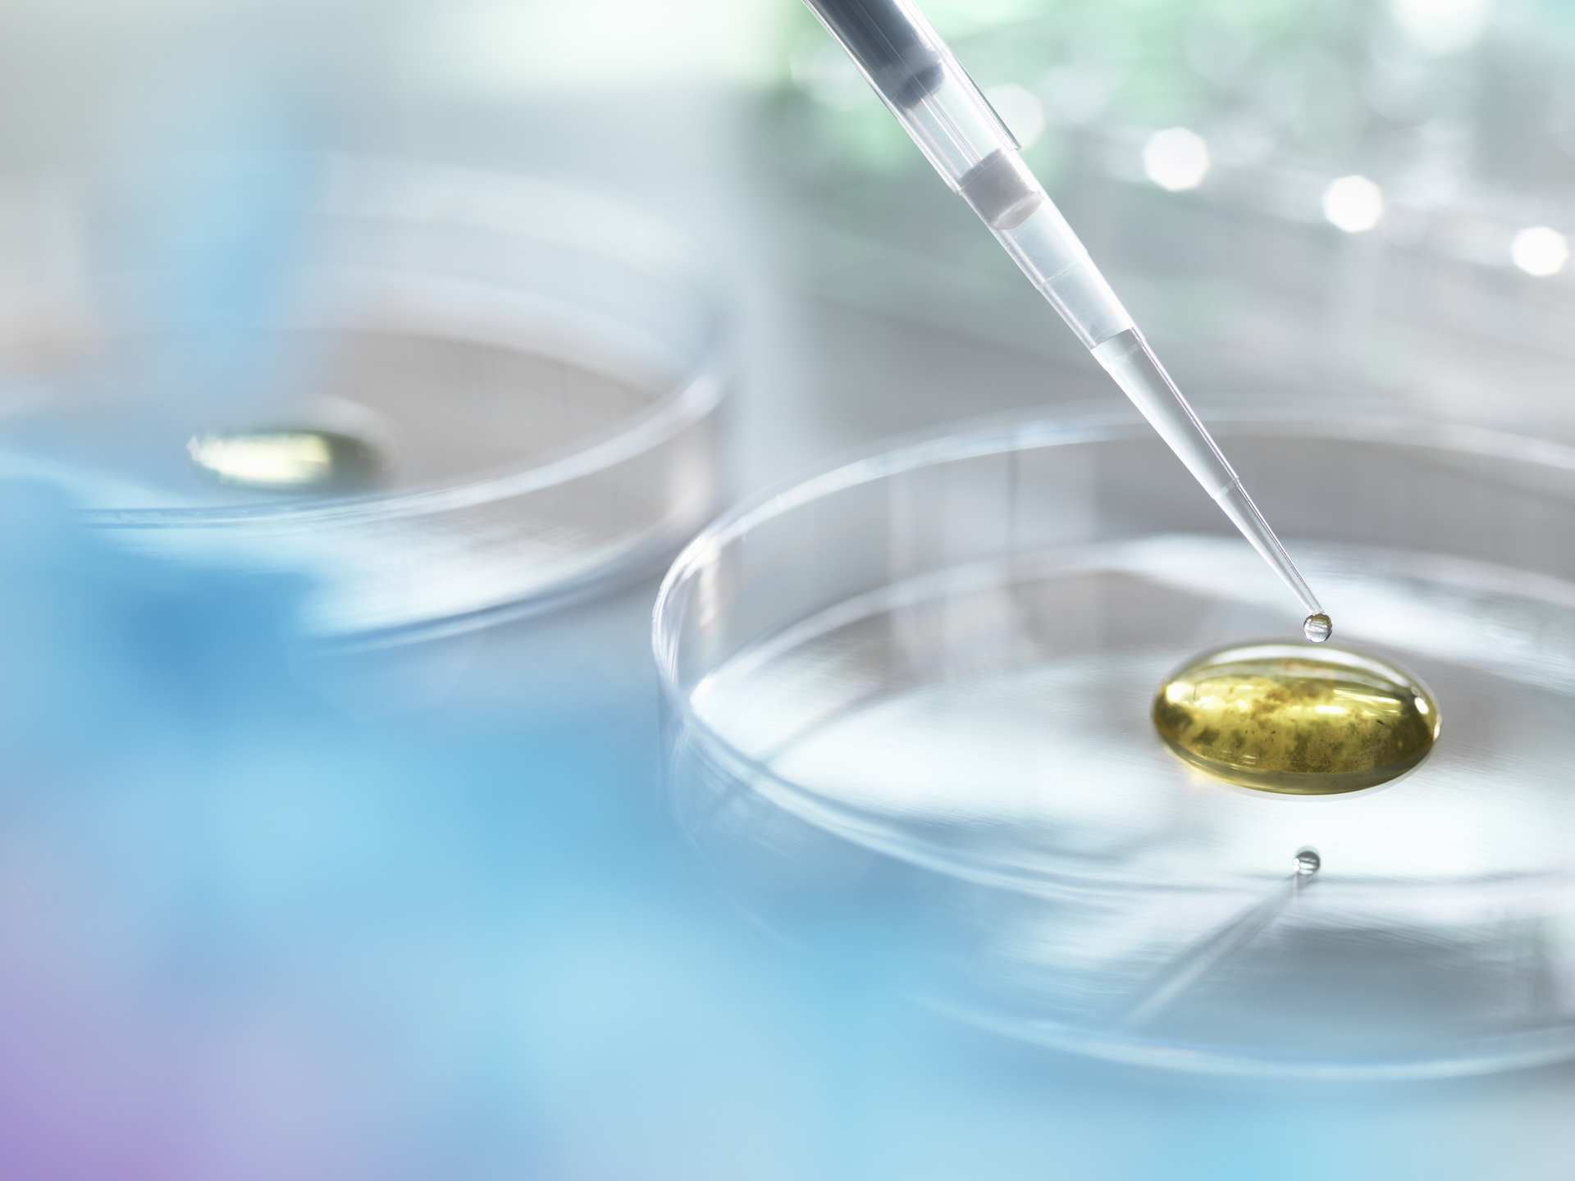
Thank you!
Roula Krayem
Roula.Krayem@outlook.com
Notes:
That is all from me today. Thank you for listening. Please let me know if you have any questions.

