Slide 1
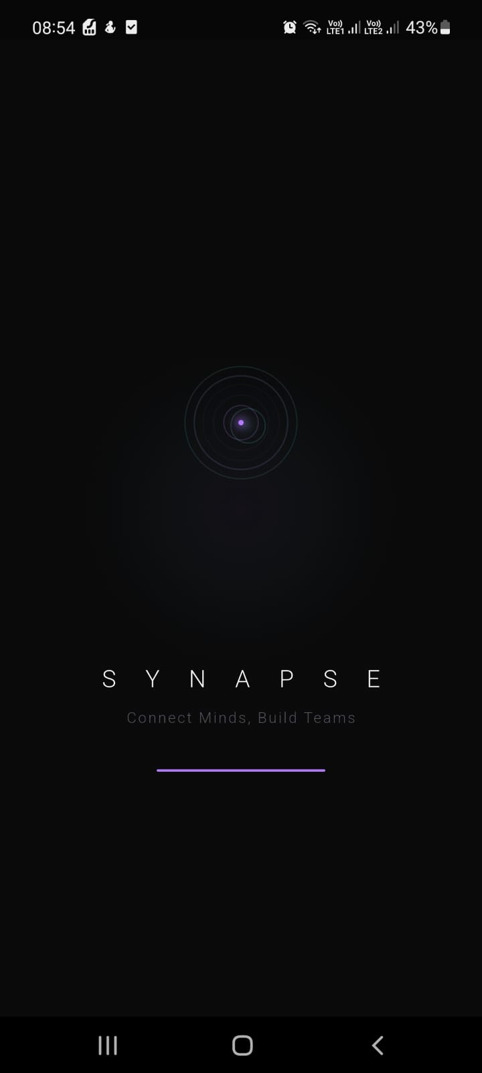
S Y N A P S E
Connect Minds, Build Teams
"Good ideas fail because of bad teams."
AI-Powered Academic Team & Mentor Matching Platform
Khadija Subhani
BITF22M019
Roumaisa Tanveer
BITF22M033
Final Year Project · BSIT · PUCIT · 2026

Slide 2
THE PROBLEM
Why Do Good Academic Teams Fail?
"Good ideas fail because of bad teams — not bad ideas."
Random Teaming
No Mentor Discovery
Zero Team Visibility
Students are grouped arbitrarily — no skill mapping, no personality fit, no compatibility signal. Conflict and free-riding follow.
Finding the right mentor is entirely luck-based. No structured channel exists to match topic expertise with actual student need.
Once formed, teams operate in the dark. No health tracking, workload insight, or early-warning signals for teams that are struggling.

Slide 3
OUR SOLUTION
Synapse — Intelligence-First Collaboration
A full-stack mobile platform replacing random grouping with AI team formation, skill-aware mentor matching, and real-time collaboration tools.
🤖 Cosine Similarity Matching
🧠 Big Five + DISC Personality
📍 Proximity Radar
Skill vectors compared across candidates — top compatible profiles surfaced automatically with ranked scores.
OCEAN psychometric quiz at onboarding powers personality-aware compatibility. DISC type adds behavioural overlay.
Real-time detection of nearby compatible students. BLE/GPS-gated — shows skill tags and match % of users in range.
🎓 AI Mentor Connect
🔍 SHAP Explainability
📊 MMR Diversity Engine
Describe your challenge; Synapse NLP routes you to the best-fit domain expert. Volunteer mode lets mentors offer proactively.
Every match has a 'Why?' card — which skills, traits, and signals drove the score. Full transparency, no black-box.
Maximal Marginal Relevance re-ranks suggestions each session — prevents echo-chamber repetition of the same profiles.

Slide 4
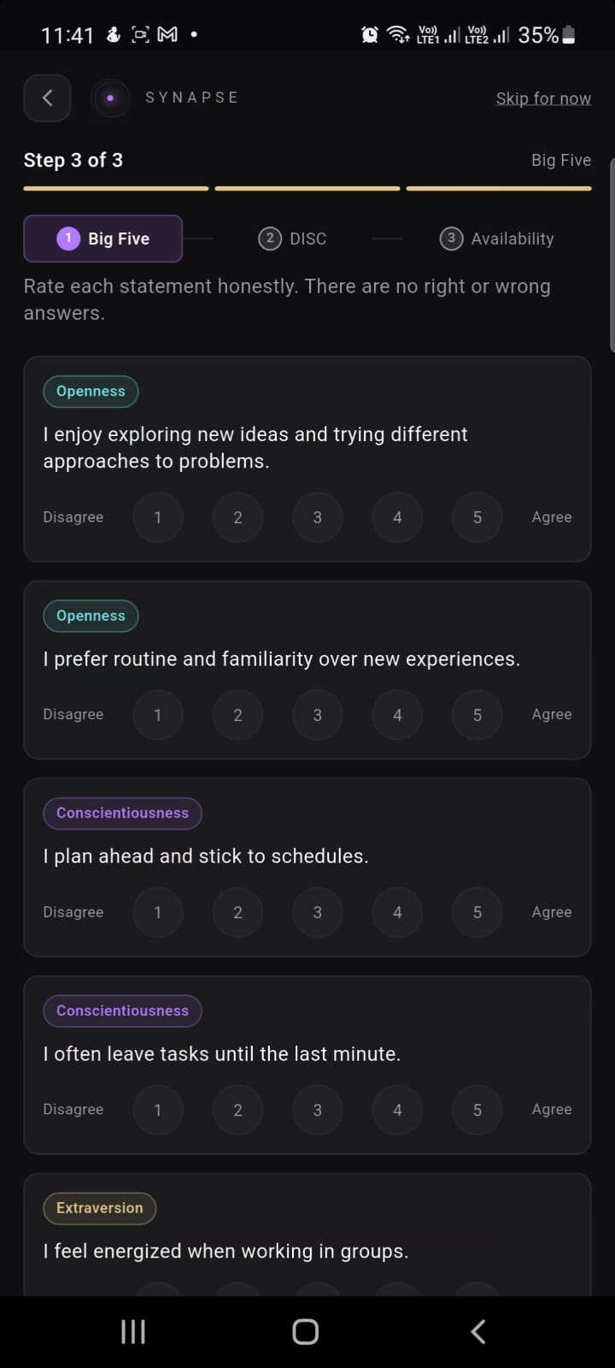
ONBOARDING FLOW
Personality Science at Entry
Big Five (OCEAN) Assessment
Step 3 of 3: users complete OCEAN psychometric quiz, then DISC, then set availability. Scores permanently power all compatibility matching.
Openness
38%
Conscientiousness
50%
Extraversion
63%
Agreeableness
63%
Neuroticism
63%
→ DISC behaviour type (D/I/S/C) assessed in Step 2
→ Retake locked for 30 days — ensures authentic scores
→ Both models feed every future compatibility match

Slide 5
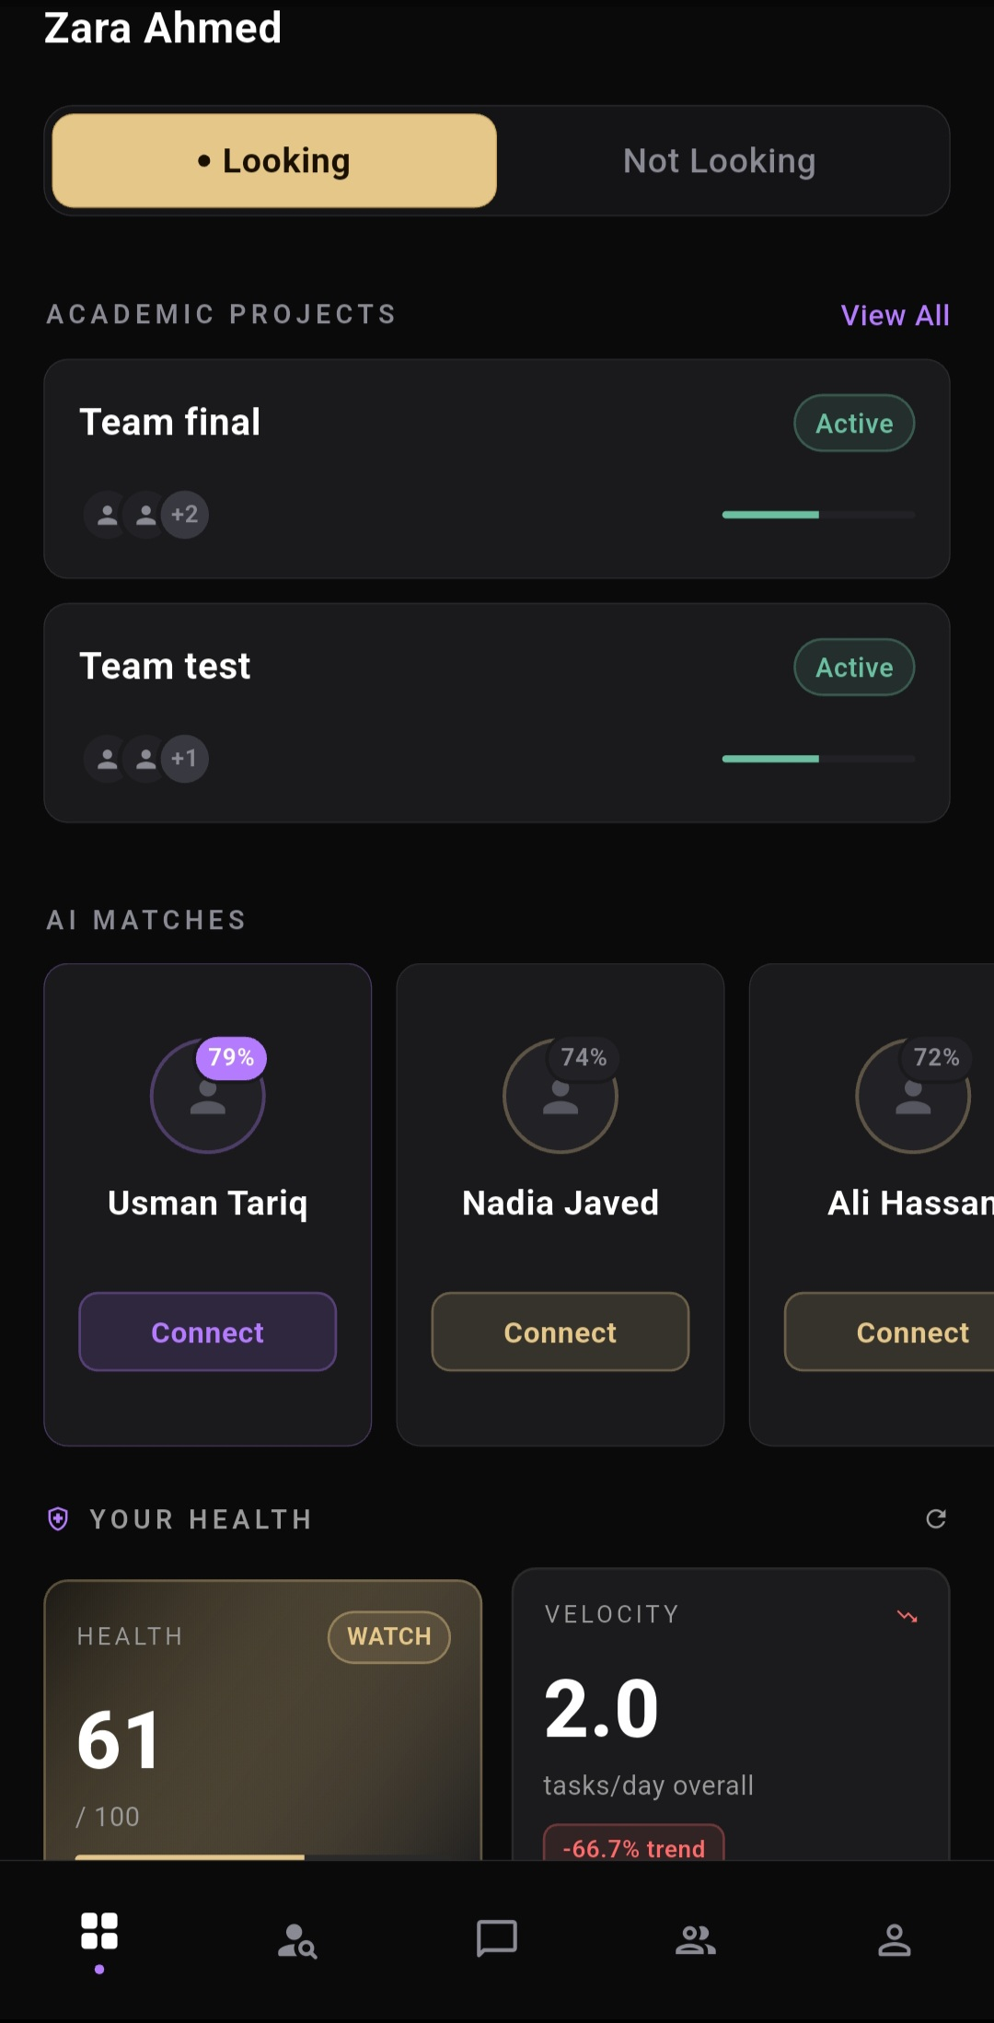
DASHBOARD
Home — Your Collaboration Hub
🔵 Looking / Not Looking Toggle
Live status visible to the whole network. Flipping on instantly makes you discoverable to AI suggestions.
📁 Active Teams Panel
All your projects with member count, progress bar, and health status summarised at a glance.
✨ AI Matches — Top 3 shown
79%, 74%, 72% — ranked by composite compatibility. One-tap Connect fires a connection request.
🛡️ Health Score + Velocity
Project health 61/100 · 2.0 tasks/day · -66.7% trend flag proactively surfaces at-risk teams.

Slide 6
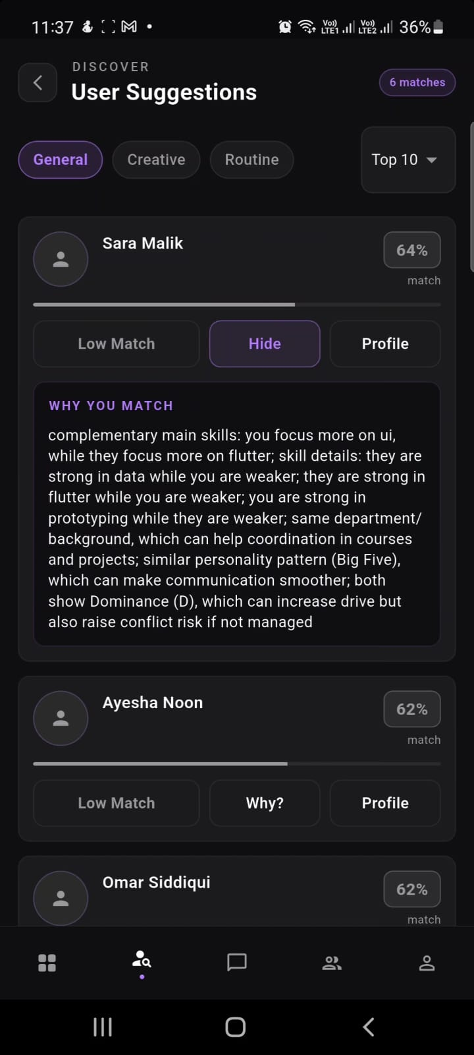
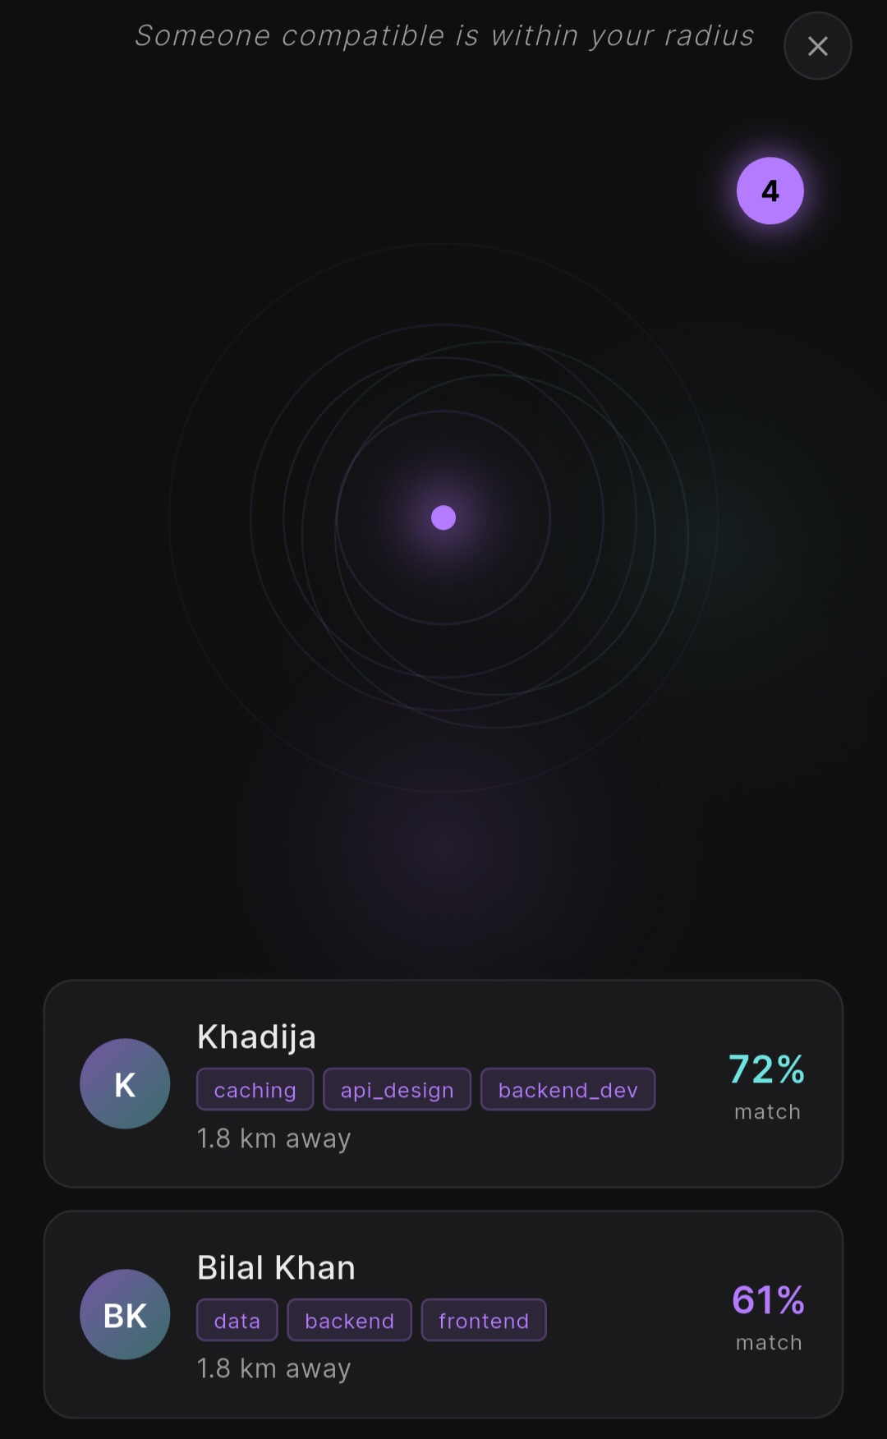
MATCHING ENGINE
User Suggestions + Proximity Radar
Explainable Matches
Tap "Why?" on any suggestion — Synapse narrates complementary skills, personality overlap, and conflict risk flags (e.g. dual-D DISC).
Category Filters
General / Creative / Routine tabs shift match weighting. Top 10 dropdown caps result density for clarity.
Proximity Radar
"Someone compatible is within your radius" — real-time detection shows nearby users by skill tags and match %. 4 active in range.
MMR Diversity Engine
Maximal Marginal Relevance re-ranks each session — you never see the same pool twice. Fresh signal every time.

Slide 7
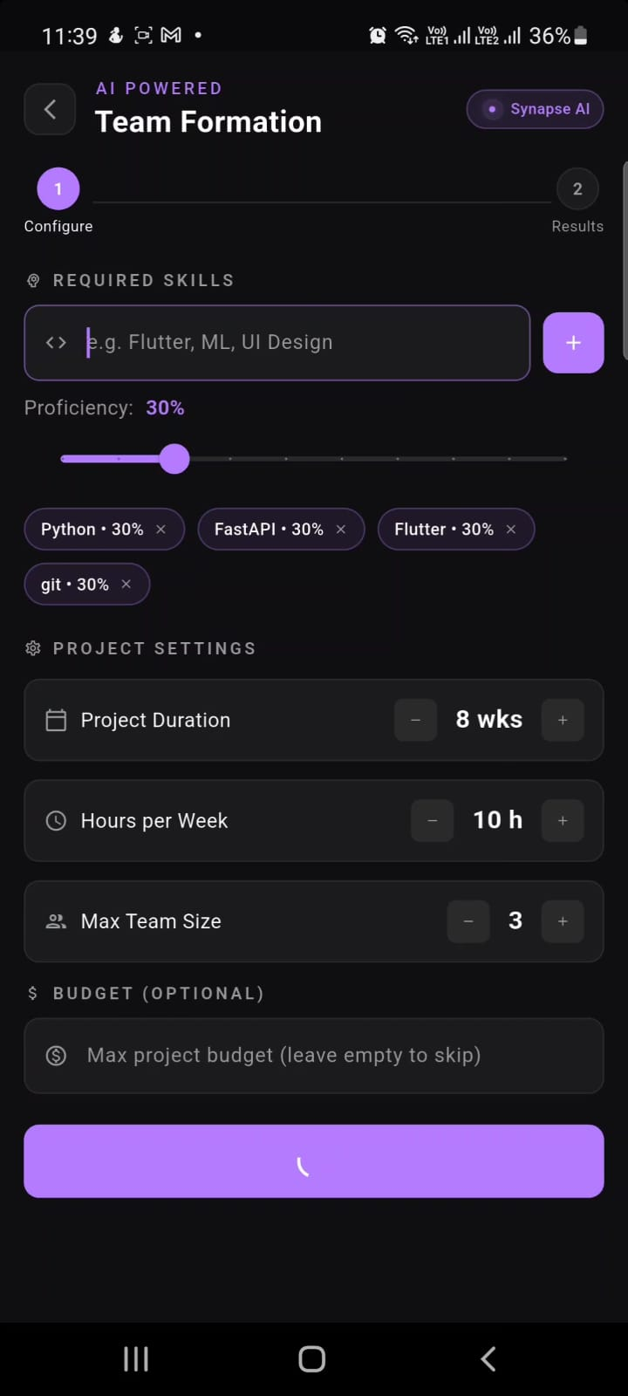
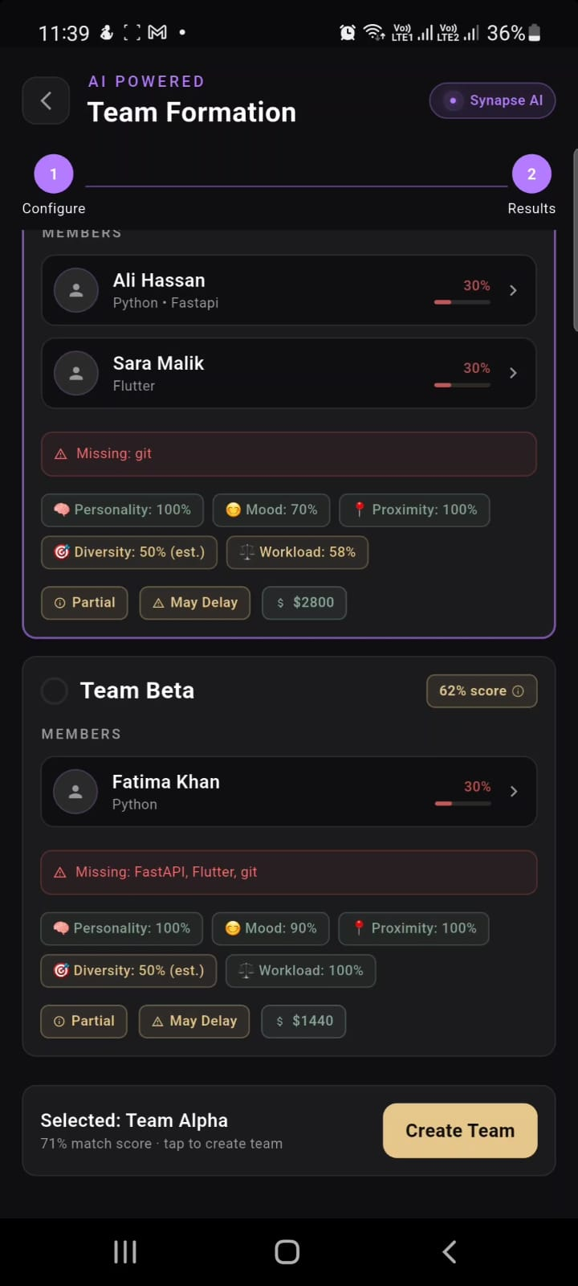
AI-POWERED CORE
Team Formation — Configure → Results
100%
70%
Personality
Mood Score
100%
50% est.
Proximity
Diversity
58%
Workload
How It Works
1 Set required skills, duration, team size & budget
2 AI generates candidate teams via cosine similarity
3 Personality + Mood + Proximity scored per team
4 SHAP values explain every score transparently
5 Select preferred team → Create with one tap

Slide 8
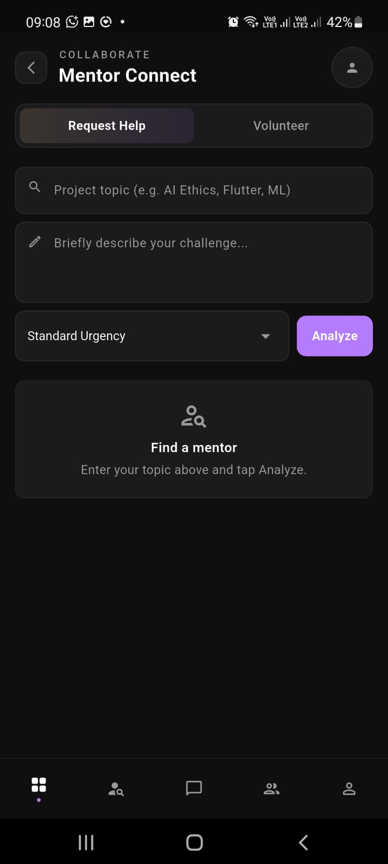
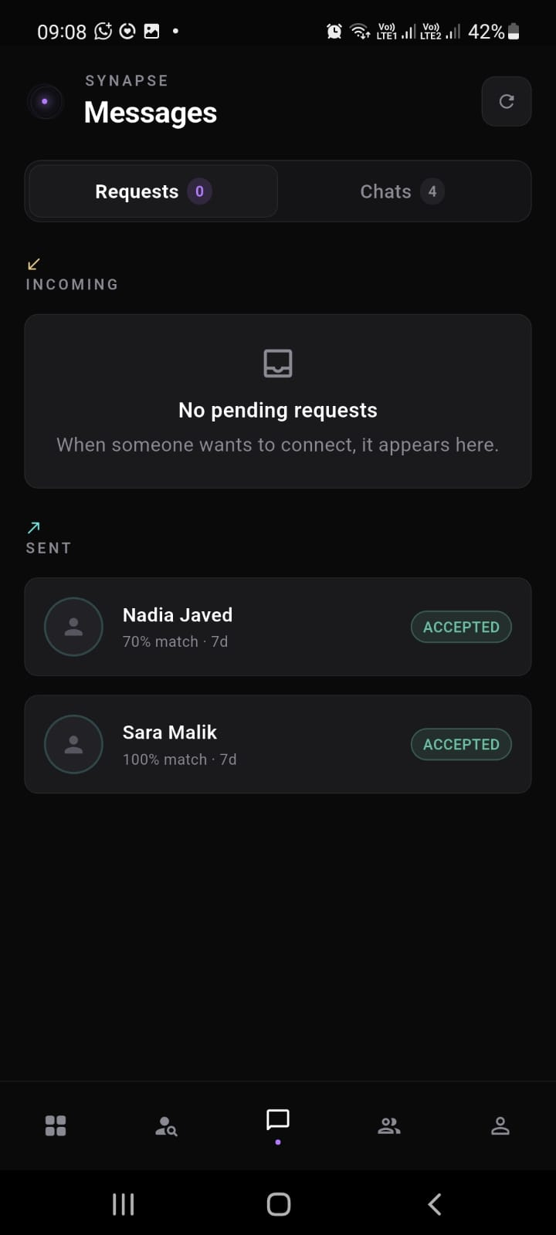
COLLABORATION
Mentor Connect + Real-Time Messaging
Topic-Aware AI Analysis
Enter project topic + challenge description. Synapse NLP routes to best-fit mentor by domain expertise score.
Request & Accept Lifecycle
Full connection flow — send, accept, decline. Shows match % and 7-day expiry. Accepted → chat opens automatically.
Volunteer Mode
Mentors switch to Volunteer tab to proactively offer help. Students set urgency (Standard / Critical).
WebSocket Chat — 4 Active
Real-time messaging with presence tracking. AI check-in stubs surface blockers at key milestones.

Slide 9
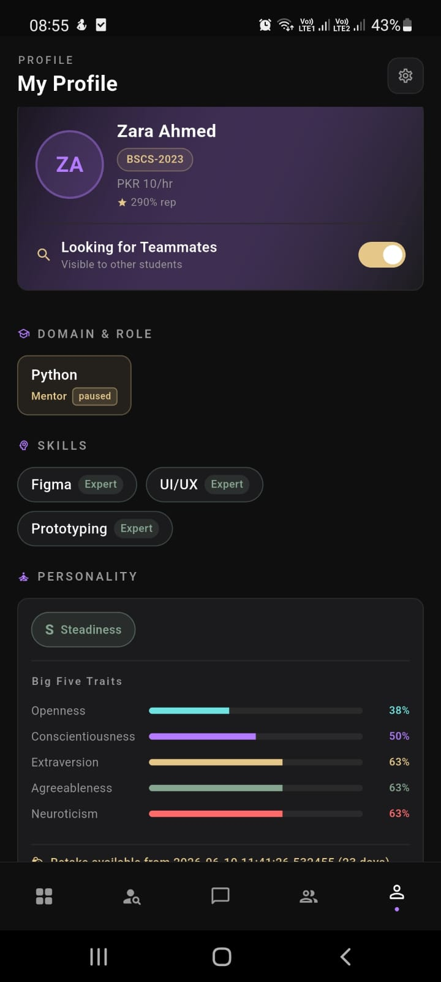
PROFILE · TASKS · STACK
Full Lifecycle — Profile to Delivery
Tech Stack
Frontend
Flutter · Dart · Riverpod · GoRouter · Dio
Backend
Python · FastAPI · SQLAlchemy · Alembic
Database
PostgreSQL (Supabase) · Firebase FCM
AI / ML
Cosine Sim · Big Five/DISC · SHAP · MMR
DevOps
Render · Netlify · GitHub · Cron Keep-Alive
✓ Live APK · Render backend · Supabase DB · Netlify frontend

Slide 10
S Y N A P S E
Connect Minds, Build Teams
Flutter · FastAPI · PostgreSQL · Big Five/DISC · SHAP · MMR · WebSockets
Khadija Subhani · BITF22M019
Roumaisa Tanveer · BITF22M033
PUCIT · University of the Punjab · 2026

