Slide 1
INTERNSHIP REPORT
AI-Powered Business Automation Assistant
Using LLM Integration and Machine Learning
Rounak Gupta
IILM University | Roll No. 25SCS1003005151 | Batch 2024–2028
Internship at ADVLST | 25 May 2026 – 10 July 2026

Slide 2
About the Organization
ADVLST
ROLE
AI & Machine Learning Intern
IT Solutions & AI Automation Company
New Delhi, India
DEPARTMENT
Software Infrastructure
Backend Systems
Automation Solutions
AI Research & Development Division
AI Research & Development
DURATION
25 May 2026 – 10 July 2026
MODE
Remote / Work From Home
2

Slide 3
Introduction & Problem Statement
Enterprises handle large volumes of repetitive queries, data-processing tasks and communication workflows — rule-based automation is rigid and struggles with natural-language variability and unstructured data.
Goal: Build an AI-driven assistant that interprets natural-language requests, applies ML models for structured prediction, and uses LLM integration for accurate, context-aware responses supporting business-automation workflows.
Key Objectives
Understand ML & LLMs in business automation
Design and preprocess required datasets
Build and evaluate ML models
Integrate LLMs via APIs
Apply prompt-engineering techniques
Evaluate outputs with appropriate metrics
3

Slide 4
Technologies & Tools Used
Python
Pandas / NumPy
Scikit-learn
Main programming language
Data handling & numerical ops
Machine-learning implementation
LLM APIs
Prompt Engineering
REST APIs
Natural-language understanding & generation
Reliable, structured LLM outputs
Model, data & app-layer integration
4

Slide 5
System Architecture
User
Request
→
Preprocessing
→
ML Model /
LLM + Prompt
→
Response
Generation
→
Automation
Action / Output
Structured requests route to the trained ML model; natural-language requests are converted into an engineered prompt and sent to the LLM API. Both paths converge at the response-generation layer.
5

Slide 6
Methodology
Requirement Understanding
Data Collection & Inspection
Cleaning & Preprocessing
1
2
3
Feature Engineering
Model Training & Evaluation
Prompt Design & LLM Integration
4
5
6
End-to-End Testing
Error Analysis & Refinement
Documentation
7
8
9
6

Slide 7
Model Evaluation Measures
Measure | Purpose
Accuracy | Overall proportion of correct predictions
Precision | Reliability of positive predictions
Recall | Ability to identify relevant positive cases
F1-score | Combined measure of precision and recall
Response Relevance (LLM) | Qualitative assessment of LLM output usefulness
7

Slide 8
Expected Outcomes & Learnings
Working prototype combining ML models and LLM-based NLP
Structured data pipeline for preprocessing & feature handling
Hands-on experience with prompt engineering & LLM API integration
Trained and evaluated ML model(s) for the chosen task
Understanding of end-to-end AI-automation workflow design
Foundation for future enhancement (fine-tuning, scaling)
8

Slide 9
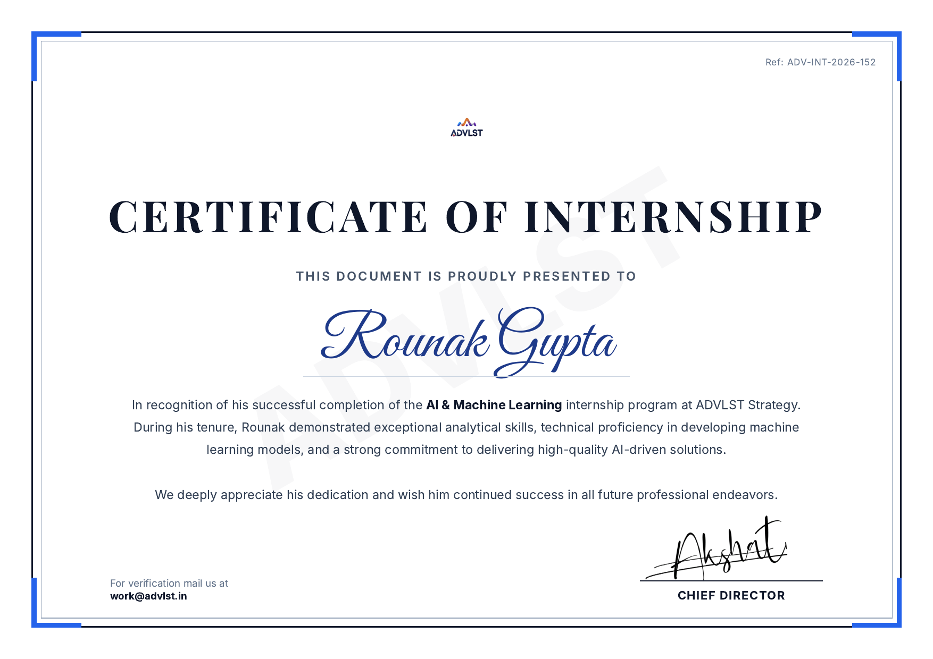
Certificate of Internship
9

Slide 10
Conclusion
This internship provided practical, industry-level exposure to Artificial Intelligence and Machine Learning, with a specific focus on integrating Large Language Models into business-automation workflows — combining classical ML with modern generative-AI capabilities to build real-world solutions.
Thank You
Rounak Gupta | AI & Machine Learning Intern, ADVLST

