Slide 1
Wikipedia - Connected People Analysis
Data Group – 4.1

Slide 2
Golden Questions!
What is the problem?
Whose problem we are solving?
How do you know the problem is solved?
What is the business outcome/benefit of solving this problem?

Slide 3

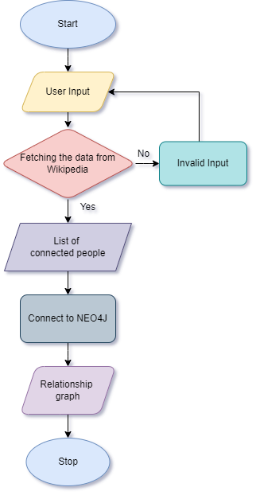
FLOW CHART

Slide 4

THANK YOU

