Slide 1
Public Key Asymmetric Cryptography
Dr. Nachiket Tapas

Slide 2
Introduction
Public key cryptography provides a secure way to exchange information and authenticate users by using pairs of keys.
The public key is used for encryption and signature verification, while the private key is used for decryption and signing.
When the two parties communicate with each other to transfer the intelligible or sensible message, referred to as plaintext, is converted into apparently random unreadable for security purposes referred to as ciphertext.

Slide 3
Public Key Encryption
Public keys of every user are present in the Public key Register.
If B wants to send a confidential message to C, then B encrypt the message using C Public key.
When C receives the message from B then C can decrypt it using its own Private key.
No other recipient other than C can decrypt the message because only C know C’s private key.

Slide 4
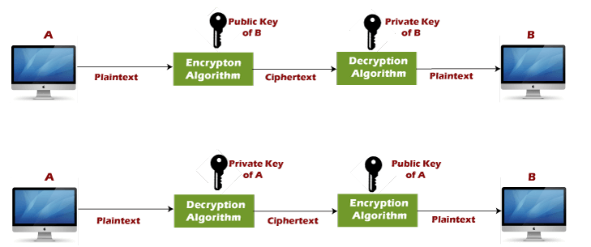
Public Key Encryption (contd.)

Slide 5
Watsapp Message to Self
When you send a message to yourself:
The message is encrypted on your device.
It is then sent to the WhatsApp servers, just like any other message.
The server stores it briefly, until it is delivered back to you.
The message is then delivered to your own device (or multiple devices if you are using linked devices), where it gets decrypted and displayed.

Slide 6
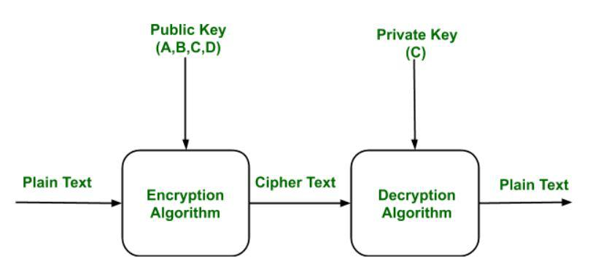

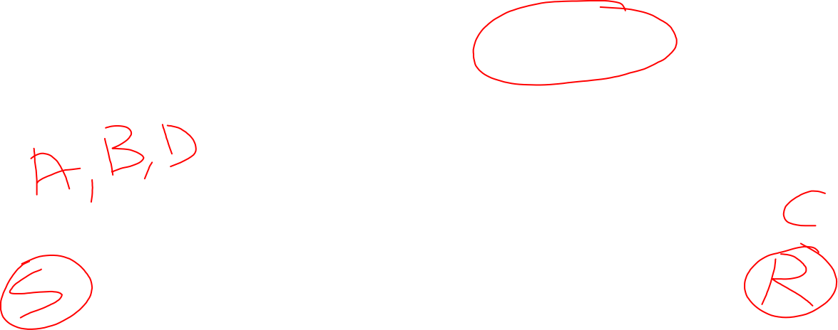
Public Key Encryption (contd.)

Slide 7
Why?
Even though you're messaging yourself, WhatsApp treats it like a regular message between two parties.
The server acts as an intermediary, handling message delivery, ensuring proper synchronization between devices (if you have WhatsApp on multiple devices), and storing the message temporarily during transit.

Slide 8
Components
Plain Text: This is the message which is readable or understandable. This message is given to the Encryption algorithm as an input.
Cipher Text: The cipher text is produced as an output of Encryption algorithm. We cannot simply understand this message.
Encryption Algorithm: The encryption algorithm is used to convert plain text into cipher text.
Decryption Algorithm: It accepts the cipher text as input and the matching key (Private Key or Public key) and produces the original plain text
Public and Private Key: One key either Private key (Secret key) or Public Key (known to everyone) is used for encryption and other is used for decryption

Slide 9
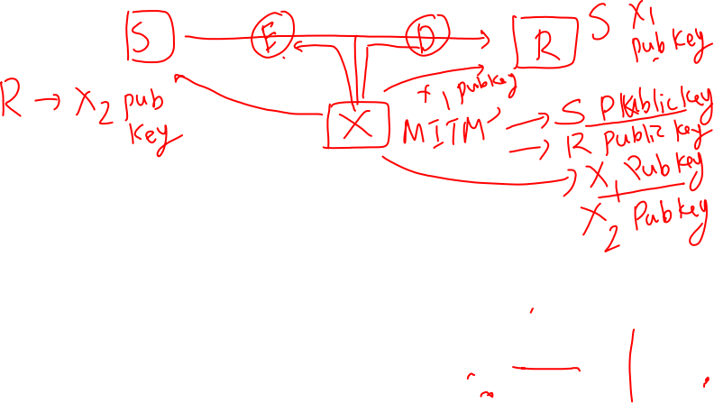
Weakness
Public key Encryption is vulnerable to Brute-force attack.
This algorithm also fails when the user lost his private key, then the Public key Encryption becomes the most vulnerable algorithm.
Public Key Encryption also is weak towards man in the middle attack. In this attack a third party can disrupt the public key communication and then modify the public keys.

Slide 10

Applications
Encryption/Decryption: Confidentiality can be achieved using Public Key Encryption. In this the Plain text is encrypted using receiver public key. This will ensure that no one other than receiver private key can decrypt the cipher text.
Digital signature: Digital signature is for senders authentication purpose. In this sender encrypt the plain text using his own private key. This step will make sure the authentication of the sender because receiver can decrypt the cipher text using senders public key only.
Key exchange: This algorithm can use in both Key-management and securely transmission of data.

Slide 11
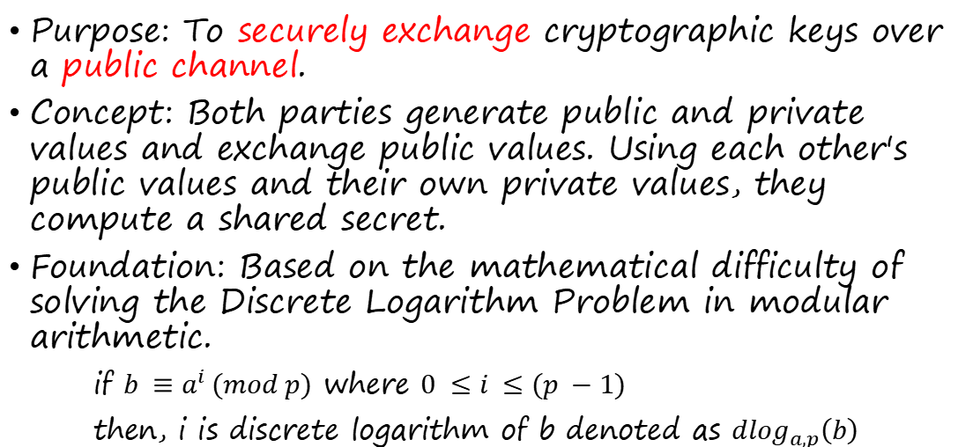
Diffie-Hellman Key Exchange
Purpose: To securely exchange cryptographic keys over a public channel.
Concept: Both parties generate public and private values and exchange public values. Using each other's public values and their own private values, they compute a shared secret.
Foundation: Based on the mathematical difficulty of solving the Discrete Logarithm Problem in modular arithmetic.
if $b ≡a^{i} (mod p)$ where $0 ≤i ≤(p −1)$
then, i is discrete logarithm of b denoted as ${dlog}_{a,p}\left(b\right)$
Notes:
The Discrete Logarithm Problem is to find x, where x is the smallest non-negative integer such that:
A=(g^x) mod p
Given g, p, and A = g^x \mod p, where x is a secret integer, it is computationally hard to find x given g, p, and A. In other words, determining the exponent x (the discrete logarithm of A with base g) is infeasible for large values of p.

Slide 12
Algorithm: step 1
Agree on Shared Public Parameters:
Both parties agree on two numbers:
A large prime number p (publicly known).
A primitive root g (also called generator) modulo p, which is a number that, when raised to different powers, produces a wide range of values modulo p.
Notes:
g = 5, p = 23

Slide 13
Algorithm: step 2
Private Key Generation:
Each party chooses a private key:
Party A selects a secret private key a.
Party B selects a secret private key b.

Slide 14
Algorithm: step 3
Public Key Generation:
Using their private keys, both parties compute their public keys:
Party A computes A = gª mod p.
Party B computes B = g^{b} mod p.

Slide 15
Algorithm: step 4
Once both parties receive each other's public keys, they can compute a shared secret key using their private keys:
Party A computes the shared secret as S = Bª mod p.
Party B computes the shared secret as S = A^{b} mod p.

Slide 16
Example
g = 5, p = 23
Alice selects a = 6 as the private key
Bob selects b = 15 as the private key

Slide 17
Important
Both values S will be equal because of the properties of modular arithmetic:
S = (g^{b} mod p)ª mod p
= (gª mod p)^{b} mod p
= g^{ab} mod p
Notes:
Example: Let p = 23, g = 5, a = 6, and b = 15.

Slide 18







Attacks
Man-in-the-Middle (MITM) Attack:
Diffie-Hellman by itself does not authenticate the communicating parties, making it vulnerable to MITM attacks. An attacker could intercept public keys and establish two separate shared keys, one with Party A and another with Party B, relaying communications between them while deciphering the messages.
Solution: To prevent MITM attacks, Diffie-Hellman is often combined with digital signatures or public key certificates to verify the identities of the communicating parties.
Notes:
How the MITM Attack Works on Diffie-Hellman:
Initial Setup:
Alice and Bob want to communicate securely by exchanging a shared key using the Diffie-Hellman algorithm.
An attacker (Eve) can position herself between Alice and Bob without either party knowing.
Intercepting the Exchange:
Alice sends her Diffie-Hellman public value A to Bob.
Eve intercepts A and does not forward it to Bob. Instead, she generates her own Diffie-Hellman value Ae​ and sends this to Bob.
Fake Exchanges:
Bob, thinking he is communicating with Alice, receives Ae​ (from Eve) and sends his public value B to Alice. However, Eve intercepts B and sends her own Be​ to Alice instead.
Now, both Alice and Bob are each unknowingly communicating with Eve.
Establishing Separate Keys:
Alice computes a shared secret with Be​ (thinking it is from Bob), but it is actually a shared secret with Eve.
Bob computes a shared secret with Ae​ (thinking it is from Alice), but it is also a shared secret with Eve.
Now, Eve has two shared keys: one with Alice and one with Bob. She can decrypt any messages from Alice, modify them, and re-encrypt them with the key she shares with Bob, and vice versa.
MITM in Action:
Eve can intercept, decrypt, alter, and re-encrypt messages between Alice and Bob. Neither Alice nor Bob would know that their communication is compromised because the key exchange proceeds without any authentication.

Slide 19
Attacks (contd.)
Precomputation Attacks:
For small prime numbers, an attacker can precompute all possible values of g^{x} mod p and use this lookup table to speed up the breaking of the system.
Solution: Use large prime numbers (2048-bit or more) to ensure security.

Slide 20
ElGamal Encryption Algorithm
ElGamal Encryption is a public-key cryptosystem.
It uses asymmetric key encryption for communicating between two parties and encrypting the message.
This cryptosystem is based on the difficulty of finding discrete logarithms in a cyclic group that is even if we know gª and g^{k}, it is extremely difficult to compute g^{ak}.
It was invented by Taher ElGamal in 1985.

Slide 21
Components
Key Generation:
Public Parameters: Select a large prime number p and a generator g of the multiplicative group (Z*, p).
Private Key: Select a private key x such that 1 ≤ x ≤p − 2.
Public Key: Compute h=g^{x} mod p. The public key is (p,g,h) and the private key is x.
Notes:
For the group Zp∗​, the values 0 and p−1 are typically avoided as exponents because they lead to trivial or redundant results. x=0: g^0 mod p = 1, which is trivial.
x = p - 1: g^{p-1} mod p = 1 by Fermat's Little Theorem, which is also a trivial result in terms of cyclic groups.

Slide 22
Components (contd.)
Encryption:
To encrypt a message M:
Choose a random integer k such that 1 ≤ k ≤ p−2.
Compute C1 = g^{k} mod p.
Compute C2 =M⋅h^{k} mod p.
The ciphertext is (c1,c2).

Slide 23
Components (contd.)
Decryption:
To decrypt the ciphertext (c1,c2) using the private key x:
Compute the shared secret s = c1^{x} mod p.
Compute s⁻¹ mod p (the modular inverse of s).
Compute the original message M = C2⋅s⁻¹ mod p.

Slide 24
Idea
Suppose Alice wants to communicate with Bob.
1. Bob generates public and private keys:
Bob chooses a very large number q and a cyclic group Fq.
From the cyclic group Fq, he choose any element g and an element a such that gcd(a, q) = 1.
Then he computes h = gª.
Bob publishes F, h = gª, q, and g as his public key and retains a as a private key.

Slide 25
Idea (contd.)
2. Alice encrypts data using Bob’s public key :
Alice selects an element k from cyclic group F such that gcd(k, q) = 1.
Then she computes p = g^{k} and s = h^{k} = g^{ak}.
She multiples s with M.
Then she sends (p, M*s) = (g^{k}, M*s).

Slide 26
Idea (contd.)
3. Bob decrypts the message :
Bob calculates s′ = pª = g^{ak}.
He divides M*s by s′ to obtain M as s = s′.

Slide 27
Example
For this example, let:
p = 23, g = 5, b = 6
Bob computes:
B = 5⁶ mod 23 = 15625 mod 23 = 8
Bob’s public key is B = 8.

Slide 28
Example Contd.
Alice wants to send an encrypted message to Bob. Let's say the message is m = 13, which Alice will encrypt.
Alice randomly picks a temporary private key k, where k is a random integer between 1 and p - 1. Let k = 10.
C1​ = 5¹⁰ mod 23 = 9765625 mod 23 = 9
C2 ​= 13 ⋅ 8¹⁰ mod 23
= 13 ⋅ 1073741824 mod 23
= 13 ⋅ 9 mod 23
= 117 mod 23 = 2
Alice then sends (C1, C2) to Bob.

Slide 29
Example Contd.
To decrypt, Bob uses his private key b = 6 and the received values C1​ and C2​.
s = 9⁶ mod 23 = 531441 mod 23 = 9
Bob then computes the modular inverse of 9 mod 23 (which is 18), and decrypts the message:
m = 2 ⋅ 18 mod 23 = 36 mod 23 = 13
Thus, Bob successfully decrypts the message, m=13.

Slide 30
Limitations
Slow processing: ElGamal is slower compared to other encryption algorithms, especially when used with long keys. This can make it impractical for certain applications that require fast processing speeds.
Key size: ElGamal requires larger key sizes to achieve the same level of security as other algorithms. This can make it more difficult to use in some applications.

Slide 31
RSA Algorithm
RSA is the most common public-key algorithm, named after its inventors Rivest, Shamir, and Adelman (RSA).

Slide 32





Idea
The idea of RSA is based on the fact that it is difficult to factorize a large integer.
The public key consists of two numbers where one number is a multiplication of two large prime numbers.
And private key is also derived from the same two prime numbers.
So, if somebody can factorize the large number, the private key is compromised.
Therefore, encryption strength lies in the key size and if we double or triple the key size, the strength of encryption increases exponentially.

Slide 33
Procedure
Step 1: Generating Keys
To start, we need to generate two large prime numbers, p and q. These primes should be of roughly equal length and their product should be much larger than the message we want to encrypt.
We can generate the primes using any primality testing algorithm, such as the Miller-Rabin test. Once we have the two primes, we can compute their product n = p*q, which will be the modulus for our RSA system.
Next, we need to choose an integer e such that 1 < e < phi(n) and gcd(e, phi(n)) = 1, where phi(n) = (p-1)*(q-1) is Euler’s totient function. This value of e will be the public key exponent.
To compute the private key exponent d, we need to find an integer d such that d*e = 1 (mod phi(n)). This can be done using the extended Euclidean algorithm.
Our public key is (n, e) and our private key is (n, d).

Slide 34
Procedure (contd.)
Step 2: Encryption
To encrypt a message m, we need to convert it to an integer between 0 and n-1. This can be done using a reversible encoding scheme, such as ASCII or UTF-8.
Once we have the integer representation of the message, we compute the ciphertext c as c = m^{e} (mod n). This can be done efficiently using modular exponentiation algorithms, such as binary exponentiation.

Slide 35
Procedure (contd.)
Step 3: Decryption
To decrypt the ciphertext c, we compute the plaintext m as m = c^{d} (mod n). Again, we can use modular exponentiation algorithms to do this efficiently.

Slide 36
Example
Suppose we choose p = 11 and q = 13, giving us n = 143 and phi(n) = 120.
We can choose e = 7, since gcd(7, 120) = 1. Using the extended Euclidean algorithm, we can compute d = 103, since 7*103 = 1 (mod 120).
Our public key is (143, 7) and our private key is (143, 103).

Slide 37
Example
Suppose we want to encrypt the message 42. Using the public key, we compute the ciphertext as c = 42^7 (mod 143) = 81.
To decrypt the ciphertext, we use the private key to compute m = 81^103 (mod 143) = 42, which is the original message.

Slide 38
Security Foundation of RSA
The RSA algorithm is based on three core mathematical principles:
Factoring Large Composite Numbers: RSA's security depends on the difficulty of factoring a large number N, which is the product of two large prime numbers p and q. The public key in RSA includes N and an exponent e, while the private key includes the exponent d (the modular multiplicative inverse of e modulo ϕ(N), where ϕ(N)=(p−1)(q−1)). Knowing N without knowing p and q makes it infeasible to compute d without factoring N.

Slide 39
Security Foundation of RSA (contd.)
2. Difficulty of Computing the Modular Inverse: The decryption key d is derived by computing the modular inverse of e modulo ϕ(N). This is feasible only if the values of p and q are known, as they are necessary to calculate ϕ(N).
3. Assumption of Prime Selection: RSA's security also depends on using primes that are chosen carefully to avoid common factoring techniques. If these primes are too small or chosen poorly (e.g., predictable), it weakens RSA's security.

Slide 40
Common Attacks on RSA
1. Brute Force Attack:
Attackers attempt to factor N by brute force, trying different combinations of potential factors. However, for sufficiently large primes (2048 bits or more), brute-force factoring is computationally infeasible due to the time required.

Slide 41
Common Attacks on RSA (contd.)
2. Unconcealed Message attack:
Sometimes it happens that plain text is the same as cipher text after encryption. So, it must be checked, or it will be of no use as the attacker will see right through it.

Slide 42
Common Attacks on RSA (contd.)
3. Timing Attack:
A timing attack on RSA is a side-channel attack that leverages the time variations in RSA decryption or signing operations to gain insights into the private key.
The general approach of a timing attack involves the following steps:
Collect Timing Data: The attacker sends numerous chosen ciphertexts (or observes legitimate transactions) to the target, carefully measuring the time each decryption or signing operation takes.

Slide 43
Common Attacks on RSA (contd.)
2. Analyze Patterns: The attacker examines timing variations across multiple requests. Small timing differences can indicate specific information about the factors used in the computation, such as the length of intermediate values, divisions, or operations that depend on the private key.
3. Infer Key Information: Using the timing patterns, the attacker applies mathematical analysis to infer bits of the private key. This is especially relevant when the RSA algorithm employs certain optimizations like the Chinese Remainder Theorem (CRT) to speed up decryption.

Slide 44
ECC
Elliptic Curve Cryptography (ECC) is a type of public-key cryptography based on the algebraic structure of elliptic curves over finite fields.
ECC has become popular in recent years due to its ability to provide a high level of security with relatively small key sizes, making it efficient in terms of computation, storage, and bandwidth.

Slide 45
Key Idea
Elliptic Curves: An elliptic curve is a set of points that satisfy a specific mathematical equation. Over a finite field, an elliptic curve can be defined by an equation of the form:
y² = x³ + ax + b
where a and b are constants that satisfy certain conditions to ensure the curve has no singularities (i.e., it is smooth and connected).

Slide 46
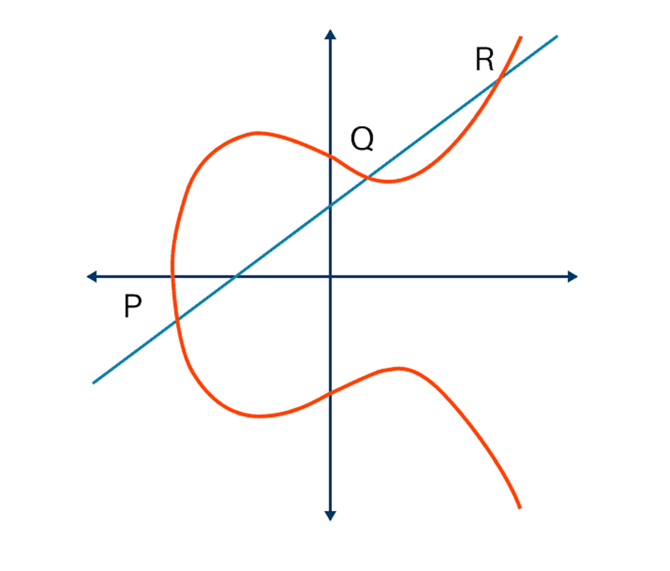
Key Idea (contd.)

Slide 47
Security
The security of ECC relies on the difficulty of the Elliptic Curve Discrete Logarithm Problem (ECDLP).
Given two points P and Q on an elliptic curve, where Q = kP for some unknown integer k, it is computationally difficult to determine k.
This problem is considered hard even for advanced algorithms, which makes ECC a secure choice for cryptographic applications.

