Slide 1
Private Key Encryption Schemes and Block Ciphers
An Overview of DES, Attacks, and Modes of Operation
Dr. Nachiket Tapas

Slide 2
Introduction to Private-Key Encryption
Private-key encryption, also known as symmetric encryption, is a cryptographic system where the same key is used for both encryption and decryption of data.
In this method, the sender and receiver must both possess the secret key to securely communicate.
Encryption: Transforming plaintext (readable data) into ciphertext (unreadable data) using a key.
Decryption: Reverting ciphertext back into plaintext using the same key.

Slide 3
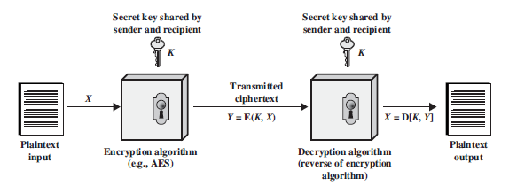

Slide 4
Importance
Private-key encryption plays a crucial role in:
1. Data Confidentiality: Ensures that unauthorized parties cannot read the encrypted data.
2. Performance: Symmetric encryption tends to be faster than asymmetric encryption, making it suitable for bulk data encryption.
3. Widespread Use: Often used in securing data in transit, such as in VPNs, Wi-Fi security protocols (e.g., WPA2), and file encryption.

Slide 5
Limitation
However, one of the challenges is securely distributing the private key, as anyone with the key can decrypt the data.

Slide 6
Pseudorandom Functions and Permutations
A Pseudorandom Function (PRF) is a deterministic algorithm that, given an input (typically a key and a message), produces an output that appears random but is fully determined by the input.
A Pseudorandom Permutation (PRP) is a bijective (one-to-one and onto) function that, like PRFs, looks random but is reversible, meaning there is an inverse function that can recover the original input.

Slide 7
PRF
Example:
Key: k = 5
Message: m = 7
Now, we define a simple PRF function:
f_{k}(m) = (k x m) + 3 mod 11
Using this formula:
f₅(7) = (5 x 7) + 3 mod 11 = 38 mod 11 = 5

Slide 8
PRP
Example:
Input: x = 1234
Permutation Rule: Swap the first and last digits, then swap the second and third digits.
Applying the permutation rule:
Original: 1234
After Permutation: 4321
The number is now permuted to 4321, but with the secret permutation rule, we can reverse it to get the original number 1234.

Slide 9
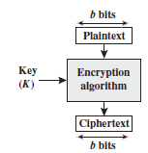
Block Cipher
A Block Cipher is a type of private-key encryption where the message is divided into fixed-size blocks (e.g., 64 or 128 bits), and each block is encrypted separately using the same secret key.
Example DES (Data Encryption Standard): Uses 64-bit blocks and a 56-bit key.
They are widely used for file encryption, data storage, and secure communications.

Slide 10
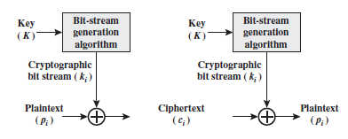
Stream Cipher
A Stream Cipher is a different type of private-key encryption that encrypts data one bit or byte at a time, rather than in blocks.
Examples:RC4: A well-known stream cipher.

Slide 11
Data Encryption Standard (DES)
DES (Data Encryption Standard) is a symmetric key block cipher that was one of the most widely used encryption algorithms in the world for securing digital information.
Developed in the 1970s, DES encrypts data by breaking it into fixed-size blocks and applying multiple rounds of transformations to ensure confidentiality.

Slide 12
Block Size and Key Length
Block Size: DES operates on 64-bit blocks, meaning the input plaintext is divided into chunks of 64 bits, and each block is independently encrypted.
Key Length: DES uses a 56-bit key to control the encryption process, though the key is typically presented as a 64-bit value (with 8 bits used for error-checking, reducing the effective key size to 56 bits).
Number of Rounds: DES uses 16 rounds of encryption, where the key and the plaintext block are mixed and permuted through a series of complex operations to generate the final ciphertext.
Notes:
Every 8th bit of the 64-bit key is a parity bit. For each 7-bit segment of the key, one extra bit is added to ensure that the number of 1s in that segment is odd (odd parity).

Slide 13
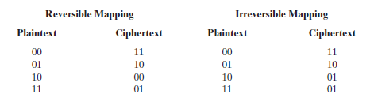
Motivation for Feistel Cipher Structure
A block cipher operates on a plaintext block of n bits to produce a ciphertext block of n bits.
There are 2^{n} possible different plaintext blocks and, for the encryption to be reversible, each must produce a unique ciphertext block.

Slide 14
Motivation for Feistel Cipher Structure (Contd.)
In the latter case, a ciphertext of 01 could have been produced by one of two plaintext blocks.
So, if we limit ourselves to reversible mappings, the number of different transformations is 2^{n}!.

Slide 15
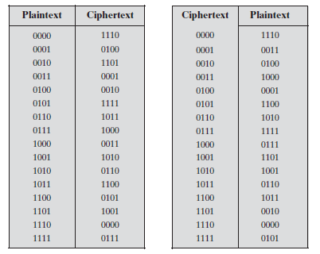
What if there are 4 bits?

Slide 16
Problems
If the block size is less, then the system is equivalent to classical substitution cipher.
Thus, n should be sufficiently large.
If n is sufficiently large, then the key requirement is n x 2^{n} bits.
For example, for previous table, the key will be of 4 x 16 bits i.e. 64 bits in length. The key would look like:
1110 0100 1101 0001 0110 1000 1011 0111 0010 1111 1010 0011 1100 0000 1001 0101

Slide 18
Problems (contd.)
Using the logic, for 64 bit block, the key size would be 64 x 2⁶⁴ = 2⁷⁰ 10²¹ bits.
Feistel Cipher reduces this computation problem to n²

Slide 19
Substitution and Confusion
In cryptography, substitution refers to the process of replacing elements of the plaintext (e.g., letters, numbers, or bits) with corresponding elements from a different set according to a predefined system or algorithm.
Confusion is the property that the relationship between the ciphertext and the encryption key is obscured.
Substitution contributes to confusion by making it difficult for an attacker to predict how a change in the input or key will affect the output.

Slide 20
Permutation and Diffusion
Permutation, also called transposition, involves rearranging the positions of elements in the plaintext according to a specific system.
Diffusion is the property that ensures a change in one part of the input (such as a single bit) affects many parts of the output.
Permutation contributes to diffusion by spreading out the influence of individual bits or groups of bits.
This makes it harder for an attacker to find patterns that might help reverse the encryption or determine the key.

Slide 21
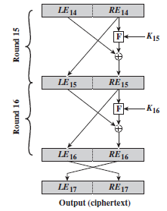
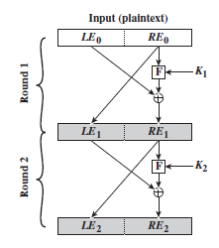
Feistel Cipher Structure

Slide 22
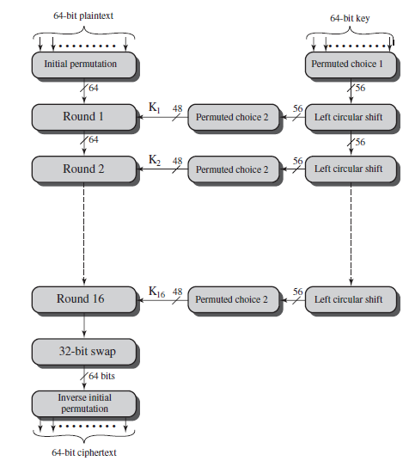
Methodology

Slide 23
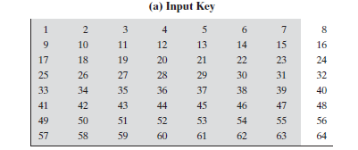











Input 64 bit

Slide 24
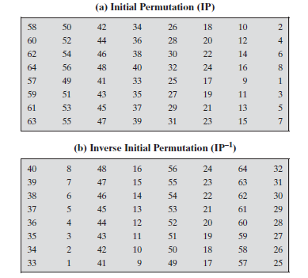
Initial Permutation

Slide 25
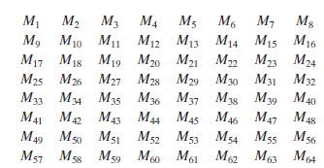
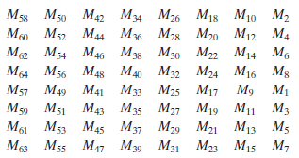
Meaning

Slide 26
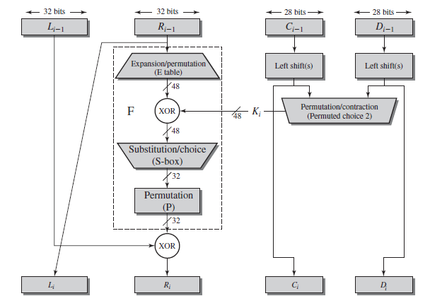
Single round DES

Slide 27
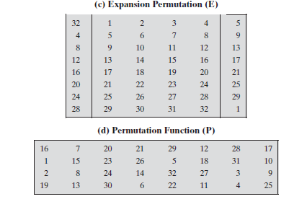
Expansion Permutation

Slide 28
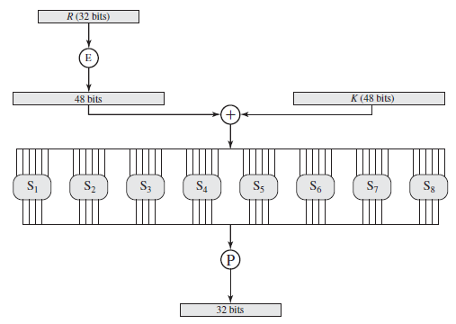
F(R, K)

Slide 29
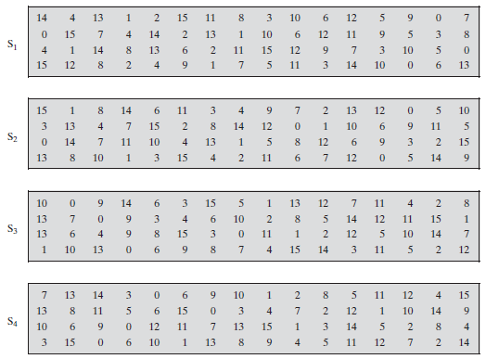
S-boxes
Notes:
Detailed Steps for 48-bit to 32-bit Conversion Using S-boxes:
Input to S-boxes (48-bit):
After the expansion permutation (E), the right half of the 32-bit data block is expanded to 48 bits.
This 48-bit expanded data is XORed with a 48-bit subkey generated from the key scheduling process.
The 48-bit result is then divided into 8 groups of 6 bits each, where each group is fed into a separate S-box.
Example of dividing 48-bit input:
Copy code
6 bits | 6 bits | 6 bits | 6 bits | 6 bits | 6 bits | 6 bits | 6 bits
S-box Operation: Each of the 8 S-boxes takes a 6-bit input and produces a 4-bit output. The S-boxes are pre-defined and are used for substitution. The function of the S-box is to map the 6-bit input to a 4-bit output according to a lookup table, which introduces non-linearity into the encryption process.
For each 6-bit input, the S-box interprets:
The first and last bits (bit positions 1 and 6) as the row.
The middle four bits (bit positions 2, 3, 4, and 5) as the column.
Each row and column combination corresponds to a 4-bit output from the S-box lookup table.

Slide 30
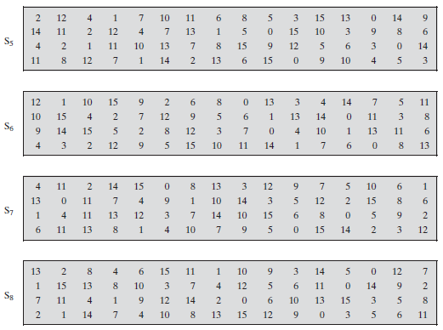
S-boxes

Slide 31






Key modification

Slide 32
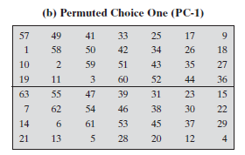
Key modification (contd.)

Slide 33
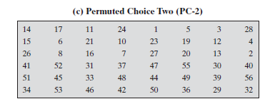
Key modification (contd.)

Slide 34

Key modification (contd.)

Slide 35
Example
Plaintext: 02468aceeca86420 (In Hex)
Key: 0f1571c947d9e859 (In Hex)
Ciphertext: da02ce3a89ecac3b (In Hex)

Slide 36
Key: 0f1571c947d9e859 (In Hex)

Slide 37
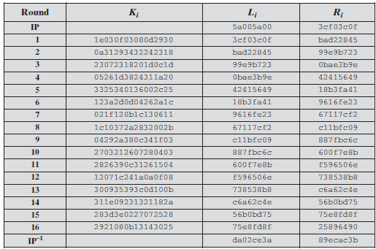

Slide 38
Modes of Operations
Electronic Codebook (ECB) Mode
In ECB mode, each block of plaintext is encrypted independently of other blocks.
It divides the plaintext into 64-bit blocks (the block size of DES), encrypts each block separately, and concatenates the resulting ciphertext blocks.
Identical plaintext blocks are encrypted into identical ciphertext blocks, which is a significant security risk.

Slide 39
Modes of Operations (contd.)
Cipher Block Chaining (CBC) Mode
In CBC mode, each plaintext block is XORed with the previous ciphertext block before being encrypted. The first block is XORed with an Initialization Vector (IV), a random value that ensures even identical plaintext blocks produce different ciphertexts.
The ciphertext from one block is chained into the encryption of the next block.

Slide 40
Modes of Operations (contd.)
Cipher Feedback (CFB) Mode
CFB mode converts a block cipher into a stream cipher. In this mode, encryption is applied to the previous ciphertext block to generate a keystream, which is then XORed with the current plaintext block to produce the ciphertext.
It can encrypt data smaller than the block size, so it can be used to encrypt byte by byte or bit by bit.

