Slide 1
Classical Encryption Techniques
Dr. Nachiket Tapas

Slide 2
Content
Symmetric Cypher Model
Steganography
Limitations of Perfect Secrecy
Shannon’s Theorem

Slide 3
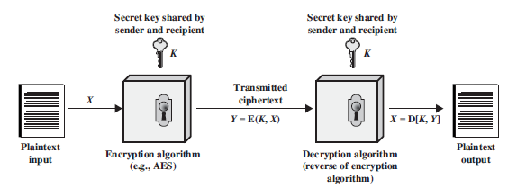
Symmetric Cypher Model

Slide 4
Symmetric Cypher Model
A symmetric encryption scheme has five ingredients:
1. Plaintext: This is the original intelligible message or data that is fed into the algorithm as input.
2. Encryption algorithm: The encryption algorithm performs various substitutions and transformations on the plaintext.
3. Secret key: The secret key is also input to the encryption algorithm. The key is a value independent of the plaintext and of the algorithm. The algorithm will produce a different output depending on the specific key being used at the time. The exact substitutions and transformations performed by the algorithm depend on the key.

Slide 5
Symmetric Cypher Model
4. Ciphertext: This is the scrambled message produced as output. It depends on the plaintext and the secret key. For a given message, two different keys will produce two different ciphertexts. The ciphertext is an apparently random stream of data and, as it stands, is unintelligible.
5. Decryption algorithm: This is essentially the encryption algorithm run in reverse. It takes the ciphertext and the secret key and produces the original plaintext.

Slide 6
Secure Encryption
There are two requirements for secure use of conventional encryption:
We need a strong encryption algorithm. At a minimum, we would like the algorithm to be such that an opponent who knows the algorithm and has access to one or more ciphertexts would be unable to decipher the ciphertext or figure out the key.
This requirement is usually stated in a stronger form: The opponent should be unable to decrypt ciphertext or discover the key even if he or she is in possession of a number of ciphertexts together with the plaintext that produced each ciphertext.

Slide 7
Secure Encryption
Sender and receiver must have obtained copies of the secret key in a secure fashion and must keep the key secure. If someone can discover the key and knows the algorithm, all communication using this key is readable.

Slide 8
Thus!!
It is impractical to decrypt a message on the basis of the ciphertext plus knowledge of the encryption/decryption algorithm.
In other words, we do not need to keep the algorithm secret; we need to keep only the key secret.
With the use of symmetric encryption, the principal security problem is maintaining the secrecy of the key.

Slide 9
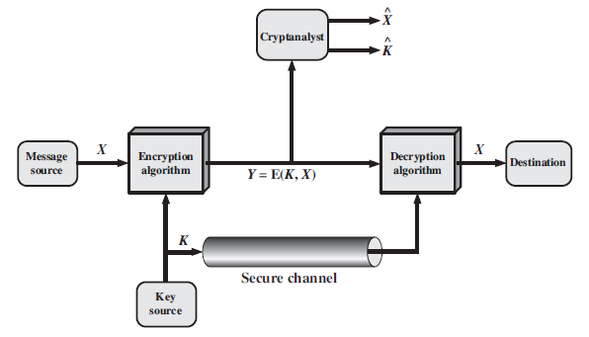
Process

Slide 10
Process
The notation Y = E(K, X) indicates that is produced by using encryption algorithm E as a function of the plaintext , with the specific function determined by the value of the key.
The intended receiver, in possession of the key, is able to invert the transformation: X = D(K, Y)

Slide 11
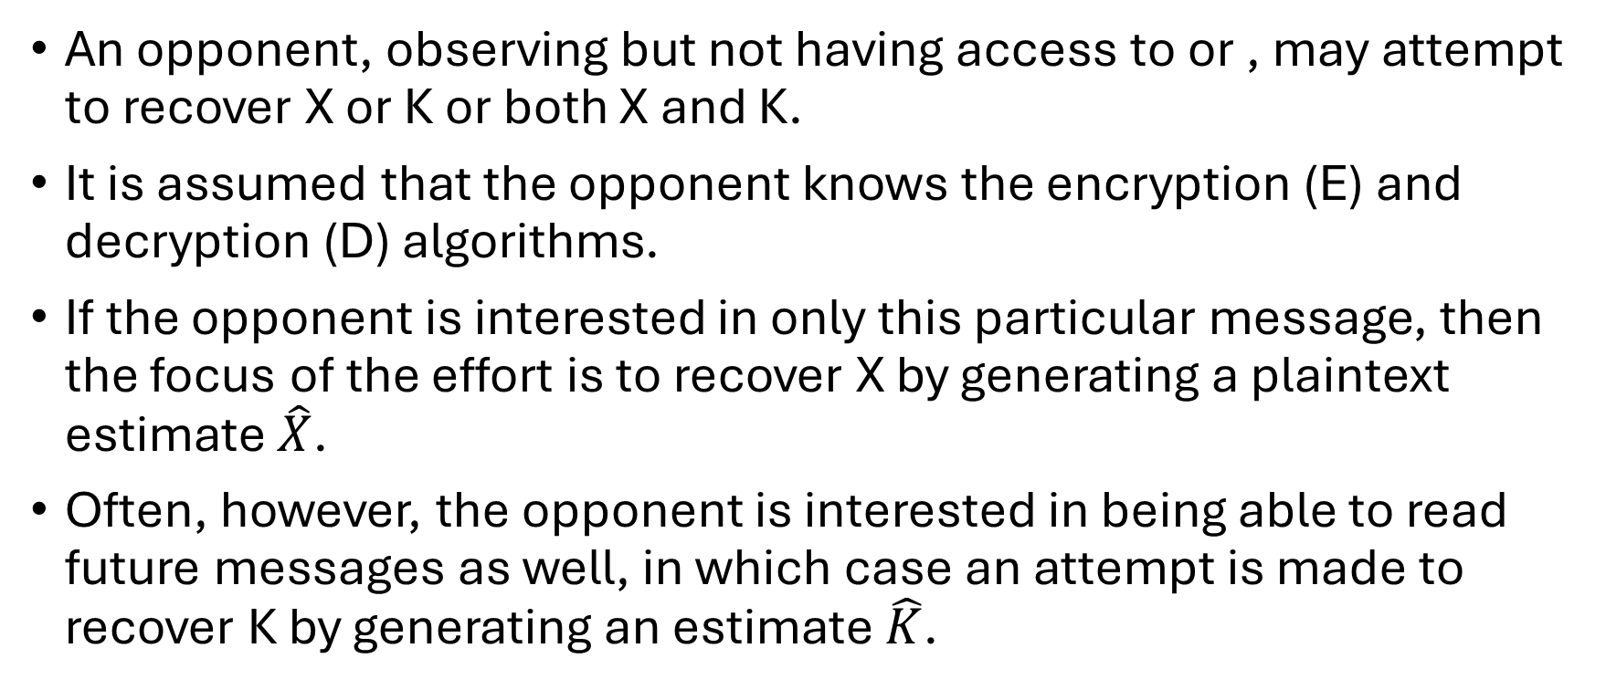
Hack!!
An opponent, observing but not having access to or , may attempt to recover X or K or both X and K.
It is assumed that the opponent knows the encryption (E) and decryption (D) algorithms.
If the opponent is interested in only this particular message, then the focus of the effort is to recover X by generating a plaintext estimate $\hat{X}$.
Often, however, the opponent is interested in being able to read future messages as well, in which case an attempt is made to recover K by generating an estimate $\hat{K}$.

Slide 12
Cryptography
Cryptographic systems are characterized along three independent dimensions:
1. The type of operations used for transforming plaintext to ciphertext. All encryption algorithms are based on two general principles: substitution, in which each element in the plaintext (bit, letter, group of bits or letters) is mapped into another element, and transposition, in which elements in the plaintext are rearranged. The fundamental requirement is that no information be lost (that is, that all operations are reversible). Most systems, referred to as product systems, involve multiple stages of substitutions and transpositions.

Slide 13
Cryptography
2. The number of keys used. If both sender and receiver use the same key, the system is referred to as symmetric, single-key, secret-key, or conventional encryption. If the sender and receiver use different keys, the system is referred to as asymmetric, two-key, or public-key encryption.

Slide 14
Cryptography
3. The way in which the plaintext is processed. A block cipher processes the input one block of elements at a time, producing an output block for each input block. A stream cipher processes the input elements continuously, producing output one element at a time, as it goes along.

Slide 15
Attacks!!
Typically, the objective of attacking an encryption system is to recover the key in use rather than simply to recover the plaintext of a single ciphertext.
Cryptanalysis: Cryptanalytic attacks rely on the nature of the algorithm plus perhaps some knowledge of the general characteristics of the plaintext or even some sample plaintext–ciphertext pairs.
This type of attack exploits the characteristics of the algorithm to attempt to deduce a specific plaintext or to deduce the key being used.

Slide 16
Attacks!!
Brute-force attack: The attacker tries every possible key on a piece of ciphertext until an intelligible translation into plaintext is obtained. On average, half of all possible keys must be tried to achieve success.

Slide 17
Unconditionally vs Computationally Secure
An encryption scheme is unconditionally secure if the ciphertext generated by the scheme does not contain enough information to determine uniquely the corresponding plaintext, no matter how much ciphertext is available.
An encryption scheme is said to be computationally secure if either of the following to criteria are met:
1. The cost of breaking the cipher exceeds the value of the encrypted information.
2. The time required to break the cipher exceeds the useful lifetime of the information.

Slide 18
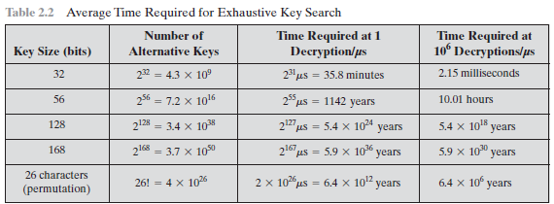
Computationally Secure

Slide 19
Symmetric Encryption Techniques
Substitution Technique (Caesar cypher)
Transposition Technique (rail fence)
https://www.cryptool.org/en/cto/
https://www.dcode.fr/columnar-transposition-cipher

