Slide 1
Enterprise Credit Risk & Portfolio Analytics Platform
End-to-End Credit Risk Analytics — SQL, Python, Machine Learning & Power BI
Presented by
Scope
Rounak Pyne | Business Analyst
A comprehensive, multi-stage analytics platform covering data engineering, exploratory analysis, predictive modelling, time-series forecasting, and executive dashboarding for enterprise credit risk management.

Slide 2

Business Problem
A financial institution is facing:
Five questions this project answers:
01
Rising Customer Defaults
Which customers are most likely to default?
Default rates are climbing, eroding portfolio quality and capital adequacy.
02
Increasing Delinquency Rates
What factors drive default risk?
More accounts are falling behind on payments, signalling systemic stress.
03
Which customer segments are riskiest?
Growing Fraud Incidents
04
Fraud alerts are multiplying, compounding credit losses.
How effective is collections recovery?
Higher Collection Costs
05
Recovery efforts are consuming resources without proportionate returns.
What will happen to risk over the next 6 months?
Limited Visibility into Future Portfolio Risk
No forward-looking signal exists to anticipate deterioration before it occurs.

Slide 3

Dataset & Architecture
20K
20K
Customers
Accounts
1M
720K
Transactions
Monthly Snapshots
50K
100K
Fraud Alerts
Collections Records
End-to-End Pipeline
CSV Files
PostgreSQL Data Mart
Raw source data ingestion
Structured storage & SQL analytics
Python EDA & Modelling
Power BI Dashboard
Feature engineering, Logistic Regression, ARIMA
Executive reporting & monitoring
Tech Stack: PostgreSQL · Python (pandas, scikit-learn, statsmodels) · Power BI

Slide 4
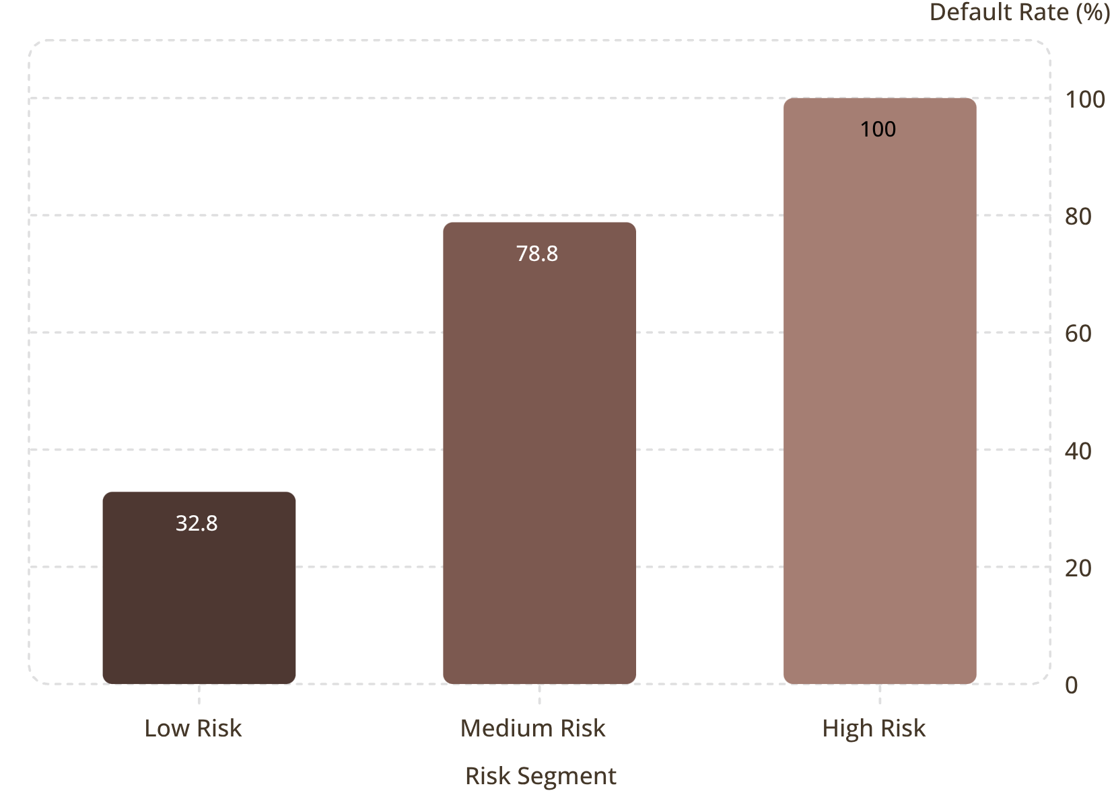
SQL Analysis — Portfolio KPIs
Portfolio-Level Metrics
Risk Segmentation — Validates the Scoring Model
A clean monotonic increase in default rate across risk tiers confirms the risk score works exactly as intended.
Total Accounts
Total Exposure
20,000
₹15.51 Billion
Delinquency Rate
Overall Default Rate
55.61%
51.95%
Fraud Rate
91.44%

Slide 5

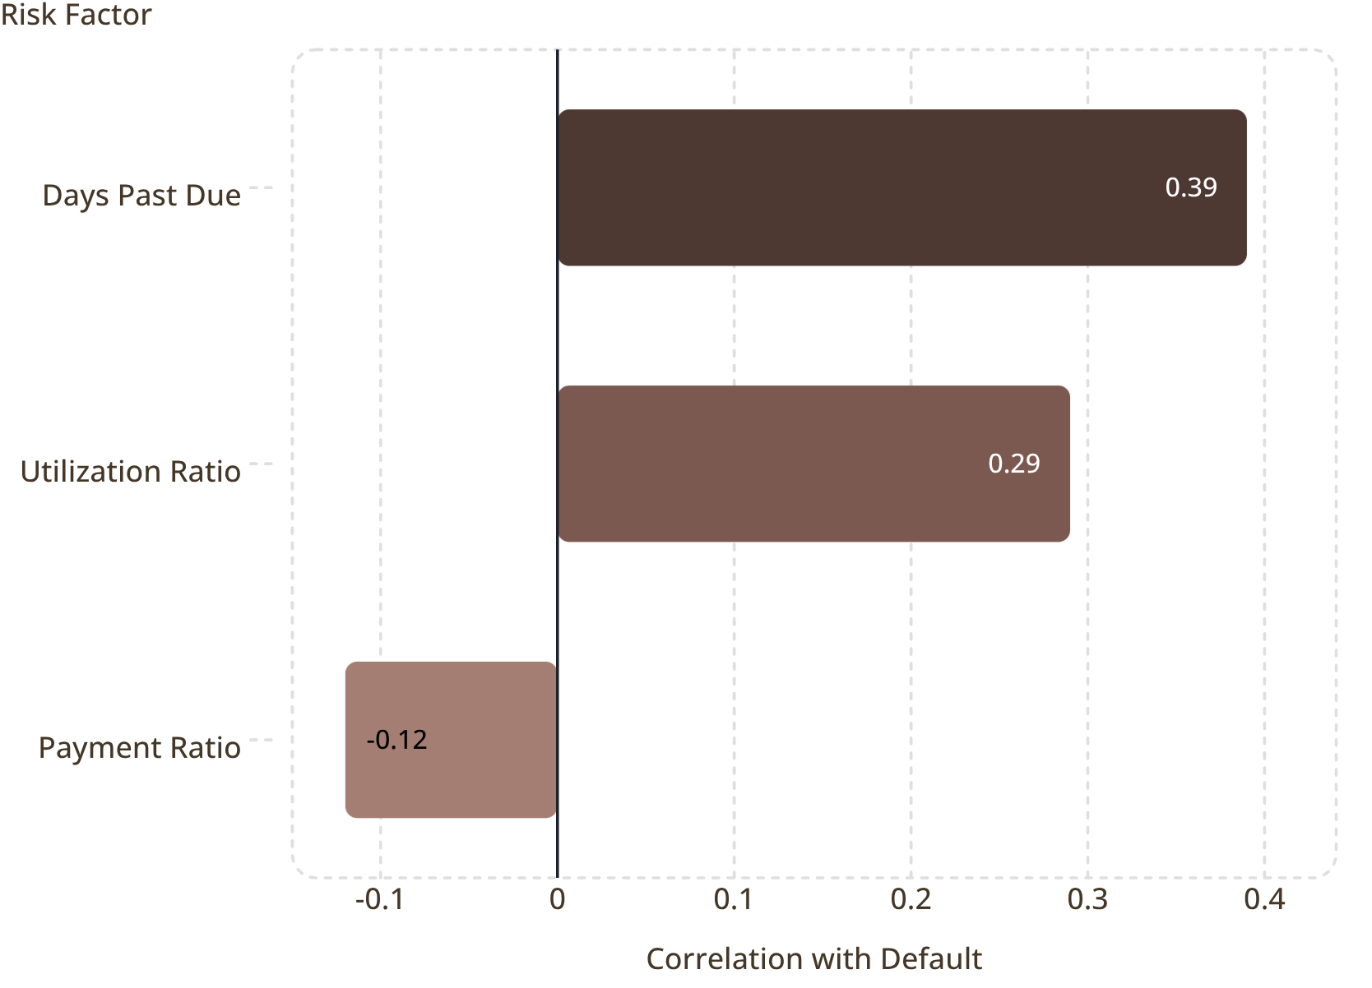

EDA Findings — What Actually Drives Default
Strongest Signals
Surprising Null Result
Days Past Due
City, occupation, age, and income show almost NO variation in default rate (~50–53% flat everywhere) — this portfolio's risk is behavioral, not demographic.
Correlation 0.39 — the single strongest predictor of default in the portfolio.
This finding has direct policy implications: risk models and collections strategies built around demographic proxies will underperform. The actionable signals are entirely in customer behaviour — how they pay, how much they borrow, and whether fraud has touched their account.
Utilization Ratio
Correlation 0.29 — high credit utilization is a reliable leading indicator of stress.
Fraud Count
Default rate climbs from 45% → 100% as fraud alerts increase from 0 → 5. A compounding risk signal.
Payment Ratio
Correlation -0.12 — the only protective factor identified; consistent payment behaviour reduces default probability.

Slide 6


Predictive Model — Logistic Regression
Why Logistic Regression
Model Performance Metrics
Interpretable
Metric
Score
Coefficients map directly to business intuition and can be explained to stakeholders.
ROC-AUC
0.83
Accuracy
75%
Regulator-Friendly
Industry standard for credit risk — accepted by regulators and auditors.
Precision (Default)
76%
Recall (Default)
77%
Probability Scores
Outputs a continuous probability of default, enabling risk-tiered decision-making.
An ROC-AUC of 0.83 indicates strong discriminatory power — the model reliably separates defaulters from non-defaulters well above random chance.
Model Features
Utilization Ratio
Days Past Due
Fraud Count
Payment Ratio
Account Age

Slide 7
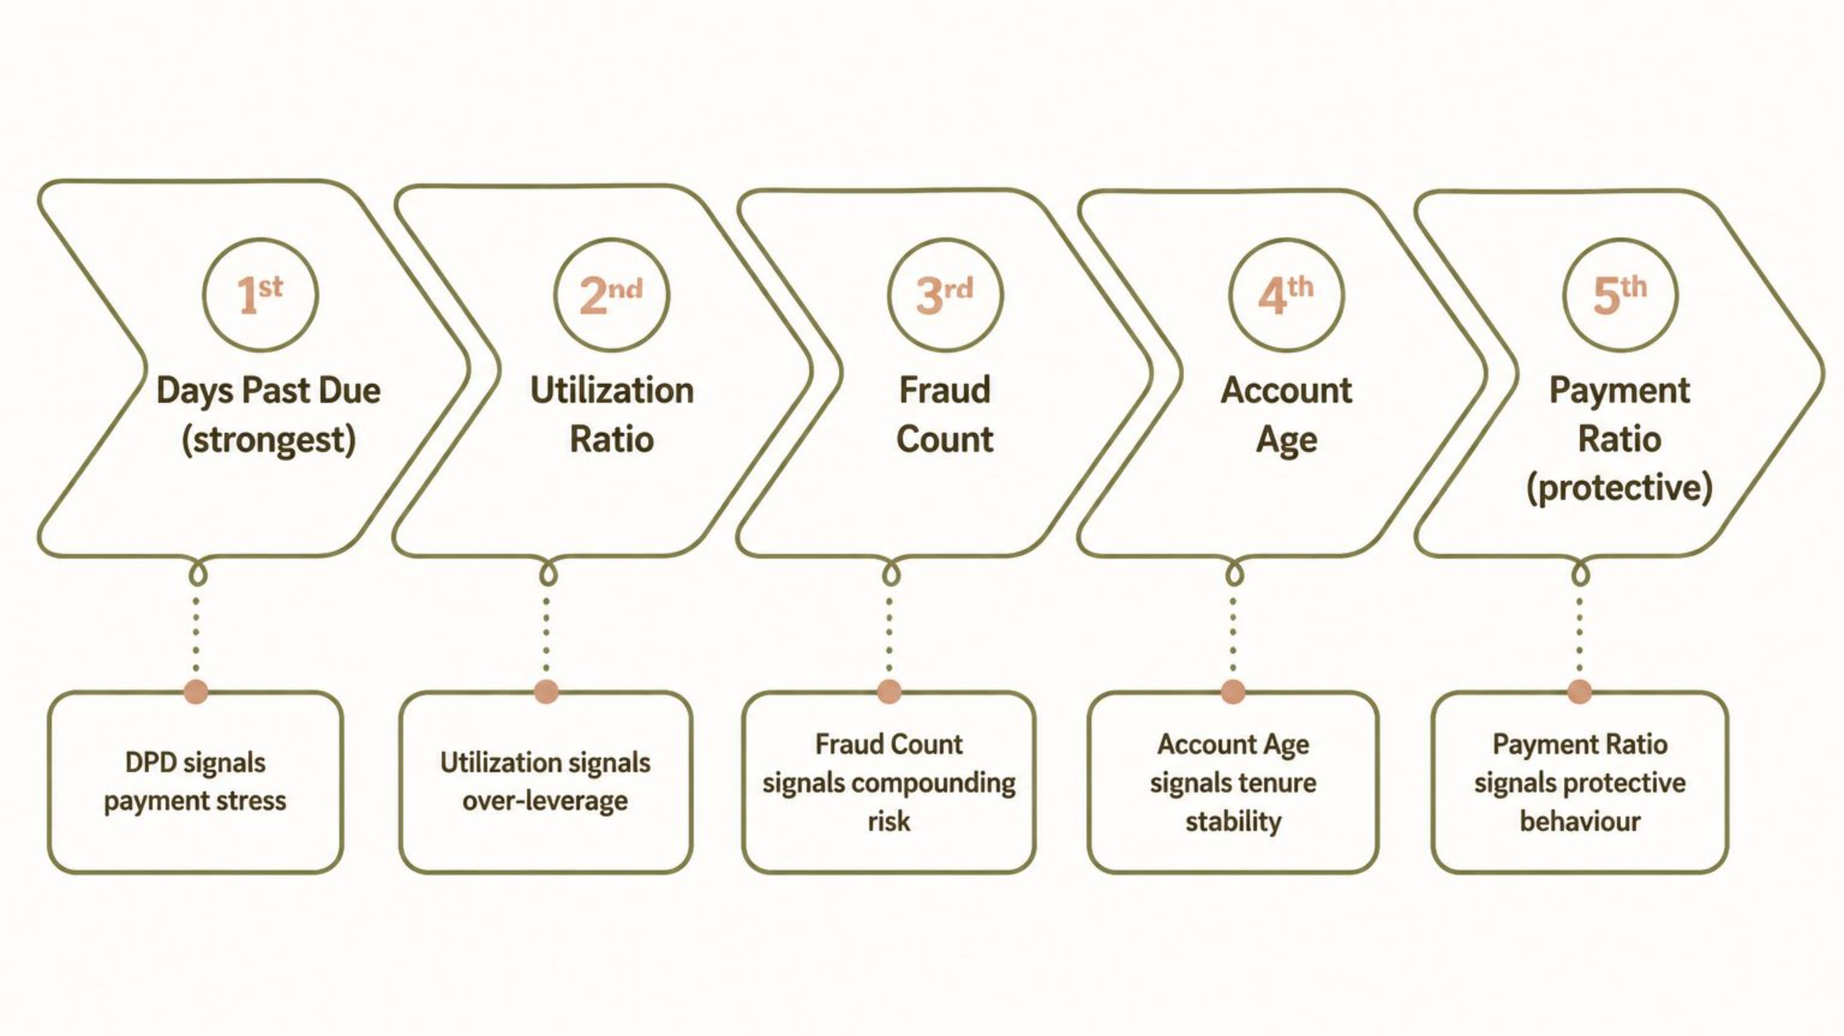
Model Consistency — Feature Importance
Feature importance ranking matches EDA findings exactly — consistent story across every stage of analysis.
What This Consistency Means
Analytical Integrity
When SQL segmentation, Python EDA correlation analysis, and the logistic regression model all rank the same features in the same order, it validates that the signals are real — not artefacts of any single analytical method. The story is coherent end-to-end.
SQL → EDA → Model
All three stages independently surface the same top risk drivers, confirming the robustness of the analytical pipeline.
Behavioural, Not Demographic
The model's selected features are entirely behavioural — reinforcing the EDA null result on demographics.

Slide 8

Forecasting — What Happens Next
Historical Stability
Business Read
Monthly default rate held stable between 10.6% and 11.8% over 3 years of historical data — no worsening trend detected across the observation window.
Portfolio risk is not deteriorating. No emergency action is statistically justified — but continued monitoring is essential to catch any future drift early.
The tight confidence interval (±0.5%) reflects a well-behaved, predictable portfolio. The ARIMA model provides a reliable baseline against which future monthly actuals can be benchmarked. Any reading outside the 10.6%–11.6% band should trigger a formal review.
6-Month ARIMA Forecast
Forecast Rate
95% Confidence Interval
~11.1%
10.6% – 11.6%
Trend Direction
Stable / Flat
Historical Data
6‑Month Forecast
ARIMA Model

Slide 9
Power BI Dashboard — 7 Pages
1
Executive Summary
Portfolio KPIs & risk segmentation — top-line view for senior leadership.
2
Risk Monitoring
DPD buckets & utilization distribution — operational risk tracking.
3
Customer Analytics
Demographic segmentation — understanding the customer base.
4
Fraud Dashboard
Fraud patterns & default impact — connecting fraud and credit risk.
5
Collections Dashboard
Recovery performance — measuring collections effectiveness.
6
Forecast Dashboard
Historical trend + 6-month ARIMA forecast — forward-looking risk view.
7
ML Dashboard
Model metrics & feature importance — transparency into the predictive model.

Slide 10
Business Recommendations
1
Build automated early-warning alerts on DPD & utilization thresholds
Operationalize the strongest predictive signals into real-time monitoring triggers.
2
Treat fraud history as a compounding risk signal — connect fraud & credit risk teams
Fraud count drives default rate from 45% to 100%; siloed teams miss this compounding effect.
3
Don't build risk policy around demographics — focus on behavioral signals
City, occupation, age, and income show no predictive power; policy built on them will underperform.
4
Reward strong payment behavior with proactive credit limit increases
Payment ratio is the only protective factor — incentivize it to improve portfolio quality.
5
Rethink collections strategy — call volume alone isn't driving recovery
Collections data shows effort is not translating to recovery; strategy redesign is warranted.
6
Pilot the model at credit origination, not just for existing-account monitoring
Applying the model at the point of application prevents high-risk accounts from entering the portfolio.
7
Maintain current monitoring investment — the portfolio is stable, not deteriorating
The ARIMA forecast confirms stability; the priority is early detection of any future drift, not crisis response.

Slide 11
Key Takeaway
This portfolio is stable, its risk drivers are well understood, and the path forward is clear: operationalize the early-warning signals already validated across SQL, Python, and the predictive model — turning reactive risk management into proactive risk prevention.
What Was Built
The Strategic Shift
01
Reactive
SQL Data Mart & KPI Layer
Responding to defaults after they occur — high cost, low recovery.
20,000 accounts, ₹15.51B exposure, full risk segmentation.
02
Proactive
Python EDA & Feature Engineering
Early-warning signals trigger intervention before default — lower cost, higher recovery.
Behavioural signals identified; demographic null result confirmed.
Thank you.
03
Logistic Regression Model
ROC-AUC 0.83 — regulator-friendly, interpretable, production-ready.
04
ARIMA Forecast
6-month outlook stable at ~11.1%; tight confidence interval.
05
Power BI Dashboard
7-page executive reporting suite covering all risk dimensions.

