Slide 1
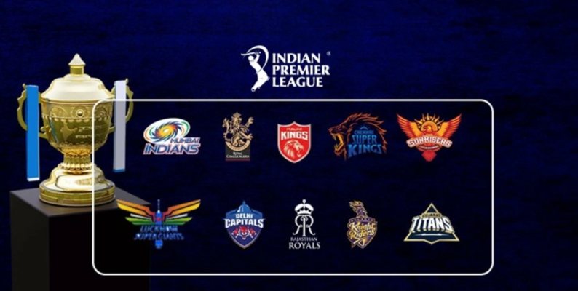
Project Done by – Rounak Pyne

Slide 2
Content
Case Study
Objectives
Data Analysis
Analysis of the IPL Auction:
List of all the teams.
List of teams and how many overseas players are there in 2022.
List of top 10 players based on the price they were sold over the years.
Teams which have paid highest money for their players over the years.
Which team has spent the most amount from 2013-2022.
How many overseas and Indian players have played from 2013 -2022.

Slide 3
Objectives
Analyse the IPL data and find useful information based on the given parameters using SQL query.
Publish the final analysis based on data we found.

Slide 4

Data Analysis
We analyze the data by producing charts of
important factors in the datasets.
Highest paid players in which team and
overseas player is something to look for .

Slide 5
Case study
This is IPL Auction Case Study where this data comprises of IPL teams , players, price they where sold for from 2013-2022.
There are 7 columns :
Player Name – Here we have name of players for all the teams over the years.
Nationality – Here we have list where it specifies if the players is and overseas and Indian player.
Type – Here we specify if the players is a batsman, bowler, wicket-keeper or an All-rounder.
Teams – Here we all the list of teams over the years .
Year – We have a range of year from 2013-2022.
Sponsored By – List of sponsors from 2013-2022.
Sold price – For what price each player was sold.

Slide 6
Analysis of the IPL Auction:
List of teams and how many overseas players are there.
List of top 10 players based on the price they were sold over the years.
Teams which have paid highest money for their players over the years.
Which team has spent the most amount from 2013-2022.
How many overseas and Indian players have played from in 2022
Teams | Year | Count
Name of player | Price | Year
Teams | Price
Teams | Total Money spent
Nationality | Count

Slide 7
List of all the teams.
Chennai Super Kings
Delhi Capitals
Gujarat Titans
Kolkata Knight Riders
Lucknow Super Giants
Mumbai Indians
Punjab Kings
Pune Warriors India
Rajasthan Royals
Royal Challengers Bangalore
Sunrisers Hyderabad
Kings XI Punjab
Delhi Daredevils
Gujarat Lions
Rising Pune Supergiant

Slide 8
List of top 10 players based on the price they were sold over the years.
2022 |  | 2021 |  | 2020 |  | 2019 |  | 2018
player_name | sold_price | player_name | sold_price | player_name | sold_price | player_name | sold_price | player_name | sold_price
Ishan Kishan | 152500000 | Christopher Morris | 162500000 | Pat Cummins | 155000000 | Varun Chakaravarthy | 84000000 | Benjamin Stokes | 125000000
Deepak Chahar | 140000000 | Kyle Jamieson | 150000000 | Marcus Stoinis | 48000000 | Jaydev Unadkat | 84000000 | Jaydev Unadkat | 115000000
Lockie Ferguson | 100000000 | Glenn Maxwell | 142500000 | Eoin Morgan | 52500000 | Colin Ingram | 64000000 | KL Rahul | 110000000
Nicholas Pooran | 107500000 | Jhye Richardson | 140000000 | Sam Curran | 55000000 | Mohit Sharma | 50000000 | Manish Pandey | 110000000
Harshal Patel | 107500000 | Krishnappa Gowtham | 92500000 | Piyush Chawla | 67500000 | Axar Rajesh Patel | 50000000 | Chris Lynn | 96000000
Wanindu Hasaranga | 107500000 | Riley Meredith | 80000000 | Shimron Hetmyer | 77500000 | Carlos Brathwaite | 50000000 | Mitchell Starc | 94000000
Shardul Thakur | 107500000 | Moeen Ali | 70000000 | Nathan Coulter-Nile | 80000000 | Shivam Dube | 50000000 | Glenn Maxwell | 90000000
Liam Livingstone | 115000000 | Shahrukh Khan | 52500000 | Sheldon Cottrell | 85000000 | Mohammad Shami | 48000000 | Rashid Khan Arman | 90000000
Shreyas Iyer | 122500000 | Nathan Coulter-Nile | 50000000 | Christopher Morris | 100000000 | Sam Curran | 72000000 | Krunal Pandya | 88000000
Avesh Khan | 100000000 | Tom Curran | 52500000 | Glenn Maxwell | 107500000 | Prabhsimran Singh | 48000000 | Sanju Samson | 80000000

Slide 9
List of top 10 players based on the price they were sold over the years.
2017 |  | 2016 |  | 2015 |  | 2014 |  | 2013
player_name | sold_price | player_name | sold_price | player_name | sold_price | player_name | sold_price | player_name | sold_price
Benjamin Stokes | 145000000 | Sanju Samson | 42000000 | Amit Mishra | 35000000 | Kevin Pietersen | 90000000 | Ajantha Mendis | 54375000
T Natarajan | 30000000 | Carlos Brathwaite | 42000000 | Zaheer Khan | 40000000 | Michael Hussey | 50000000 | Kane Richardson | 52500000
Karn Sharma | 32000000 | M. Ashwin | 45000000 | Angelo Mathews | 75000000 | Robin Uthappa | 50000000 | Abhishek Nayar | 50625000
Nathan Coulter-Nile | 35000000 | Mitchell Marsh | 48000000 | Dinesh Karthik | 105000000 | Murali Vijay | 50000000 | Thisara Perera | 50625000
Rashid Khan Arman | 40000000 | Ashish Nehra | 55000000 | Yuvraj Singh | 160000000 | David Warner | 55000000 | Christopher Morris | 46875000
Chris Woakes | 42000000 | Mohit Sharma | 65000000 | Trent Boult | 38000000 | Jacques Kallis | 55000000 | Glenn Maxwell | 75000000
Patrick Cummins | 45000000 | Shane Watson | 95000000 | David Wiese | 28000000 | Glenn Maxwell | 60000000 | Manpreet Gony | 37500000
Trent Boult | 50000000 | Pawan Negi | 85000000 | Darren Sammy | 28000000 | Mitchell Johnson | 65000000 | Jaydev Unadkat | 39375000
Kagiso Rabada | 50000000 | Christopher Morris | 70000000 | Murali Vijay | 30000000 | Dinesh Karthik | 125000000 | Dirk Nannes | 45000000
Tymal Mills | 120000000 | Yuvraj Singh | 70000000 | Aaron Finch | 32000000 | Yuvraj Singh | 140000000 | Sachithra Senanayaka | 46875000

Slide 10
Teams which have paid highest money for their players over the years.

Slide 11
Teams which have paid highest money for their players over the years.
From the above chart we get to know the top 3 teams who have paid the highest money for their players:
Rajasthan royals have paid the highest amount for Christopher Morris who is an
all-rounder for 162500000 in 2021.
Delhi daredevils have paid the highest amount for Yuvraj Singh who is a Batsman for 160000000 in 2015.
Kolkata Knight Riders have paid the highest amount for Pat Cummins who is an
all-rounder for 155000000 in 2020.

Slide 12
Which team has spent the most amount from 2013-2022.

Slide 13
Which team has spent the most amount from 2013-2022.
From the above chart we get to know that:
Royal Challengers Bangalore have spent 2709625000 on their players from 2013-22.
Sunrisers Hyderabad have spent 2311000000 on their players from 2013-22.
Kolkata Knight Riders have spent 2165125000 on their players from 2013-22.
These are the top 3 teams who have paid the highest amount for their team players.

Slide 14
How many overseas and Indian players have played from in 2022.

Slide 15
Conclusion
The data set has all the details of IPL auction from 2013-22.
Finding out the top players , teams and their sold price has given us the clear picture of what IPL brings for the players, teams and sponsors in terms of business.
We can say IPL has mix of overseas and Indian players which brings the global cricket community to a better tomorrow in terms of learnings and game mindset.

Slide 16
Thank you

