Slide 1
Advertisement Success Prediction
By Rounak Sharma

Slide 2
Overview
When one starts a business or is running a business, one needs to make people aware of the fact. Promotion is important for any type of business to let others know about the business.
Advertising is important for every aspect of a business. It plays an imperative role for both manufacturers and consumers.
Advertising is important for the business on the whole as it lets the business gain more customers, thereby increasing business turnaround.

Slide 3
Problem Statement
Building a machine learning model to predict whether an advertisement buy will lead to a net gain to the business.
This model will predict how much an advertisement add value to the business.

Slide 4
Stakeholder
Head of The Marketing Department
Head of Advertising Firm
Manager of Regulatory Bodies

Slide 5
Data Science Metric
F1 Score

Slide 6
Data
Feature | Description
UserID | Unique id for each row
ratings | Ratings for advertisement
airlocation | Country of origin
airtime | Time when the advertisement was aired
average_runtime(minutes_per_week) | Minutes per week the advertisement was aired
targeted_sex | Gender targeted by advertisement
genre | Type of advertisement
industry | The industry to which the product belonged
relationship_status | Relationship status of the customers
expensive | Advertisement expenses
money_back_guarantee | Whether the product offers a refund or not
netgain | Targeted feature which identify profit or loss for ads

Slide 7
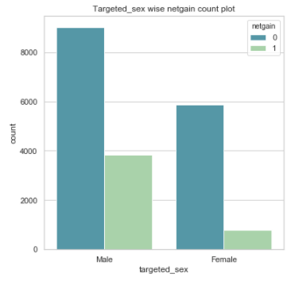
EDA
Targeted Sex Count
Male add more value to net gain as compare to female.

Slide 8
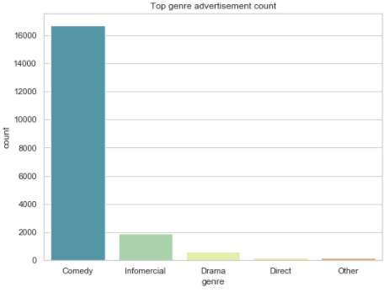
EDA
Top Genre wise Advertisement Count
Comedy is the most preferable genre.
Direct is the least preferable genre.

Slide 9
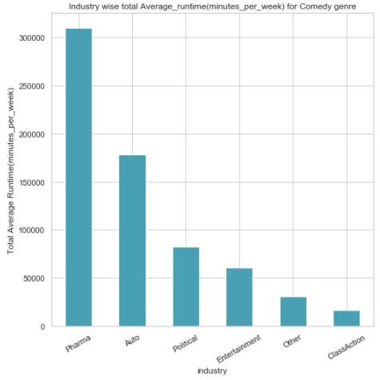
EDA
Top Industries in Comedy Genre
Pharma industry having highest total average runtime for Comedy genre.
ClassAction industry having lowest total average runtime for Comedy genre.

Slide 10
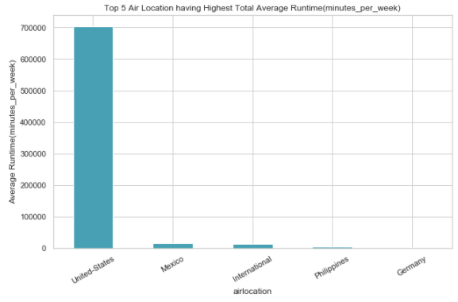
EDA
Top 5 Air Location for Avg Runtime
United-States having highest total average runtime(minutes_per_week).

Slide 11
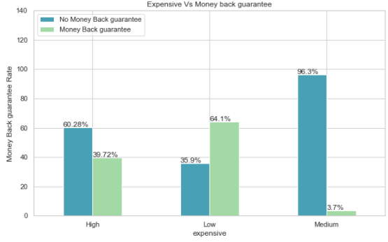
EDA
Expensive Vs Money back guarantee rate
High and medium expensive advertisements having low money back guarantee rate.
Low expensive advertisements having high money back guarantee rate.

Slide 12
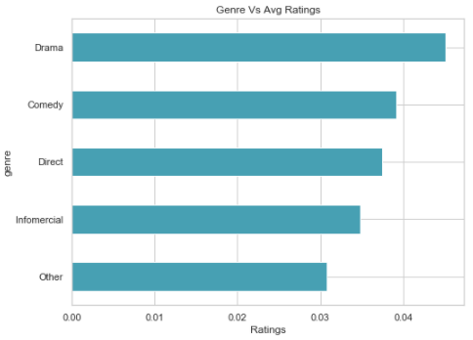
EDA
Genre Vs Average Ratings
Drama advertisements having highest average ratings.

Slide 13
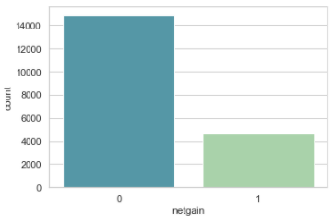
Pipeline
Missing Values :
There are no missing values present in the data.
Null Values :
There are no null values present in the data.
Imbalanced Class :
0 | 1
14886 | 4650

Slide 14
Feature Engineering
One Hot Encoding
Frequency Encoding
Column Name | Technique
targeted_sex | One Hot Encoding
airtime | One Hot Encoding
expensive | One Hot Encoding
money_back_guarantee | One Hot Encoding
realtionship_status | Frequency Encoding
industry | Frequency Encoding
genre | Frequency Encoding
airlocation | Frequency Encoding

Slide 15
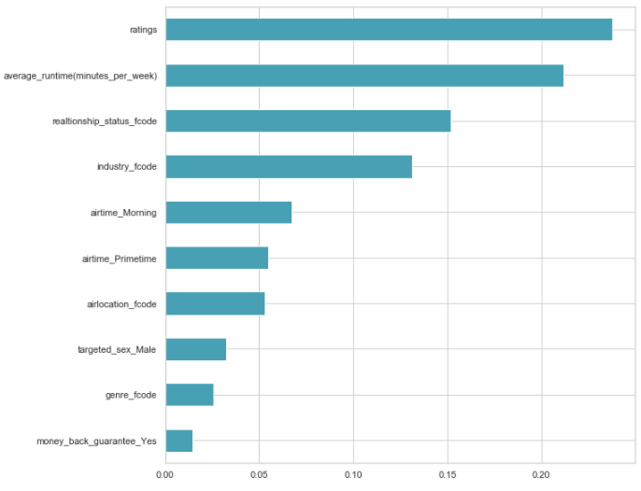
Feature Selection
Numerical Data(Co-relation)
Categorical Data(Chi Square)
Recursive Feature Elimination
Extra Trees Classifier for feature importance
XGBoost Classifier with Grid search

Slide 16
Model Selection
Logistic Regression
Decision Tree Classifier
Random Forest Classifier
XGBoost Classifier

Slide 17
Different Model Scores
With Imbalanced Data
Model | F1 Score
Logistic Regression | 0.40
Decision Tree Classifier | 0.49
Random Forest Classifier | 0.52
XGBoost Classifier | 0.53

Slide 18
Balanced Data & Hyper parameter Tuning
Imbalanced data handling techniques:
SMOTE
SMOTE Tomek
Hyper parameter tuning techniques:
Grid Search CV
Random Search CV

Slide 19
Different Model Scores
With Balanced Data
Model | F1 Score(SMOTE) | F1 Score(SMOTE Tomek)
Logistic Regression | 0.77 | 0.77
Decision Tree Classifier | 0.82 | 0.83
Random Forest Classifier | 0.83 | 0.84
XGBoost Classifier | 0.84 | 0.85

Slide 20
Final Confusion Matrix
Top two algorithms:
Random Forest Classifier : 0.84
XGBoost Classifier : 0.85
From the above observations, it can be inferred that best performing model is XGBoost Classifier with F1 score of 0.85
 |  | Actual
 |  | No Net Gain | Net Gain
Predicted | No Net Gain | 3426 | 980
 | Net Gain | 429 | 3968

Slide 21
Recommendations
There are very less net gain found for female targeted gender, in such case company should have to plan some future strategies to target this part of advertisement.
As the low expensive advertisements provide maximum number of money back guarantee, so company can increase the cost of such advertisement slightly to earn more profit for such cases.
As Comedy genre having maximum number of advertisement, so for this case company should have work on resources to improve the ratings of such advertisements.

Slide 22
Thank You!!!

