Slide 1

Computer Information Technology 2380 Applied Systems Development Student Project

Slide 2

Introduction
Knoxville Utility Board (KUB)
Serves Knox county and parts of 7 surrounding counties with electric, gas, water, and wastewater utilities
Client-mentors: DeWayne Lane, Keith Clinard, and Zachary Berardo
Pellissippi State Community College (PSTCC) Knoxville, Tennessee
5 campus serving the greater Knoxville area with a variety of technical & transferrable courses
Student Team: Amber Rivera (team leader), Donald Nash, Michal Kaminski, and Maude Volk

Slide 3
Project Charter
This cloud-based Fieldwork System is a proof of concept for KUB to develop mobile and dispatch applications for their fieldwork system.
These applications will be implemented in Ember JS using Firebase hosting for data, photos, static web pages, database, and security. We are using GitHub for source control, Heroku for hosting as well as NodeJS applications.
More details are available at http://fdlane.com/fieldwork-site/
Notes:
MV- This proof of concept for a fieldwork system is like a well-designed experiment to grow the pool of knowledge in a particular area of interest, in this case communication about jobs to be done, who does them, and job status.

Slide 4
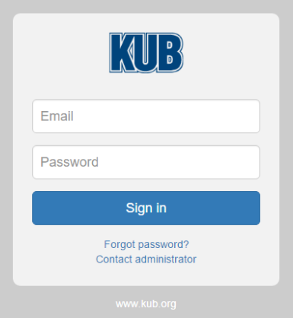

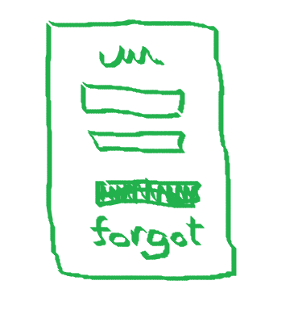


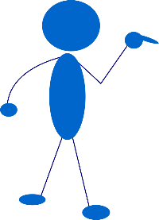




Brainstorming & Using MVC
Import Ember from ‘ember’;
Export default Ember.Controller.extend({
invalidCredentials: false,
});
Import Ember from ‘ember’;
Export default Ember.Component.extend({
actions: {
resetPassword(){
this.sendAction(‘action’, this.get(‘userEmail’));
}
}
});

Slide 5


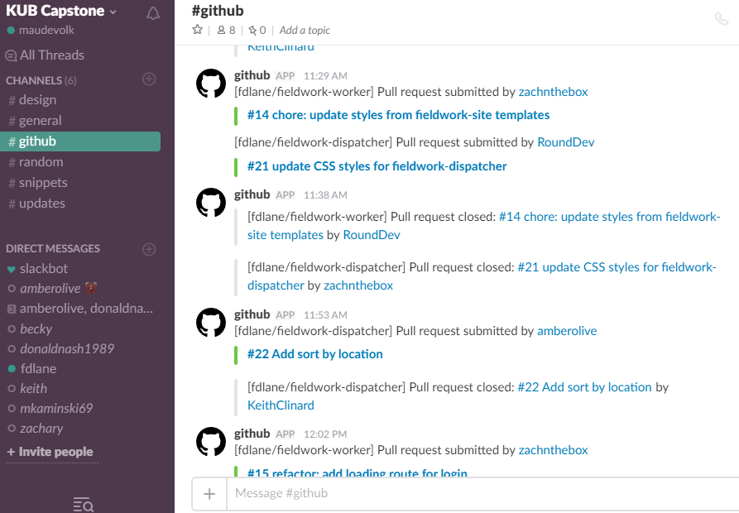
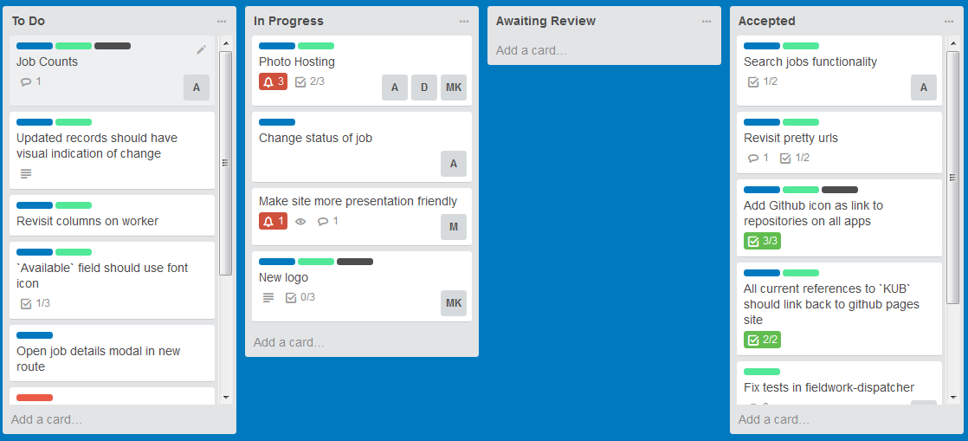


Project Management
Version Control!
Notes:
AR- Communication is vital to keeping everyone on track. Trello uses a system of “cards” to assign jobs and move them to various stages of completion while Slack allows a type of messaging among all the team members.
Version control prevents confusion as to which programs are the ones to deploy.

Slide 6
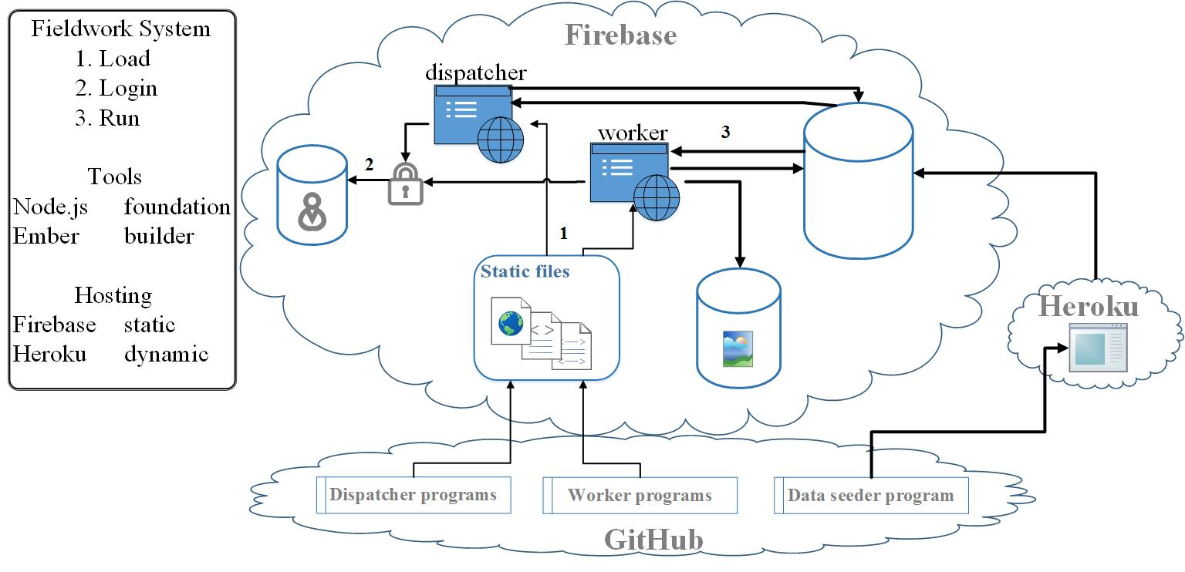

Slide 7
Demo
Notes:
MK- could show various screens but especially the worker screen and its modal.

Slide 8

Challenges
Amber Ember?
Fire where?
Notes:
I thought we could all say something about this.

Slide 9
Thank You
KUB
&
Professor Negahban!

Slide 10

Questions
?

