Slide 1
Analysis of Call Center Performance
[Rounit Rakesh] - [11/10/24]

Slide 2
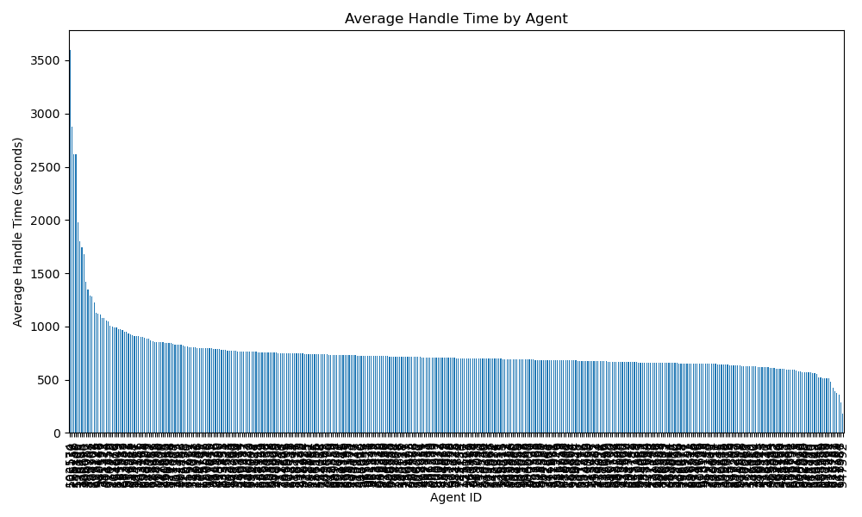
Average Handle Time by Agent

Slide 3
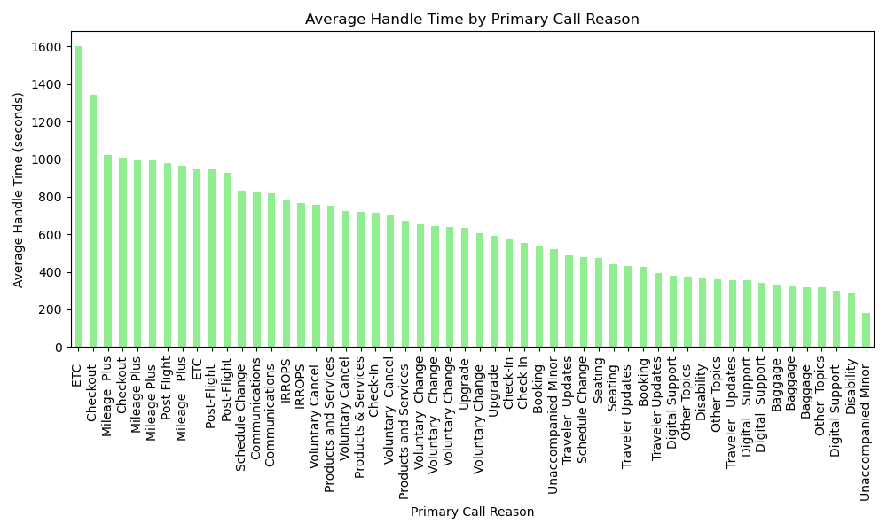
Average Handle Time by Primary Call Reason

Slide 4
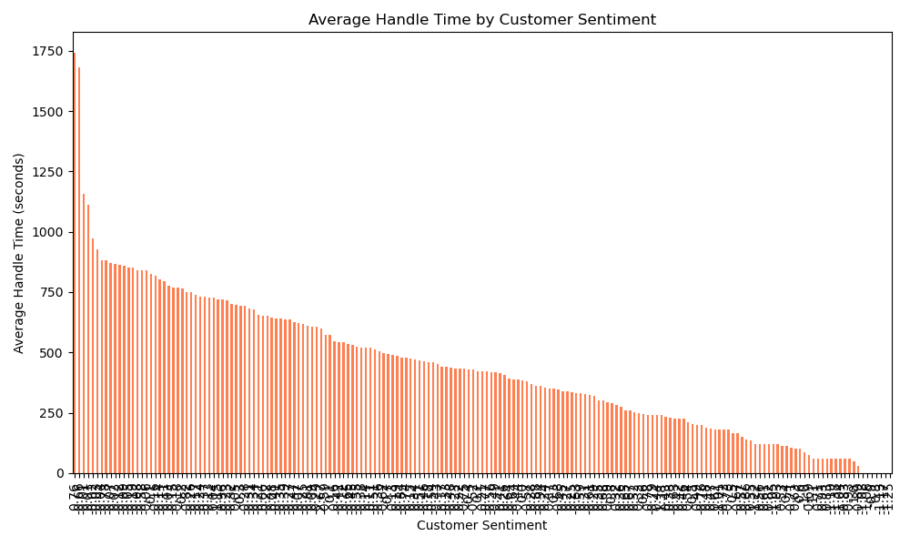
Average Handle Time by Customer Sentiment

