Slide 1
Multi-Sector Portfolio Build & Forecast (FTEC 6V98)
Rounok Joardar
Nov-02-2020

Slide 2
Outline
Project objectives
Factor models for individual sector portfolios
Time series (ARIMA) models for individual factors
Portfolio optimization using MPT approach

Slide 3
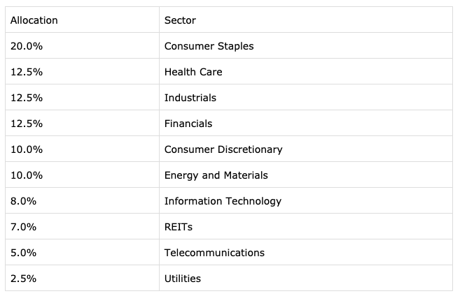
Project Objectives
Develop a methodology for optimizing an overall portfolio comprised of individual funds from various economic sectors
Develop a methodology for forecasting portfolio performance
How do we decide these allocations?
How do we predict performance?

Slide 4
Portfolio Optimization Process
Determine individual sector portfolio
Input, using some generic sector indicies for now
Build structural model (eg. FF3) for each sector
Done, using index data for now
Build ARIMA model for factors
Complete for Fama-French 3
Forecast factors using time series model
Complete for Fama-French 3
Forecast performance of each sector
Done using sector index data
Build overall portfolio using MPT
Done using sector index data

Slide 5
Sectorwise Factor Based Models (Index Based)
Fama French 5 Factor
Other factors to be considered
Fama French 3 Factor
Sector | Intercept* | HML | SMB | Mkt_excess | Profitability (RMW) | Investment (CMA) | Momentum | Quality | Low volatlity
Industrial (IXI) | -0.000419 | 0.422623 | 0.052563 | 0.814758 | TBD | TBD | TBD | TBD | TBD
Financial (IXM) | -0.004161 | 0.767634 | -0.283176 | 1.192206 | TBD | TBD | TBD | TBD | TBD
Consumer Discretionary (IXY) | 0.000618 | 0.269688 | -0.074478 | 1.062901 | TBD | TBD | TBD | TBD | TBD
Consumer Staples (IXR) | 0.001011 | 0.167031 | -0.397471 | 0.523321 | TBD | TBD | TBD | TBD | TBD
Communication Services (IXC) | -0.002977 | 0.196831 | 0.085789 | 0.85529 | TBD | TBD | TBD | TBD | TBD
Utilities | TBD | TBD | TBD | TBD | TBD | TBD | TBD | TBD | TBD
Information Technology | TBD | TBD | TBD | TBD | TBD | TBD | TBD | TBD | TBD
Healthcare | TBD | TBD | TBD | TBD | TBD | TBD | TBD | TBD | TBD
Factor coefficients were obtained by linear regression of monthly closing values of each index for the last 20 years
"TBD" values will be populated in future updates
* Values in grey are statistically insignificant

Slide 6
Actual Price Based Factor Models
Index data used so far will be replaced by historic close prices of individually optimized sector portfolios ➔ Factor models for sector portfolios
Expected inputs are:
Monthly adjusted close price for each sector portfolio over a minimum five year span
Closing prices for all sector portfolios should span the same time period
Ex. 1: ‘IXI’ only has data through April 2020, it is not a good sample to build a model on
Outlier / missing values should be cleaned - e.g. impute using mean or median
Ex. 2: ‘IXY’ has data interspersed with small unrelated values that need to be caught by a threshold
Without quality input data even the best models will not produce helpful results.

Slide 7
Time-Series (ARIMA) Models for Factors
Sample ACF and PACF plots for HML
ARIMA model orders were optimized using a grid search algorithm (written in Python)
Model order corresponding to lowest AIC value was chosen
Model fitted to historical factor data (20 years, monthly)
Rm-Rf
p = 2, d= 0, q = 2
const 0.006687 ar1 -0.246489 ar1 -0.683139 ma1 0.364716 ma2 0.721735
SMB
p = 2,d = 0, q = 1
const 0.001883 ar1 -0.412648 ar2 0.092031 ma1 0.469908
HML
p = 0, d = 0, q = 1
const 0.003209 ma1 0.211941
01/2000 – 09/2020
Input FF3 Factor Data
10/31/2020 Forecasts
from ARIMA Models
﻿ADF Statistic: -8.258635103081202
p-value: 5.154929819178421e-13
Fama French factor values are already Stationary

Slide 8
All-Sector Portfolio Construction
All-sector portfolio constructed using Modern Portfolio Theory (MPT) approach
Step 1: Obtain historical price / return data for individual portfolios (using corresponding sector indicies as a substitute for now)
Step 2: Estimate expected returns and covariance matrix
Step 3: Construct efficient frontier
Step 4: Construct Capital Market Line (CML) using current risk-free rate
Assumed no restrictions on short-selling
All of the above steps have been coded into a Python script for automatic updates

Slide 9
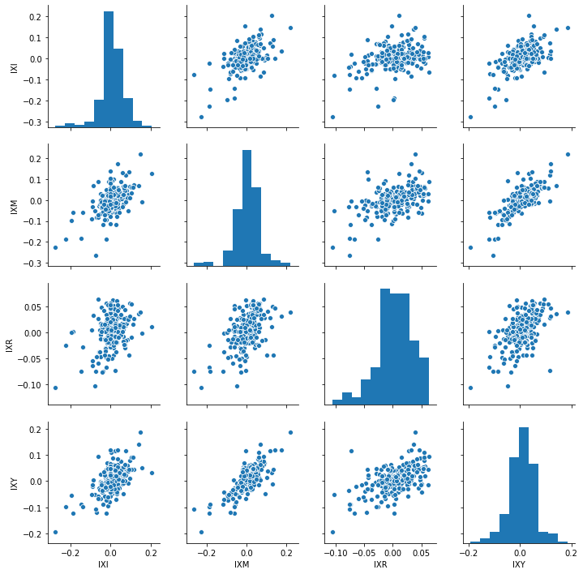
All-Sector Portfolio Construction - Sector Correlations
μ = 0.0693
σ = 0.679
Example correlations shown using first four indicies (IXI, IXM, IXR, and IXY)
These are the inputs for Efficient Frontier and CML construction
No negative correlations observed
μ = 0.0375
σ = 0.724
μ = 0.0486
σ = 0.383
Sector Correlation Matrix
Symbol | IXI | IXM | IXR | IXY
IXI | 1 | 0.570235 | 0.344128 | 0.599598
IXM | 0.570235 | 1 | 0.519293 | 0.773027
IXR | 0.344128 | 0.519293 | 1 | 0.56554
IXY | 0.599598 | 0.773027 | 0.56554 | 1
μ = 0.-0033
σ = 0.6

Slide 10
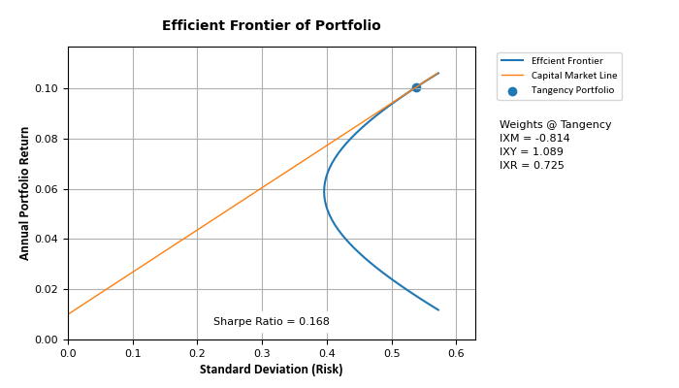
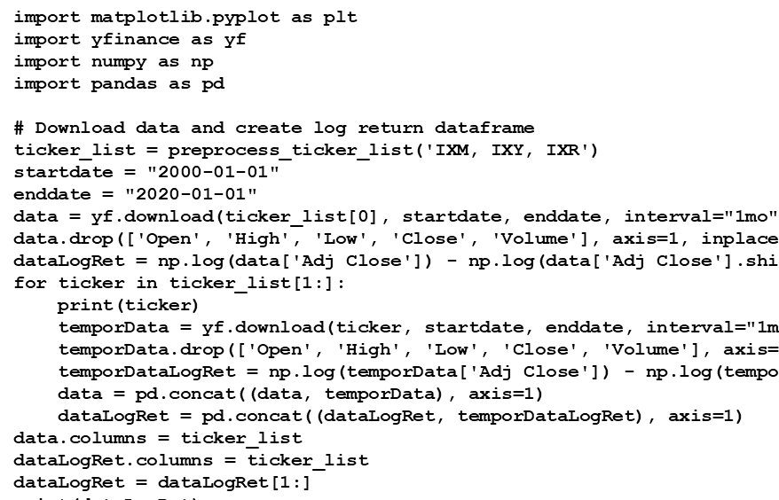
All-Sector Portfolio Construction - Results (Using Sector Indicies)
Preliminary results for Efficient Frontier, CML, and optimized Market Portfolio obtained using IXM, IXY, and IXR
Functionality of Python script verified

Slide 11
Forecasting With Time-Series and Factor Models
Unified portfolio performance can be forecasted using time-series model developed (as shown in slide 7)
Step 1: Forecast future value of factors using respective ARIMA models
Step 2: Use forecasted factors in factor model to predict future return of each sector portfolio
Step 3: Recompute unified all-sectors portfolio with forecasted sector returns
Step 4: Optional - rebalance portfolio if desired
Example (Step 2): Financial Sector Index ‘IXM’
Predicted Factor Values for 10/31/2020
(from Slide 7)
Coefficients of Factor Model for IXM
(from Slide 5)
Rm - Rf | SMB | HML
﻿-0.538841 | 0.264975 | -0.161899
Intercept | Rm - Rf | SMB | HML
﻿-0.004161 | 1.192206 | -0.283176 | 0.767634
﻿293.001 is predicted IXM value for 10/31/2020
0.2% Error
﻿293.600 is actual IXM value on 10/31/2020

Slide 12
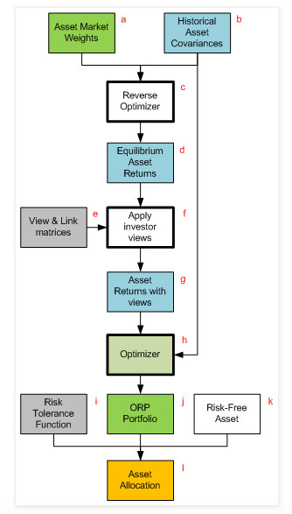
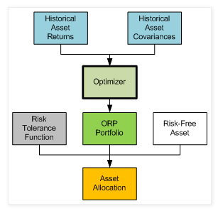
Portfolio Optimization with Black-Litterman
Adjusting Efficient Frontier using Black-Litterman to account for error in returns:

Slide 13
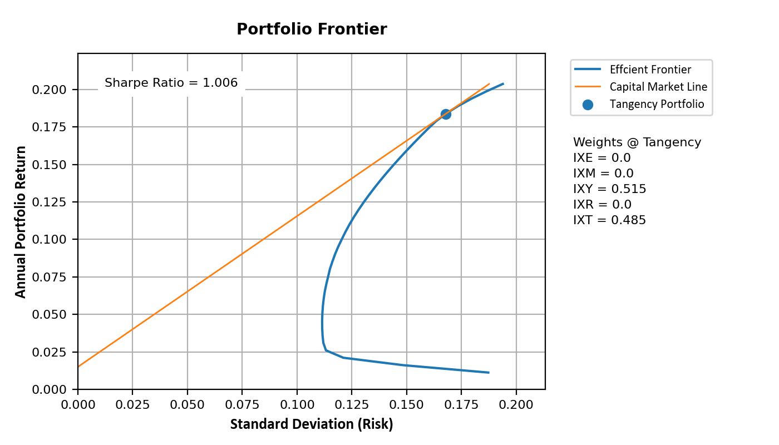
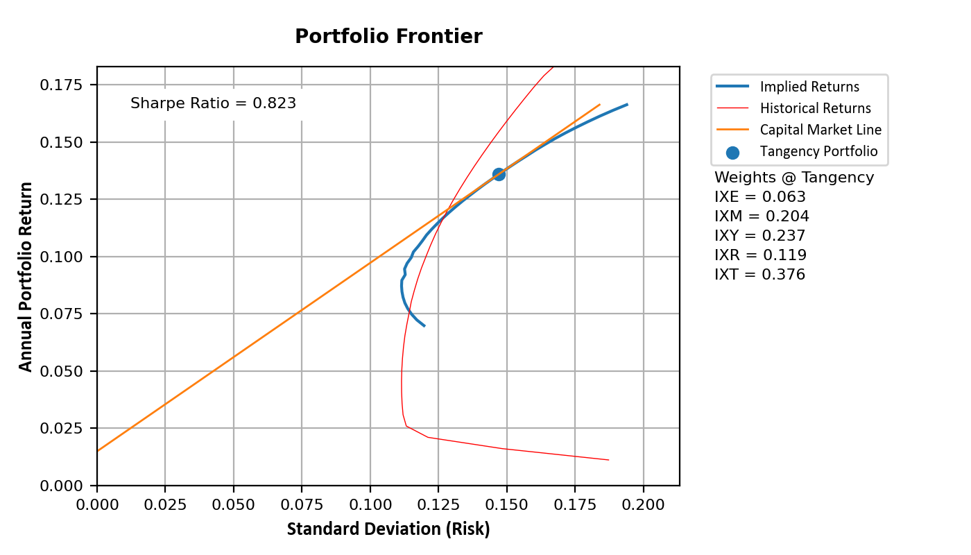


Portfolio Optimization with Black-Litterman
Adjusting Efficient Frontier using Black-Litterman to account for error in returns:
Without optimization the weights are split across two sectors
This does not properly reflect market capitalization
After optimization, the weightage is well matched to market cap

Slide 14
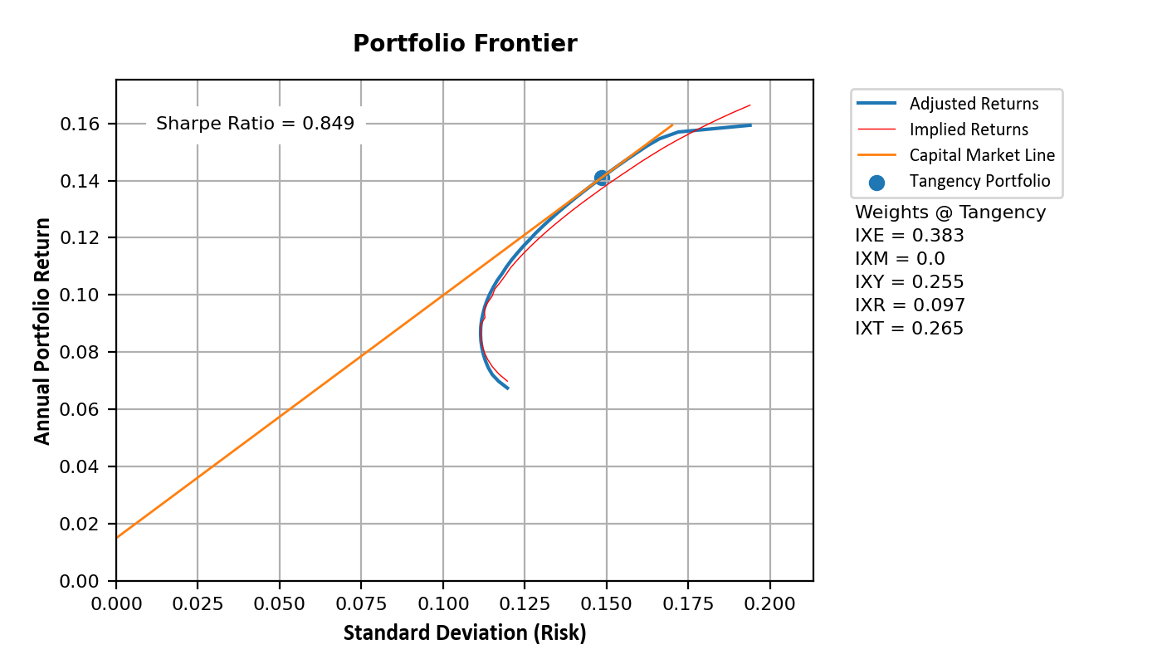
Portfolio Optimization using Views
Adjusting Efficient Frontier using Black-Litterman to account for error in returns:
Views generated using output from ARIMA and Fama-French Models

Slide 15
Summary
Infrastructure for optimizing and forecasting performance of unified all-sector portfolio has been developed
All aspects of the system has been tested for correct functionality using historical sector index data
All Python code generated for this project will be made available through github

