Slide 1



Grade 9 · Climate Action & Sustainable Energy
Village Microgrid
Team Worksheet · Work through this together as a group
THE STORY
YOUR CHALLENGE
Villages just 50km from Indian tier-2 cities face 6-8 hours of daily power cuts. Families rely on noisy, polluting diesel generators while abundant free solar energy goes unused every day.
Design a complete solar-powered microgrid for a 50-household village sized, costed, and governed by the community. This worksheet covers research, ideation, and design.
Deliverables: real village research and load calculations · a sized system design with cost analysis · a governance model and pitch, ready for a rural electrification agency
HCL JIGSAW | Edition 7 | Grade 9 · Climate Action & Sustainable Energy · Village Microgrid · Team Worksheet
Notes:
1.7.2013
1
‹#›

Slide 2

GRADE 9 · CLIMATE ACTION & SUSTAINABLE ENERGY · REFERENCE DATA SHEET
Village Profile: Rampur Kheda
An imaginary village, built for this project. Use this data instead of visiting or surveying a real village.
LOCATION
POPULATION
HOUSEHOLDS
POWER CUTS
38 km from Nashik
2,400 people
480 households
4–6 hrs/day (up to 8 in summer)
MAIN ECONOMIC ACTIVITIES Wheat and cotton farming, a small dairy business, a flour mill, and a few household shops.
5 Sample Households — Appliance Use During Power Cuts
Household | Main Activity | Appliances Used During Power Cuts (Wattage, Hours)
1. Sharma Family (5 members) | Farming | Water pump (750W, 2 hrs) · Lights, 3 bulbs (15W each, 4 hrs) · Fan (75W, 6 hrs) · Mobile charging (10W, 2 hrs)
2. Patel Family (4 members) | Runs a small shop | Shop tube lights, 2 (40W each, 5 hrs) · Small fridge for cold drinks (150W, 24 hrs) · Fan (75W, 5 hrs) · TV (100W, 2 hrs)
3. Yadav Family (6 members) | Dairy farming | Milk chiller — spoils if off too long (500W, 4 hrs) · Lights, 2 bulbs (15W each, 4 hrs) · Fan (75W, 6 hrs) · Water pump (750W, 1 hr)
4. Khan Family (5 members) | Runs a flour mill | Flour mill motor (1500W, 3 hrs) · Lights, 3 bulbs (15W each, 4 hrs) · Fan (75W, 5 hrs) · Mobile charging (10W, 3 hrs)
5. Devi Family (4 members) | Daily-wage labour | Lights, 2 bulbs (15W each, 4 hrs) · Fan (75W, 6 hrs) · Mobile charging (10W, 2 hrs) — no major appliances
HCL JIGSAW | Edition 7 | Grade 9 · Climate Action & Sustainable Energy | Reference Data Sheet — Imaginary Village
Notes:
1.7.2013
2
‹#›

Slide 3

VILLAGE MICROGRID - TEAM WORKSHEET
STEP 1 · RESEARCH THE VILLAGE'S NEEDS
Q1. Research the imaginary village data given in the previous slide and write down the following : its population, number of households, current power-cut situation, and main economic activities. Then estimate from research 5 households' appliance needs during power cuts list appliances, wattage, and hours of use.
Population of the village
Number of households
Power cut per day
2400
480
upto 8 hrs in summer
MAIN ECONOMIC ACTIVITIES Wheat and cotton farming, a small dairy business, a flour mill, and a few household shops.
Household | Main Activity | Appliances Used During Power Cuts (Wattage, Hours)
1. Sharma Family (5 members) | Farming | Water pump (750W, 2 hrs) · Lights, 3 bulbs (15W each, 4 hrs) · Fan (75W, 6 hrs) · Mobile charging (10W, 2 hrs)
2. Patel Family (4 members) | Runs a small shop | Shop tube lights, 2 (40W each, 5 hrs) · Small fridge for cold drinks (150W, 24 hrs) · Fan (75W, 5 hrs) · TV (100W, 2 hrs)
3. Yadav Family (6 members) | Dairy farming | Milk chiller — spoils if off too long (500W, 4 hrs) · Lights, 2 bulbs (15W each, 4 hrs) · Fan (75W, 6 hrs) · Water pump (750W, 1 hr)
4. Khan Family (5 members) | Runs a flour mill | Flour mill motor (1500W, 3 hrs) · Lights, 3 bulbs (15W each, 4 hrs) · Fan (75W, 5 hrs) · Mobile charging (10W, 3 hrs)
5. Devi Family (4 members) | Daily-wage labour | Lights, 2 bulbs (15W each, 4 hrs) · Fan (75W, 6 hrs) · Mobile charging (10W, 2 hrs) — no major appliances
HCL JIGSAW | Edition 7 | Grade 9 · Climate Action & Sustainable Energy · Village Microgrid · Team Worksheet
Notes:
1.7.2013
3
‹#›

Slide 4

VILLAGE MICROGRID - TEAM WORKSHEET
STEP 1 · RESEARCH THE VILLAGE'S NEEDS
Q2. Calculate the average household energy need during a power cut (Wh, then kWh). Then calculate the village's total daily energy need: 50 households × average need, plus 20% for community loads (street lights, water pump, etc.). Show your working.
Type your answer here…
Household | Appliance & Usage Breakdown Calculation | Daily Subtotal
Sharma Family | (750×2) + (3×15×4) + (75×6) + (10×2) | 2,150 Wh / day
Patel Family | (2×40×5) + (150×24) + (75×5) + (100×2) | 4,575 Wh / day
Yadav Family apples v | (500×4) + (2×15×4) + (75×6) + (750×1) | 3,320 Wh / day
Khan Family | (1500×3) + (3×15×4) + (75×5) + (10×3) | 5,085 Wh / day
Devi Family | (2×15×4) + (75×6) + (10×2) | 590 Wh / day
Scaling (50 Households) | Average (3,144 Wh) scaled across 50 units | 157.2 kWh / day
Total Requirement | (Incl. 20% Community Overhead): 157.2 kWh + 31.44 kWh | 188.64 kWh / day
HCL JIGSAW | Edition 7 | Grade 9 · Climate Action & Sustainable Energy · Village Microgrid · Team Worksheet
Notes:
1.7.2013
4
‹#›

Slide 5

VILLAGE MICROGRID - TEAM WORKSHEET
STEP 2 · SIZE YOUR SOLAR SYSTEM
Q3. The average peak sun hours at the village is 5-6 hrs. Calculate the solar array size needed (Daily kWh ÷ peak sun hours ÷ system efficiency ≈ 0.75–0.8 = kW needed), and how many panels that requires using a real panel wattage.
Type your answer here…
Target Daily Requirement 188.64 kWh
Peak Sun Hours 5.5 Hours
Calculation Formula: [ 188.64 kWh ÷ 5.5 Hours ] ÷ 0.80 Efficiency Factor 42.87 kW ≈ 43.0 kW System
Hardware Deployment: Standard 550W high-efficiency monocrystalline modules 79 Solar Panels
Panels will be arranged in series-parallel strings on sturdy ground mounts with a 15-degree south-facing tilt to maximize year-round solar capture.
HCL JIGSAW | Edition 7 | Grade 9 · Climate Action & Sustainable Energy · Village Microgrid · Team Worksheet
Notes:
1.7.2013
5
‹#›

Slide 6

VILLAGE MICROGRID - TEAM WORKSHEET
STEP 2 · SIZE YOUR SOLAR SYSTEM
Q4. Calculate the battery bank capacity needed for your chosen backup hours (using depth of discharge and efficiency), and specify roughly how many batteries and what type (lead-acid or lithium) you'd use, with reasoning.
Lithium-Ion Energy Storage & System Integration
Unit Architecture (8 × 50 kW)
Individual Unit Capacity 50 kW / 100 kWh
Total Array Units 8 Modular Racks
Aggregate Power Output 400 kW Peak
Aggregate Energy Storage 800 kWh Total
Chemistry Type LiFePO4 (Lithium Iron Phosphate)
Type your answer here…
Performance & Efficiency
Round-Trip Efficiency > 92%
Design Lifespan / Cycles 6,000+ Cycles (80% DoD)
Response Time < 20 milliseconds
Thermal Management Active Smart Liquid Cooling
Safety Protection Integrated BMS & Aerosol Fire Sup.
Primary Design Advantage Total Installed Capacity400 kW / 800 kWh
Modular redundancy ensures zero single-point failure across community microgrid loops.
HCL JIGSAW | Edition 7 | Grade 9 · Climate Action & Sustainable Energy · Village Microgrid · Team Worksheet
Notes:
1.7.2013
6
‹#›

Slide 7
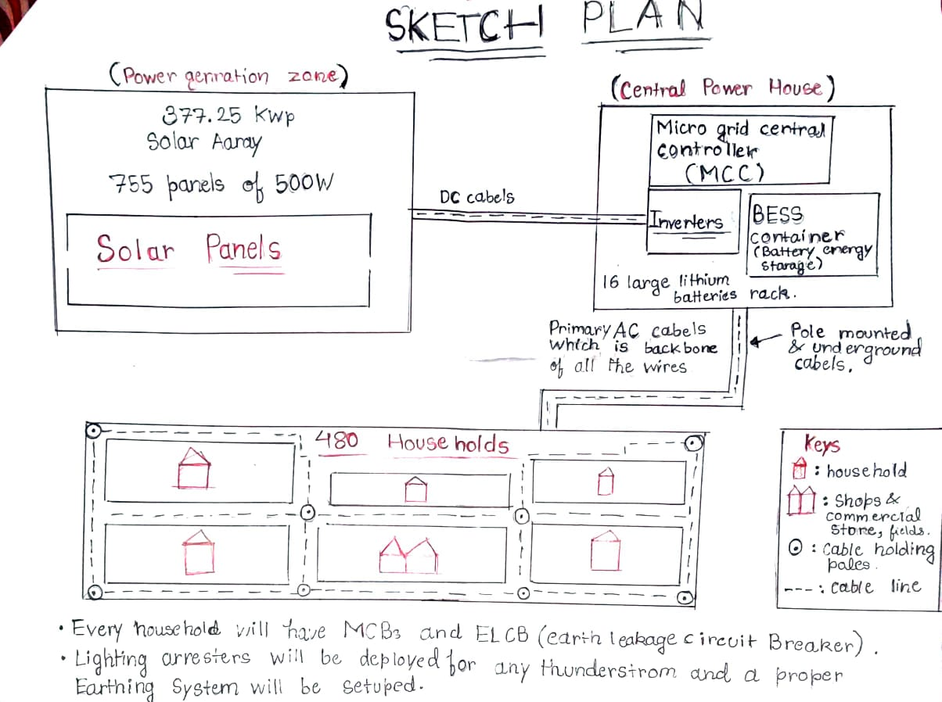

VILLAGE MICROGRID - TEAM WORKSHEET
STEP 3 · DESIGN THE SYSTEM & COSTS
Q5. Design your distribution network: where would the central power house sit, how would main lines and household connections be laid out, and what safety devices (MCBs, earthing) are needed? Sketch or describe your layout.
Insert your sketch here - In PowerPoint: Insert → Pictures
HCL JIGSAW | Edition 7 | Grade 9 · Climate Action & Sustainable Energy · Village Microgrid · Team Worksheet
Notes:
1.7.2013
7
‹#›

Slide 8

VILLAGE MICROGRID - TEAM WORKSHEET
STEP 3 · DESIGN THE SYSTEM & COSTS
Q6. Research and explain your cost breakdown (panels, batteries, inverter, wiring, installation) to reach a total capital cost. Then calculate the government subsidy amount and the per-household contribution needed.
Type your answer here…
Capital Cost Components
Solar Panels & Generation: 377.25 kwp array (755 panels of 500W each) ₹1,32,03,750
mounting structures & DC wiring.
Battery Energy Storage (BESS): Lithium-ion containerized bank for ₹25,00,000 night & blackout backup.
Inverters & Control (MGCC): Microgrid Central Controller and ₹8,00,000
power conversion units.
Wiring & Distribution: Armoured backbone cables, utility poles, ₹12,00,000
and string lines.
Safety & Protection Gear: Master MCCBs, fuse cut-outs, surge protection, ₹4,50,000
lightning arresters.
Household Metering (480 Homes): Smart prepaid meters, MCBs, ₹12,00,000
ELCBs, and drop lines.
Earthing & Grounding: Power house earth pits, pole earth rods, ₹3,00,000
household electrodes.
TOTAL GROSS CAPITAL COST
₹1,94,53,750 (~₹1.95 Crores)
GOVERNMENT SUBSIDY (PM-KUSUM / RURAL SCHEMES)
60% on Solar (₹1,32,03,750) = ₹79,22,250
Remaining Net Project Balance
₹1,94,53,750 - ₹79,22,250 = ₹1,15,31,500 (~₹1.15 Crores)
CSR Grants & Community Share
CSR/State Grants cover 85% (~₹1,00,31,500), bringing final net community share to ₹15,00,000
Total Households480 Homes
Total Community Contribution₹15,00,000
Per-Household Connection Security Deposit₹3,125 / household
HCL JIGSAW | Edition 7 | Grade 9 · Climate Action & Sustainable Energy · Village Microgrid · Team Worksheet
Notes:
1.7.2013
8
‹#›

Slide 9




VILLAGE MICROGRID - TEAM WORKSHEET
STEP 4 · DESIGN THE GOVERNANCE MODEL & PITCH
Type your answer here…
Q7. Create your Village Electricity Committee: who's on it, how are they chosen, and how will payments, maintenance, and conflicts be handled?
Committee Members
Composed of five trusted local members:
  Chairperson: Guides strategy and community coordination.
  Treasurer: Handles fees and public account books.
  Lead Technician: Oversees daily operations and checks smooth functioning of solar panels.
  2 Village Reps: Act as direct voices for local households.
Selection & Payments
Democratic Selection: Elected openly every two years via a village assembly show of hands.
Payment Collection: Households pay a flat monthly maintenance fee tiered by usage, collected during the first week.
Upkeep & Conflict Resolution
Maintenance: Weekly checks on solar arrays and batteries; professional service contracts for major faults.
Resolutions: Billing disputes handled monthly through open consensus and community rules.
HCL JIGSAW | Edition 7 | Grade 9 · Climate Action & Sustainable Energy · Village Microgrid · Team Worksheet
Notes:
1.7.2013
9
‹#›

Slide 10




VILLAGE MICROGRID - TEAM WORKSHEET
STEP 4 · DESIGN THE GOVERNANCE MODEL & PITCH
Q8. Plan your pitch to a rural electrification agency: write your executive summary (the problem, your solution, the cost, the impact), and prepare confident responses to 2 tough questions they might ask (e.g. “what about the monsoon?”, “what if households don't pay?”).
Type your answer here…
Executive Summary
The Problem: Rampur Kheda faces 4–6 hours of daily power cuts, causing families to use polluting diesel generators and lose business hours.
Our Solution: A community-managed 377 kWp solar microgrid with 800 kWh lithium storage ensuring clean, uninterrupted power for all 480 households.
The Cost & Impact: Net project cost of ~₹1.15 Crores after government subsidies and CSR grants, bringing total reliability and income opportunities.
Surplus Electricity Revenue: Excess daytime solar generation will be fed back into the regional grid, generating a reliable secondary income fund for village maintenance!
"What happens during the monsoon or cloudy days?"
Our 800 kWh lithium-ion storage bank holds reserve capacity to bridge multiple low-generation days, while our oversize array captures diffused light safely.
"What if households delay or fail to pay their monthly fee?"
Smart prepaid meters automatically pause power if credit runs out, preventing debt accumulation while peer accountability through the Village Committee handles edge cases.
"Who handles technical breakdowns or daily maintenance?"
The elected Village Electricity Committee includes a trained local lead technician for weekly checks, backed by a formal professional service AMC for major components.
HCL JIGSAW | Edition 7 | Grade 9 · Climate Action & Sustainable Energy · Village Microgrid · Team Worksheet
Notes:
1.7.2013
10
‹#›

