Slide 1

Basic Details Of The Team And Problem Statement
Problem Statement Title : Millions Struggle with mental health issues globably , yet lack access to timely, affordable, and stigma-free support—highlighting the need for an intelligent, accessible mental wellness solution.
Problem Statement Solution: Our solution leverages AI (Artificial Intelligence) to deliver personalized, engaging mental wellness guidance and analyzing sentiments while encouraging self-care through engaging activites.
Team Name :TESSERACT(R.C.E.T)
Team Leader Name : Roushan Kumar
Institute Name : Rungta College Of Engineering And Technology
Theme Name : Open innovation

Slide 2



Depression Statistics:
Suicide Statistics:
Global Prevalence: According to WHO, more than 264 million people worldwide suffer from depression.
Impact on Age Groups: Depression can affect people of all ages, but it is particularly common among adults, with the highest prevalence occurring in those aged 18-29.
Gender Differences: Women are more likely than men to be diagnosed with depression.
Global Suicide Rates: According to the World Health Organization (WHO), nearly 800,000 people die by suicide each year, which translates to one person every 40 seconds.
Impact on Age Groups : Suicide is one of the leading causes of death among people aged 15–29, particularly in high-income countries.
Gender Differences: Men are more likely to die by suicide than women, but women are more likely to attempt suicide.
Alignment with UNSDG:
Our project contributes to: Goal 3 –
Good Health and Well-being.

Slide 3
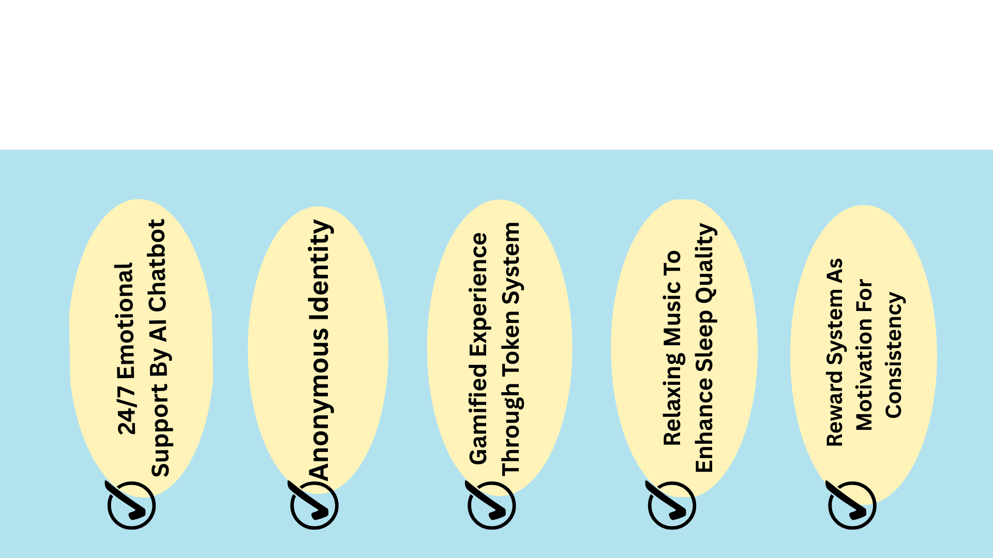
Idea/Approach Details :
We are looking for a solution by creating a platform with an AI-powered chatbot that helps users to assess their mental well-being through analyzing their mental health by interactive questions and provides them personalized self-care recommendations.
The Prototype will function as follows:
Analyzing the mental health level through 8 mental health-related questions.
A wellness score is calculated based on the responses and Artificial Intelligence(AI) provides personalized suggestions.
User is given an option to either:
End the session and receive a motivational temporary token
Continue chatting with the smart supportive chatbot.
A Smart AI chatbot that connects with users in natural and empathetic language, providing emotional support and counseling.
User are rewarded with tokens called Reward points each for their efforts made to improve their mental health level.
Reward points can be earned in various forms such as listing music, performing breathing exercises and interacting with chatbot.
After interaction with the chatbot, the token fades — symbolizing that difficulties are temporary too.

Slide 4
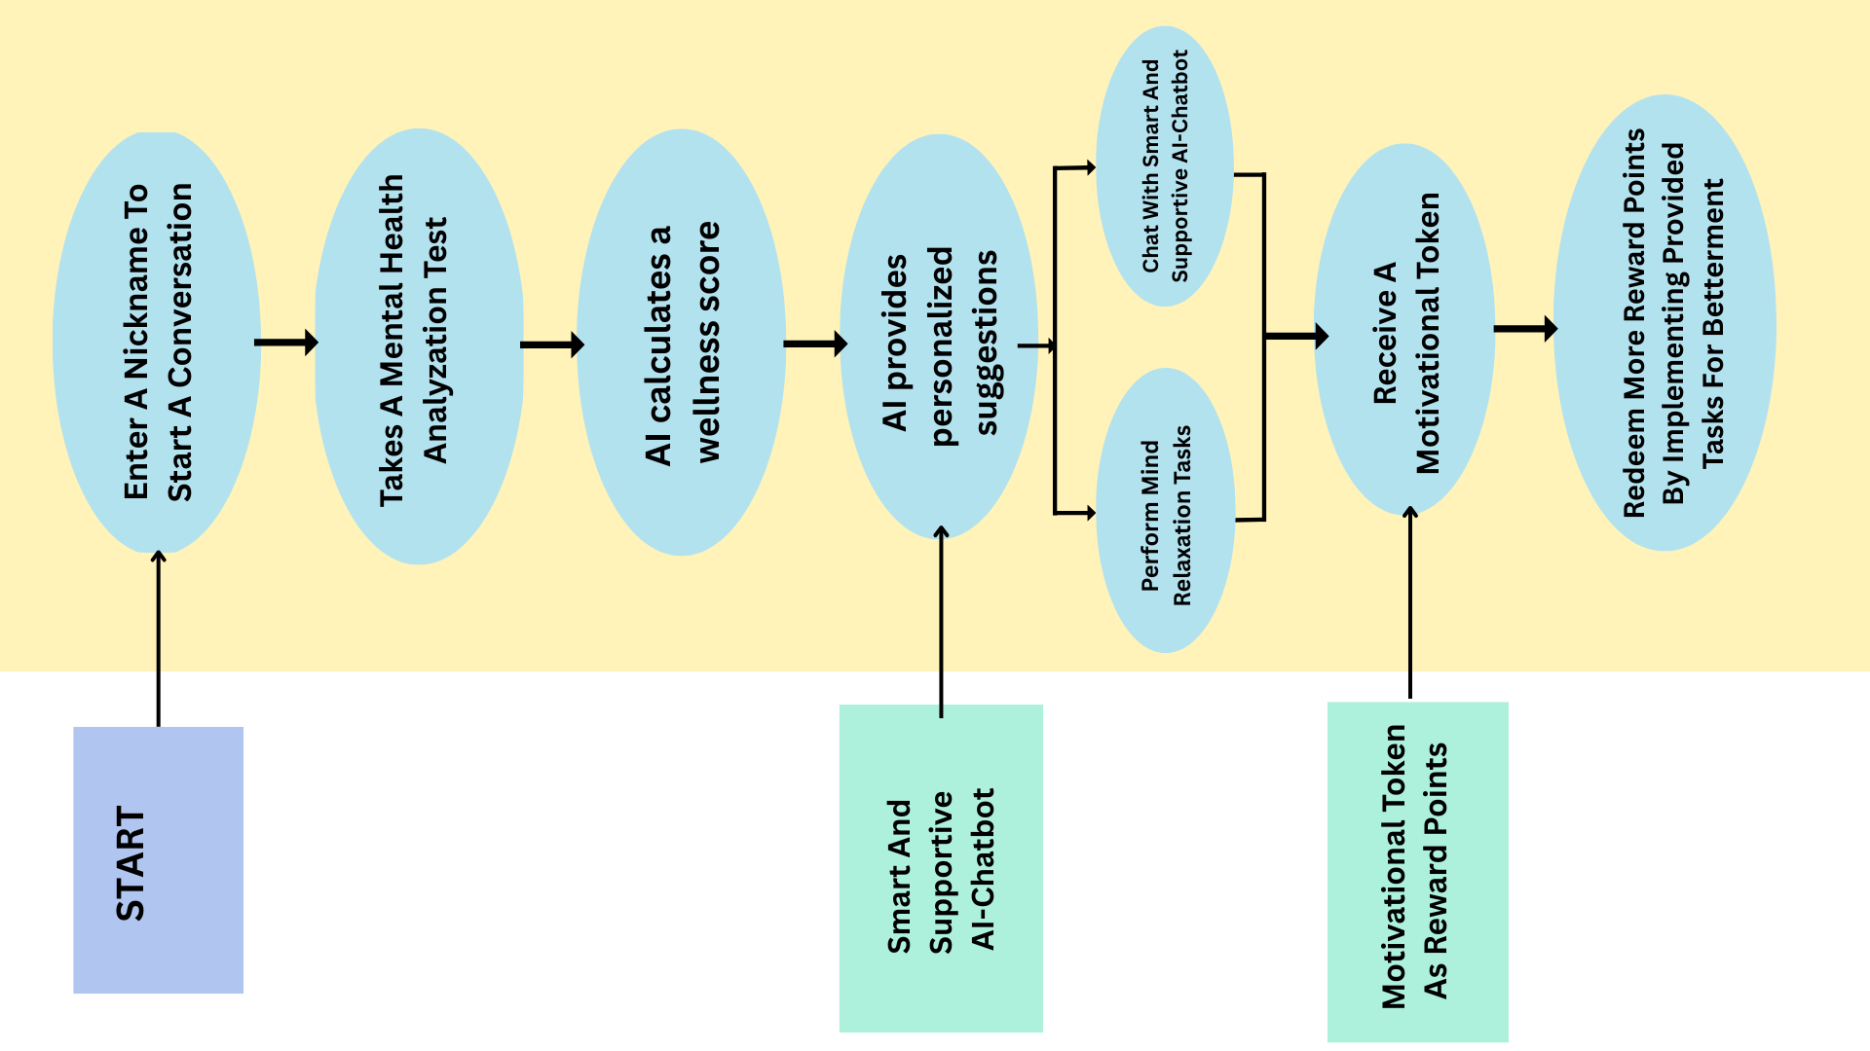
Workflow:
Simply first take a mental health analyzation assessment so that our AI-chatbot can understand the mental health level of the user.
AI would calculate your scores give personalized coping strategies
for practical implementation.
Start a conversation with the chatbot. More the frequent conversations are made, more the smarter our AI-chatbot becomes.
Mental Health Development Tasks are given to the user according to their well-being state and are rewarded with tokens each time they complete the task.
Users will also receive various calming music who are experiencing insomnia or sleep disturbances to enhance their sleep quality.

Slide 5
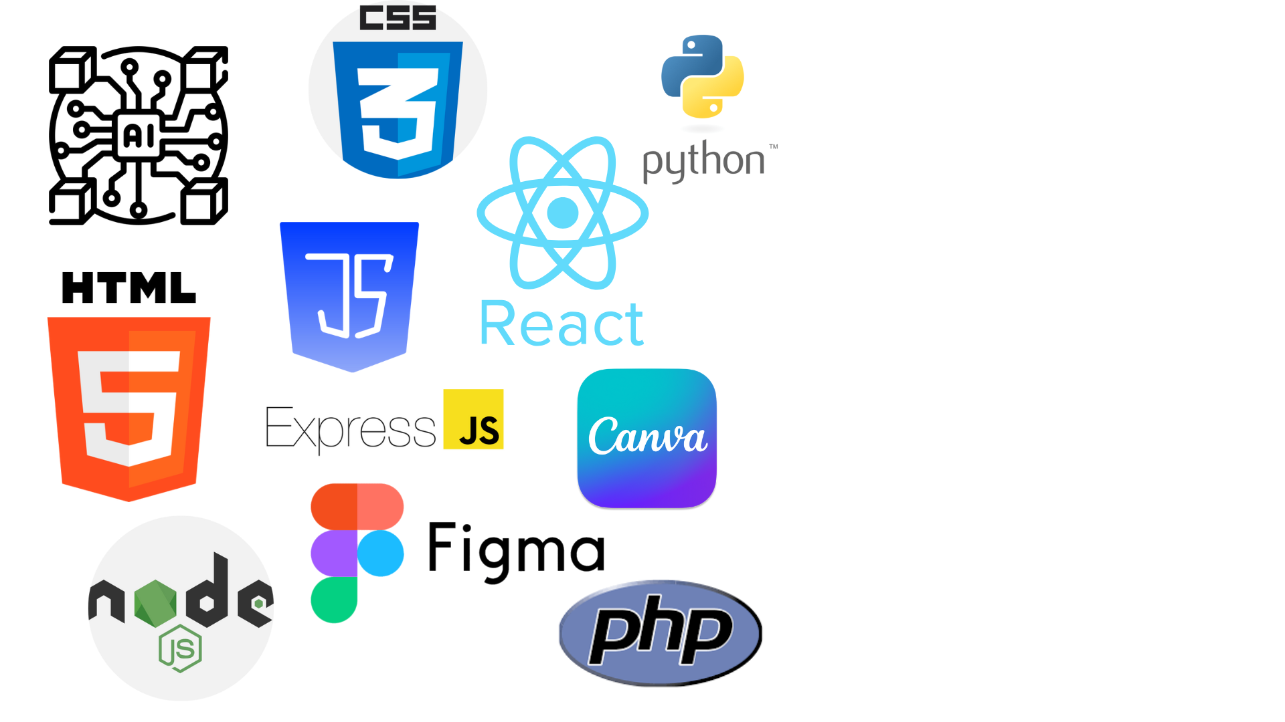
Highlights:
Tech stack
HTML — Frontend structure
CSS — Styling and calm UI
JavaScript — Handling token display, music player, and UI interactivity
Python — Core logic for:
Asking 8 mental health questions
Calculating the wellness score
Generating personalized suggestions
Building the chatbot
Figma — UI/UX
PHP, Express.js, Node.js —Backend
Key Features
Anonymous interaction as no login needed but just a nickname.
8-question assessment for mental health analyzation.
Personalized wellness suggestions.
AI-supportive chatbot (rule-based).
Relaxing music for calming the user after assessment.
Practical self-care activities and suggestions (breathing exercises, relaxation techniques and mind-calming music).
Temporary motivational token as a reward for their efforts.
Calm and relaxing UI, creating a positive environment for user.
Focused on mental health awareness and emotional support.

Slide 6
Solutions for Overcoming these Challenges:
Potential Challenges:
Accuracy and Reliability of AI Chatbot | Implementing continuous monitoring of the AI bot’s performance to identify areas where it might be making errors.
Lack of User Authentication | Implementing anonymous usage monitoring that tracks user behavior patterns and flags suspicious activity.
Competition | Working on the improvement of existing features and adding new features like story telling, audio book, motivation sessions, etc.

Slide 7
Thank you
TEAM MEMBERS:
Piyush Kumar
Roushan Kumar
Kundan Gupta
Prachi Arya
Aayushi Kumari

