Slide 1

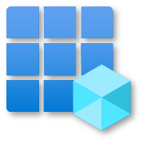
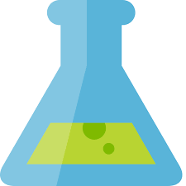
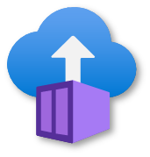
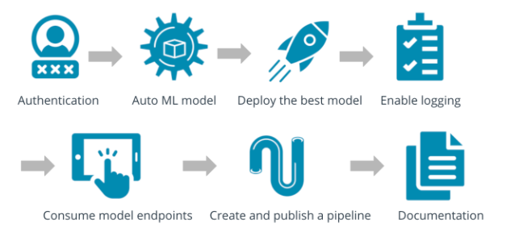
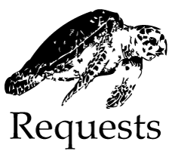
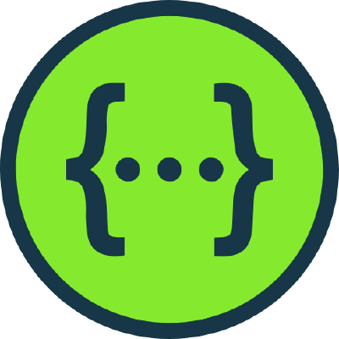

Step 0:
Infrastructure Setup
Step 1:
Authentication
Step 2:
AutoML Experiment
Step 3:
Model Deployment
Create Azure Machine Learning (AML) Workspace
Create Compute Instance
Create Compute Cluster
Create Azure Active Directory Service Principal (SP)
Grant SP access to the AML Workspace
Register data as AML Dataset
Create AutoMl Experiment with required settings using the registered Dataset
Select best AutoMl model & deploy it to Azure Container Instance (ACI)
Enable authentication
Step 7.1:
Creating a Pipeline
Step 6:
Consuming Model Endpoint
Step 5:
Swagger UI
Step 4:
Enabling Logging
Update variables in pipeline jupyter notebook
Run corresponding notebook cells to create a pipeline
Configure correct scoring_uri and key in endpoint.py script
Run the script to interact with the trained model
Download Swagger JSON file
Download Swagger container
Run serve.py script to serve Swagger JSON file
Point Swagger UI to served Swagger JSON file
Enable Application Insights
Retrieve Logs
Step 7.2:
Publishing a Pipeline
Step 8:
Documentation
Run corresponding notebook cells to publish the pipeline if everything works as expected
Create screencast
Create README
Create architectural diagram
Make screenshots

