Slide 1
CREDIT EDA CASE STUDY
BY:- ROUSHAN KUMAR AND SRINIVAS SAIKAM

Slide 2
Analysis of Application Data

Slide 3
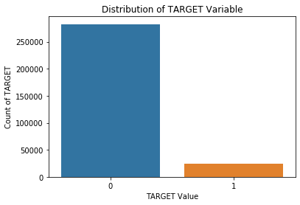
Distribution of target variable for defaulter and non-defaulter customer.
Percentage of people who have paid their loan is: 91.93 % Percentage of people who have NOT paid their loan is: 8.07 %
This is a imbalance distribution.
** 0- Non-Defaulter
** 1- Defaulter
Observation:
1. From this information, we see this is an imbalanced dataset. There are far more loans that were repaid on time than loans that were not repaid.
2. More than 25000 loans were repaid, Less than 5000 loans were not repaid

Slide 4
Categorical
Univariate Analysis

Slide 5
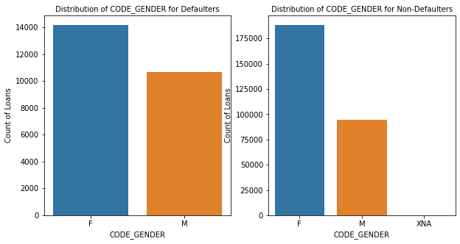
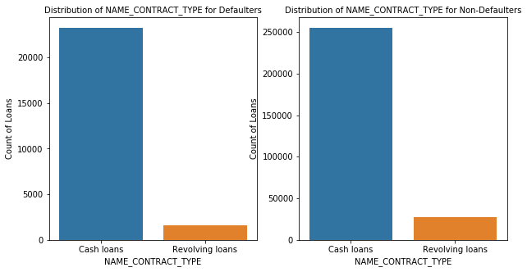
OBSERVATION OVER GENDER AND CONTRACT TYPE
We observe that the number of Cash loans is much higher than the number of Revolving loans for both Target = 0 and Target = 1.
We observe that the number of Females taking loans is much higher than the number of Males for both Target = 0 and Target = 1.
Y

Slide 6
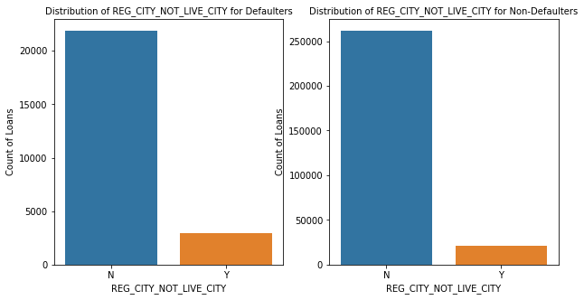
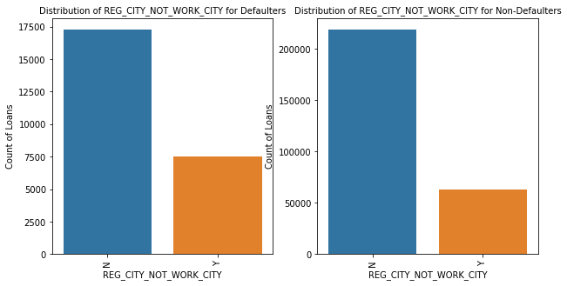
OBSERVATION OVER CUSTOMER LIVING PREFERENCES
We observe that the Ratio of people whose Registration City is not the same as live city or work city is higher in case of defaulters are compared to defaulters.
It tells us that people who live or work in a city different than the registration city are more likely to have payment difficulties.
Y

Slide 7
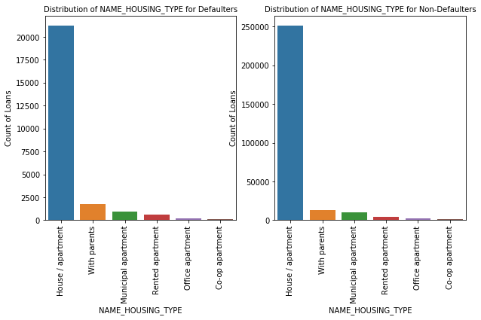
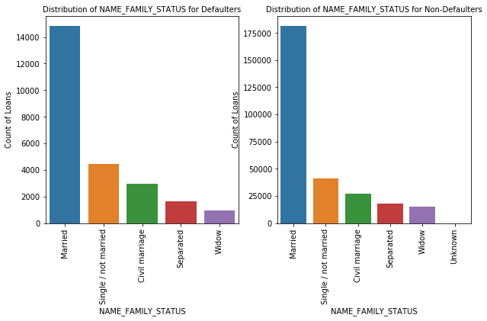
OBSERVATION OVER CUSTOMER FAMILY TYPE AND MARITIAL STATUS
Most people live in a House/Apartment.
Ratio of People who live With Parents is more for defaulter than non-defaulters. It tells us that applicant who live with parents have a higher chance of having payment difficulties.
Ratio of Single/Unmarried people is more in the left graph.
Single/Unmarried people are more likely to have payment difficulties.
Y

Slide 8
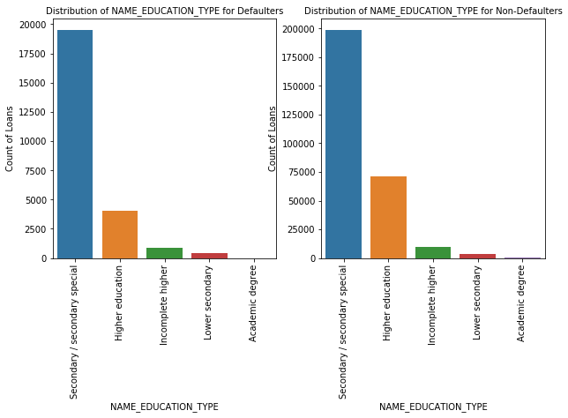
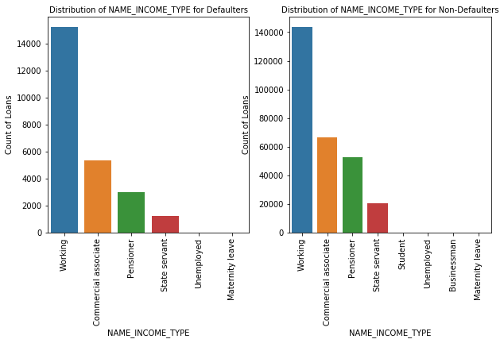
OBSERVATION OVER EDUCATION AND INCOME TYPE
Academic Degree rarely take loans and are rarely defaulters. So they are potentially good customers.
People with higher education are less likely to have payment difficulties. The Ratio is higher for non-defaulters than defaulters.
Commercial associates, Pensioner, State Servants have a higher ratio to total in non-defaulters.
Y

Slide 9
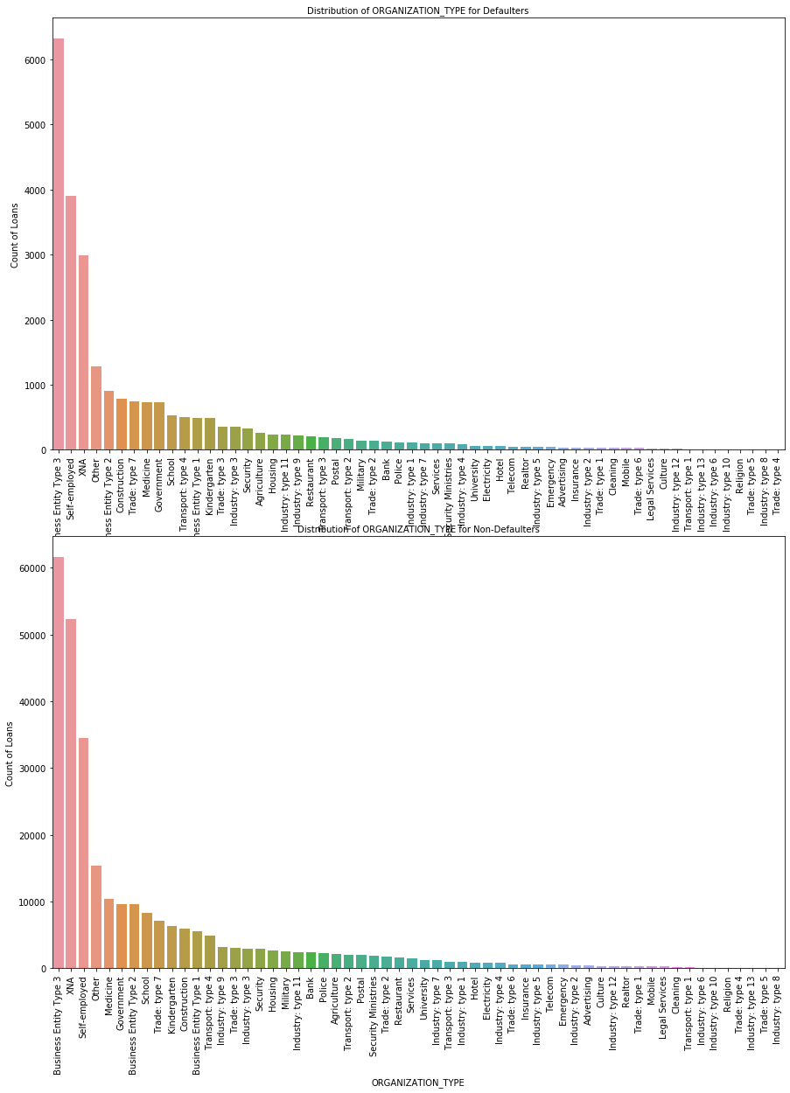
Distribution of the organization type of the for defaulter customer.
Distribution of the organization type of the for non defaulter customer.
Y

Slide 10
Univariate & Bivariate Analysis on Numeric Columns

Slide 11
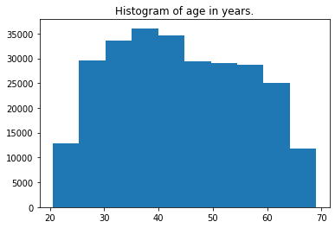
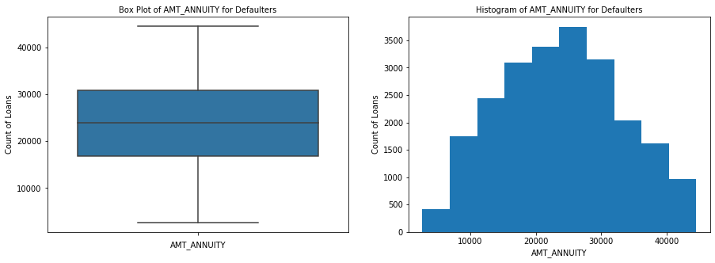
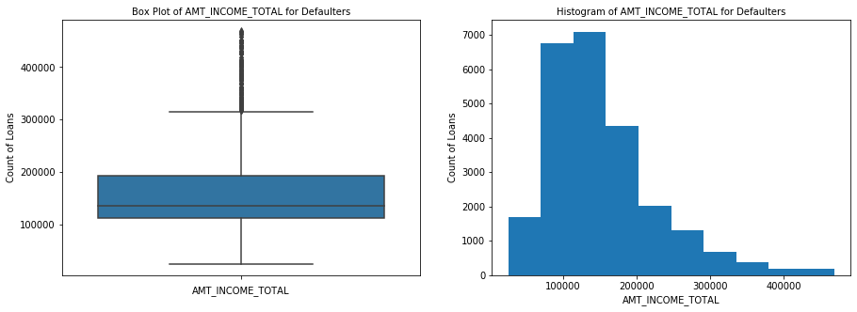
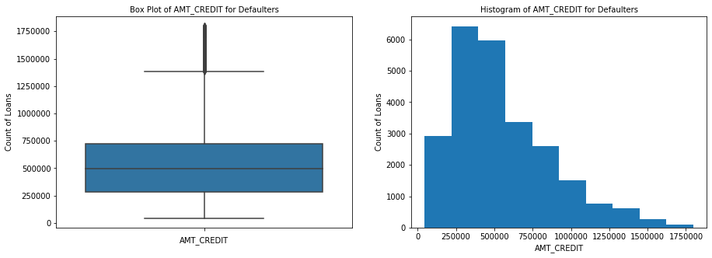
Y

Slide 12
Analysis of Continuous Variables
(TARGET=1 and TARGET=0)

Slide 13
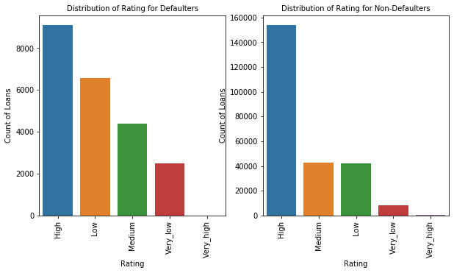
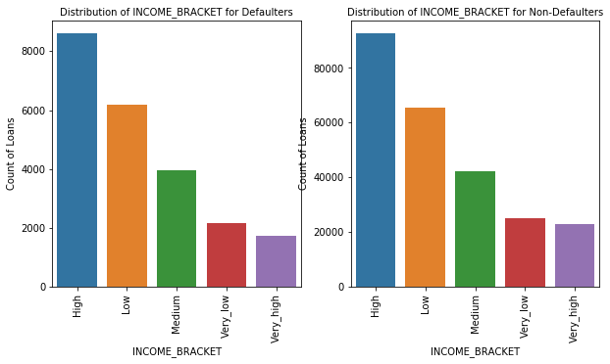
A large number of defaulters have very Low rating, while a large number of non-defaulters have a high rating.
People with very high income are very less in defaulters.

Slide 14
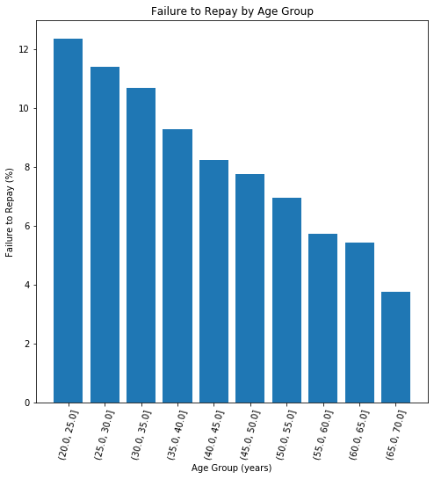
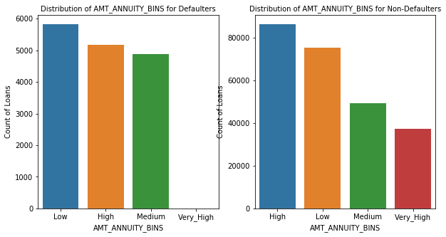
Maximum number of defaulters have Low annuity Values, while maximum number of non-defaulters have high annuity.
Maximum Failure to Repay is in Age Group 20-25.
Notes:
he topic?

Slide 15
Multivariate Analysis of Variables by HeatMap

Slide 16
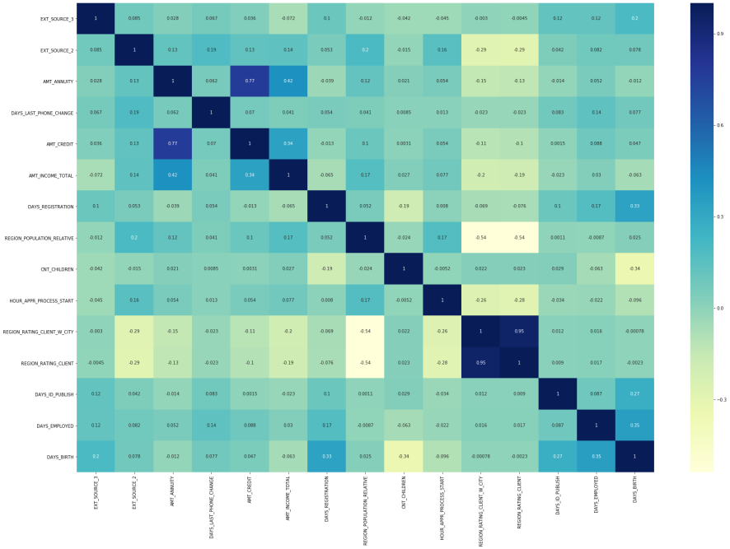
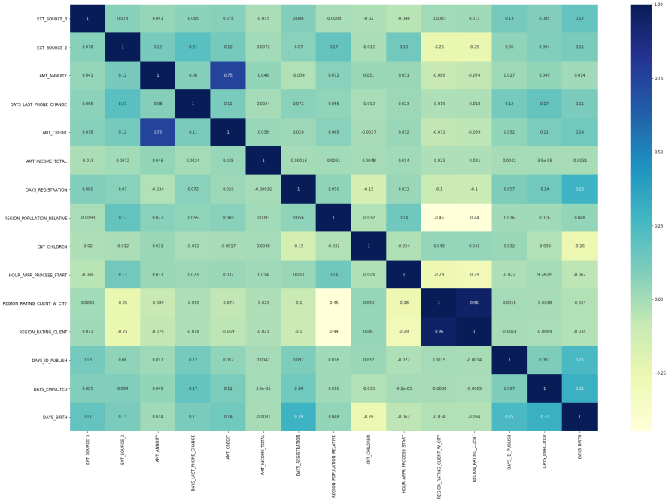
Most positive correlations
AMT_CREDIT - AMT_GOODS_PRICE
REGION_RATING_CLIENT_W_CITY - REGION_RATING_CLIENT
CNT_CHILDREN - CNT_FAM_MEMBERS
AMT_CREDIT - AMT_ANNUITY
AMT_GOODS_PRICE - AMT_ANNUITY
Most negative correlations
HOUR_APPR_PROCESS_START - REGION_RATING_CLIENT_W_CITY
REGION_RATING_CLIENT - HOUR_APPR_PROCESS_START
REGION_POPULATION_RELATIVE - REGION_RATING_CLIENT
REGION_RATING_CLIENT_W_CITY - REGION_POPULATION_RELATIVE
EXT_SOURCE_2 - REGION_RATING_CLIENT

Slide 17
Analysis of Previous Application

Slide 18
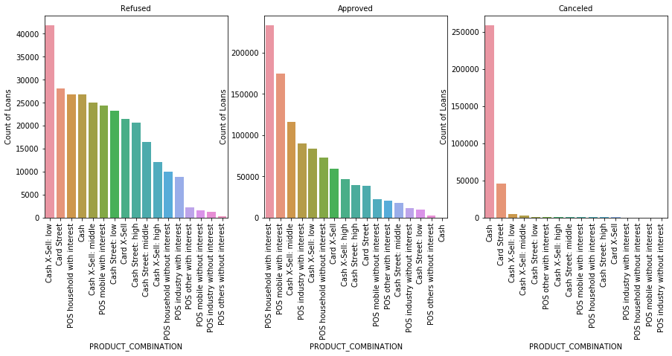
Observation:
1. We observe most number of loans were approved for POS household with interest.
2. Most number of refused loans were of Cash X-Sell: Low Product combination.
3. Most Canceled loans were Cash loans.

Slide 19
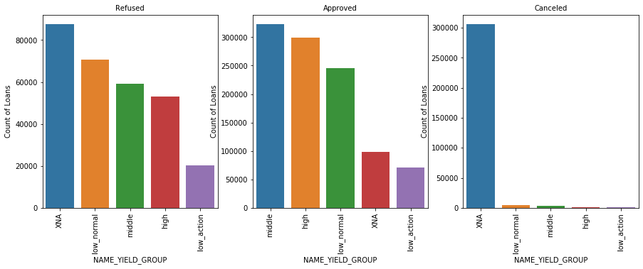
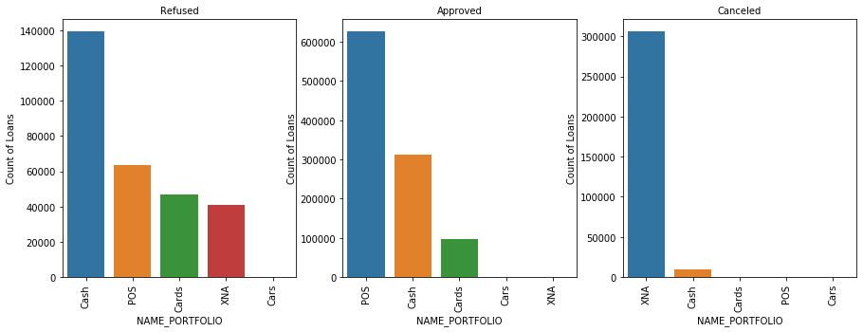
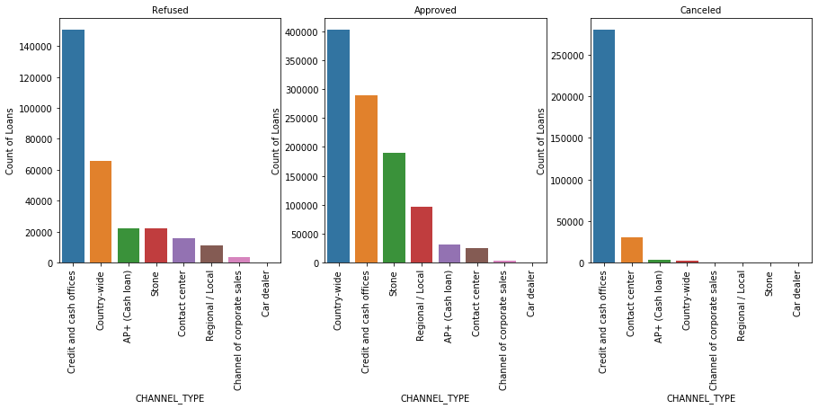
Observation:
1. Most approved loans were from Middle Yield Group
2. Most refused loans were from Yield Groups Not specified
1. Most approved loans were POS
2. Most refused loans were Cash
1. Most approved loans were from Country-wide Channel
2. Most refused loans were from Credit and Cash Offices Channel

Slide 20
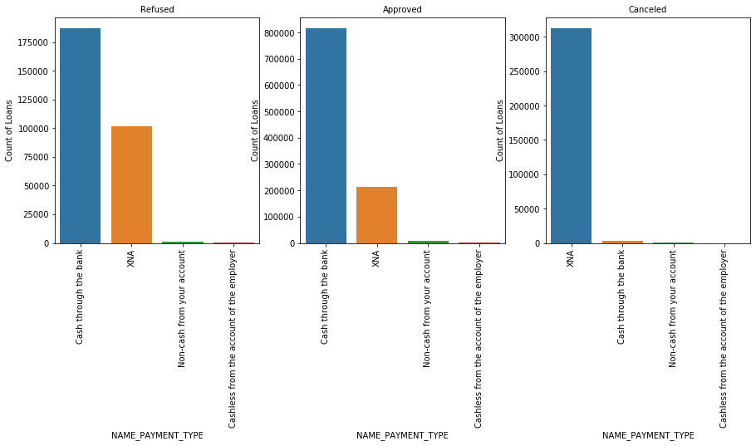
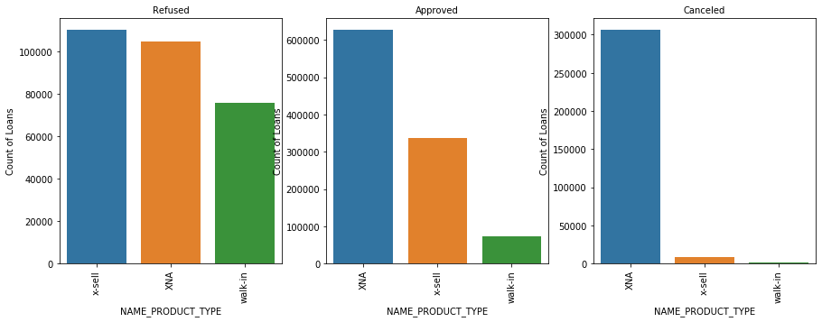
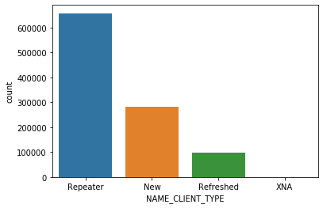
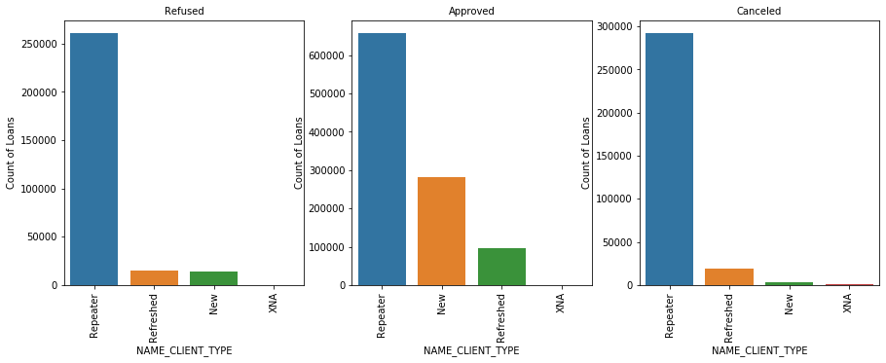
Repeat client loan type is very high in which bank should focus after existing customer.

Slide 21
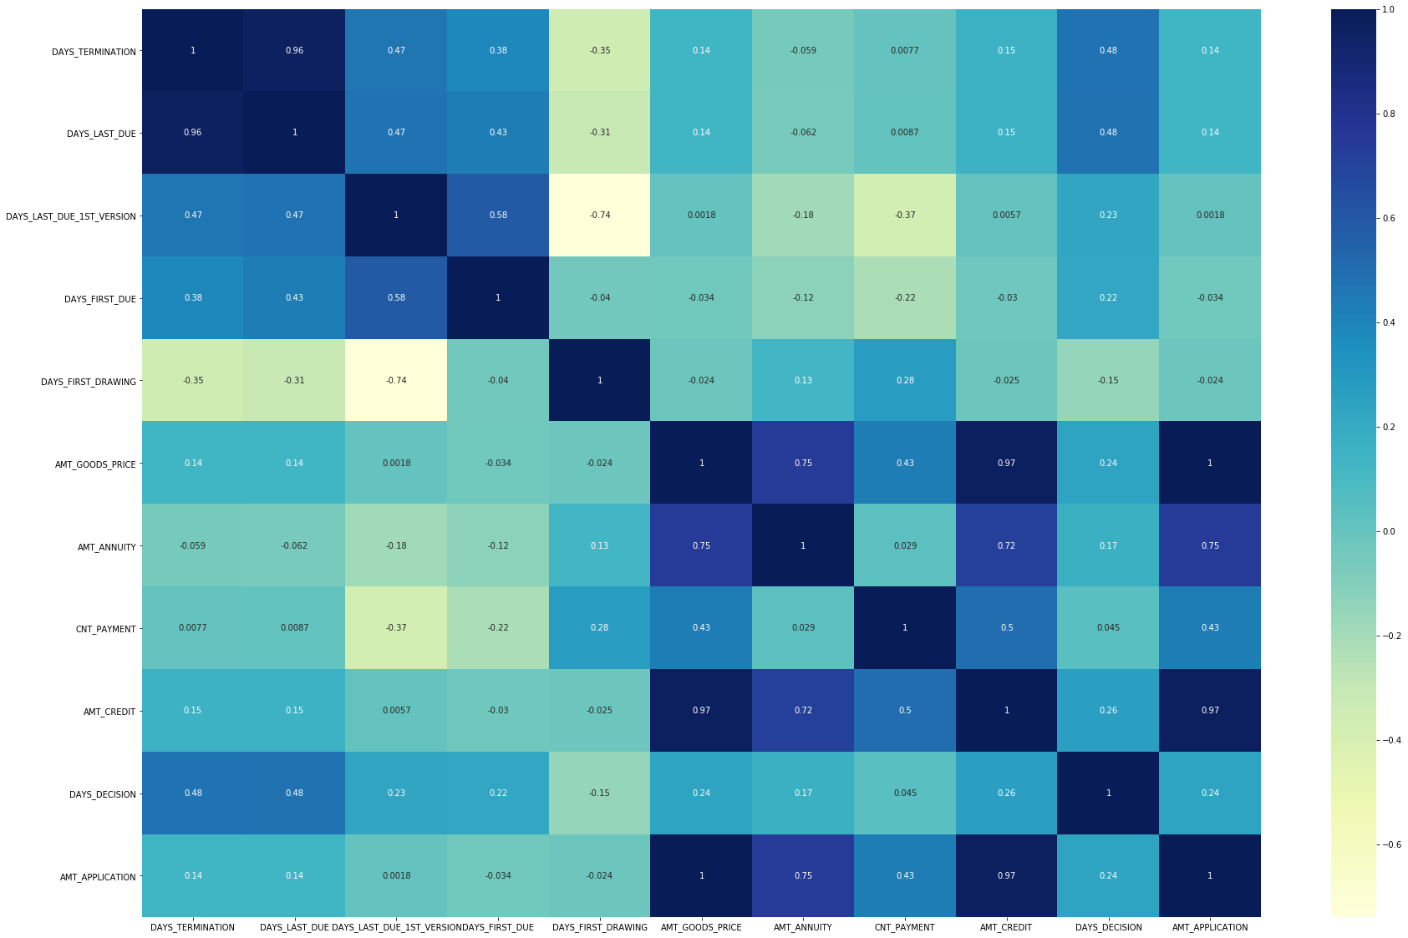
HEAT MAP FOR APPROVED CORRELATION

Slide 22
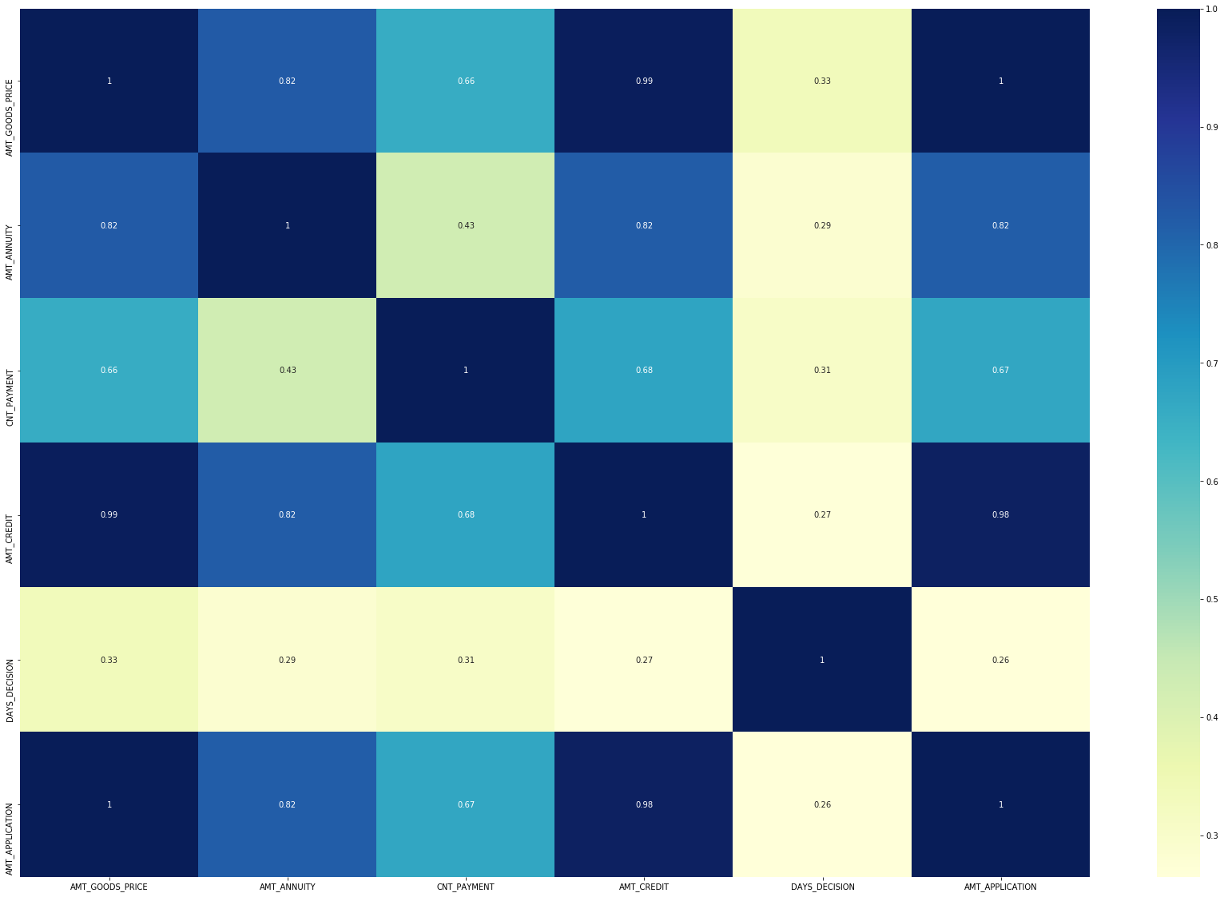
HEAT MAP FOR REFUSED CORRELATION

Slide 23
Conclusions
1. Banks should focus more on contract type ‘Student’, ’pensioner’ and ‘Businessman’ with housing ‘type other than ‘Co-op apartment’ for successful payments.
2. Banks should focus less on income type ‘Working’ as they are having most number of unsuccessful payments.
3. Also with loan purpose ‘Repair’ is having higher number of unsuccessful payments on time.
4. Get as much as clients from housing type ‘With parents’ as they are having least number of unsuccessful payments.
5. From the above we can conclude some points-
6. The credit amount of Loan purposes like 'Buying a home', 'Buying a land', 'Buying a new car' and 'Building a house' is higher.
7. Income type of state servants have a significant amount of credit applied Money for third person or a Hobby is having less credits applied for.
8. There are few places where loan payment is significant higher than facing difficulties. They are 'Buying a garage', 'Business development', 'Buying land', 'Buying a new car' and 'Education' Hence we can focus on these purposes for which the client is having for minimal payment difficulties.
9. Paying other loans and buying a new car is having significant higher rejection than approves.
Y

